Slide 1
NP - Completeness

Slide 2
What is NP problem?
The subject of computational complexity theory is dedicated to classifying problems by how hard they are. There are many different classifications; some of the most common and useful are the following.
P: Problems that can be solved in polynomial time. ("P" stands for polynomial.) These problems have formed the main material of this course.
NP: This stands for "nondeterministic polynomial time" where nondeterministic is just a fancy way of talking about guessing a solution. A problem is in NP if you can quickly (in polynomial time) test whether a solution is correct (without worrying about how hard it might be to find the solution). Problems in NP are still relatively easy: if only we could guess the right solution, we could then quickly test it.
unsolved problem: P=NP?

Slide 3
Reduction (1)
We say that A is easier than B, and write A < B, if A can be solved by at most polynomial number of B calls + at most polynomial time of other actions.
If A < B, we say that that A is reducible in polynomial time to B.
There are several minor variations of this definition. It may be a polynomial number of calls, a fixed constant number, or just one call.
Then if A < B, and B is in P, so is A: we can write down a polynomial algorithm for A by expanding the subroutine calls to use the fast algorithm for B.
Although A < B, it is possible for the algorithms for A to be slower than those for B, even though A < B.

Slide 4
Reduction (2)
As an example, consider the Hamiltonian cycle problem. Does a given graph have a cycle visiting each vertex exactly once? Here's a solution, using longest path as a subroutine:
for each edge (u,v) of G
if there is a simple path of length n-1 from u to v return yes
// path + edge form a cycle
return no
This algorithm makes m calls to a longest path subroutine, and does O(m) work outside those subroutine calls, so it shows that Hamiltonian cycle < longest path. (It doesn't show that Hamiltonian cycle is in P, because we don't know how to solve the longest path subproblems quickly.)

Slide 5
NP-hard and NP-complete problems
We are now ready to formally define NP-completeness.
We say that a problem A (not necessarily in NP) is NP-Hard if
For every other problem B in NP, B < A.
We say that a problem A is NP-complete when
  1. It is NP
  2. A is NP-Hard.
Thus, A is NP-hard if all other NP problems are easier than A.
If A is NP and also NP-hard, it is called NP-complete.
After all, if B < A, then the two problems are very closely related; for instance Hamiltonian cycle and longest path are both about finding very similar structures in graphs.
Cook's theorem: an NP-complete problem exists.

Slide 6
How to prove NP-completeness in practice?
It is easily to prove that if A < B and B < C, then A < C.
As a consequence of this observation,
if A is NP-complete, B is in NP, and A < B, B is NP-complete.
In practice that's how we prove NP-completeness: We start with one specific problem that we prove NP-complete, and we then prove that it's easier than lots of others which must therefore also be NP-complete.
So e.g. since Hamiltonian cycle is known to be NP-complete, and Hamiltonian cycle < longest path, we can deduce that longest path is also NP-complete.

Slide 7
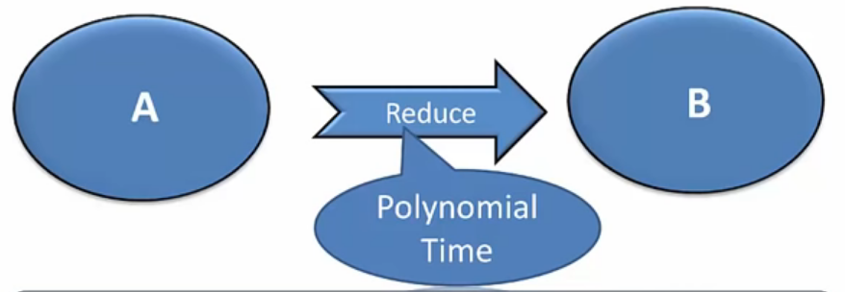
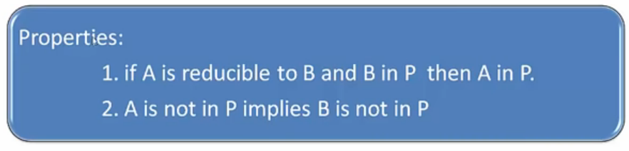
P, NP,NP-hard and NP-complete Relation (1)

Slide 8
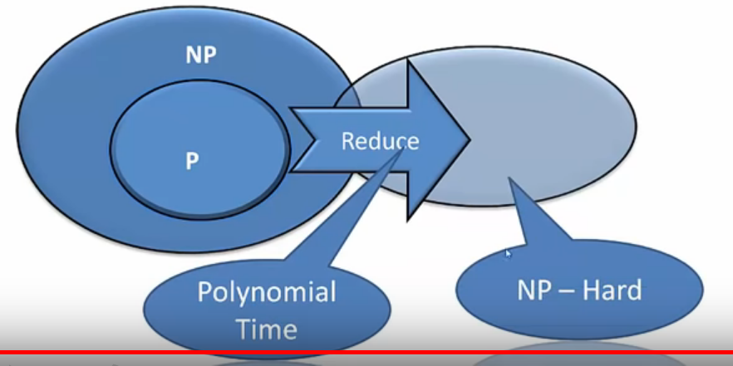
P, NP,NP-hard and NP-complete Relation (2)
NP-Hard: A problem is NP-Hard if every problem in NP can be polynomially reduced to it.

Slide 9
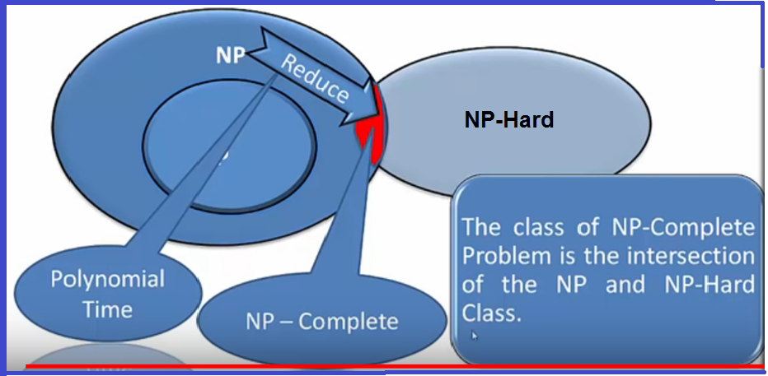
P, NP,NP-hard and NP-complete Relation (3)
NP-complete: A problem is NP-Complete if it is NP and NP-hard (thus it is an intersection of NP and NP-Hard classes).

Slide 10
P, NP,NP-hard and NP-complete Relation (4)
Computational complexity
P-class
NP-class
Every one can be polynomially reduced to
NP-Hard
NP-Complete

