Slide 1
Approximation Algorithms

Slide 2
Introduction
Many problems of practical significance are NP-complete. These problems requires exponential time in the worst case. It is too time-consuming. We have at least three ways to get around NP-completeness.
First, if the actual inputs are small, an algorithm with exponential running time may be perfectly satisfactory. Second, we may be able to isolate important special cases that we can solve in polynomial time. Third, we might come up with approaches to find near-optimal solutions in polynomial time (either in the worst case or the expected case). In practice, near-optimality is often good enough. We call an algorithm that returns near-optimal solutions an approximation algorithm. This chapter presents polynomial-time approximation algorithms for several NP-complete problems.
One compromise is to use heuristic solutions.
The word “heuristic” may be interpreted as “educated guess.”

Slide 3
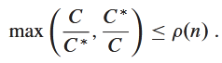
Approximation ratio
We say that an algorithm for a problem has an approximation ratio of ρ(n) if, for any input of size n, the cost C of the solution produced by the algorithm is within a factor of ρ(n) of the cost C* of an optimal solution: ρ(n)
If an algorithm achieves an approximation ratio of ρ(n), we call it a ρ(n)-approximation algorithm. The definitions of the approximation ratio and of a ρ(n)-approximation algorithm apply to both minimization and maximization problems.

Slide 4
Vertex Cover Problem
In graph theory, a vertex cover of a graph is a set of vertices that includes at least one endpoint of every edge of the graph.
The Vertex Cover problem is to find a vertex cover of the minimum size. It is NP-hard or the optimization version of an NP-complete decision problem.

Slide 5
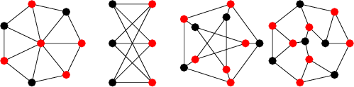
Examples of vertex cover

Slide 6
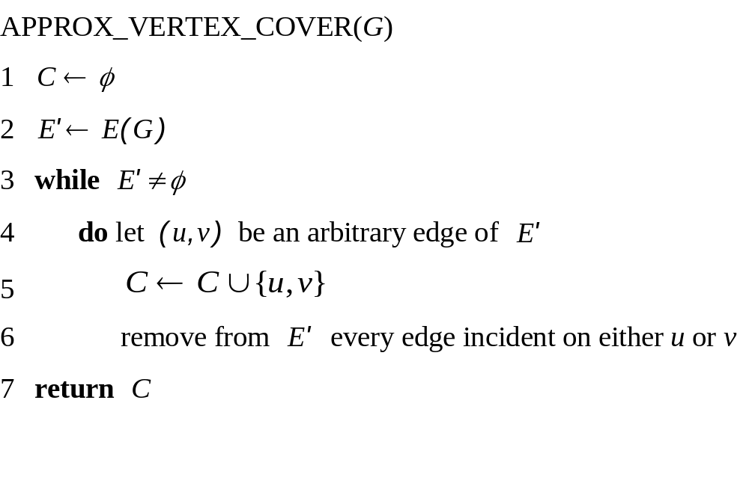
Appropximate Vertex Cover (1)

Slide 7
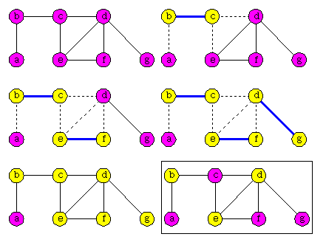
Appropximate Vertex Cover (2)

Slide 8
Approximation ratio of AVC (1)
AVC is a polynomial-time 2-approximation algorithm.
Proof
From the algorithm, AVC runs in O(V+E), which is polynomial time.
Let C* be a set of optimal vertex cover.
Let C be the set of vertices returned by AVC.
C is a vertex cover because AVC loops until all edges in the graph is removed.
Next, we will show that |C|/|C*| ≤ 2.

Slide 9
Approximation ratio of AVC (2)
Let A be the set of all edges chosen in the loop.
Since all edges incident on the chosen nodes in C are removed, no two edges in A share an endpoint.
An edge is chosen in the loop when neither of its endpoints are already in C.
Thus, |C|=2|A|.

Slide 10
Approximation ratio of AVC (3)
For any vertex v in C*, there is at least one edge in A with v as an endpoint (because C* is a cover).
And, no two edges in A share an endpoint.
Thus, |A| ≤ |C*|.
Thus, |C|=2|A|≤ 2|C*|.
That is, |C|/|C*| ≤ 2.
Thus, AVC has approximation ratio of 2.

Slide 11
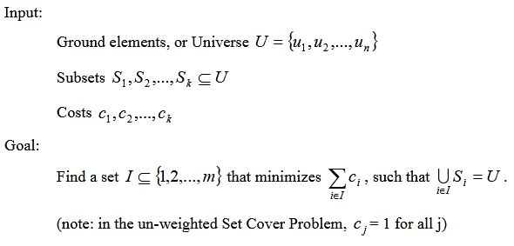
Set Cover Problem
Given a universe U of n elements, a collection of subsets of U say S = {S₁, S₂…,S_{m}} where every subset S_{i} has an associated cost. Find a minimum cost subcollection of S that covers all elements of U.
This problem is NP-Hard. There is a polynomial time Greedy approximate algorithm, the greedy algorithm provides a Logn approximate algorithm.

Slide 12
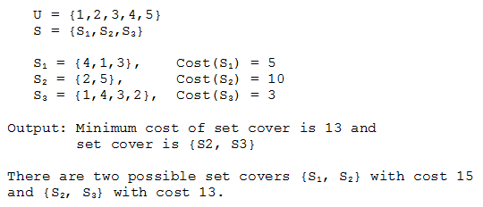
Set Cover Example

Slide 13
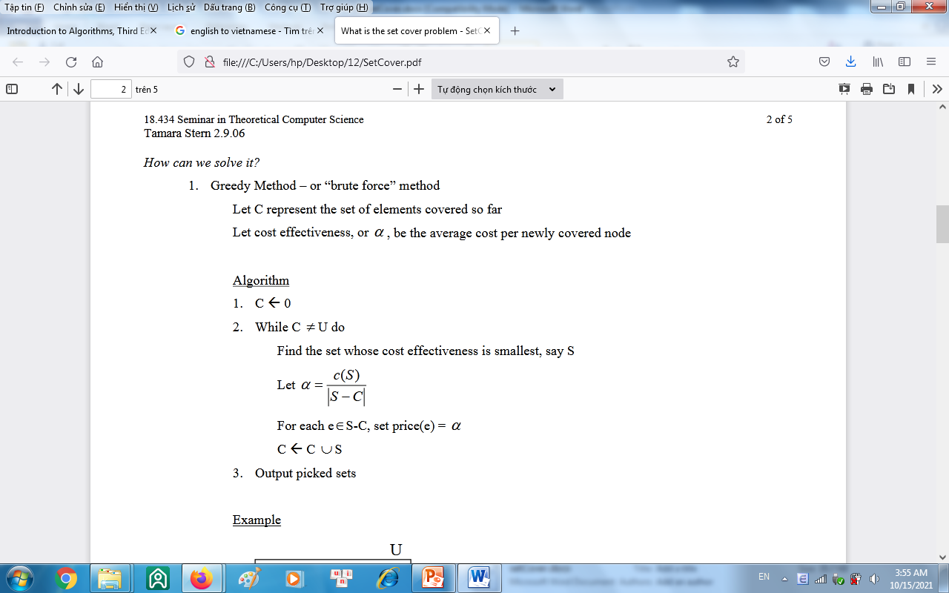
Set Cover Approximate Solution

Slide 14
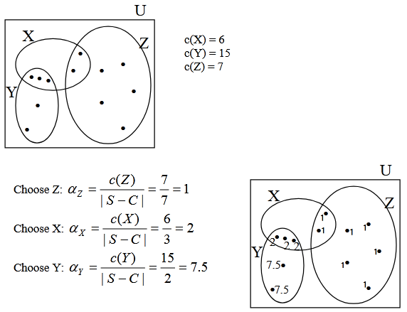
Approximate Solution Example
Total cost = 6 + 15 + 7 = 28
Note: The greedy algorithm is not optimal. An optimal solution would have chosen Y and Z for a cost of 22.

