Slide 1
Red Black Tree insertion

Slide 2
Insertion algorithm (1)
First, we insert the node x similarly to that in a binary search tree and assign a red colour to it.
If x’ father is black -> stop.
If x is the root, change its’ color to black and stop.
Otherwise we should balance the tree. In the Red-Black tree, we use two tools to do the balancing.
Recoloring
Rotation
Recolouring is the change in colour of the node i.e. if it is red then change it to black and vice versa. It must be noted that the colour of the NULL node is always black. Moreover, we always try recolouring first, if recolouring doesn’t work, then we go for rotation. Following is a detailed algorithm.
The algorithms have mainly two cases depending upon the colour of the uncle:
If the uncle is red, we do recolour.
If the uncle is black, we do rotations and/or recolouring.

Slide 3
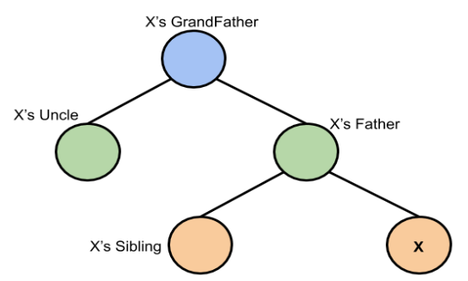
If x’ father is black -> stop.
If x is the root, change its’ color to black and stop.
Otherwise we should balance the tree. We try recoloring first, if recolouring doesn’t work, then we go for rotation.
Insertion algorithm (2)
Now, if the node is not the root, and its’ father (c) is red then check the colour of the node’s uncle (b). If the node’s uncle has a red colour then
a
b
c
Figure 1
change the colour of the node’s parent and uncle to black and that of grandfather (a) to red colour and repeat the same process for him (i.e. grandfather). See figure 2 in next slide

Slide 4
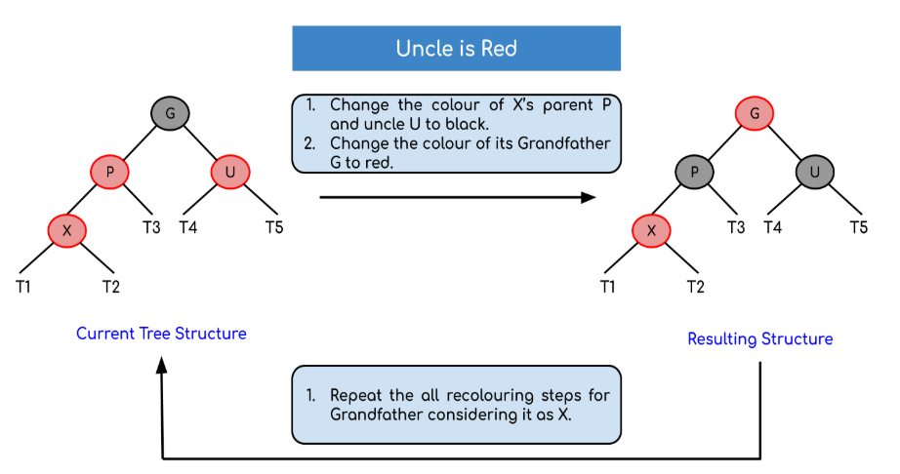
Insertion algorithm (3)
Figure 2

Slide 5
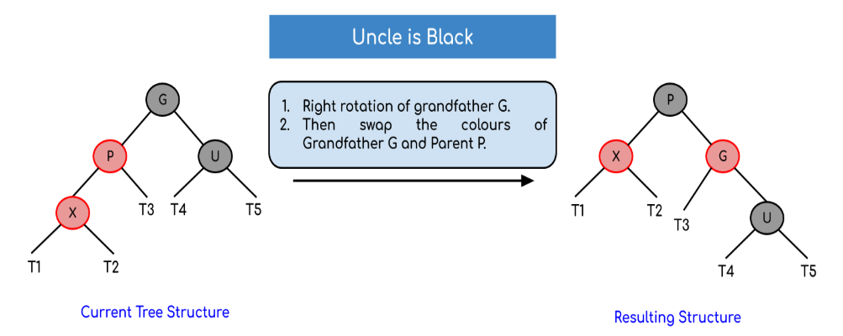
Insertion algorithm (4)
But, if the node’s uncle has black colour then there are 4 possible cases:
1 - Left Left Case (Single rotation):
Figure 3

Slide 6
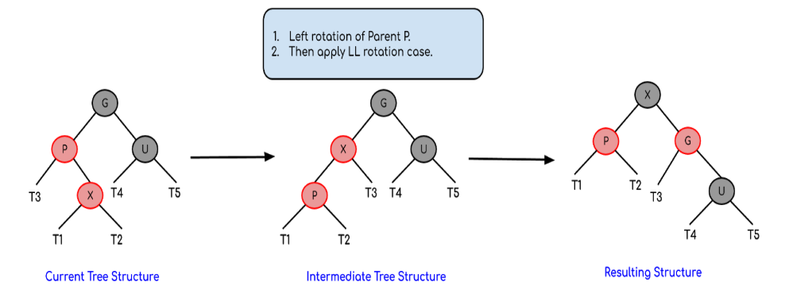
Insertion algorithm (5)
2 - Left Right Case (double rotation):
Figure 4

Slide 7
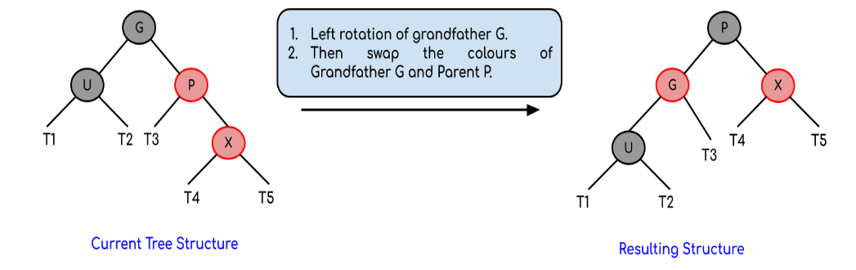
Insertion algorithm (6)
3 - Right Right Case (Single rotation):
Figure 5

Slide 8
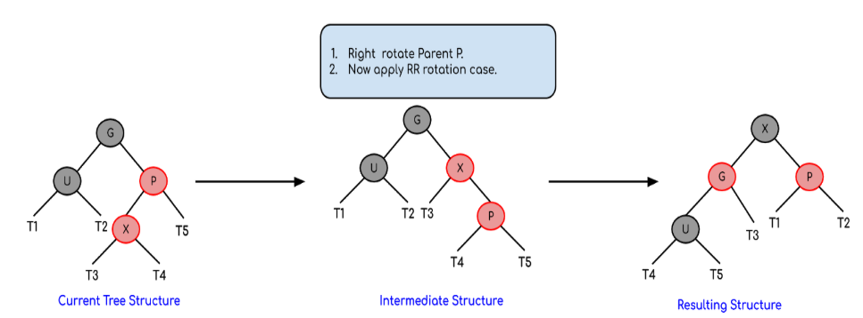
Insertion algorithm (7)
4 - Right Left Case (double rotation):
Figure 6

Slide 9

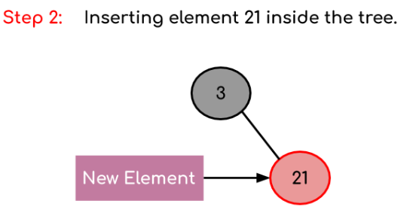
Insertion example (1)
When the first element is inserted it is inserted as a root node and as root node has black colour so it acquires the colour black.
The new element is always inserted with a red colour and as 21 > 3 so it becomes the part of the right subtree of the root node.

Slide 10
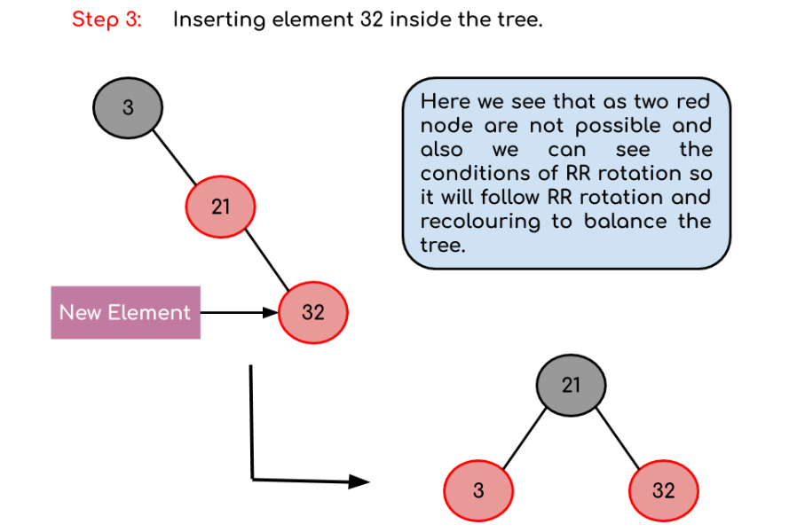
Insertion example (2)

Slide 11
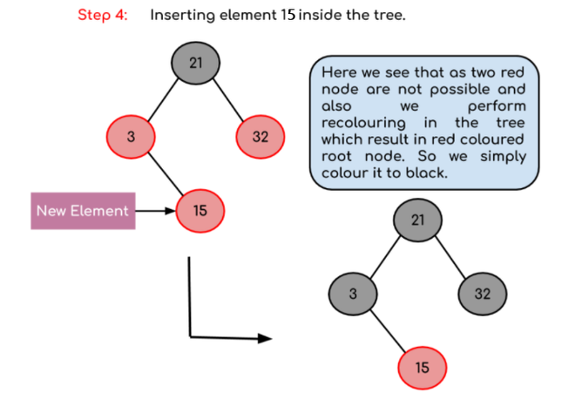
Insertion example (3)

