Slide 1
Research Handover
Social-Navigation Handover: From Simulation to the Real Robot
Hong-Son Nguyen (阮洪山)
hongsonnguyen.haui@gmail.com
Notes:
This guide hands over the social-navigation line of work of the lab. It gives
you a working pipeline from a 2-D Python simulation, through MuJoCo and Gazebo,
to a ROS 2 node for the real robot, together with baselines and a roadmap.

Slide 2
01
Overview
02
Stage 1 · 2-D Simulation & RL
03
Stage 2 · Gazebo
04
Stage 3 · Real Robot
05
Research Directions
Notes:
The guide has five parts: an overview of the kit, then the three stages from
simulation to the real robot, and finally directions for your own research.

Slide 3
What This Handover Contains
Simulation and learning
Robot and tooling
▪ Shared Python library socialnav_core: four crowd scenarios, Social Force crowd, unicycle robot with acceleration limits, metrics, 2-D plots and GIFs
▪ Baselines: goal seeker, Social Force, predictive Social Force with constant-velocity prediction
▪ Plug-in slots: Predictor, Controller, LearnedPolicy
▪ A working RL pipeline (stable-baselines3 PPO): train, save a .pt model, play in 2-D, MuJoCo, Gazebo and on the robot
▪ MuJoCo runner with inertia, velocity actuators and a ray-cast LiDAR
▪ ROS 2 packages: Gazebo world generator + people tracker
▪ Robot controller node with safety layers, people adapter and trial logger
▪ One-command automation (Makefile), environment check, tests and docs
Goal: be productive in week one, then build your own method on solid, tested infrastructure.
Notes:
On the left is the simulation and learning side: a shared library, three
baselines, plug-in points for your own predictor or policy, and a working
reinforcement-learning pipeline. On the right is the robot side: the MuJoCo
runner, the ROS 2 packages for Gazebo and the robot, and the automation that
ties everything together.

Slide 4
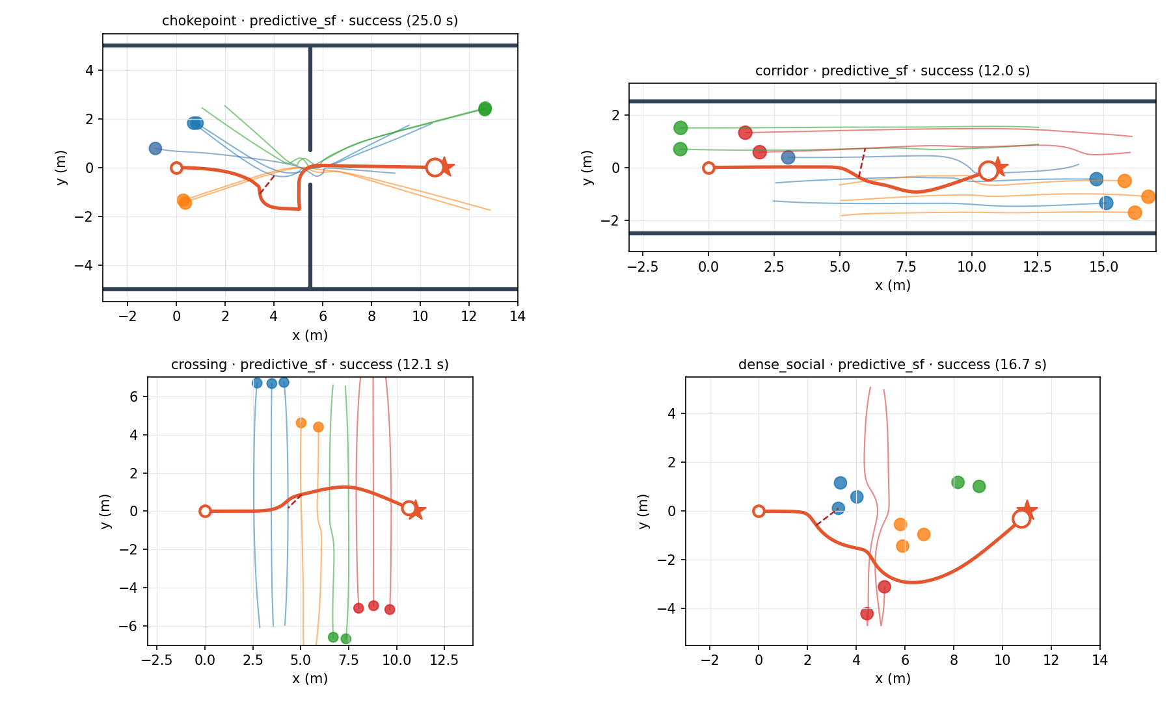
The Problem in One Slide
▪ Reach a goal through a space shared with people: collision-free is not enough; comfort, predictability and respect for groups matter
▪ People's intentions are unobserved; perception is noisy
▪ Freezing robot problem: treating everyone as an obstacle makes dense crowds look impassable
▪ Test protocol: simulated people ignore the robot (they never yield), so a method cannot succeed by pushing through
▪ Measure success / collision / timeout, time to goal, minimum distance, exposure
Four scenarios, predictive Social Force, seed 0. Robot path in orange; people coloured by group.
Notes:
The task is to reach a goal through a crowd. Collision avoidance is necessary but
not sufficient: people care about distance, predictability and their groups. The
four scenarios on the left are the benchmark of this kit: corridor, crossing,
chokepoint and dense social groups. An important convention is that the
simulated people ignore the robot. This makes the test harder and more honest,
because a method cannot succeed by forcing people out of its way.

Slide 5
Roadmap
0
Orientation
1
2-D simulation
2
Gazebo
3
Real robot
week 1
weeks 2–10
weeks 11–14
weeks 15+
▪ Read docs/CONCEPTS.md
▪ make test, sim2d, gifs
▪ Baselines, prediction, metrics
▪ Design or train your method
▪ ROS 2 topics, timing, noise
▪ Same controller in Gazebo
▪ Perception adapter, calibration
▪ Supervised trials with people
Exit: Explain the baselines' failures
Exit: Beat the baselines on all 4 scenarios
Exit: make smoke passes on 4 worlds
Exit: Logged trials, checklist followed
Detailed tasks per stage: docs/ROADMAP.md
Notes:
The roadmap has four stages. Each one has an exit criterion, and you should not
move on before meeting it: bugs are cheap in 2-D, more expensive in Gazebo, and
dangerous on the robot. The durations are indicative for part-time work.

Slide 6
One Controller, Three Stages
socialnav_core
Controller.act(Obs) → (v, w)
Stage 1 · Python
Stage 2 · Gazebo
Stage 3 · Real robot
Simulator fills Obs from the Social Force crowd
actor_tracker → /crowd/people; nav_controller fills Obs
people_adapter → /crowd/people; nav_controller fills Obs
▪ run_benchmark.py
▪ animate.py
▪ CrowdNavEnv for RL
▪ generated worlds
▪ diff-drive robot + LiDAR
▪ isolated ROS domain
▪ your detector
▪ safety layers
▪ trial_logger
Notes:
The key design decision is that every controller sees the same observation
structure and returns a velocity command. In stage 1 the simulator fills that
structure. In stages 2 and 3 the ROS node nav_controller fills it from
odometry, the people topic and the LiDAR. So a controller that you write and
test in 2-D runs in Gazebo and on the robot without any change.

Slide 7
Everything Is One Command
bash scripts/setup_python.sh
Python deps into .venv (system Python untouched)
≈ 5 min
make doctor
what can this machine run? (changes nothing)
seconds
make test · make sim2d · make gifs
tests, 2-D benchmark, animations
≈ 1 min
make train · make play
PPO with stable-baselines3; evaluate and animate
≈ 15 min
make mujoco
trained policy (or a baseline) in MuJoCo, GIFs
≈ 1 min
make ros · make smoke
build ROS 2 packages; headless Gazebo trial
≈ 2 min
make gazebo CONTROLLER=learned
Gazebo with GUI and your policy
interactive
make slides
rebuild this deck from the current code
≈ 20 s
Notes:
Every step has one command, and everything runs on your own machine. First
install the Python dependencies with the setup script, which uses a virtual
environment so your system stays clean, and run make doctor to see what is
ready. Then the 2-D benchmark, the RL training, MuJoCo, and finally the ROS 2
packages and a headless Gazebo trial.

Slide 8
01
Overview
02
Stage 1 · 2-D Simulation & RL
03
Stage 2 · Gazebo
04
Stage 3 · Real Robot
05
Research Directions
Notes:
Part 2: Stage 1 · 2-D Simulation. Crowd model, baselines, metrics, and your method.

Slide 9
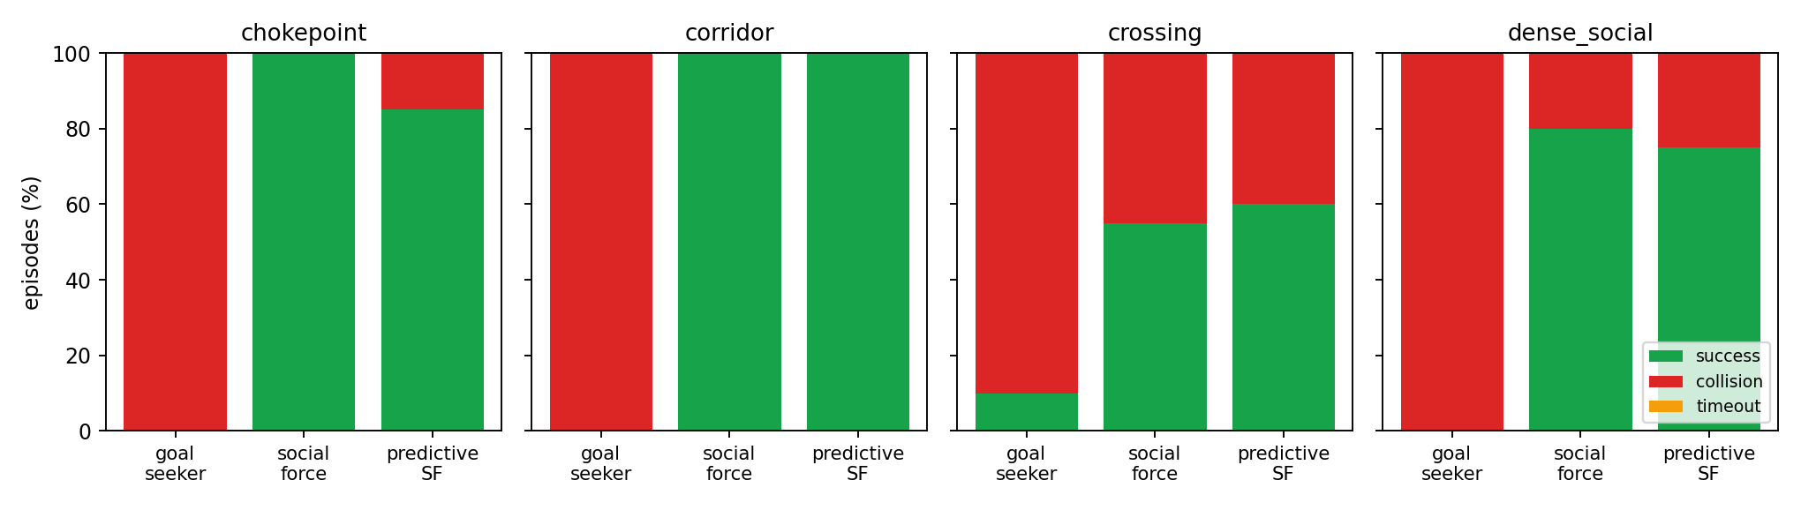
Baseline Results (Pedestrians Never Yield)
Scenario | Social Force: success / min dist | Predictive SF: success / min dist
chokepoint | 100% / 1.24 m | 85% / 1.12 m
corridor | 100% / 0.92 m | 100% / 1.13 m
crossing | 55% / 0.82 m | 60% / 0.83 m
dense_social | 80% / 0.98 m | 75% / 1.01 m
Read the failures. Reactive control collides or freezes when people do not yield; prediction helps in some scenes, not all. That gap is the research question.
20 seeds per cell, generated by this deck's build script from the current code.
Notes:
These are the baselines on the four scenarios with people who never yield.
Driving straight to the goal fails everywhere. The Social Force controller and
its predictive variant do well in some scenes and fail in others, either by
colliding or by hesitating. Use the GIFs to understand each failure; your first
research question is how to close this gap.

Slide 10
Where Your Method Plugs In
Predictor
Controller
Learned policy
Scenario
prediction.py
controllers.py
env.py + LearnedPolicy
scenarios.py
▪ predict(pos, vel, horizon, dt) → (K, T, N, 2)
▪ Evaluate with ade_fde on saved logs
▪ Use it in PredictiveSocialForce
▪ act(Obs) → (v, w)
▪ Register it in CONTROLLERS
▪ Runs unchanged in Gazebo and on the robot
▪ CrowdNavEnv: reset / step
▪ to_vector(obs): goal, people, rays
▪ Save as .pt for MuJoCo, Gazebo, robot
▪ Start, goal, speed, group, via points
▪ Seeds jitter positions and timing
▪ make worlds turns it into Gazebo
First exercises
▪ Tune the Social Force gains and plot the collision / timeout trade-off; add a fifth scenario; implement a better predictor than constant velocity; train a first policy with train_policy_template.py
Notes:
There are four extension points. A predictor returns multimodal futures. A
controller maps the observation to a command. A learned policy uses the
reset-step environment and is saved as a PyTorch model for the robot. And scenarios
define new crowds, which are converted to Gazebo worlds automatically.

Slide 11
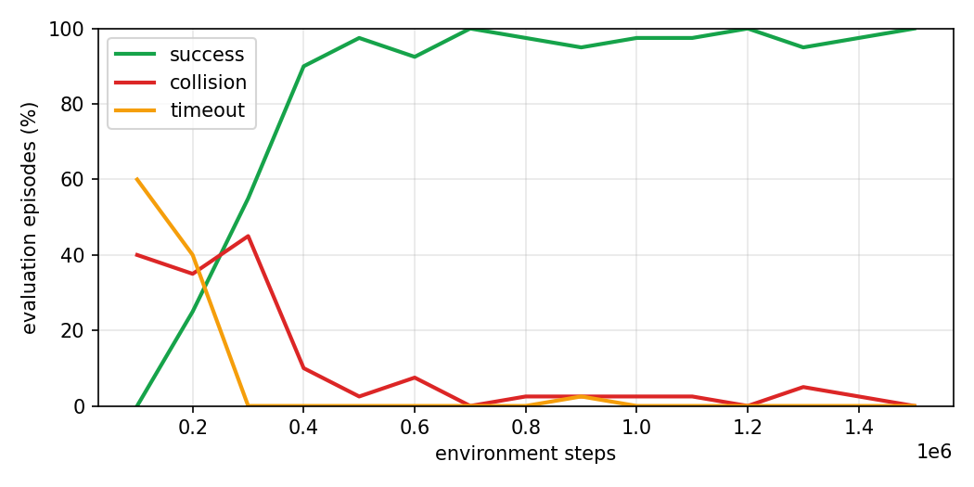
Reinforcement Learning with stable-baselines3
train_sb3.py
PPO, 16 envs, mixed crowds
best_model.zip
kept by evaluation
export_policy.py
.pt + .npz + meta, parity check
play.py
2-D metrics, GIFs
MuJoCo · Gazebo · robot
same policy file
A generic baseline, not a method
▪ Observation: goal, own speed, 8 nearest people (body frame), 16 range rays
▪ Action: speed and yaw rate every 0.1 s, through acceleration limits
▪ Reward: progress, goal +10, collision −10, too-close and time penalties
▪ People never yield; random crowds avoid memorising the layouts
▪ Swap the encoder, reward, curriculum or algorithm: keep the export contract
Evaluation on the 4 benchmark scenarios during training (run 'ppo_mixed').
Notes:
The kit includes a working reinforcement-learning pipeline built on
stable-baselines3. The training script runs PPO on sixteen parallel copies of the
2-D environment, evaluates on the benchmark scenarios, keeps the best model, and
saves it as a PyTorch .pt model, plus a numpy copy and a metadata file. The same policy
file then runs in the 2-D simulator, in MuJoCo, in Gazebo and on the robot. The
setup is deliberately generic: a plain MLP, a standard reward. It is a baseline
and a template for your own method.

Slide 12
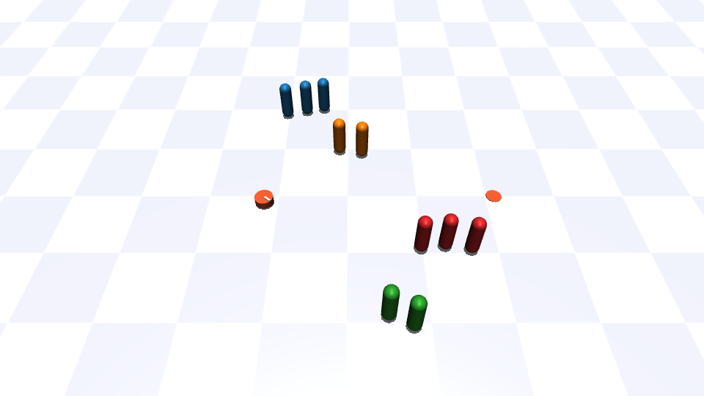
MuJoCo: the Same Policy in a Physics Engine
What the runner adds
▪ World generated from the same scenarios
▪ Robot with mass and inertia on velocity actuators
▪ Walls with contacts: touching one is a collision
▪ Simulated 360° LiDAR with mj_ray (walls only, as in Gazebo)
▪ No ROS needed: python3 stage2_mujoco/mujoco_crowd.py --policy …
Why: a policy that only works with perfect kinematics will fail on hardware; MuJoCo is a cheap first check before Gazebo and the robot.
Notes:
MuJoCo is a quick physics check without ROS. The world is generated from the
same scenarios, the robot has mass and inertia, walls produce contacts, and a
simulated LiDAR provides the range rays. If a policy only works with perfect
kinematics, you will see it here, long before the robot.

Slide 13
01
Overview
02
Stage 1 · 2-D Simulation & RL
03
Stage 2 · Gazebo
04
Stage 3 · Real Robot
05
Research Directions
Notes:
Part 3: Stage 2 · Gazebo. ROS 2 topics, timing and noise, with the same controller.

Slide 14
Gazebo Crowd Simulation
scenarios.py
same crowds as stage 1
generate_worlds.py
walls, actors, robot
Gazebo Classic
actors walk scripted routes
actor_tracker
/crowd/people
nav_controller
/cmd_vel, safety layers
trial_logger
trials.csv
How to run
Know the simulator
▪ make ros, then source scripts/sim_env.sh in each terminal
▪ make gazebo SCENARIO=crossing CONTROLLER=social_force
▪ Noise: ros2 param set /actor_tracker noise_std 0.1 (and drop_prob)
▪ make smoke SCENARIO=… : headless end-to-end check
▪ Actors follow scripts: they never react and have no collision (the LiDAR does not see them)
▪ Simulation uses an isolated ROS domain (localhost, ID 77): a simulated /cmd_vel can never reach a real robot
▪ The robot has no wall map: LiDAR returns become obstacle points for the controller
Notes:
Gazebo worlds are generated from the same scenario definitions, so the crowds
match stage 1. The tracker converts actor poses into the same people topic that
a real detector will produce, and the controller node adds the safety layers.
Two warnings: actors do not react and are invisible to the LiDAR, and all
simulation must run in the isolated ROS domain so that it can never drive a real
robot on the lab network.

Slide 15
01
Overview
02
Stage 1 · 2-D Simulation & RL
03
Stage 2 · Gazebo
04
Stage 3 · Real Robot
05
Research Directions
Notes:
Part 4: Stage 3 · Real Robot. Perception adapter, safety layers, calibration, trials.

Slide 16
Running the Controller on the Robot
Your detector
PoseArray or Detection3DArray
people_adapter
TF to odom, velocities
nav_controller
controller + safety
Base driver
/cmd_vel with timeout
Safety layers in nav_controller
Bring-up order
▪ Stale odometry → zero command
▪ LiDAR stop: obstacle within estop_distance around the travel direction
▪ Kinematic filter: speed and acceleration limits
▪ yaw_rate_scale for bases that turn slower than commanded
▪ Conservative defaults: 0.5 m/s, 0.8 rad/s
▪ Odometry checked against a tape measure
▪ Detector → /crowd/people verified in RViz
▪ Empty room → one person → small groups
▪ Every trial logged: outcome, time, path, min distance, exposure
▪ launch: real_robot.launch.py controller:=… input_topic:=…
Notes:
On the robot, your people detector feeds the adapter, which transforms the
detections into the odometry frame and estimates velocities. The controller node
applies four safety layers after your controller. Bring the system up in the
order on the right, and never skip the empty-room runs.

Slide 17
Real-Robot Checklist (Excerpt)
Approval
Lab / supervisor approval for experiments with people (IRB when required); volunteers informed
Operator
A second person holds the hardware emergency stop for every run
Network
Real robot on its own ROS domain; never run a simulation on it
Timeout
Base driver stops when /cmd_vel stops
Calibration
Odometry < 5 % error; yaw_rate_scale measured; LiDAR position set
Limits
Start at 0.3–0.5 m/s; raise step by step, never above training limits
Records
Unique trial names, lab notebook, data copied to lab storage
Notes:
This is the short version of docs/REAL_ROBOT_CHECKLIST.md. Print the full list
and tick every item before each session. If any item fails, do not run the
robot.

Slide 18
01
Overview
02
Stage 1 · 2-D Simulation & RL
03
Stage 2 · Gazebo
04
Stage 3 · Real Robot
05
Research Directions
Notes:
Part 5: Research Directions. Ideas to explore next.

Slide 19
Directions Worth Exploring
1
Forecast, then act
2
Social structure
A learned, multimodal forecaster that models interactions between people and is fast enough for the control loop; compare against constant velocity first.
People walk in groups. How can a robot recognise groups and avoid splitting them, without hand-tuned clustering?
3
Learning the policy
4
Closing the sim-to-real gap
RL in parallel simulation with a reward that balances progress, safety and comfort; demonstrations to speed up the start of training.
Actuator lag, perception noise, frames and control rate must match between training and the robot.
Background: the MSc thesis on safe robot-crowd navigation (NCKU) and arXiv:2608.21411; see docs/CONCEPTS.md for papers.
Notes:
Four directions to explore next: how to forecast people, how to reason about
groups, how to shape and train a policy, and how to make it survive the
transfer to hardware. The thesis and the preprint give the motivation.

Slide 20
Getting Started This Week
1
On your own Ubuntu 22.04 machine: follow docs/GETTING_STARTED.md, bash scripts/setup_python.sh, make doctor
2
make test, make sim2d, make gifs; explain one failure of each baseline
3
make train-quick, then make train and make play; compare with run_benchmark.py
4
make mujoco; then install ROS 2 Humble and run make ros, make smoke
5
Read docs/CONCEPTS.md, docs/ROADMAP.md and two papers
6
Write your stage-1 plan: which method, which metrics, which baseline to beat
Notes:
To finish, six concrete steps for the first week. By the end of the week you
should have run every stage once, understood the baselines, and written a short
plan for your own method. Good luck.

Slide 21


hongsonnguyen.haui@gmail.com
Department of Mechanical Engineering
National Cheng Kung University
Tainan, Taiwan
Notes:
Thank you. Everything shown here is in the Handover folder; start with
docs/GETTING_STARTED.md and make doctor on your own machine, and ask me if
anything is unclear.

