Slide 1
RagaMoodSync
Facial expression, physiological context and Hindustani raga research
Music, expression
and personal listening
Group: [Group name] Members: [Names / IDs]
Guide: [Guide name] Institution: [Institution]
Paper-informed implementation · Windows CPU · Research prototype
Pingle & Ragha, 2025
01 / 13
Notes:
Pingle & Ragha, 2025: https://doi.org/10.1007/s41870-025-02531-y
Editable group placeholders intentionally retained. No group identities were supplied. Project does not claim exact reproduction or clinical validation.

Slide 2
Motivation and significance
Music discovery can reflect a listener’s expression, cultural context and feedback.
Facial expressions offer a convenient, uncertain input that a user can correct.
Hindustani metadata adds cultural context beyond generic genre labels.
Persistent feedback lets recommendations adapt to individual experience.
Research objective: build and test the full software loop. Therapeutic efficacy remains unestablished.
Mathur et al., 2015 · Valla et al., 2017
02 / 13
Notes:
Mathur et al., 2015: https://doi.org/10.3389/fpsyg.2015.00513
Valla et al., 2017: https://doi.org/10.3389/fpsyg.2017.02115

Slide 3
Literature review
The selected paper defines the architecture. Adjacent work supplies context.
Research | Contribution | Project implication
RagaMoodSync (2025) | FusDenseNet and FDCF | Implement mechanisms, disclose assumptions
FER challenge (2013) | Facial-expression benchmark | Keep held-out classification evaluation
DenseNet (2017) | Dense feature reuse | Use concatenated earlier features
Neural CF (2017) | Learned neural matching | Learn user/music interaction representations
Raga emotion study (2015) | Listener-rated musical structure | Do not equate a raga name with a universal outcome
FER2013 training and expanded test evaluation completed. Real listener trials remain pending.
Pingle & Ragha, 2025 · Goodfellow et al., 2013 · Huang et al., 2017 · He et al., 2017 · Mathur et al., 2015
03 / 13
Notes:
Pingle & Ragha, 2025: https://doi.org/10.1007/s41870-025-02531-y
Goodfellow et al., 2013: https://doi.org/10.1007/978-3-642-42051-1_16
Huang et al., 2017: https://doi.org/10.1109/CVPR.2017.243
He et al., 2017: https://doi.org/10.1145/3038912.3052569
Mathur et al., 2015: https://doi.org/10.3389/fpsyg.2015.00513

Slide 4
Prior art and preliminary IP search
The broad concept of facial-emotion music recommendation is already disclosed.
US20230153350A1
“Music recommendation system by facial emotion using deep learning”
Publication: 18 May 2023. Description includes audio preprocessing and attention.
Search scope: targeted web/Google Patents review. Official claims, families, prosecution and jurisdictional coverage remain to be assessed.
Rights: the supplied Raag Ratnakar archive contains no license file. Preserve attribution and resolve permission before redistribution.
US20230153350A1 · RagaMoodSync · Raag Ratnakar
04 / 13
Notes:
US20230153350A1: https://patents.google.com/patent/US20230153350A1/en
RagaMoodSync: https://doi.org/10.1007/s41870-025-02531-y
Raag Ratnakar: https://github.com/alronova/raag-ratnakar
Preliminary technical review, not patentability or freedom-to-operate clearance. Dates are bibliographic page information. No novelty or legal-status conclusion is claimed.

Slide 5
Relevance, applications and end users
A local research studio for culturally informed music exploration.
End user | Use | Boundary
Listeners | Explore vocal/instrumental raga links | User can correct inferred mood
Students and educators | Inspect source metadata and missing fields | Associations require expert review
AI / MIR researchers | Train models and evaluate feedback loops | Synthetic tests do not show real-world quality
Future study teams | Investigate consented affect/music responses | Clinical use requires separate evidence
Windows CPU execution makes the prototype usable without a GPU or physical sensors.
05 / 13

Slide 6
Proposed solution and innovation
An executable integration, with mechanisms and evidence kept traceable.
Operational loop: image or manual mood, raga ranking, links, feedback and listening history.
Paper-informed models: repeated fusion-dense stages, cross-attention, multi-pooling and a trainable FDCF focus network.
Engineering contribution: field provenance, explicit unknown metadata, optional signal inputs and reproducible CPU experiments.
Default: locally trained FusDenseNet v4. Navrasa remains a separately labeled baseline.
Paper architecture · Initial knowledge source
06 / 13
Notes:
Paper architecture: https://doi.org/10.1007/s41870-025-02531-y
Initial knowledge source: https://github.com/alronova/raag-ratnakar
No scientific novelty or measured recommendation benefit is asserted. Native nine-Rasa baseline probabilities map heuristically to seven emotion labels.

Slide 7
System architecture
Confirmed feelings, listening goals, weather and recorded body context shape the ranking.
Webcam /
image upload
FusDenseNet
Raw probabilities
Confirm feeling
Confirmed feeling
Listening goal
IKS + preferences
Optional trained FDCF
EEG / HRV
City / manual weather
Optional context
Context-aware ranking
Raga details + links
SQLite
Feedback and history
FusDenseNet v4 adds early spatial features while retaining dense fusion and attention.
Weather/body rules adjust listening context. Their outcome benefit remains untested.
Paper core: Figs 1–4 and Eqs 3–15 · Weather extension
07 / 13
Notes:
Paper core: Figs 1–4 and Eqs 3–15: https://doi.org/10.1007/s41870-025-02531-y
Weather extension: https://open-meteo.com/en/docs

Slide 8
Dataset sources and methodology
Face and physiological benchmarks have separate evidence roles. DENS access was checked.
Resource | Role | Access / current evidence
Raag Ratnakar | Metadata and Navrasa weights | 72 ragas, 528 entries, 516 unique URLs
FER2013 | Real facial CPU training / test | Version 1, 63.3 MB ZIP. ODbL / DbCL advertised
DEAP / WESAD | Physiological affect benchmarks | Access review. Not raga-response data
GamER | Real paired EEG + ECG evaluation | Fixed-game / fixed-30s tests, held-out people
Saraga / CompMusic | Future features and metadata | Saraga data: CC BY-NC. Check each source
IndRaga | Future precomputed audio features | Primary DOI record unavailable in review
Weather: Open-Meteo or manual entry. Model-based city data; experimental Ritu preference.
GamER · FER2013 · DEAP · WESAD · Saraga · Open-Meteo
08 / 13
Notes:
GamER: https://doi.org/10.5281/zenodo.8191877
FER2013: https://doi.org/10.1007/978-3-642-42051-1_16
DEAP: https://doi.org/10.1109/T-AFFC.2011.15
WESAD: https://doi.org/10.1145/3242969.3242985
Saraga: https://doi.org/10.18061/emr.v16i1.7641
Open-Meteo: https://open-meteo.com/en/terms
Source links: https://www.kaggle.com/datasets/msambare/fer2013 ; https://www.eecs.qmul.ac.uk/mmv/datasets/deap/ ; https://archive.ics.uci.edu/dataset/465/wesad ; https://physionet.org/ ; https://mtg.github.io/saraga/ ; https://doi.org/10.5281/zenodo.19978345 ; https://compmusic.upf.edu/ . IndRaga primary metadata/files/license were not verified.
DENS: https://doi.org/10.18112/openneuro.ds003751.v1.0.2 . Planned crossed participant/movie-held-out evaluation not scored: only 2 of 12 predeclared participant headers match referenced FDT dimensions. README/LICENSE ODbL/DbCL conflicts with dataset_description CC0. No DENS performance or synthetic replacement is reported.

Slide 9
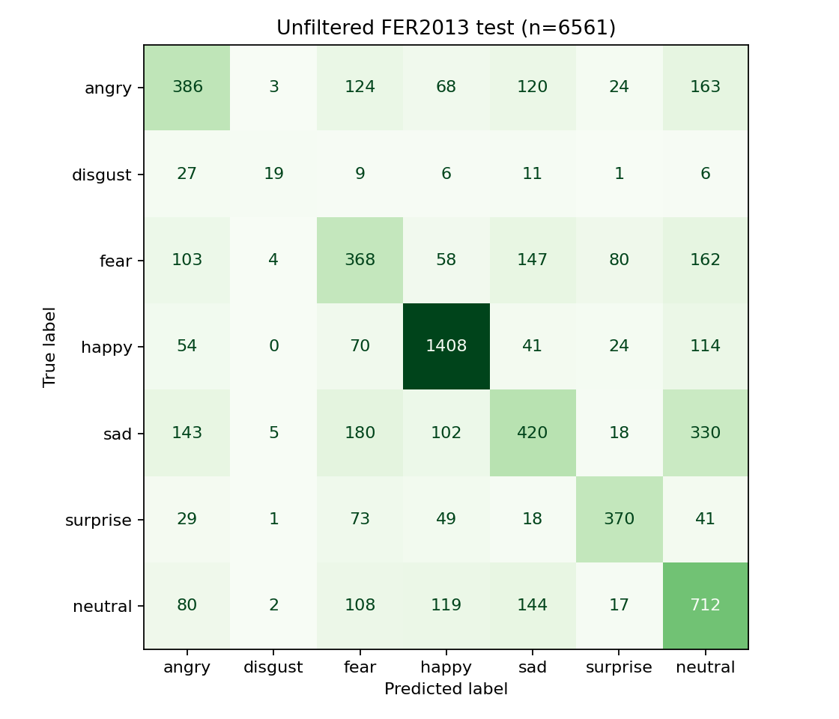
FusDenseNet implementation and results
Logged: 19 full-network + 101 MLP epochs. Selected index 110.
1,828,896 parameters. 3,276 classifier inputs
3 fusion stages, attention and early spatial path
23,503 train / 3,970 validation; 57.41% with TTA
Test n=6561. Accuracy 56.13%
Macro P 0.5466, R 0.4981
Macro F1 0.5105
Disgust: recall 24.05%, precision 0.559, F1 0.336. All 79 test examples included.
Figs 2–3, Eqs 3–9 · Actual project evidence · HOG method: Dalal & Triggs, 2005
09 / 13
Notes:
Paper: https://doi.org/10.1007/s41870-025-02531-y . Actual report reports/emotion_evaluation.json; SHA 9a733a87fc5ec0db544b74504d60ca9ea3d3c94c3648d85e61e5397ca10d43ed. All seven labels and all 6561 retained test faces. Historic combined Kaggle test folder, not fresh or identity-disjoint. v4 retains all prior features and adds1920 spatial features from the first dense blocks before8x8 pooling. Selected MLP3276→512→7;1828896 parameters. These are project architecture choices. Project extension with unknown author dimensions, not exact reproduction. Initialization preserved v2 logits. Candidate selection and flip/temperature calibration used validation only. No test-driven continuation after this frozen evaluation. Epoch indices include cheaper frozen-backbone MLP training. Baseline/recipes/negative results are detailed in FURTHER_RESULTS.md. Disgust remains weak and webcam-domain performance unverified. No equal-budget causal architecture ablation. Paper's very high reported accuracies are not reproduced.

Slide 10
EEG / HRV, weather, IKS and FDCF
Real GamER, fixed 30s: QWOP 13 windows / 12 people. CBAAD 13 windows / 13 people.
FDCF + IKS
Input | QWOP acc. | QWOP F1 | CBAAD F1
EEG | 53.85% | 0.458 | 0.606
Cardiac | 46.15% | 0.316 | 0.575
Fusion | 53.85% | 0.458 | 0.606
Majority | 76.92% | 0.435 | 0.409
Game const. | 76.92% | 0.435 | 0.409
User/music/emotion embeddings
Focus, dynamic preferences and MLP
Bhava, Prahara, Ritu: source-supplied
Missing raga fields remain unknown
Game and duration held constant
Separate within-game source labels
Held-out people, fold-fitted scaling
Real EEG and ECG in each window
Offset-sign sensitivity reported
Weather / raga outcomes remain untested
No primary fusion F1 gain over EEG.
Fusion accuracy below majority in both tasks.
Paired 95% intervals include zero.
30s RR features remain exploratory.
GamER: Papadopoulos et al., 2023 · FDCF Eqs 10–15 · NeuroKit2
10 / 13
Notes:
GamER source https://doi.org/10.5281/zenodo.8191877 . Actual fixed-context reports/gamer_fixed_context_evaluation.json and raw/fold audit gamer_fixed_context_audit.json. Each task has constant game identity and exactly 30-second duration. EEG/cardio/fusion use the same labelled source windows and leave-one-participant-out folds, logistic C=1 class-balanced, scaler fitted only on training participants. QWOP Angry/Happy, CBAAD Bored/Stressed. Duration-only and game-only controls match the majority control. Neither task gains macro F1 from fusion. QWOP paired interval [-0.24019047619047618,0.24455544455544453]; CBAAD [-0.2837301587301587,0.28360177404295045]. Primary subtract-offset convention not independently confirmed; alternate-sign results remain sensitivity, never selected for higher score. Other artifacts/annotation/movement confounds remain. Old pooled emotion/game confounding is historical only. No facial/physiology, disgust, weather or raga joint validation. FDCF paper Eqs10–15: https://doi.org/10.1007/s41870-025-02531-y. NeuroKit2 https://doi.org/10.3758/s13428-020-01516-y .

Slide 11

Application, experiments and limitations
Unfiltered facial results and controlled real-recording evidence are visible in the app.
41 / 41 automated tests pass
Previous 52.58% model versus selected model:
Accuracy 52.58% to 56.13%
Macro F1 0.4658 to 0.5105
Disgust recall 22.78% to 24.05%
Disgust F1 0.2571 to 0.3363
All seven labels and test errors retained.
Accuracy gain: 233 / 6,561 test faces.
Disgust / webcam recognition remains weak.
Fixed-game fusion: no gain. DENS pending.
No joint face / raga outcome validation.
Listener interface: earlier capture; current model metrics at right
Project tests · Actual physiology · Actual emotion comparison
11 / 13
Notes:
Historical listener-interface capture. Current measured model results appear alongside it; this screenshot is not evidence of the new classifier performance. The controlled physiology table appears on slide10. Tests: reports/pytest.xml. Same-set FER comparison: reports/emotion_training_comparison.json. DENS attempted predeclared 12-person cohort, only2 headers matched referenced FDT dimensions. No DENS benchmark performance or invented sensor readings. Data source: https://doi.org/10.18112/openneuro.ds003751.v1.0.2 .

Slide 12
Future work and publication possibilities
Publication depends on sound data, rights and evaluation.
Train equal-budget attention / pooling ablations with multiple seeds, stronger split controls and calibrated uncertainty.
Collect consented listening feedback and expert-reviewed raga annotations. Evaluate chronological ranking and IKS ablation.
Resolve physiological source-dimension and timing issues, obtain adequate windows and validate on held-out people and stimulus identities.
A reproducibility or systems paper is plausible after these experiments. Clinical and patent claims require separate substantiation.
12 / 13
Notes:
No publication acceptance, novelty, clinical efficacy or patentability is promised. Resolve third-party permissions before releasing catalog or checkpoint assets.

Slide 13
Complete references
Academic, data and prior-art sources cited throughout the presentation
1. Pingle, Y. P. & Ragha, L. K. (2025). RagaMoodSync: a deep learning framework for Hindustani Raga recommendations driven by facial emotions. International Journal of Information Technology, 17, 2765–2778. DOI: 10.1007/s41870-025-02531-y.
2. Goodfellow, I. et al. (2013). Challenges in Representation Learning: A report on three machine learning contests. DOI: 10.1007/978-3-642-42051-1_16.
3. Huang, G., Liu, Z., van der Maaten, L. & Weinberger, K. Q. (2017). Densely Connected Convolutional Networks. CVPR. DOI: 10.1109/CVPR.2017.243.
4. He, X. et al. (2017). Neural Collaborative Filtering. WWW. DOI: 10.1145/3038912.3052569.
5. Mathur, A. et al. (2015). Emotional responses to Hindustani raga music: the role of musical structure. Frontiers in Psychology, 6, 513. DOI: 10.3389/fpsyg.2015.00513.
6. Valla, J. M. et al. (2017). Music and Emotion—A Case for North Indian Classical Music. Frontiers in Psychology, 8, 2115. DOI: 10.3389/fpsyg.2017.02115.
7. Koelstra, S. et al. (2012). DEAP: A Database for Emotion Analysis Using Physiological Signals. IEEE TAC. DOI: 10.1109/T-AFFC.2011.15.
16. Papadopoulos, A., Episkopou, C., Malegiannaki, A., Kyritsis, K., Sarafis, I., Papaefstathiou, I. & Delopoulos, A. (2023). GamER: Gameplay Physiological Signal Dataset for Emotion Recognition. Zenodo v1. DOI: 10.5281/zenodo.8191877. CC BY 4.0.
8. Schmidt, P. et al. (2018). Introducing WESAD, a Multimodal Dataset for Wearable Stress and Affect Detection. ICMI. DOI: 10.1145/3242969.3242985.
9. Srinivasamurthy, A. et al. (2021). Saraga: Open Datasets for Research on Indian Art Music. Empirical Musicology Review, 16, 85–98. DOI: 10.18061/emr.v16i1.7641.
10. Gramfort, A. et al. (2013). MEG and EEG data analysis with MNE-Python. DOI: 10.3389/fnins.2013.00267.
11. Makowski, D. et al. (2021). NeuroKit2: A Python toolbox for neurophysiological signal processing. DOI: 10.3758/s13428-020-01516-y.
12. US20230153350A1 (2023). Music recommendation system by facial emotion using deep learning. patents.google.com/patent/US20230153350A1/en.
13. alronova. Raag Ratnakar. github.com/alronova/raag-ratnakar. Supplied ZIP, license unresolved. NASA portrait provenance: scikit-image.org/docs/stable/api/skimage.data.html.
14. Dalal, N. & Triggs, B. (2005). Histograms of Oriented Gradients for Human Detection. CVPR, pp. 886–893. DOI: 10.1109/CVPR.2005.177. HOG baseline here uses project-selected FER settings.
15. Open-Meteo. Forecast / Geocoding API documentation and Terms. open-meteo.com/en/docs; open-meteo.com/en/docs/geocoding-api; open-meteo.com/en/terms.
17. Mishra, S., Asif, M., Tiwary, U. S. & Srinivasan, N. DENS. OpenNeuro ds003751 v1.0.2. DOI: 10.18112/openneuro.ds003751.v1.0.2. Source review only, no result claimed. Full dataset access links: DATASETS.md.
13 / 13
Notes:
paper: https://doi.org/10.1007/s41870-025-02531-y
fer: https://doi.org/10.1007/978-3-642-42051-1_16
dense: https://doi.org/10.1109/CVPR.2017.243
ncf: https://doi.org/10.1145/3038912.3052569
mathur: https://doi.org/10.3389/fpsyg.2015.00513
valla: https://doi.org/10.3389/fpsyg.2017.02115
deap: https://doi.org/10.1109/T-AFFC.2011.15
wesad: https://doi.org/10.1145/3242969.3242985
saraga: https://doi.org/10.18061/emr.v16i1.7641
mne: https://doi.org/10.3389/fnins.2013.00267
nk: https://doi.org/10.3758/s13428-020-01516-y
patent: https://patents.google.com/patent/US20230153350A1/en
repo: https://github.com/alronova/raag-ratnakar
Full titles, access notes and license status are in LITERATURE_REVIEW.md, DATASETS.md and PRIOR_ART_AND_IP.md. Source access review: 2 November 2026.
Further actual project results and failed DENS source integrity checks: FURTHER_RESULTS.md. DENS source https://github.com/OpenNeuroDatasets/ds003751 . Public dataset licence ambiguity documented. No claim that all possible prior art has been found.

