Slide 1
RagaMoodSync
A facial emotion-driven Hindustani raga research application
Music, expression
and personal listening
Group: [Group name] Members: [Names / IDs]
Guide: [Guide name] Institution: [Institution]
Paper-informed implementation · Windows CPU · Research prototype
Pingle & Ragha, 2025
01 / 13
Notes:
Pingle & Ragha, 2025: https://doi.org/10.1007/s41870-025-02531-y
Editable group placeholders intentionally retained. No group identities were supplied. Project does not claim exact reproduction or clinical validation.

Slide 2
Motivation and significance
Music discovery can reflect a listener’s expression, cultural context and feedback.
Facial expressions offer a convenient, uncertain input that a user can correct.
Hindustani metadata adds cultural context beyond generic genre labels.
Persistent feedback lets recommendations adapt to individual experience.
Research objective: build and test the full software loop. Therapeutic efficacy remains unestablished.
Mathur et al., 2015 · Valla et al., 2017
02 / 13
Notes:
Mathur et al., 2015: https://doi.org/10.3389/fpsyg.2015.00513
Valla et al., 2017: https://doi.org/10.3389/fpsyg.2017.02115

Slide 3
Literature review
The selected paper defines the architecture. Adjacent work supplies context.
Research | Contribution | Project implication
RagaMoodSync (2025) | FusDenseNet and FDCF | Implement mechanisms, disclose assumptions
FER challenge (2013) | Facial-expression benchmark | Keep held-out classification evaluation
DenseNet (2017) | Dense feature reuse | Use concatenated earlier features
Neural CF (2017) | Learned neural matching | Learn user/music interaction representations
Raga emotion study (2015) | Listener-rated musical structure | Do not equate a raga name with a universal outcome
FER2013 training and expanded test evaluation completed. Real listener trials remain pending.
Pingle & Ragha, 2025 · Goodfellow et al., 2013 · Huang et al., 2017 · He et al., 2017 · Mathur et al., 2015
03 / 13
Notes:
Pingle & Ragha, 2025: https://doi.org/10.1007/s41870-025-02531-y
Goodfellow et al., 2013: https://doi.org/10.1007/978-3-642-42051-1_16
Huang et al., 2017: https://doi.org/10.1109/CVPR.2017.243
He et al., 2017: https://doi.org/10.1145/3038912.3052569
Mathur et al., 2015: https://doi.org/10.3389/fpsyg.2015.00513

Slide 4
Prior art and preliminary IP search
The broad concept of facial-emotion music recommendation is already disclosed.
US20230153350A1
“Music recommendation system by facial emotion using deep learning”
Publication: 18 May 2023. Description includes audio preprocessing and attention.
Search scope: targeted web/Google Patents review. Official claims, families, prosecution and jurisdictional coverage remain to be assessed.
Rights: the supplied Raag Ratnakar archive contains no license file. Preserve attribution and resolve permission before redistribution.
US20230153350A1 · RagaMoodSync · Raag Ratnakar
04 / 13
Notes:
US20230153350A1: https://patents.google.com/patent/US20230153350A1/en
RagaMoodSync: https://doi.org/10.1007/s41870-025-02531-y
Raag Ratnakar: https://github.com/alronova/raag-ratnakar
Preliminary technical review, not patentability or freedom-to-operate clearance. Dates are bibliographic page information. No novelty or legal-status conclusion is claimed.

Slide 5
Relevance, applications and end users
A local research studio for culturally informed music exploration.
End user | Use | Boundary
Listeners | Explore vocal/instrumental raga links | User can correct inferred mood
Students and educators | Inspect source metadata and missing fields | Associations require expert review
AI / MIR researchers | Train models and evaluate feedback loops | Synthetic tests do not show real-world quality
Future study teams | Investigate consented affect/music responses | Clinical use requires separate evidence
Windows CPU execution makes the prototype usable without a GPU or physical sensors.
05 / 13

Slide 6
Proposed solution and innovation
An executable integration, with mechanisms and evidence kept traceable.
Operational loop: image or manual mood, raga ranking, links, feedback and listening history.
Paper-informed models: repeated fusion-dense stages, cross-attention, multi-pooling and a trainable FDCF focus network.
Engineering contribution: field provenance, explicit unknown metadata, optional signal inputs and reproducible CPU experiments.
Default: locally trained FusDenseNet v2. Supplied Navrasa remains a separately labeled baseline.
Paper architecture · Initial knowledge source
06 / 13
Notes:
Paper architecture: https://doi.org/10.1007/s41870-025-02531-y
Initial knowledge source: https://github.com/alronova/raag-ratnakar
No scientific novelty or measured recommendation benefit is asserted. Native nine-Rasa baseline probabilities map heuristically to seven emotion labels.

Slide 7
System architecture
Confirmed feelings, listening goals, weather and recorded body context shape the ranking.
Webcam /
image upload
FusDenseNet
Uncertain outputs
are withheld
Confirmed feeling
Listening goal
IKS + preferences
Optional trained FDCF
EEG / HRV
City / manual weather
Optional context
Context-aware ranking
Raga details + links
SQLite
Feedback and history
FusDenseNet v2 retains dense fusion, cross-attention and spatial/global pooling.
Weather/body rules adjust listening context; they do not identify the person’s mood.
Paper core: Figs 1–4 and Eqs 3–15 · Weather extension
07 / 13
Notes:
Paper core: Figs 1–4 and Eqs 3–15: https://doi.org/10.1007/s41870-025-02531-y
Weather extension: https://open-meteo.com/en/docs

Slide 8
Dataset sources and methodology
Facial benchmark, optional recordings and live/manual weather have different evidence roles.
Resource | Role | Access / current evidence
Raag Ratnakar | Metadata and Navrasa weights | 72 ragas, 528 entries, 516 unique URLs
FER2013 | Real facial CPU training / test | Version 1, 63.3 MB ZIP. ODbL / DbCL advertised
DEAP / WESAD | Physiological affect benchmarks | Access review. Not raga-response data
PhysioNet | Future ECG/PPG resource | Per-dataset access and license
Saraga / CompMusic | Future features and metadata | Saraga data: CC BY-NC. Check each source
IndRaga | Future precomputed audio features | Primary DOI record unavailable in review
Weather: Open-Meteo or manual entry. Model-based city data; experimental Ritu preference.
FER2013 · DEAP · WESAD · Saraga · Open-Meteo
08 / 13
Notes:
FER2013: https://doi.org/10.1007/978-3-642-42051-1_16
DEAP: https://doi.org/10.1109/T-AFFC.2011.15
WESAD: https://doi.org/10.1145/3242969.3242985
Saraga: https://doi.org/10.18061/emr.v16i1.7641
Open-Meteo: https://open-meteo.com/en/terms
Source links: https://www.kaggle.com/datasets/msambare/fer2013 ; https://www.eecs.qmul.ac.uk/mmv/datasets/deap/ ; https://archive.ics.uci.edu/dataset/465/wesad ; https://physionet.org/ ; https://mtg.github.io/saraga/ ; https://doi.org/10.5281/zenodo.19978345 ; https://compmusic.upf.edu/ . IndRaga primary metadata/files/license were not verified.

Slide 9
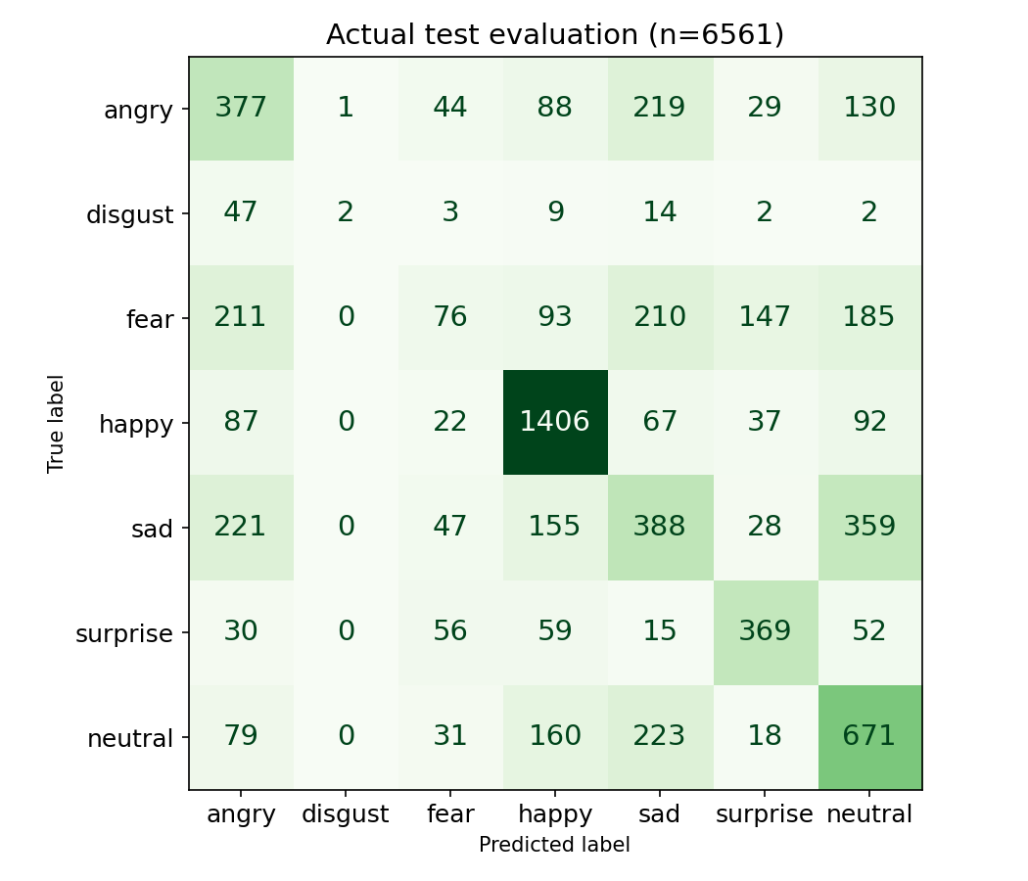
FusDenseNet implementation and results
CPU training: 17 epochs · selected epoch 16 by validation macro F1
223,776 parameters · spatial + global pooling
3 fusion stages, cross-attention, dilation
23,503 train / 3,970 validation
Held-out n=6561, accuracy 50.13%
Macro precision 0.4841, recall 0.4115
Macro F1 0.3960
Same-test accuracy: pilot 26.52% · HOG/SVM 41.47% · revised 50.13%.
Figs 2–3, Eqs 3–9 · Actual project evidence · HOG method: Dalal & Triggs, 2005
09 / 13
Notes:
Figs 2–3, Eqs 3–9: https://doi.org/10.1007/s41870-025-02531-y
Actual project evidence: reports/emotion_evaluation.json
HOG method: Dalal & Triggs, 2005: https://doi.org/10.1109/CVPR.2005.177
Actual project training from random initialization, not supplied Navrasa or paper weights. Train 23503, validation 3970, test 6561, seed 42. Exact grayscale-pixel duplicates removed. Combined Kaggle test folder includes examples previously used in the old pilot evaluation, not a fresh dataset or original FER PrivateTest-only/identity-disjoint protocol. Best checkpoint epoch 16, SHA-256 04e2a0e288b071a576422ba5adbf02d8fad604e4f22747064eab6aa7f7e7f53e. Architecture v2 adds normalized inputs/fusion and spatial 2x2 pooling; all dimensions are project assumptions. AdamW/cosine, class-weighted smoothed CE + 0.05 reconstruction MSE. Accuracy 0.501295534217345, macro precision 0.48406225987938367, recall 0.4115291529865773, F1 0.39598172626072886. Baseline reevaluated on exactly the same retained test faces: accuracy 0.2652034750800183, macro F1 0.10478527891409024. This is not a controlled architecture ablation. Paper Table 2 accuracy 99.72% and Table 5 accuracy 99.82% are inconsistent and not reproduced.

Slide 10
EEG / HRV, weather, IKS and FDCF
Implemented context rules; no validated physiological emotion or music-response model.
FDCF
SIMULATED feature | Actual output
Alpha / beta relative | 6.60% / 92.88%
RMSSD / demo reference | 11.71 / 30 ms
SDNN | 22.12 ms
Automatic listening goal | Context → calm
User/music/emotion embeddings
Focus and dynamic preferences + MLP
EEG/HRV: matched session + reference
Weather: city lookup or manual entry
IKS
Bhava, Prahara and Ritu are source-supplied.
Thaat, Aaroh, Avaroh, Vadi, Samvadi: missing.
Reference policy changes a listening goal.
It does not label the user’s mood.
FDCF Eqs 10–15 · MNE-Python · NeuroKit2 · Weather
10 / 13
Notes:
FDCF Eqs 10–15: https://doi.org/10.1007/s41870-025-02531-y
MNE-Python: https://doi.org/10.3389/fnins.2013.00267
NeuroKit2: https://doi.org/10.3758/s13428-020-01516-y
Weather: https://open-meteo.com/en/docs
All values in this table come from simulated EEG/HRV and an illustrative synthetic reference. No sensors or personal resting baseline were measured. Both alpha/beta and RMSSD must be below 80% of their supplied references; this is an unvalidated engineering hypothesis. Missing references/modalities do not activate the joint policy; matching real-session IDs are required but are not proof of synchronization. Weather-inspired Ritu adjustment is bounded at 0.03, as is the body-context adjustment. No multimodal emotion accuracy or mood-improvement gain has been measured.

Slide 11
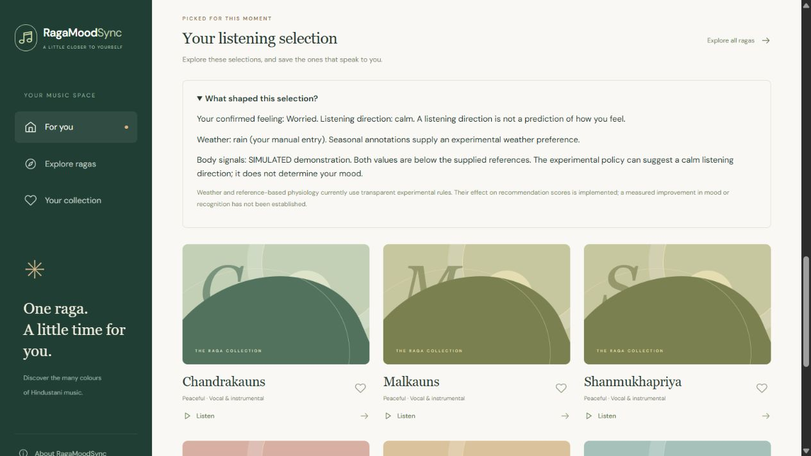
Application, experiments and limitations
Confirmed mood and visible weather/body contributions; classifier weakness remains explicit.
29 / 29 automated tests pass
Functional test with confirmed worry:
Mood alone: Jait
Manual rain: Malshree
Simulated EEG/HRV + reference:
Chandrakauns, with a calm listening goal.
These are software effects, not outcomes.
Face accuracy remains 50.13% overall.
Most expressions require self-report.
No demonstrated multimodal benefit.
Project tests · Synthetic context ablations · Abstention coverage
11 / 13
Notes:
Project tests: reports/pytest.xml
Synthetic context ablations: reports/multimodal_extension_evaluation.json
Abstention coverage: reports/selective_face_evaluation.json
Screenshot uses an isolated synthetic UI test database. Confirmed worry is not changed to calm; calm is a listening direction selected by the experimental reference policy. Underlying face recognition remains 50.13% on 6561 test images. Validation-based abstention offers suggestions for only 1464/6561 test images (22.31% coverage), with 88.39% accuracy on that restricted happy/surprise subset; this is not overall classifier accuracy. Weather/body integration has no measured recognition, ranking-quality or clinical benefit.

Slide 12
Future work and publication possibilities
Publication depends on sound data, rights and evaluation.
Train equal-budget attention / pooling ablations with multiple seeds, stronger split controls and calibrated uncertainty.
Collect consented listening feedback and expert-reviewed raga annotations. Evaluate chronological ranking and IKS ablation.
Validate physiology with signal-quality checks and participant-disjoint data before learning multimodal fusion.
A reproducibility or systems paper is plausible after these experiments. Clinical and patent claims require separate substantiation.
12 / 13
Notes:
No publication acceptance, novelty, clinical efficacy or patentability is promised. Resolve third-party permissions before releasing catalog or checkpoint assets.

Slide 13
Complete references
Academic, data and prior-art sources cited throughout the presentation
1. Pingle, Y. P. & Ragha, L. K. (2025). RagaMoodSync: a deep learning framework for Hindustani Raga recommendations driven by facial emotions. International Journal of Information Technology, 17, 2765–2778. DOI: 10.1007/s41870-025-02531-y.
2. Goodfellow, I. et al. (2013). Challenges in Representation Learning: A report on three machine learning contests. DOI: 10.1007/978-3-642-42051-1_16.
3. Huang, G., Liu, Z., van der Maaten, L. & Weinberger, K. Q. (2017). Densely Connected Convolutional Networks. CVPR. DOI: 10.1109/CVPR.2017.243.
4. He, X. et al. (2017). Neural Collaborative Filtering. WWW. DOI: 10.1145/3038912.3052569.
5. Mathur, A. et al. (2015). Emotional responses to Hindustani raga music: the role of musical structure. Frontiers in Psychology, 6, 513. DOI: 10.3389/fpsyg.2015.00513.
6. Valla, J. M. et al. (2017). Music and Emotion—A Case for North Indian Classical Music. Frontiers in Psychology, 8, 2115. DOI: 10.3389/fpsyg.2017.02115.
7. Koelstra, S. et al. (2012). DEAP: A Database for Emotion Analysis Using Physiological Signals. IEEE TAC. DOI: 10.1109/T-AFFC.2011.15.
8. Schmidt, P. et al. (2018). Introducing WESAD, a Multimodal Dataset for Wearable Stress and Affect Detection. ICMI. DOI: 10.1145/3242969.3242985.
9. Srinivasamurthy, A. et al. (2021). Saraga: Open Datasets for Research on Indian Art Music. Empirical Musicology Review, 16, 85–98. DOI: 10.18061/emr.v16i1.7641.
10. Gramfort, A. et al. (2013). MEG and EEG data analysis with MNE-Python. DOI: 10.3389/fnins.2013.00267.
11. Makowski, D. et al. (2021). NeuroKit2: A Python toolbox for neurophysiological signal processing. DOI: 10.3758/s13428-020-01516-y.
12. US20230153350A1 (2023). Music recommendation system by facial emotion using deep learning. patents.google.com/patent/US20230153350A1/en.
13. alronova. Raag Ratnakar. github.com/alronova/raag-ratnakar. Supplied ZIP, license unresolved. NASA portrait provenance: scikit-image.org/docs/stable/api/skimage.data.html.
14. Dalal, N. & Triggs, B. (2005). Histograms of Oriented Gradients for Human Detection. CVPR, pp. 886–893. DOI: 10.1109/CVPR.2005.177. HOG baseline here uses project-selected FER settings.
15. Open-Meteo. Forecast / Geocoding API documentation and Terms. open-meteo.com/en/docs; open-meteo.com/en/docs/geocoding-api; open-meteo.com/en/terms.
Data portals: Kaggle msambare/fer2013; eecs.qmul.ac.uk/mmv/datasets/deap; archive.ics.uci.edu/dataset/465/wesad; physionet.org; mtg.github.io/saraga; compmusic.upf.edu. IndRaga DOI: 10.5281/zenodo.19978345 (primary access unresolved).
13 / 13
Notes:
paper: https://doi.org/10.1007/s41870-025-02531-y
fer: https://doi.org/10.1007/978-3-642-42051-1_16
dense: https://doi.org/10.1109/CVPR.2017.243
ncf: https://doi.org/10.1145/3038912.3052569
mathur: https://doi.org/10.3389/fpsyg.2015.00513
valla: https://doi.org/10.3389/fpsyg.2017.02115
deap: https://doi.org/10.1109/T-AFFC.2011.15
wesad: https://doi.org/10.1145/3242969.3242985
saraga: https://doi.org/10.18061/emr.v16i1.7641
mne: https://doi.org/10.3389/fnins.2013.00267
nk: https://doi.org/10.3758/s13428-020-01516-y
patent: https://patents.google.com/patent/US20230153350A1/en
repo: https://github.com/alronova/raag-ratnakar
Full titles, access notes and license status are in LITERATURE_REVIEW.md, DATASETS.md and PRIOR_ART_AND_IP.md. Source access review: 2 November 2026.

