Slide 1
RagaMoodSync
A facial emotion-driven Hindustani raga research application
Music, expression
and personal listening
Group: [Group name] Members: [Names / IDs]
Guide: [Guide name] Institution: [Institution]
Paper-informed implementation · Windows CPU · Research prototype
Pingle & Ragha, 2025
01 / 13
Notes:
Pingle & Ragha, 2025: https://doi.org/10.1007/s41870-025-02531-y
Editable group placeholders intentionally retained. No group identities were supplied. Project does not claim exact reproduction or clinical validation.

Slide 2
Motivation and significance
Music discovery can reflect a listener’s expression, cultural context and feedback.
Facial expressions offer a convenient, uncertain input that a user can correct.
Hindustani metadata adds cultural context beyond generic genre labels.
Persistent feedback lets recommendations adapt to individual experience.
Research objective: build and test the full software loop. Therapeutic efficacy remains unestablished.
Mathur et al., 2015 · Valla et al., 2017
02 / 13
Notes:
Mathur et al., 2015: https://doi.org/10.3389/fpsyg.2015.00513
Valla et al., 2017: https://doi.org/10.3389/fpsyg.2017.02115

Slide 3
Literature review
The selected paper defines the architecture. Adjacent work supplies context.
Research | Contribution | Project implication
RagaMoodSync (2025) | FusDenseNet and FDCF | Implement mechanisms, disclose assumptions
FER challenge (2013) | Facial-expression benchmark | Keep held-out classification evaluation
DenseNet (2017) | Dense feature reuse | Use concatenated earlier features
Neural CF (2017) | Learned neural matching | Learn user/music interaction representations
Raga emotion study (2015) | Listener-rated musical structure | Do not equate a raga name with a universal outcome
FER2013 acquired for a short pilot. Real listener interaction data remains unavailable.
Pingle & Ragha, 2025 · Goodfellow et al., 2013 · Huang et al., 2017 · He et al., 2017 · Mathur et al., 2015
03 / 13
Notes:
Pingle & Ragha, 2025: https://doi.org/10.1007/s41870-025-02531-y
Goodfellow et al., 2013: https://doi.org/10.1007/978-3-642-42051-1_16
Huang et al., 2017: https://doi.org/10.1109/CVPR.2017.243
He et al., 2017: https://doi.org/10.1145/3038912.3052569
Mathur et al., 2015: https://doi.org/10.3389/fpsyg.2015.00513

Slide 4
Prior art and preliminary IP search
The broad concept of facial-emotion music recommendation is already disclosed.
US20230153350A1
“Music recommendation system by facial emotion using deep learning”
Publication: 18 May 2023. Description includes audio preprocessing and attention.
Search scope: targeted web/Google Patents review. Official claims, families, prosecution and jurisdictional coverage remain to be assessed.
Rights: the supplied Raag Ratnakar archive contains no license file. Preserve attribution and resolve permission before redistribution.
US20230153350A1 · RagaMoodSync · Raag Ratnakar
04 / 13
Notes:
US20230153350A1: https://patents.google.com/patent/US20230153350A1/en
RagaMoodSync: https://doi.org/10.1007/s41870-025-02531-y
Raag Ratnakar: https://github.com/alronova/raag-ratnakar
Preliminary technical review, not patentability or freedom-to-operate clearance. Dates are bibliographic page information. No novelty or legal-status conclusion is claimed.

Slide 5
Relevance, applications and end users
A local research studio for culturally informed music exploration.
End user | Use | Boundary
Listeners | Explore vocal/instrumental raga links | User can correct inferred mood
Students and educators | Inspect source metadata and missing fields | Associations require expert review
AI / MIR researchers | Train models and evaluate feedback loops | Synthetic tests do not show real-world quality
Future study teams | Investigate consented affect/music responses | Clinical use requires separate evidence
Windows CPU execution makes the prototype usable without a GPU or physical sensors.
05 / 13

Slide 6
Proposed solution and innovation
An executable integration, with mechanisms and evidence kept traceable.
Operational loop: image or manual mood, raga ranking, links, feedback and listening history.
Paper-informed models: repeated fusion-dense stages, cross-attention, multi-pooling and a trainable FDCF focus network.
Engineering contribution: field provenance, explicit unknown metadata, optional signal inputs and reproducible CPU experiments.
Two separate image models: supplied Navrasa baseline and a limited, real FER2013 FusDenseNet pilot.
Paper architecture · Initial knowledge source
06 / 13
Notes:
Paper architecture: https://doi.org/10.1007/s41870-025-02531-y
Initial knowledge source: https://github.com/alronova/raag-ratnakar
No scientific novelty or measured recommendation benefit is asserted. Native nine-Rasa baseline probabilities map heuristically to seven emotion labels.

Slide 7
System architecture
Paper mechanisms, operational baseline and optional extensions have distinct roles.
Webcam / upload
Manual mood
Facial model
Navrasa /
FusDenseNet
Emotion
User correction
IKS + preferences
Optional trained FDCF
Offline EEG / HRV
Explicit sample mode
Raga recommendations
Metadata + music links
SQLite
Feedback and history
Trainable FusDenseNet: three fusion stages, cross-dense links and mean/max/RMS pooling.
FastAPI / React / SQLite. Images stay local. No sensor or clinical validation is claimed.
Figs 1–4 and Eqs 3–15
07 / 13
Notes:
Figs 1–4 and Eqs 3–15: https://doi.org/10.1007/s41870-025-02531-y

Slide 8
Dataset sources and methodology
FER2013 acquisition followed license, size and disk checks. Other datasets remain optional.
Resource | Role | Access / current evidence
Raag Ratnakar | Metadata and Navrasa weights | 72 ragas, 528 entries, 516 unique URLs
FER2013 | Real facial CPU subset pilot | Version 1, 63.3 MB ZIP. ODbL / DbCL advertised
DEAP / WESAD | Physiological affect benchmarks | Access review. Not raga-response data
PhysioNet | Future ECG/PPG resource | Per-dataset access and license
Saraga / CompMusic | Future features and metadata | Saraga data: CC BY-NC. Check each source
IndRaga | Future precomputed audio features | Primary DOI record unavailable in review
Fixed splits. CPU tests. Isolated databases. Explicit synthetic labels.
FER2013 · DEAP · WESAD · Saraga · Dataset access: DATASETS.md
08 / 13
Notes:
FER2013: https://doi.org/10.1007/978-3-642-42051-1_16
DEAP: https://doi.org/10.1109/T-AFFC.2011.15
WESAD: https://doi.org/10.1145/3242969.3242985
Saraga: https://doi.org/10.18061/emr.v16i1.7641
Dataset access: DATASETS.md: Local project document
Source links: https://www.kaggle.com/datasets/msambare/fer2013 ; https://www.eecs.qmul.ac.uk/mmv/datasets/deap/ ; https://archive.ics.uci.edu/dataset/465/wesad ; https://physionet.org/ ; https://mtg.github.io/saraga/ ; https://doi.org/10.5281/zenodo.19978345 ; https://compmusic.upf.edu/ . IndRaga primary metadata/files/license were not verified.

Slide 9
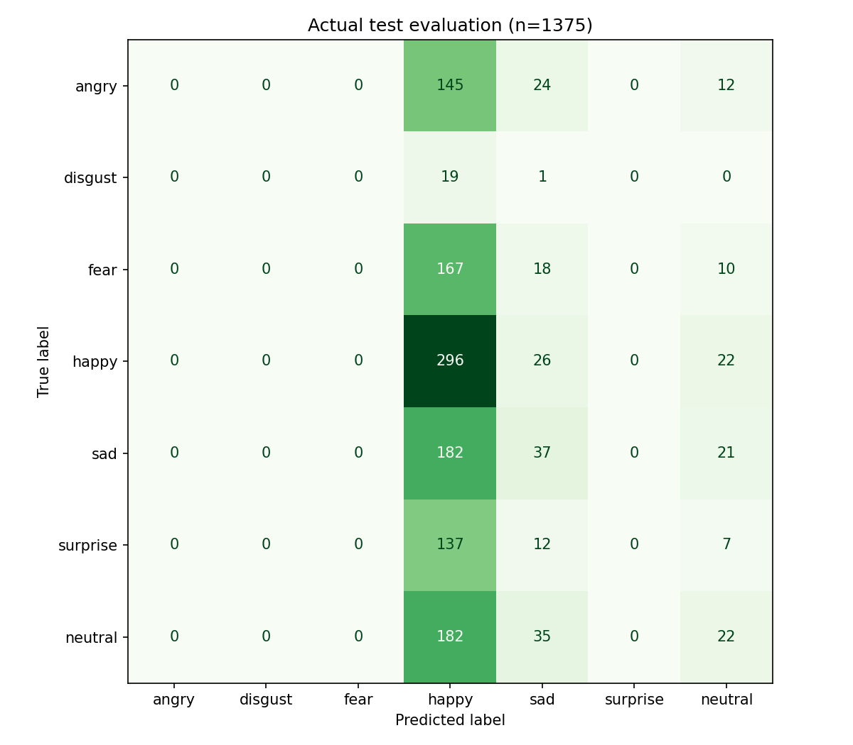
FusDenseNet implementation and results
Real FER2013 subset pilot. Two epochs on CPU, with exact-pixel deduplication.
163,744 parameters
3 fusion stages, cross-attention, dilation
2,091 train / 697 validation images
Held-out n=1375, accuracy 25.82%
Macro precision 0.1055, recall 0.1581
Macro F1 0.1032
Substantial underfitting. This limited pilot does not reproduce paper accuracy.
Figs 2–3, Eqs 3–9 · Actual pilot evidence
09 / 13
Notes:
Figs 2–3, Eqs 3–9: https://doi.org/10.1007/s41870-025-02531-y
Actual pilot evidence: reports/emotion_evaluation.json
Actual project pilot, not synthetic data. Train 2091, validation 697, test 1375, selected with seed 42. Exact grayscale-pixel duplicates removed (9 train, 3 validation, 25 selected test). Combined Kaggle test folder, not a claim of original FER PrivateTest-only or identity-disjoint protocol. Checkpoint epoch 2, SHA-256 2295f39d4de8a901457d986aa23d6aa06faf1c416c87ebd138a236ee6618bb86. Training loss combines CE and 0.1 reconstruction MSE; validation loss here is CE only. Train and validation objectives therefore differ. Accuracy 0.2581818181818182, macro precision 0.10546913800981385, recall 0.15809742745010816, F1 0.10322874436714465. Paper Table 2 accuracy 99.72% and Table 5 accuracy 99.82% are inconsistent and not reproduced. Separate synthetic test results remain in EXPERIMENTS.md.

Slide 10
EEG / HRV, IKS and FDCF
Offline extensions and personalization work without connected sensors.
FDCF
Synthetic feature | Actual output
Alpha relative power | 87.34%
Theta / beta relative | 9.97% / 1.89%
RMSSD | 11.71 ms
SDNN | 22.12 ms
User/music/emotion embeddings
Softmax focus and dynamic preferences
Elementwise interaction + MLP score
Training requires observed feedback
IKS
Bhava, Prahara and Ritu are source-supplied.
Thaat, Aaroh, Avaroh, Vadi, Samvadi: missing.
Simulated signals, no real readings.
No validated multimodal affect model.
FDCF Eqs 10–15 · MNE-Python · NeuroKit2 · Catalog
10 / 13
Notes:
FDCF Eqs 10–15: https://doi.org/10.1007/s41870-025-02531-y
MNE-Python: https://doi.org/10.3389/fnins.2013.00267
NeuroKit2: https://doi.org/10.3758/s13428-020-01516-y
Catalog: https://github.com/alronova/raag-ratnakar

Slide 11
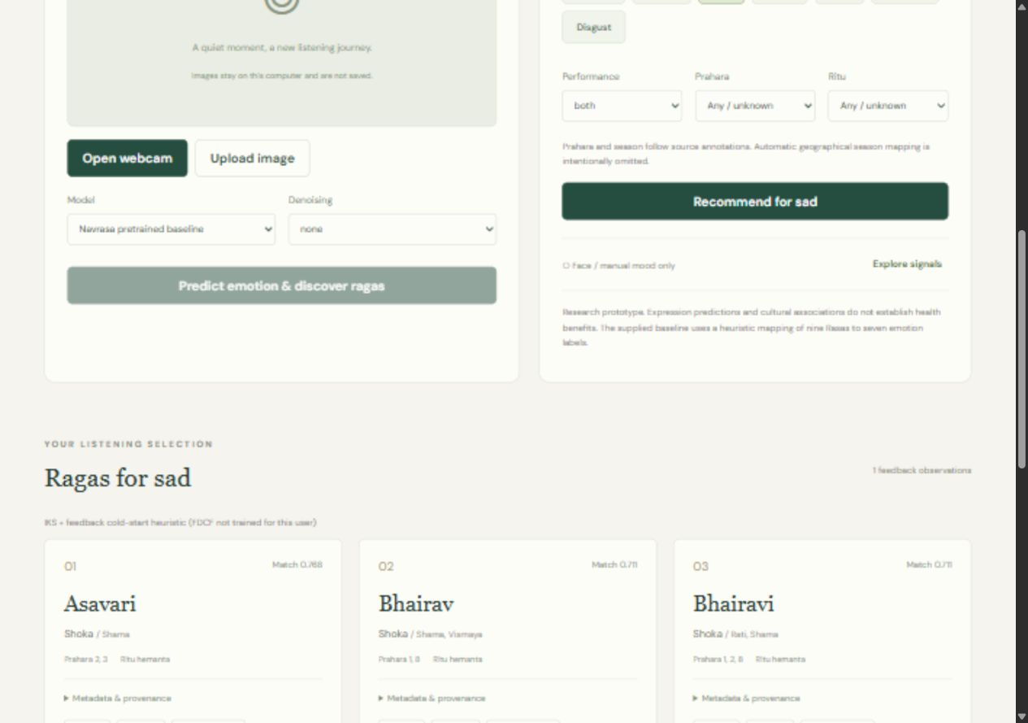
Integrated application, experiments and limitations
Working local pipeline with actual screenshots and reproducible test evidence.
18 / 18 automated tests pass
One unlabeled portrait completed:
face detection, inference, recommendation,
synthetic feedback and history.
Dhani: 0.711 to 0.780
with one synthetic positive response.
Limits: full FER and ranking validation pending.
No clinical or sensor evidence.
Project tests · One-photo API integration · Demo image provenance
11 / 13
Notes:
Project tests: reports/pytest.xml
One-photo API integration: reports/end_to_end.json
Demo image provenance: https://scikit-image.org/docs/stable/api/skimage.data.html#skimage.data.astronaut
Screenshot shows a synthetic UI test profile. Scores are ranking scores, not therapeutic probabilities. Test result from the final verified pytest run. Integration portrait has no ground-truth emotion, so no accuracy can be computed. Synthetic feedback is never real participant evidence.

Slide 12
Future work and publication possibilities
Publication depends on sound data, rights and evaluation.
Expand the small FER2013 pilot, train fixed-budget ablations and report held-out metrics with uncertainty and stronger split controls.
Collect consented listening feedback and expert-reviewed raga annotations. Evaluate chronological ranking and IKS ablation.
Validate physiology with signal-quality checks and participant-disjoint data before learning multimodal fusion.
A reproducibility or systems paper is plausible after these experiments. Clinical and patent claims require separate substantiation.
12 / 13
Notes:
No publication acceptance, novelty, clinical efficacy or patentability is promised. Resolve third-party permissions before releasing catalog or checkpoint assets.

Slide 13
Complete references
Academic, data and prior-art sources cited throughout the presentation
1. Pingle, Y. P. & Ragha, L. K. (2025). RagaMoodSync: a deep learning framework for Hindustani Raga recommendations driven by facial emotions. International Journal of Information Technology, 17, 2765–2778. DOI: 10.1007/s41870-025-02531-y.
2. Goodfellow, I. et al. (2013). Challenges in Representation Learning: A report on three machine learning contests. DOI: 10.1007/978-3-642-42051-1_16.
3. Huang, G., Liu, Z., van der Maaten, L. & Weinberger, K. Q. (2017). Densely Connected Convolutional Networks. CVPR. DOI: 10.1109/CVPR.2017.243.
4. He, X. et al. (2017). Neural Collaborative Filtering. WWW. DOI: 10.1145/3038912.3052569.
5. Mathur, A. et al. (2015). Emotional responses to Hindustani raga music: the role of musical structure. Frontiers in Psychology, 6, 513. DOI: 10.3389/fpsyg.2015.00513.
6. Valla, J. M. et al. (2017). Music and Emotion—A Case for North Indian Classical Music. Frontiers in Psychology, 8, 2115. DOI: 10.3389/fpsyg.2017.02115.
7. Koelstra, S. et al. (2012). DEAP: A Database for Emotion Analysis Using Physiological Signals. IEEE TAC. DOI: 10.1109/T-AFFC.2011.15.
8. Schmidt, P. et al. (2018). Introducing WESAD, a Multimodal Dataset for Wearable Stress and Affect Detection. ICMI. DOI: 10.1145/3242969.3242985.
9. Srinivasamurthy, A. et al. (2021). Saraga: Open Datasets for Research on Indian Art Music. Empirical Musicology Review, 16, 85–98. DOI: 10.18061/emr.v16i1.7641.
10. Gramfort, A. et al. (2013). MEG and EEG data analysis with MNE-Python. DOI: 10.3389/fnins.2013.00267.
11. Makowski, D. et al. (2021). NeuroKit2: A Python toolbox for neurophysiological signal processing. DOI: 10.3758/s13428-020-01516-y.
12. US20230153350A1 (2023). Music recommendation system by facial emotion using deep learning. patents.google.com/patent/US20230153350A1/en.
13. alronova. Raag Ratnakar. github.com/alronova/raag-ratnakar. Supplied ZIP, license unresolved. NASA portrait provenance: scikit-image.org/docs/stable/api/skimage.data.html.
Data portals: Kaggle msambare/fer2013; eecs.qmul.ac.uk/mmv/datasets/deap; archive.ics.uci.edu/dataset/465/wesad; physionet.org; mtg.github.io/saraga; compmusic.upf.edu. IndRaga DOI: 10.5281/zenodo.19978345 (primary access unresolved).
13 / 13
Notes:
paper: https://doi.org/10.1007/s41870-025-02531-y
fer: https://doi.org/10.1007/978-3-642-42051-1_16
dense: https://doi.org/10.1109/CVPR.2017.243
ncf: https://doi.org/10.1145/3038912.3052569
mathur: https://doi.org/10.3389/fpsyg.2015.00513
valla: https://doi.org/10.3389/fpsyg.2017.02115
deap: https://doi.org/10.1109/T-AFFC.2011.15
wesad: https://doi.org/10.1145/3242969.3242985
saraga: https://doi.org/10.18061/emr.v16i1.7641
mne: https://doi.org/10.3389/fnins.2013.00267
nk: https://doi.org/10.3758/s13428-020-01516-y
patent: https://patents.google.com/patent/US20230153350A1/en
repo: https://github.com/alronova/raag-ratnakar
Full titles, access notes and license status are in LITERATURE_REVIEW.md, DATASETS.md and PRIOR_ART_AND_IP.md. Source access review: 2 November 2026.

