Slide 1
RagaMoodSync
Facial expression, physiological context and Hindustani raga research
Music, expression
and personal listening
Group: [Group name] Members: [Names / IDs]
Guide: [Guide name] Institution: [Institution]
Paper-informed implementation · Windows CPU · Research prototype
Pingle & Ragha, 2025
01 / 13
Notes:
Pingle & Ragha, 2025: https://doi.org/10.1007/s41870-025-02531-y
Editable group placeholders intentionally retained. No group identities were supplied. Project does not claim exact reproduction or clinical validation.

Slide 2
Motivation and significance
Music discovery can reflect a listener’s expression, cultural context and feedback.
Facial expressions offer a convenient, uncertain input that a user can correct.
Hindustani metadata adds cultural context beyond generic genre labels.
Persistent feedback lets recommendations adapt to individual experience.
Research objective: build and test the full software loop. Therapeutic efficacy remains unestablished.
Mathur et al., 2015 · Valla et al., 2017
02 / 13
Notes:
Mathur et al., 2015: https://doi.org/10.3389/fpsyg.2015.00513
Valla et al., 2017: https://doi.org/10.3389/fpsyg.2017.02115

Slide 3
Literature review
The selected paper defines the architecture. Adjacent work supplies context.
Research | Contribution | Project implication
RagaMoodSync (2025) | FusDenseNet and FDCF | Implement mechanisms, disclose assumptions
FER challenge (2013) | Facial-expression benchmark | Keep held-out classification evaluation
DenseNet (2017) | Dense feature reuse | Use concatenated earlier features
Neural CF (2017) | Learned neural matching | Learn user/music interaction representations
Raga emotion study (2015) | Listener-rated musical structure | Do not equate a raga name with a universal outcome
FER2013 training and expanded test evaluation completed. Real listener trials remain pending.
Pingle & Ragha, 2025 · Goodfellow et al., 2013 · Huang et al., 2017 · He et al., 2017 · Mathur et al., 2015
03 / 13
Notes:
Pingle & Ragha, 2025: https://doi.org/10.1007/s41870-025-02531-y
Goodfellow et al., 2013: https://doi.org/10.1007/978-3-642-42051-1_16
Huang et al., 2017: https://doi.org/10.1109/CVPR.2017.243
He et al., 2017: https://doi.org/10.1145/3038912.3052569
Mathur et al., 2015: https://doi.org/10.3389/fpsyg.2015.00513

Slide 4
Prior art and preliminary IP search
The broad concept of facial-emotion music recommendation is already disclosed.
US20230153350A1
“Music recommendation system by facial emotion using deep learning”
Publication: 18 May 2023. Description includes audio preprocessing and attention.
Search scope: targeted web/Google Patents review. Official claims, families, prosecution and jurisdictional coverage remain to be assessed.
Rights: the supplied Raag Ratnakar archive contains no license file. Preserve attribution and resolve permission before redistribution.
US20230153350A1 · RagaMoodSync · Raag Ratnakar
04 / 13
Notes:
US20230153350A1: https://patents.google.com/patent/US20230153350A1/en
RagaMoodSync: https://doi.org/10.1007/s41870-025-02531-y
Raag Ratnakar: https://github.com/alronova/raag-ratnakar
Preliminary technical review, not patentability or freedom-to-operate clearance. Dates are bibliographic page information. No novelty or legal-status conclusion is claimed.

Slide 5
Relevance, applications and end users
A local research studio for culturally informed music exploration.
End user | Use | Boundary
Listeners | Explore vocal/instrumental raga links | User can correct inferred mood
Students and educators | Inspect source metadata and missing fields | Associations require expert review
AI / MIR researchers | Train models and evaluate feedback loops | Synthetic tests do not show real-world quality
Future study teams | Investigate consented affect/music responses | Clinical use requires separate evidence
Windows CPU execution makes the prototype usable without a GPU or physical sensors.
05 / 13

Slide 6
Proposed solution and innovation
An executable integration, with mechanisms and evidence kept traceable.
Operational loop: image or manual mood, raga ranking, links, feedback and listening history.
Paper-informed models: repeated fusion-dense stages, cross-attention, multi-pooling and a trainable FDCF focus network.
Engineering contribution: field provenance, explicit unknown metadata, optional signal inputs and reproducible CPU experiments.
Default: locally trained FusDenseNet v2. Supplied Navrasa remains a separately labeled baseline.
Paper architecture · Initial knowledge source
06 / 13
Notes:
Paper architecture: https://doi.org/10.1007/s41870-025-02531-y
Initial knowledge source: https://github.com/alronova/raag-ratnakar
No scientific novelty or measured recommendation benefit is asserted. Native nine-Rasa baseline probabilities map heuristically to seven emotion labels.

Slide 7
System architecture
Confirmed feelings, listening goals, weather and recorded body context shape the ranking.
Webcam /
image upload
FusDenseNet
Uncertain outputs
are withheld
Confirmed feeling
Listening goal
IKS + preferences
Optional trained FDCF
EEG / HRV
City / manual weather
Optional context
Context-aware ranking
Raga details + links
SQLite
Feedback and history
FusDenseNet v2 retains dense fusion, cross-attention and spatial/global pooling.
Weather/body rules adjust listening context; they do not identify the person’s mood.
Paper core: Figs 1–4 and Eqs 3–15 · Weather extension
07 / 13
Notes:
Paper core: Figs 1–4 and Eqs 3–15: https://doi.org/10.1007/s41870-025-02531-y
Weather extension: https://open-meteo.com/en/docs

Slide 8
Dataset sources and methodology
Facial benchmark, optional recordings and live/manual weather have different evidence roles.
Resource | Role | Access / current evidence
Raag Ratnakar | Metadata and Navrasa weights | 72 ragas, 528 entries, 516 unique URLs
FER2013 | Real facial CPU training / test | Version 1, 63.3 MB ZIP. ODbL / DbCL advertised
DEAP / WESAD | Physiological affect benchmarks | Access review. Not raga-response data
GamER | Real paired EEG + ECG evaluation | Official CC BY 4.0 release; participant-held-out
Saraga / CompMusic | Future features and metadata | Saraga data: CC BY-NC. Check each source
IndRaga | Future precomputed audio features | Primary DOI record unavailable in review
Weather: Open-Meteo or manual entry. Model-based city data; experimental Ritu preference.
GamER · FER2013 · DEAP · WESAD · Saraga · Open-Meteo
08 / 13
Notes:
GamER: https://doi.org/10.5281/zenodo.8191877
FER2013: https://doi.org/10.1007/978-3-642-42051-1_16
DEAP: https://doi.org/10.1109/T-AFFC.2011.15
WESAD: https://doi.org/10.1145/3242969.3242985
Saraga: https://doi.org/10.18061/emr.v16i1.7641
Open-Meteo: https://open-meteo.com/en/terms
Source links: https://www.kaggle.com/datasets/msambare/fer2013 ; https://www.eecs.qmul.ac.uk/mmv/datasets/deap/ ; https://archive.ics.uci.edu/dataset/465/wesad ; https://physionet.org/ ; https://mtg.github.io/saraga/ ; https://doi.org/10.5281/zenodo.19978345 ; https://compmusic.upf.edu/ . IndRaga primary metadata/files/license were not verified.

Slide 9
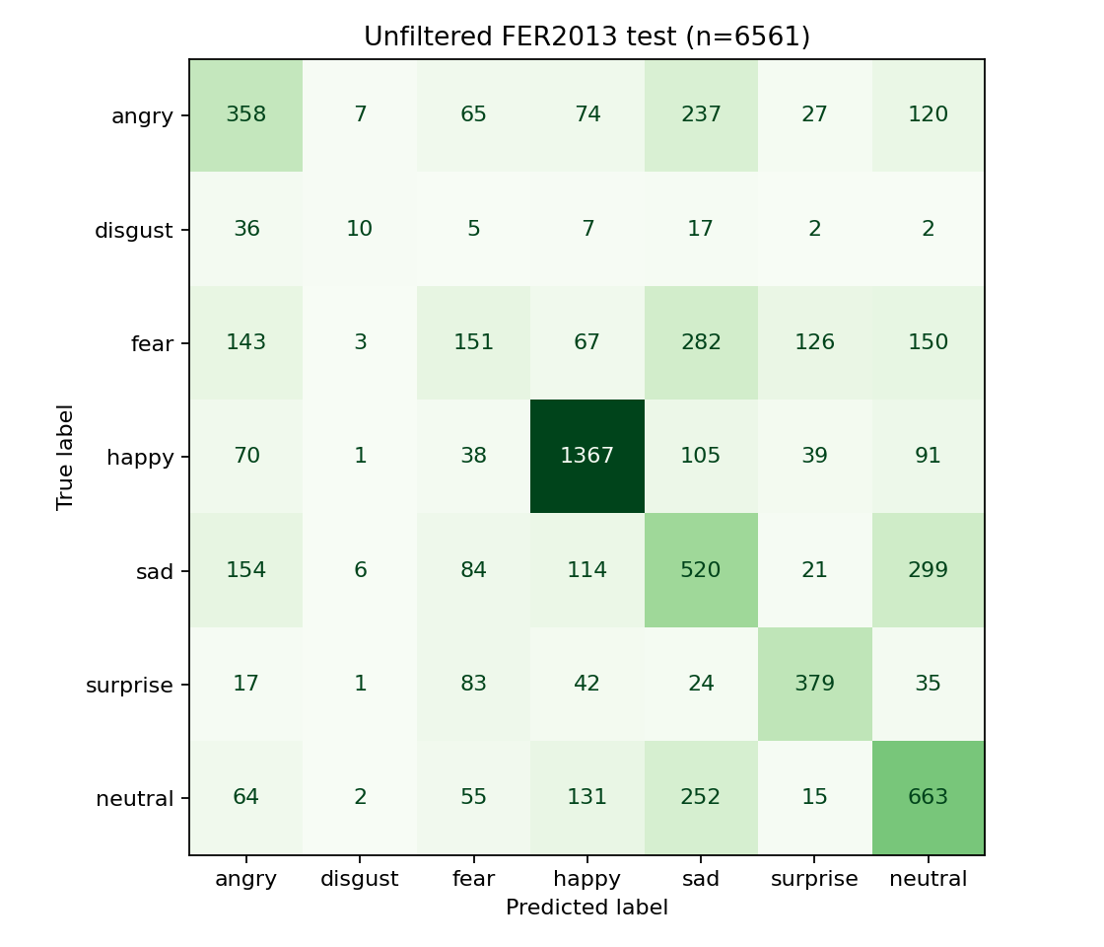
FusDenseNet implementation and results
CPU: 19 full-network + 30 head-only recorded epochs · selected index 39
223,776 parameters · spatial + global pooling
3 fusion stages, cross-attention, dilation
23,503 train / 3,970 validation
Held-out n=6561, accuracy 52.55%
Macro precision 0.4718, recall 0.4485
Macro F1 0.4492
Same-test accuracy: pilot 26.52% · HOG/SVM 41.47% · revised 52.55%.
Figs 2–3, Eqs 3–9 · Actual project evidence · HOG method: Dalal & Triggs, 2005
09 / 13
Notes:
Figs 2–3, Eqs 3–9: https://doi.org/10.1007/s41870-025-02531-y
Actual project evidence: reports/emotion_evaluation.json
HOG method: Dalal & Triggs, 2005: https://doi.org/10.1109/CVPR.2005.177
Actual project training from random initialization, not supplied Navrasa or paper weights. Train 23503, validation 3970, test 6561, seed 42. Exact grayscale-pixel duplicates removed. Combined Kaggle test folder includes examples previously used in the old pilot evaluation, not a fresh dataset or original FER PrivateTest-only/identity-disjoint protocol. Best checkpoint epoch 39, SHA-256 dbc4a9f9293fb4e1b28ae249958964cfe12e1b3b17a18f7e75bea77925b7a4ba. Architecture v2 adds normalized inputs/fusion and spatial 2x2 pooling; all dimensions are project assumptions. AdamW/cosine, class-weighted smoothed CE + 0.05 reconstruction MSE. Accuracy 0.5255296448712087, macro precision 0.4718198623111246, recall 0.4485359808038777, F1 0.44916607283447024. Baseline reevaluated on exactly the same retained test faces: accuracy 0.2652034750800183, macro F1 0.10478527891409024. The selected candidate may include classifier-only refinement on frozen features, with training-fitted normalization folded into the existing MLP. Epoch indices combine full-network and head phases; they must not be read as equal full-image training budgets. This is not a controlled architecture ablation. Paper Table 2 accuracy 99.72% and Table 5 accuracy 99.82% are inconsistent and not reproduced.

Slide 10
EEG / HRV, weather, IKS and FDCF
Real GamER: 2-class 161 intervals / 39 people; 5-class 240 / 40. Separate from FER2013 and raga outcomes.
FDCF + IKS
Input | 2-class acc. | 2-class F1 | 5-class F1
EEG | 68.94% | 0.677 | 0.253
Cardiac | 63.35% | 0.628 | 0.243
Fusion | 74.53% | 0.740 | 0.286
Majority | 57.76% | 0.366 | 0.112
Game only | 100.00% | 1.000 | 0.491
User/music/emotion embeddings
Focus, dynamic preferences and MLP
Bhava, Prahara, Ritu: source-supplied
Missing raga fields remain unknown
What was actually evaluated
EEG vs cardiac vs feature fusion
Held-out people; short RR windows
No artificial pairing with FER2013 faces
Offset sign assumed; sensitivity tested
Weather context remains experimental
5-class accuracy: 32.92% < majority 38.75%.
Fusion − EEG 2-class F1: 0.062
95% interval: [-0.040, 0.170]; includes zero.
Game ID alone: 100% → task confounding.
GamER: Papadopoulos et al., 2023 · FDCF Eqs 10–15 · NeuroKit2
10 / 13
Notes:
GamER: Papadopoulos et al., 2023: https://doi.org/10.5281/zenodo.8191877
FDCF Eqs 10–15: https://doi.org/10.1007/s41870-025-02531-y
NeuroKit2: https://doi.org/10.3758/s13428-020-01516-y
{"protocol":{"dataset":"GamER official v1; DOI 10.5281/zenodo.8191877","license":"CC-BY-4.0","seed":42,"primary_task":["Angry","Sad"],"secondary_task":["Angry","Sad","Bored","Stressed","Happy"],"intervals":"whole annotated intervals >=15 seconds; no padding or invented labels","alignment":"signal time = video annotation time - VIDEO_OFFSET; offset-sign assumption disclosed; sensitivity +offset also reported","quality":"both modalities finite/nonflat, ADC clipping <=2%, >=8 RR, >=90% RR in 300..2000ms; no label-based signal rejection","model":"StandardScaler fitted only on training subjects + LogisticRegression C=1, balanced class weights, max_iter=2000","evaluation":"leave-one-participant-out; identical accepted intervals for EEG, cardiac and concatenated fusion; no tuning","features":{"eeg":["theta_relative","alpha_relative","beta_relative","delta_relative","gamma_relative","spectral_entropy","hjorth_mobility","hjorth_complexity"],"cardiac":["mean_rr_ms","rmssd_ms","sdnn_ms","pnn50","median_rr_ms","rr_iqr_ms"]},"limitations":["No disgust annotations","No face or weather data","Not a raga-response dataset","Single EEG lead and no ICA/manual artifact adjudication","Ultra-short interval HRV is noisy and not clinical HRV","Offset sign is an explicit assumption, not independently verified from omitted videos","Overlapping intervals remain in the same subject fold; effective n is participants, not intervals"]},"primary":{"EEG":{"accuracy":0.6894409937888198,"macro_f1":0.6774839743589745,"classification_report":{"Angry":{"precision":0.7171717171717171,"recall":0.7634408602150538,"f1-score":0.7395833333333334,"support":93},"Sad":{"precision":0.6451612903225806,"recall":0.5882352941176471,"f1-score":0.6153846153846154,"support":68},"accuracy":0.6894409937888198,"macro avg":{"precision":0.6811665037471488,"recall":0.6758380771663504,"f1-score":0.6774839743589745,"support":161},"weighted avg":{"precision":0.6867573753969266,"recall":0.6894409937888198,"f1-score":0.6871267319636885,"support":161}},"confusion_matrix":[[71,22],[28,40]]},"Cardiac":{"accuracy":0.6335403726708074,"macro_f1":0.627796716429607,"classification_report":{"Angry":{"precision":0.6931818181818182,"recall":0.6559139784946236,"f1-score":0.6740331491712708,"support":93},"Sad":{"precision":0.5616438356164384,"recall":0.6029411764705882,"f1-score":0.5815602836879432,"support":68},"accuracy":0.6335403726708074,"macro avg":{"precision":0.6274128268991284,"recall":0.6294275774826059,"f1-score":0.627796716429607,"support":161},"weighted avg":{"precision":0.6376254031852602,"recall":0.6335403726708074,"f1-score":0.6349762867311076,"support":161}},"confusion_matrix":[[61,32],[27,41]]},"Fusion":{"accuracy":0.7453416149068323,"macro_f1":0.7395541526928389,"classification_report":{"Angry":{"precision":0.782608695652174,"recall":0.7741935483870968,"f1-score":0.7783783783783784,"support":93},"Sad":{"precision":0.6956521739130435,"recall":0.7058823529411765,"f1-score":0.7007299270072993,"support":68},"accuracy":0.7453416149068323,"macro avg":{"precision":0.7391304347826086,"recall":0.7400379506641366,"f1-score":0.7395541526928389,"support":161},"weighted avg":{"precision":0.7458817175263299,"recall":0.7453416149068323,"f1-score":0.7455827591657487,"support":161}},"confusion_matrix":[[72,21],[20,48]]},"Majority":{"accuracy":0.577639751552795,"macro_f1":0.3661417322834646,"classification_report":{"Angry":{"precision":0.577639751552795,"recall":1,"f1-score":0.7322834645669292,"support":93},"Sad":{"precision":0,"recall":0,"f1-score":0,"support":68},"accuracy":0.577639751552795,"macro avg":{"precision":0.2888198757763975,"recall":0.5,"f1-score":0.3661417322834646,"support":161},"weighted avg":{"precision":0.3336676825739747,"recall":0.577639751552795,"f1-score":0.42299603853866097,"support":161}},"confusion_matrix":[[93,0],[68,0]]},"Game ID control":{"accuracy":1,"macro_f1":1,"classification_report":{"Angry":{"precision":1,"recall":1,"f1-score":1,"support":93},"Sad":{"precision":1,"recall":1,"f1-score":1,"support":68},"accuracy":1,"macro avg":{"precision":1,"recall":1,"f1-score":1,"support":161},"weighted avg":{"precision":1,"recall":1,"f1-score":1,"support":161}},"confusion_matrix":[[93,0],[0,68]]}},"five_class":{"EEG":{"accuracy":0.3,"macro_f1":0.25285232151954007,"classification_report":{"Angry":{"precision":0.3793103448275862,"recall":0.23655913978494625,"f1-score":0.2913907284768212,"support":93},"Sad":{"precision":0.5806451612903226,"recall":0.5294117647058824,"f1-score":0.5538461538461539,"support":68},"Bored":{"precision":0.14285714285714285,"recall":0.16666666666666666,"f1-score":0.15384615384615385,"support":30},"Stressed":{"precision":0.07692307692307693,"recall":0.12,"f1-score":0.09375,"support":25},"Happy":{"precision":0.13043478260869565,"recall":0.25,"f1-score":0.17142857142857143,"support":24},"accuracy":0.3,"macro avg":{"precision":0.2620341017013648,"recall":0.26052751423149906,"f1-score":0.25285232151954007,"support":240},"weighted avg":{"precision":0.3504123292837806,"recall":0.3,"f1-score":0.31597623558147153,"support":240}},"confusion_matrix":[[22,14,14,21,22],[16,36,6,4,6],[5,8,5,6,6],[8,2,6,3,6],[7,2,4,5,6]]},"Cardiac":{"accuracy":0.25,"macro_f1":0.24277173478456557,"classification_report":{"Angry":{"precision":0.30434782608695654,"recall":0.07526881720430108,"f1-score":0.1206896551724138,"support":93},"Sad":{"precision":0.417910447761194,"recall":0.4117647058823529,"f1-score":0.4148148148148148,"support":68},"Bored":{"precision":0.125,"recall":0.2,"f1-score":0.15384615384615385,"support":30},"Stressed":{"precision":0.13114754098360656,"recall":0.32,"f1-score":0.18604651162790697,"support":25},"Happy":{"precision":0.2682926829268293,"recall":0.4583333333333333,"f1-score":0.3384615384615385,"support":24},"accuracy":0.25,"macro avg":{"precision":0.24933969955171728,"recall":0.29307337128399746,"f1-score":0.24277173478456557,"support":240},"weighted avg":{"precision":0.29245821328617594,"recall":0.25,"f1-score":0.2367548736150046,"support":240}},"confusion_matrix":[[7,19,19,33,15],[6,28,17,11,6],[5,12,6,4,3],[4,2,5,8,6],[1,6,1,5,11]]},"Fusion":{"accuracy":0.32916666666666666,"macro_f1":0.2860535881402913,"classification_report":{"Angry":{"precision":0.42857142857142855,"recall":0.22580645161290322,"f1-score":0.29577464788732394,"support":93},"Sad":{"precision":0.5714285714285714,"recall":0.5882352941176471,"f1-score":0.5797101449275363,"support":68},"Bored":{"precision":0.1276595744680851,"recall":0.2,"f1-score":0.15584415584415584,"support":30},"Stressed":{"precision":0.1,"recall":0.16,"f1-score":0.12307692307692308,"support":25},"Happy":{"precision":0.23529411764705882,"recall":0.3333333333333333,"f1-score":0.27586206896551724,"support":24},"accuracy":0.32916666666666666,"macro avg":{"precision":0.2925907384230288,"recall":0.3014750158127767,"f1-score":0.2860535881402913,"support":240},"weighted avg":{"precision":0.37787971571607365,"recall":0.32916666666666666,"f1-score":0.33875112298339066,"support":240}},"confusion_matrix":[[21,15,16,26,15],[9,40,15,1,3],[5,13,6,3,3],[11,1,4,4,5],[3,1,6,6,8]]},"Majority":{"accuracy":0.3875,"macro_f1":0.11171171171171171,"classification_report":{"Angry":{"precision":0.3875,"recall":1,"f1-score":0.5585585585585585,"support":93},"Sad":{"precision":0,"recall":0,"f1-score":0,"support":68},"Bored":{"precision":0,"recall":0,"f1-score":0,"support":30},"Stressed":{"precision":0,"recall":0,"f1-score":0,"support":25},"Happy":{"precision":0,"recall":0,"f1-score":0,"support":24},"accuracy":0.3875,"macro avg":{"precision":0.0775,"recall":0.2,"f1-score":0.11171171171171171,"support":240},"weighted avg":{"precision":0.15015625000000002,"recall":0.3875,"f1-score":0.21644144144144142,"support":240}},"confusion_matrix":[[93,0,0,0,0],[68,0,0,0,0],[30,0,0,0,0],[25,0,0,0,0],[24,0,0,0,0]]},"Game ID control":{"accuracy":0.6166666666666667,"macro_f1":0.49103135191390673,"classification_report":{"Angry":{"precision":0.7666666666666667,"recall":0.4946236559139785,"f1-score":0.6013071895424836,"support":93},"Sad":{"precision":0.9315068493150684,"recall":1,"f1-score":0.9645390070921985,"support":68},"Bored":{"precision":0.5263157894736842,"recall":0.6666666666666666,"f1-score":0.5882352941176471,"support":30},"Stressed":{"precision":0,"recall":0,"f1-score":0,"support":25},"Happy":{"precision":0.2028985507246377,"recall":0.5833333333333334,"f1-score":0.3010752688172043,"support":24},"accuracy":0.6166666666666667,"macro avg":{"precision":0.48547757123601143,"recall":0.5489247311827957,"f1-score":0.49103135191390673,"support":240},"weighted avg":{"precision":0.6470896027292771,"recall":0.6166666666666667,"f1-score":0.609929526603595,"support":240}},"confusion_matrix":[[46,0,1,0,46],[0,68,0,0,0],[0,4,20,0,6],[6,1,15,0,3],[8,0,2,0,14]]}},"delta_interval":[-0.04039629782349649,0.1700190957247994]} Primary labels Angry/Sad. Secondary labels Angry/Sad/Bored/Stressed/Happy. StandardScaler fitted inside each training-subject fold; fixed logistic regression C=1 and balanced loss. Cardiac features use real ECG-derived RR intervals, often shorter than 60 seconds, so they are exploratory ultra-short statistics, not clinical HRV. No disgust, face, weather or raga response is present. Both offset-sign conventions are reported separately; no favorable sign is selected after testing. Negative deltas are regressions. Original source annotations are psychologist assessments, not universal emotion ground truth.

Slide 11
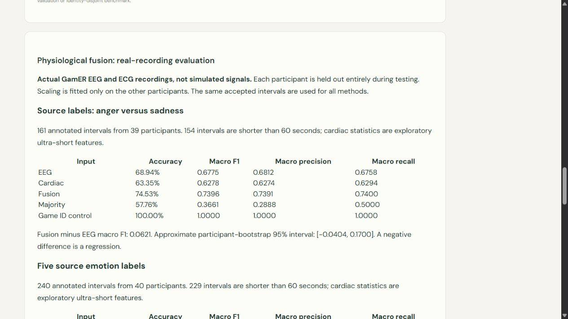
Application, experiments and limitations
Unfiltered facial metrics and real-recording fusion evidence are visible in the app.
37 / 37 automated tests pass
New selected model vs prior 50.13% model:
Accuracy: 50.13% → 52.55%
Macro F1: 0.3960 → 0.4492
Macro precision: 0.4841 → 0.4718
Macro recall: 0.4115 → 0.4485
Disgust recall: 2.53% → 12.66%
All seven labels and retained test faces.
No validated webcam-domain accuracy.
GamER game / label confounding.
No face–physiology joint benchmark.
No raga or weather outcome evidence.
Project tests · Actual physiology · Actual emotion comparison
11 / 13
Notes:
Project tests: reports/pytest.xml
Actual physiology: reports/gamer_evaluation.json
Actual emotion comparison: reports/colab_comparison.json
Screenshot shows the actual participant-held-out physiology report. The new FER experiment uses validation-only checkpoint selection; the historically inspected combined test folder is not fresh or identity-disjoint. All errors remain included. Deployment is gated on full-test accuracy and macro F1 increasing without lower disgust recall. If that gate fails, the app retains its old classifier and reports the new experiment separately. No sample/simulated physiological result is used for the real-data metrics.

Slide 12
Future work and publication possibilities
Publication depends on sound data, rights and evaluation.
Train equal-budget attention / pooling ablations with multiple seeds, stronger split controls and calibrated uncertainty.
Collect consented listening feedback and expert-reviewed raga annotations. Evaluate chronological ranking and IKS ablation.
Extend the real physiology baseline with independent signal-quality review, confirmed annotation alignment and external participant validation.
A reproducibility or systems paper is plausible after these experiments. Clinical and patent claims require separate substantiation.
12 / 13
Notes:
No publication acceptance, novelty, clinical efficacy or patentability is promised. Resolve third-party permissions before releasing catalog or checkpoint assets.

Slide 13
Complete references
Academic, data and prior-art sources cited throughout the presentation
1. Pingle, Y. P. & Ragha, L. K. (2025). RagaMoodSync: a deep learning framework for Hindustani Raga recommendations driven by facial emotions. International Journal of Information Technology, 17, 2765–2778. DOI: 10.1007/s41870-025-02531-y.
2. Goodfellow, I. et al. (2013). Challenges in Representation Learning: A report on three machine learning contests. DOI: 10.1007/978-3-642-42051-1_16.
3. Huang, G., Liu, Z., van der Maaten, L. & Weinberger, K. Q. (2017). Densely Connected Convolutional Networks. CVPR. DOI: 10.1109/CVPR.2017.243.
4. He, X. et al. (2017). Neural Collaborative Filtering. WWW. DOI: 10.1145/3038912.3052569.
5. Mathur, A. et al. (2015). Emotional responses to Hindustani raga music: the role of musical structure. Frontiers in Psychology, 6, 513. DOI: 10.3389/fpsyg.2015.00513.
6. Valla, J. M. et al. (2017). Music and Emotion—A Case for North Indian Classical Music. Frontiers in Psychology, 8, 2115. DOI: 10.3389/fpsyg.2017.02115.
7. Koelstra, S. et al. (2012). DEAP: A Database for Emotion Analysis Using Physiological Signals. IEEE TAC. DOI: 10.1109/T-AFFC.2011.15.
16. Papadopoulos, A., Episkopou, C., Malegiannaki, A., Kyritsis, K., Sarafis, I., Papaefstathiou, I. & Delopoulos, A. (2023). GamER: Gameplay Physiological Signal Dataset for Emotion Recognition. Zenodo v1. DOI: 10.5281/zenodo.8191877. CC BY 4.0.
8. Schmidt, P. et al. (2018). Introducing WESAD, a Multimodal Dataset for Wearable Stress and Affect Detection. ICMI. DOI: 10.1145/3242969.3242985.
9. Srinivasamurthy, A. et al. (2021). Saraga: Open Datasets for Research on Indian Art Music. Empirical Musicology Review, 16, 85–98. DOI: 10.18061/emr.v16i1.7641.
10. Gramfort, A. et al. (2013). MEG and EEG data analysis with MNE-Python. DOI: 10.3389/fnins.2013.00267.
11. Makowski, D. et al. (2021). NeuroKit2: A Python toolbox for neurophysiological signal processing. DOI: 10.3758/s13428-020-01516-y.
12. US20230153350A1 (2023). Music recommendation system by facial emotion using deep learning. patents.google.com/patent/US20230153350A1/en.
13. alronova. Raag Ratnakar. github.com/alronova/raag-ratnakar. Supplied ZIP, license unresolved. NASA portrait provenance: scikit-image.org/docs/stable/api/skimage.data.html.
14. Dalal, N. & Triggs, B. (2005). Histograms of Oriented Gradients for Human Detection. CVPR, pp. 886–893. DOI: 10.1109/CVPR.2005.177. HOG baseline here uses project-selected FER settings.
15. Open-Meteo. Forecast / Geocoding API documentation and Terms. open-meteo.com/en/docs; open-meteo.com/en/docs/geocoding-api; open-meteo.com/en/terms.
Data portals: Kaggle msambare/fer2013; eecs.qmul.ac.uk/mmv/datasets/deap; archive.ics.uci.edu/dataset/465/wesad; physionet.org; mtg.github.io/saraga; compmusic.upf.edu. IndRaga DOI: 10.5281/zenodo.19978345 (primary access unresolved).
13 / 13
Notes:
paper: https://doi.org/10.1007/s41870-025-02531-y
fer: https://doi.org/10.1007/978-3-642-42051-1_16
dense: https://doi.org/10.1109/CVPR.2017.243
ncf: https://doi.org/10.1145/3038912.3052569
mathur: https://doi.org/10.3389/fpsyg.2015.00513
valla: https://doi.org/10.3389/fpsyg.2017.02115
deap: https://doi.org/10.1109/T-AFFC.2011.15
wesad: https://doi.org/10.1145/3242969.3242985
saraga: https://doi.org/10.18061/emr.v16i1.7641
mne: https://doi.org/10.3389/fnins.2013.00267
nk: https://doi.org/10.3758/s13428-020-01516-y
patent: https://patents.google.com/patent/US20230153350A1/en
repo: https://github.com/alronova/raag-ratnakar
Full titles, access notes and license status are in LITERATURE_REVIEW.md, DATASETS.md and PRIOR_ART_AND_IP.md. Source access review: 2 November 2026.

