Slide 1
INDIA RUNS · TRACK 1 — THE DATA & AI CHALLENGE
Intelligent Candidate Discovery
Beyond keyword filters: an explainable, signal-driven candidate ranking engine.
TEAM NAME
<your team name>
PROBLEM STATEMENT
Data & AI Challenge — Intelligent Candidate Discovery
TEAM LEADER NAME
<your name>

Slide 2
Solution Overview
What differentiates this approach from traditional matching systems?
What is the proposed solution?
Beyond keywords
An explainable, modular candidate-ranking pipeline that scores every candidate against a job posting across four signal types — contextual semantic relevance, skill coverage, experience fit, and behavioral / intent signals — and returns a ranked shortlist with a plain-English justification for every score.
Semantic match vs the JD AND a synthesized 'ideal candidate' profile — surfaces 'hidden gems' phrased differently from the posting.
Behavioral / intent signals
Models who is reachable right now via activity recency, upskilling, and engagement — most systems skip this entirely.
Fully explainable
Every score = 4 components + matched/missing skills + a plain-English justification. No black box.
Hallucination-safe
Rule-based justifications are template-filled from facts; the optional LLM layer is grounding-checked with automatic fallback.
Config-driven
Zero code changes to point at a new dataset, or to swap the embedding layer for a production model.
2 / 11

Slide 3
JD Understanding & Candidate Evaluation
Key requirements extracted from every JD
How candidate fit is evaluated beyond keyword matching
Required vs. preferred skills
Four complementary signals, combined into final_score. Behavioral/intent (20%) is the signal most systems skip — it captures who is reachable right now.
via a 25-skill taxonomy with synonyms/abbreviations (e.g. "ML" ↔ "machine learning"), classified using sentence-level cue detection.
Experience range
min/max years extracted via pattern matching (e.g. "2-5 years", "3+ years").
Seniority level
junior / mid / senior / lead, via keyword detection.
Hypothetical ideal candidate profile
a synthesized skills-forward description used as a SECOND comparison target for semantic matching.
3 / 11

Slide 4
Ranking Methodology
final_score = 0.35 × semantic + 0.30 × skill_match + 0.15 × experience_fit + 0.20 × behavioral
(× 0.85 confidence discount if the profile is flagged sparse_profile — see slide 5)
How candidates are retrieved, scored & ranked
Models, algorithms & heuristics used
Every candidate in the pool is scored against every job — a complete re-score, not a coarse pre-filter. At this scale (~45 candidates × 3 jobs) this runs in under 2 seconds, and guarantees no 'hidden gem' is filtered out before scoring.
TF-IDF + Truncated SVD (LSA) for semantic embeddings — offline, no model downloads
Rule-based sentence-cue NLP for required vs. preferred skill classification
Taxonomy-based skill extraction with word-boundary matching
Trapezoidal experience-fit curve (steep penalty if under-qualified, gentle if over)
Pool-relative min-max normalization for behavioral signals
Optional: grounded Claude re-ranking for top-N, with hallucination rejection
4 / 11

Slide 5
Explainability & Data Validation
How decisions are explained
Preventing hallucinations
Human stays in the loop
Every justification is built ENTIRELY from pre-computed fields: contextual-fit tier, matched/missing required skills, experience-vs-range, and behavioral highlights. A template fill, not free generation — zero hallucination risk by construction.
The optional LLM step's output is re-scanned with the same taxonomy skill extractor used everywhere else. If it asserts a skill outside the 'grounding set' (JD skills + candidate's own detected skills), that justification is REJECTED and the rule-based one is used instead.
Every output row carries a justification_source (rule_based / llm) flag. Quality flags below are SURFACED for recruiter review, not silently acted on — except the sparse-profile score discount, where confidence is genuinely low.
Handling inconsistent, low-quality, or suspicious profiles
Flag | Trigger | Effect
sparse_profile | Resume text under 8 words — too little to assess | Final score discounted ×0.85, noted in justification
implausible_experience_value | years_experience negative or > 45 | Surfaced for review (no auto-penalty)
skills_not_substantiated_in_narrative | >80% of listed skills never appear in the resume narrative | Surfaced for review (possible keyword-stuffing)
possible_duplicate_profile | Resume text near-identical to another candidate's | Surfaced for review, noted in justification (possible spam/fraud)
5 / 11

Slide 6
End-to-End Workflow
From job description input to a ranked, explainable shortlist
Input
Data Validation
1
Job descriptions, candidate profiles, behavioral signals, skill taxonomy
5
Flag sparse / implausible / duplicate profiles → confidence multiplier + reviewer notes
Deep Job Understanding
Ranking
2
Parse each JD → required/preferred skills, experience range, seniority → synthesize ideal profile
6
Weighted combination → ranked shortlist + plain-English justification per candidate
Contextual Relevance
Optional LLM Refinement
3
Shared TF-IDF + LSA space across JDs, ideal profiles & resumes → semantic scores
7
Grounded re-ranking / justification polish for top-N, with automatic hallucination rejection
Signal Integration
Output
4
Skill-match, experience-fit, and pool-normalized behavioral/intent scores per candidate
8
ranked_shortlist.csv — rank, full score breakdown, matched skills, quality flags, justification
6 / 11

Slide 7
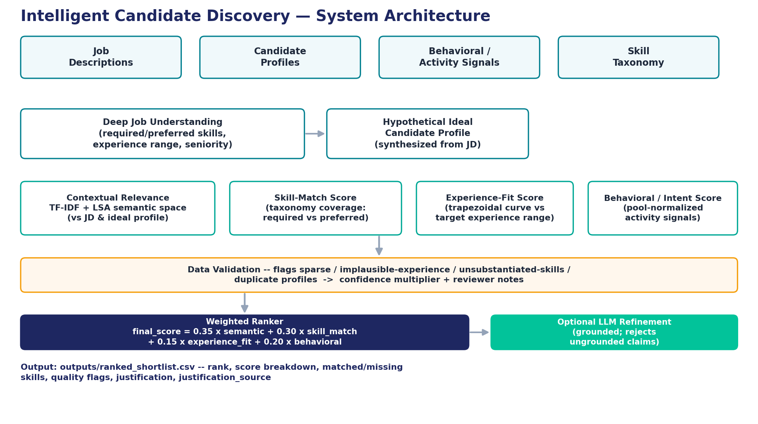
System Architecture
7 / 11

Slide 8
Results & Performance
Top 1/3
< 2 sec
100%
Hidden-gem candidates (off-title, real ML substance) rank in the top third — ahead of a dozen+ adjacent-domain candidates
Full pipeline run: ~45 candidates × 3 jobs, fit + score, on a standard CPU — fully offline, no GPU/model downloads
Of ranking decisions are explainable — every score = 4 components + matched/missing skills + plain-English justification
What the included 44-candidate / 3-job demo dataset shows
A candidate with a 100% required-skill match but a profile dormant for 4+ months ranks below several candidates with lower raw skill overlap but strong recent activity — the behavioral signal is doing real work, not decoration.
Off-domain candidates (Sales, HR, Content) correctly sink to the bottom of every job's ranking.
Planted 'suspicious' profiles (sparse, implausible experience, duplicate text) are all correctly flagged and surfaced with explanations.
Replace with real-dataset numbers once available (see SUBMISSION_GUIDE §4).
8 / 11

Slide 9
Technologies Used
Technology | Why
Python 3 | Core implementation language
pandas / numpy | Data loading, feature computation, normalization
scikit-learn (TfidfVectorizer, TruncatedSVD) | Offline semantic embeddings (TF-IDF + LSA) — no model downloads, fully reproducible
PyYAML | Config-driven design — data paths, column mapping, ranking weights all externalized
Streamlit (optional) | Interactive demo dashboard for live evaluation
Anthropic Claude API (optional) | Grounded LLM re-ranking / justification refinement, with automatic hallucination rejection
Why this stack?
Chosen deliberately for an offline-first, dependency-light, fully explainable baseline — architected so production-grade components (sentence embeddings, learning-to-rank) can be swapped in without touching the rest of the pipeline.
Every swap point is documented in the README (§3.2, §3.5).
9 / 11

Slide 10
Submission Assets
GitHub Repository
<your repo URL — make sure it's public>
Demo Video
<link, if recorded — e.g. streamlit run app.py walkthrough>
Ranked Output File
outputs/ranked_shortlist.csv
10 / 11

Slide 11
Thank You
Intelligent Candidate Discovery — India Runs, Track 1
<Team Name> · <contact email / LinkedIn>

