Slide 1

RAJASTHAN TECHNICAL UNIVERSITY, KOTA
DEPARTMENT OF COMPUTER SCIENCE AND ENGINEERING
Major Project
Topic - Facial Recognition Enabled Attendance Record System
Presented to :- Dr. C.P. Gupta
Professor
DEPARTMENT OF
COMPUTER SCIENCE AND ENGINEERING
Mentored by :- Ms. Gowri Choudhary
Asst. Professor
DEPARTMENT OF COMPUTER SCIENCE AND ENGINEERING
Name :- Sonu Kumar & Sparsh Jain
College Roll No. - 19/530 & 19/531
Batch :- 8CSE4
Final Year
VIII SEM

Slide 2
Introduction
The main objective of this automation attendance system of face detection and recognition is to present face recognition in a real time environment, to see and mark the attendance of their employees on a daily to keep track of their presence. The system will mark and record the attendance in any environment. This system is automated and accordingly attendance will be marked, improving the accuracy to great extent and finally the attendance report will be generated.
The main elements of this technology are as follows:
Face Detection: is the act of finding and extracting a face from any given image, video, webcam… based on some specific features (skin color, nose, eyes, mouth…)
Face Recognition: A facial recognition system is a computer application capable of identifying or verifying a person from a digital image.

Slide 3
Need For Face Recognition Enabled Record System
The proposed system will reduce the paperwork where attendance will no longer involve any manual recording.
The new system will also reduce the total time needed to do attendance recording.
Significant increase in Electronics Transaction
Greater demand for fast and accurate user identification and authentication
Face recognition technology may solve this problem since a face is undeniably connected to its owner.
It is one of the many biometrics such as finger scan, Iris scan, Retina scan, Hand scan.

Slide 4
Face Recognition Over Other Biometric
It requires no physical interaction on behalf of the user.
It is accurate and allows for high enrolment and verification rates.
It does not require an expert to interpret the comparison result.
It can use the existing hardware infrastructure, camera and image already captured without causing any problem to the device.
It is the only biometric that allows passive identification in any environment (e.g. Identifying a terrorist in a busy Airport).

Slide 5
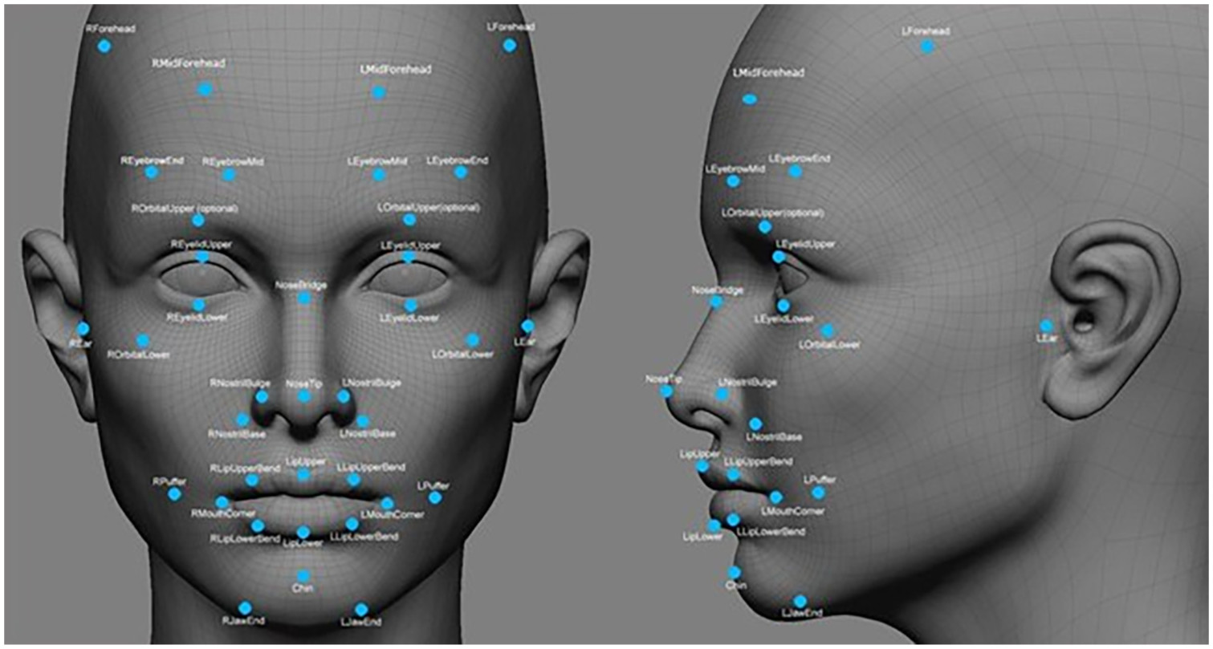
Facial Features to Create a Unique Numerical Representation of a Face
Distance between the eyes.
Shape and size of the nose.
Width of the mouth and lips
Distance between the corners of the mouth.
Shape and size of the jawline
Shape and size of the eyebrows
Distance between the eyebrows
Texture and color of the skin in various regions of the face.
Contours of the cheeks and other facial regions

Slide 6
LBPH Algorithm
Local Binary Pattern (LBP) is a simple yet very efficient texture operator which labels the pixels of an image by thresholding the neighborhood of each pixel and considers the result as a binary number.
Parameters : the LBPH uses 4 parameters:
Radius: the radius is used to build the circular local binary pattern and represents the radius around the central pixel. It is usually set to 1.
Neighbors: the number of sample points to build the circular local binary pattern. It is usually set to 8.
Grid X: the number of cells in the horizontal direction. It is usually set to 8.
Grid Y: the number of cells in the vertical direction. It is usually set to 8.

Slide 7
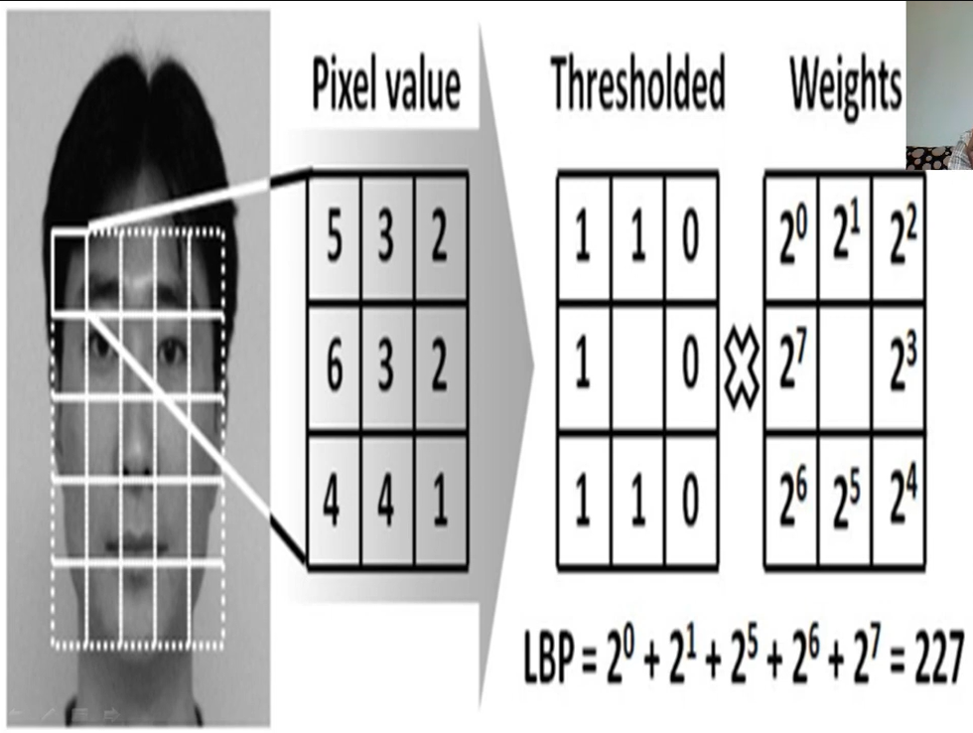
LBPH Algorithm (Cont…)
Step 1 (Training the Algorithm):
We need to use a dataset with the facial images of the people we want to recognize. We need to also set an ID (it may be a number or the name of the person) for each image, so the algorithm will use this information to recognize an input image.
Step 2 (Applying the LBP Operation):

Slide 8
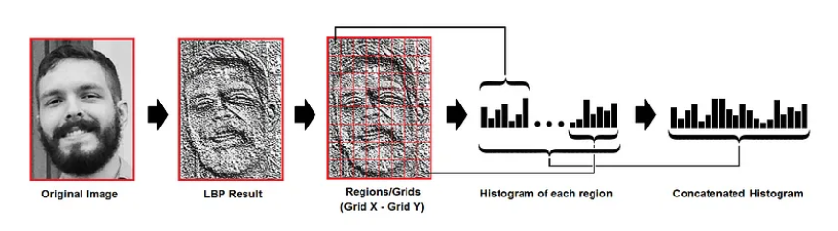
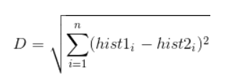
LBPH Algorithm (Cont…)
Step 3 (Extracting the Histograms):
Step 4 (Performing the face recognition):
We perform same steps again with the new input image and create a histogram which represent the image.
So to find the image that matches the input image we just need to compare two histograms and return the image with the closest histogram.

Slide 9
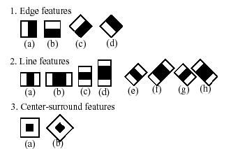
Types of Haar Features
This method uses the signs of Haar — a set of elementary combinations of dark and bright areas. As shown in the figure below, signs are divided into three types: edge, linear, and central features.

Slide 10
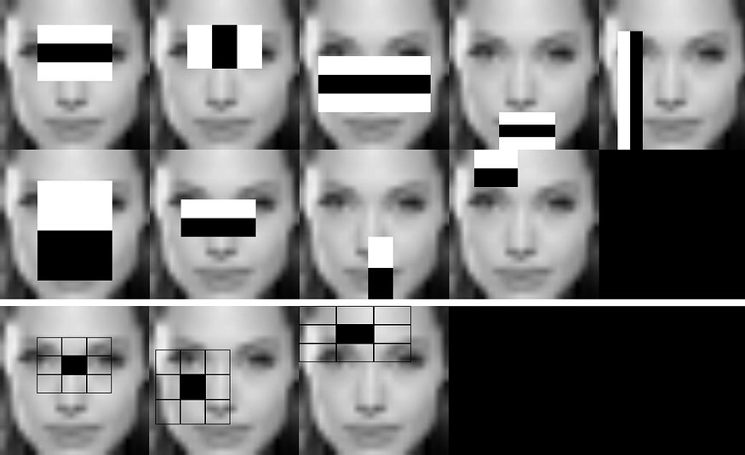
Types of Haar Features (Cont…)
So if the area in which it is found in the image, if there are enough signs, then the object can be considered found. So, for instance, it’s known that the upper cheeks and the nose are lighter than the human eye area.
Each feature is calculated by subtracting the sum of pixels under the white rectangle from the sum of pixels under the black rectangle.

Slide 11
About haarcascade_frontalface_default.xml
It is pre-trained module in OpenCV library.
The “haarcascade” refers to the Haar-like features used for object detection.
Haar-like features are simple rectangular features that are calculated based on the differences in intensity between adjacent rectangular regions in an image.
The "frontalface_default" indicates that the classifier is specifically trained to detect frontal faces in images.
XML file defines a cascade of weak classifiers, which are combined to form a strong classifier capable of identifying faces.
Each weak classifier examines a specific Haar-like feature and decides whether that feature matches a face or not.

Slide 12
Start
Project Workflow
No
Authenticated?
Dashboard
Student Details
Attendance
Train Data
Photos
Student Information
Student Records
Photos Database
Model Building
Face Recognition
Attendance Record
Camera Opens & Marks Attendance
Yes

Slide 13
Conclusion
Achievement of a good level of understanding LBPH algorithm, and it was a good opportunity for us to distinguish between local features and global features of images.
One of the problems was faced during the testing, is image quality.
Euclidean Distance was the solution by finding the distance between histograms of the original image and the enrolled images.
By the minimum distance between the histograms, it will find the most matching image of the original one.
It is compulsory to crop bad quality images.

Slide 14


