Slide 1
Dialog NLI
Welleck et. al. - 2019

Slide 2
Paper Contribution
Generate Dialogue NLI dataset
Method (using NLI model trained on the above dataset) to enhance the consistency of dialog generation – i.e., reduce contradictions and improve entailments of dialogs

Slide 3
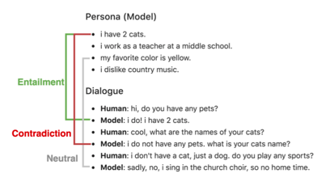
Problem Statement Example
Reduce contradictions and enhance entailments

Slide 4
Step 1 of 2 – Dialog Model
Dialogue Model
Scores for the next-candidate utterances ui
Persona Sentences

Slide 5


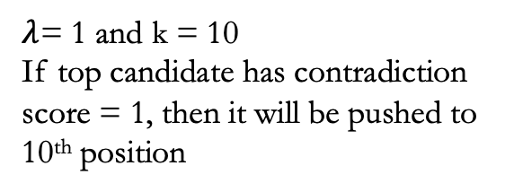
Step 2 of 2 – Re-ranking using NLI Model
NLI Model
For each candidate ui, check for contradiction with all of the persona sentences pj
Predict {Entailment, Neutral, Contradiction} and the confidence score
Contradiction score for each candidate ui
0 if no contradiction with any persona sentence
Else, max confidence score among all the contradicted pj
$λ$= 1 and k = 10
If top candidate has contradiction score = 1, then it will be pushed to 10th position

Slide 6
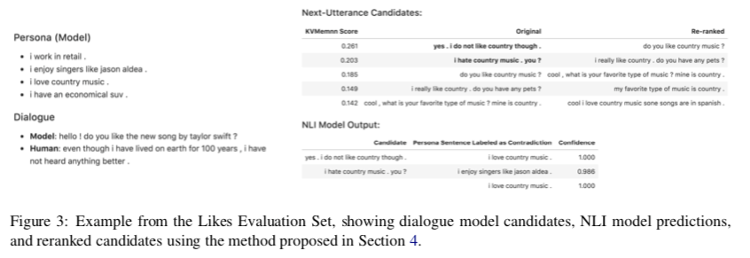
Example

Slide 7
NLI Model Design NLI Dataset Generation – Step 1 of 2
We need dataset of the below form to train a NLI model
Step 1: Obtain entity, relation triple
Crowd sourced Triple generation
Triple: 2 Entities, and its relation
Persona Chat Dataset
(Zhang et. Al)
Triple Generation

Slide 8
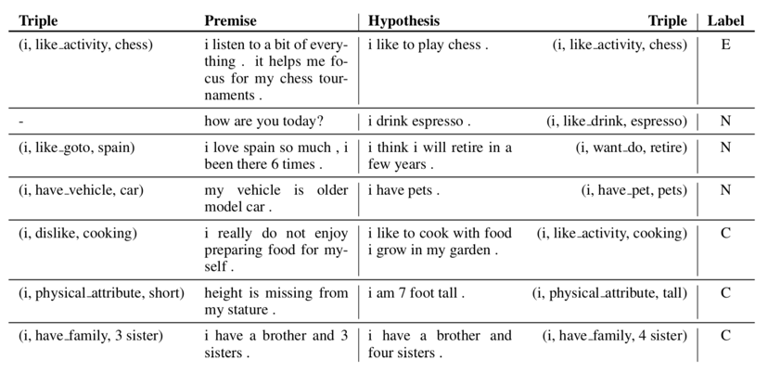
NLI Dataset Generation – Step 2 of 2
Step 1: Obtaining dataset for {E, N, C}
Entailment Dataset: Matching Triple
Neutral Dataset:
Misc Utterance: E.g. greeting
Persona Pairing: Statements from a single persona is neither redundant nor contradictory. Hence (p, p’) are neutral if they do not share the same triple
Relation Swap: Swap relations (r, r’) that represent independent facts
Contradiction Dataset:
Relation Swap
Entity Swap
Numerics

Slide 9
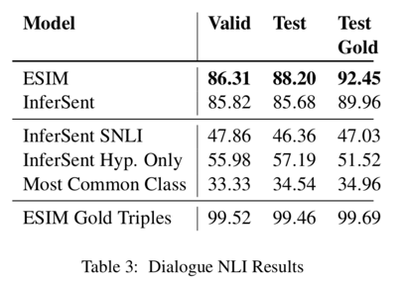
Training NLI model on the dataset
ESIM: Attention based model (computing attention between each word pair).
InferSent: Sentence encoding using Bi-LSTM on two sentences separately. Later this is used to predict {E, N, C}
InferSent SNLI: Model trained on SNLI data

Slide 10
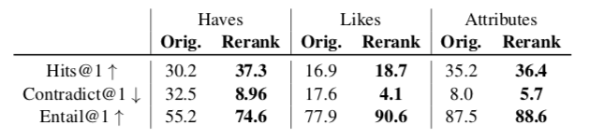
Performance
Hits@1 → Number of exact matches
Contradict@1 → Percentage of top candidate returned by model which are contradictions with previous ui or persona sentences (lower the better)
Entail@1 → Percentage of top candidate returned by model which are entailment of previous ui or persona sentences

