Slide 1
Semantic Compositionality through Recursive Matrix-Vector Spaces
Course Project of cs365a
Sonu Agarwal
Viveka kulharia

Slide 2
Goal
Classifying semantic relationships such as “cause-effect” or “component-whole” between nouns
Examples:
"The introduction in the book is a summary of what is in the text."
Component-Whole
"The radiation from the atomic bomb explosion is a typical acute radiation.“
Cause-Effect

Slide 3
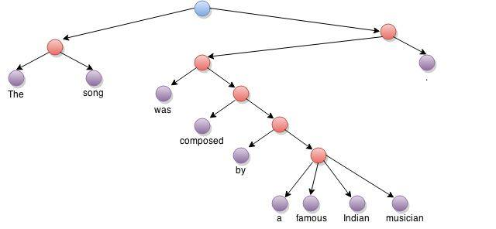
Parse Tree
Image created using www.draw.io

Slide 4
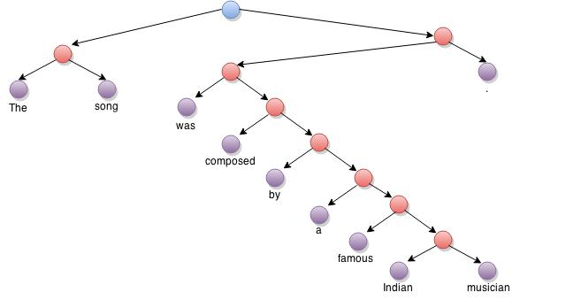
Binary Parse Tree
Image created using www.draw.io

Slide 5
What’s Novel ?
We introduce a recursive neural network model (RNN) that learns compositional vector representations of vectors or sentences of arbitrary length or syntactic type
We assign a vector and a matrix to every node in the parse tree
Vector captures the inherent meaning of the word
Matrix captures how the word modifies the neighboring words
A representation for a longer phrase is computed in a bottom-up manner by recursively combining children words according to the syntactic structure in the parse tree

Slide 6
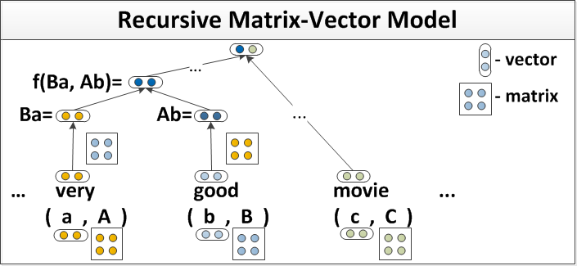
Recursive Matrix-Vector Model
Image Source: http://www.socher.org/index.php/Main/SemanticCompositionalityThroughRecursiveMatrix-VectorSpaces

Slide 7



Training
Initialize all the word vectors with pre-trained n-dimensional word-vectors
Initialize matrices as , where is the identity matrix and is Gaussian noise
Combining two words:
$$X=I+ε$$
$$I$$
$$ε$$

Slide 8
Training
We train vector representations by adding on top of each parent node a softmax classifier to predict a class distribution over sentiment or relationship classes
Error function: sum of cross-entropy errors at all node, where s is the sentence and t is its tree.

Slide 9
Learning
Model parameters:
where and are the set of word vectors and word matrices.
Objective Function:
where is the cross entropy error and is the regularization parameter.

Slide 10
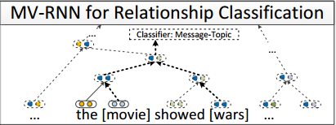
Classification of Semantic Relationship
Image Source: reference¹

Slide 11
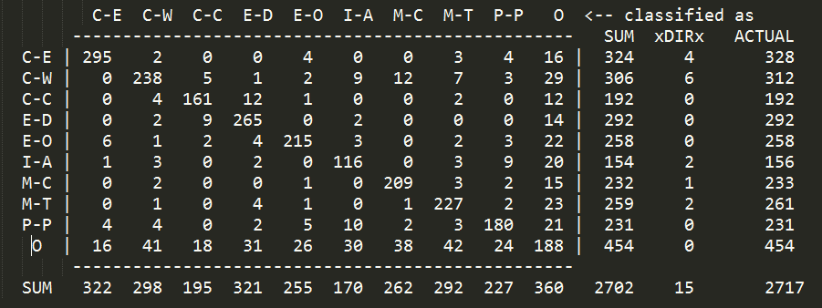
Results
Accuracy (calculated for the above confusion matrix) = 2094/2717 = 77.07%
F1 Score = 82.51%
Dataset: SemEval 2010 Task 8
Code Source: http://www.socher.org/index.php/Main/SemanticCompositionalityThroughRecursiveMatrix-VectorSpaces

Slide 12
Reference
Semantic Compositionality through Recursive Matrix-Vector Spaces, Richard Socher, Brody Huval, Christopher D. Manning and Andrew Y. Ng. Conference on Empirical Methods in Natural Language Processing (EMNLP 2012, Oral)
Composition in distributional models of semantics, J. Mitchell and M. Lapata Cognitive Science,34(2010):1388–1429
Simple customization of recursive neural networks for semantic relation classification, Kazuma Hashimoto, Makoto Miwa, Yoshimasa Tsuruoka, and Takashi Chikayama 2013 In EMNLP.

