Slide 1
Parkinson’s Disease Detection by: Harsh Tanwar
Sonu Besra
Adithi Sadananda Upadhya
Novelty: Synthetic Data generation

Slide 2



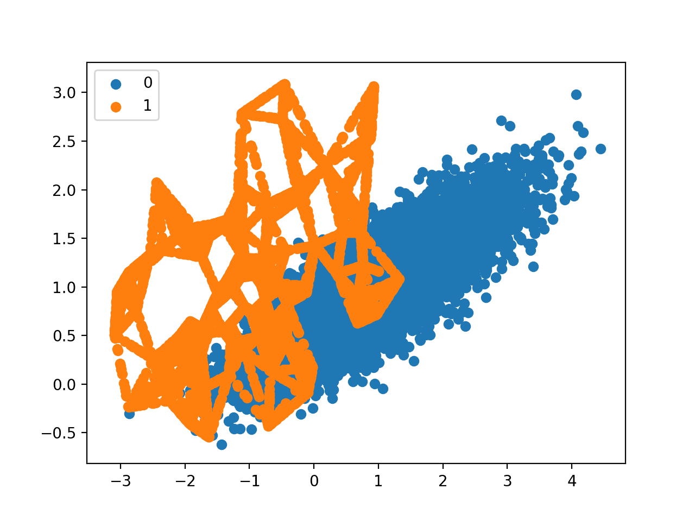

Parkinson’s Disease Detection
Novelty: Synthetic Data generation
Why we need synthetic dataset
Why not SMOTE or other classical sampling methods
Healthcare datasets availability are restricted and
have lesser records( utmost thousands)
Class imbalance and noise
Privacy concerns
Comprehensive scenario analysis, missing value filling
and privacy protection of the datasets
While generating synthetic examples, SMOTE does not take into consideration neighboring examples that can be from other classes. This can increase the overlapping of classes and can introduce additional noise.
SMOTE is not very practical for high dimensional data.

Slide 3
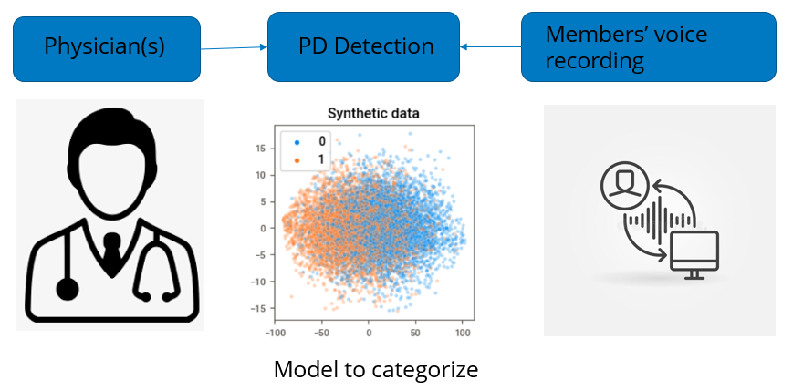
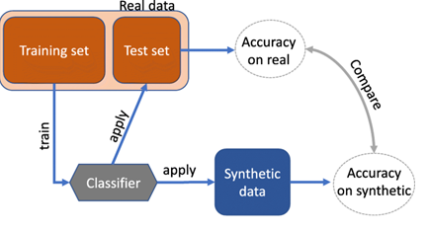
Parkinson’s Disease Detection
Novelty: Synthetic Data generation
Problem:
  Parkinson’s disease (PD) is the second most common neurodegenerative disorder after Alzheimer’s disease, affecting an estimated 7 to 10 million people worldwide (source: Parkinson’s Disease Foundation).
  Since there is no definitive diagnostic test, the task of identifying patients with PD is often difficult, particularly in the early stages when motor symptoms are not severe. Symptoms can be so subtle in these first stages that they go unnoticed, leaving the disease undiagnosed or misdiagnosed for extended periods of time.
Physician Assessment:
  Historical prescriptions
  Review of signs and symptoms
  Motor skills - examination
Business Perspective
Goal: Augment physicians in diagnosing Parkinson’s in the early stages using features extracted from voice recordings. Overcome the shortcoming of minimal data by generating synthetic data to train the classification model.
Solution: Compare and analyze different synthetic models – Gaussian Copula, CTGAN, Copula GAN and TVAE to find the optimum model for binary classification of the PD dataset.
Models Trained: Perform Hyperparameter tuning of the synthetic data using SGD classifier and Logistic regression, then train the synthetic data.
Best Model: With respect to recall values Logistic regression was the best model.
~84% Accuracy in identifying patients with PD
Framework

Slide 4

Results based on SDV framework
Novelty: Synthetic Data generation
Gaussian Copula Average CV score on the training set was: 0.7464
CTGAN Average CV score on the training set was: 0.6476
Copula GAN Average CV score on the training set was: 0.5346
TVAE Average CV score on the training set was: 0.9092

Slide 5
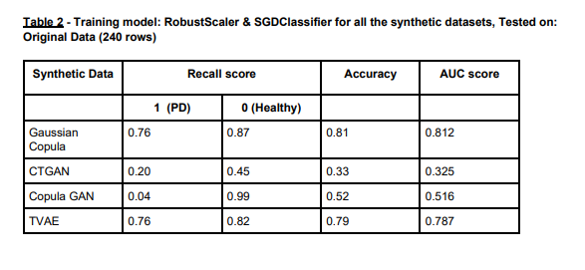
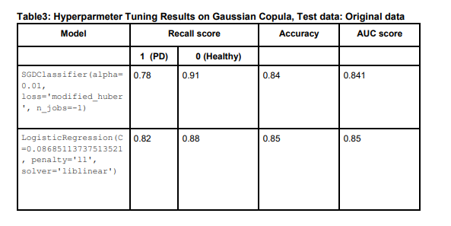
Results based on SGD classifier
Novelty: Synthetic Data generation
Robust Scaler & SGD Classifier for all synthetic dataset tested on original data
Tuning results on Gaussian Copula on original data

Slide 6
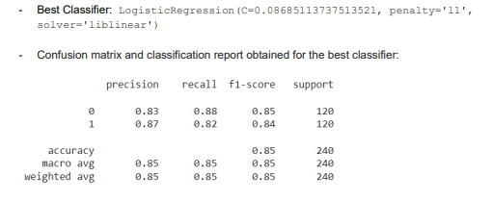
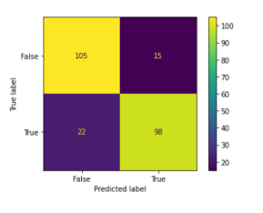
Best Classifier
Novelty: Synthetic Data generation
Logistic Regression
Confusion matrix

Slide 7
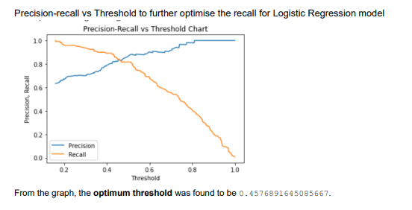
Recall optimization
Novelty: Synthetic Data generation

Slide 8
Further Studies
Novelty: Synthetic Data generation
The proposed approach has been implemented and tested for two-classes classification problems, but it can be easily extended to the multi-class problem with stage-wise PD detection. Although the model has been developed w.r.t PD detection, it can be used in similar experiments for different purposes. Yet another future prospect could include the development of an intelligent telediagnosis system prototype based on mobile devices for PD detection

Slide 9
Thank You

