Slide 1
A Presentation on Fees Management System
Course Code: CSE 420 Course Title: System Analysis and Design Sessional
Developed by:
Sonu Kumar Keshari
ID: 1802079, Session: 2018
Bsc(Engineering) in CSE.
Umar Rabiu El-Yakub
ID: 1802081, Session: 2018
Bsc(Engineering) in CSE.
Submitted to:
Hasi Saha
Associate Professor
Faculty of CSE
Department of CSE.
HSTU, Dinajpur.

Slide 2

Contents
Introduction
Motivations & Objectives
Proposed System
Structured Analysis Tools
Results and Outputs of the System
Unit Testing & Functional Testing
Requirement Analysis
Tools and Technology
Limitations and Future Works
Conclusion

Slide 3

Introduction
Fees Management System is a software solution designed to simplify the process of managing fees-related activities in educational institutions.
The system provides a platform for students, parents, and administrators to access relevant information about fees, including fee structures, payment schedules, and overdue fees.

Slide 4

Motivation & Objectives
Some of the motivations behind developing this system includes
From experience, we the developers want to bring more automatic systems to our campus and society.
Objectives:
Automating the fee collection and management process.
Streamlining administrative tasks.
Providing valuable insights into fee-related data.

Slide 5

Proposed System
The main functions of this application are as follows
Provides an automatic payment invoice system to the administration.
Administer a fees related data record of each and every student.
Grants an easy way to get a report on the finances of a university.
Provides efficiency, reliable and qualitative data.
Accounts access are only granted to staffs.

Slide 6
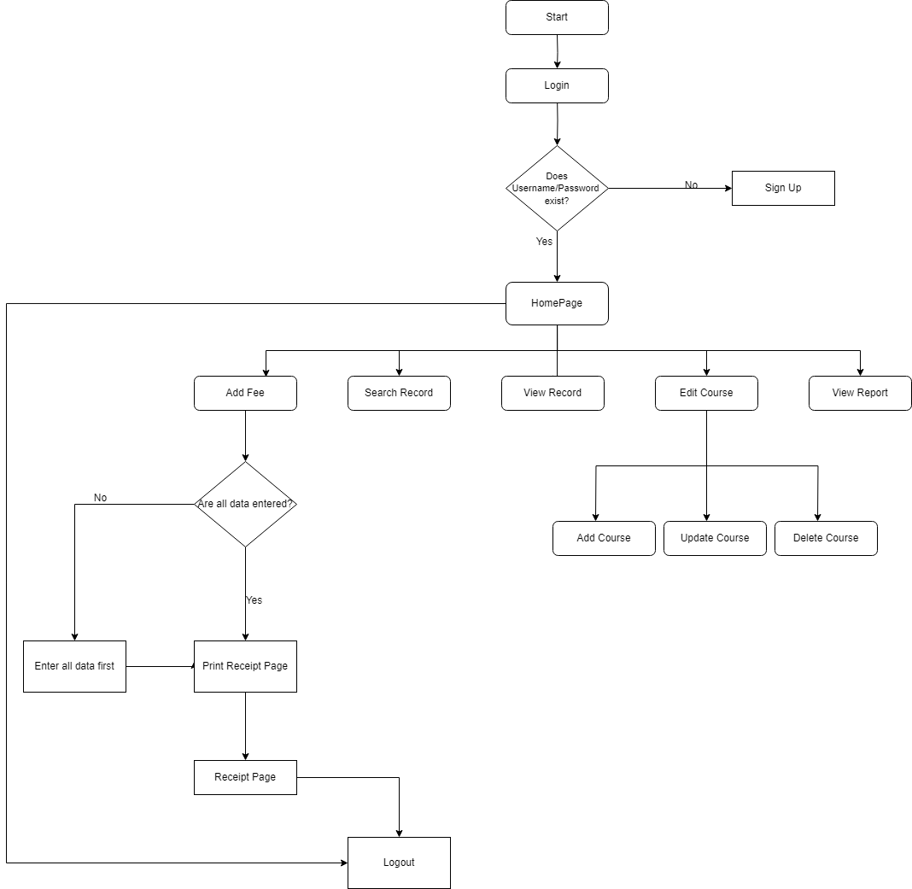
Structured Analysis Tools

Slide 7
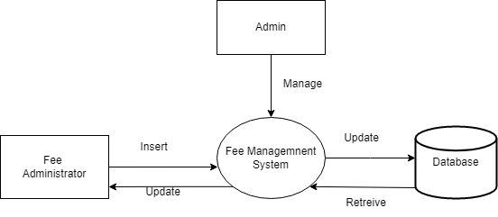
Structed Analysis Tools
Data Flow Diagram

Slide 8
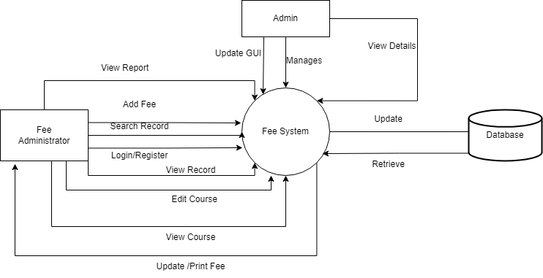
Structured Analysis Tools
Data Flow Diagram

Slide 9
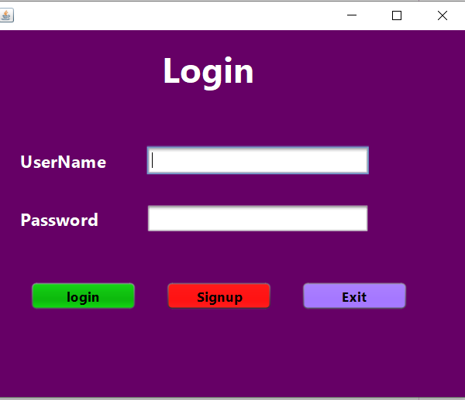
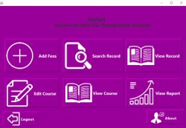
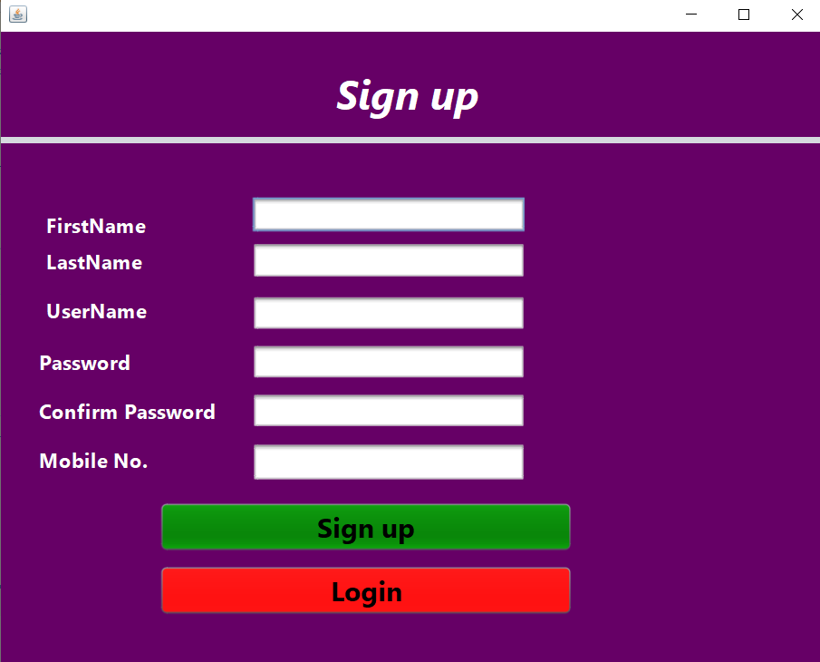
Results and Outputs

Slide 10
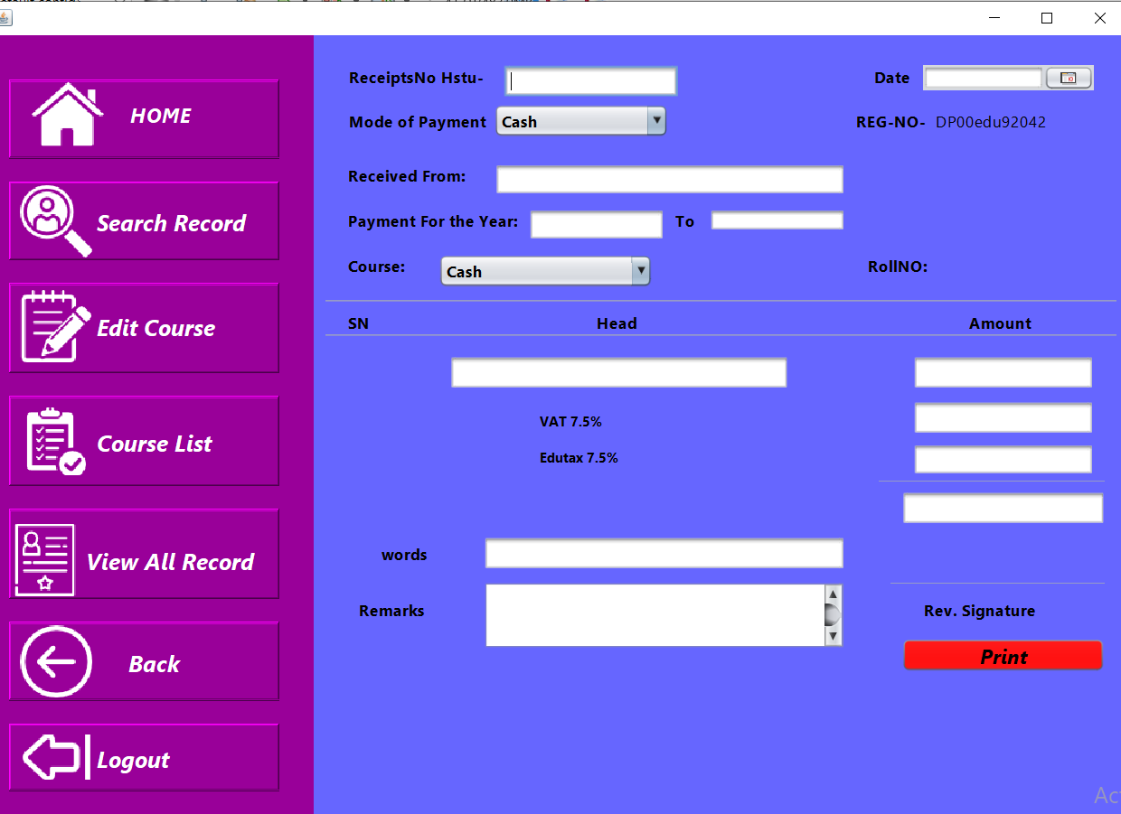

Slide 11
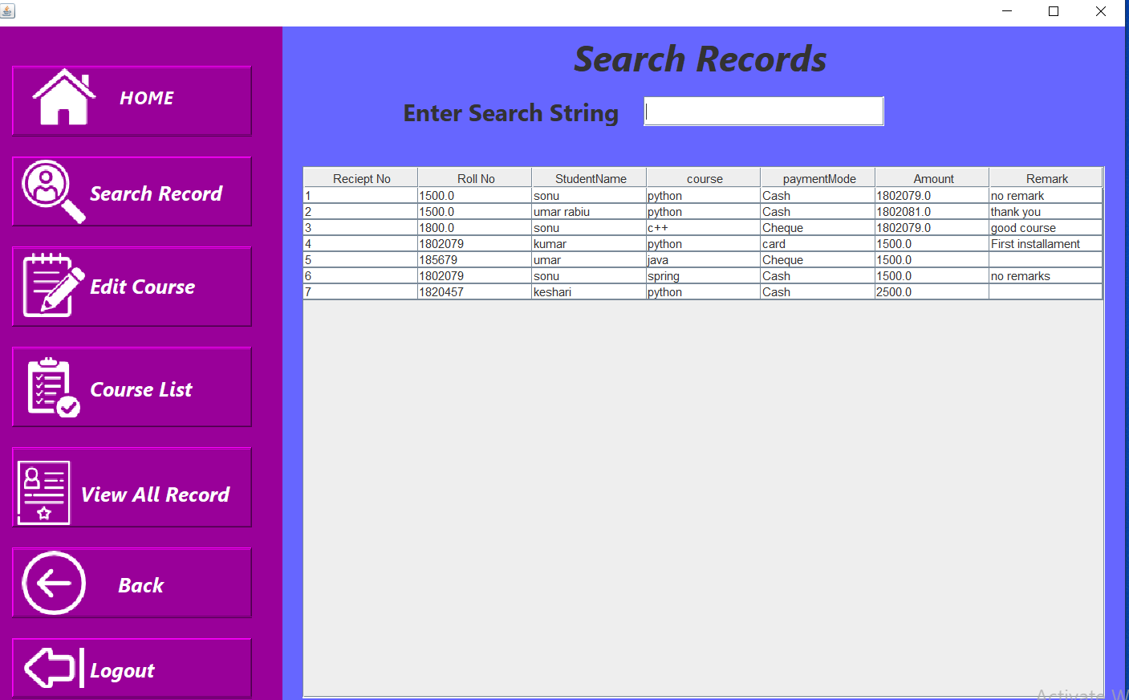
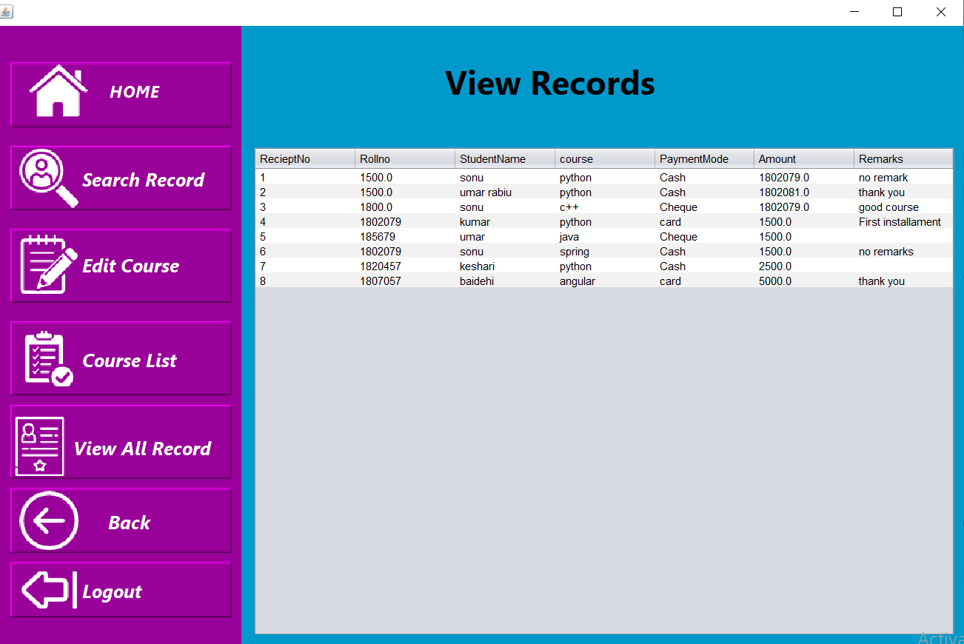

Slide 12
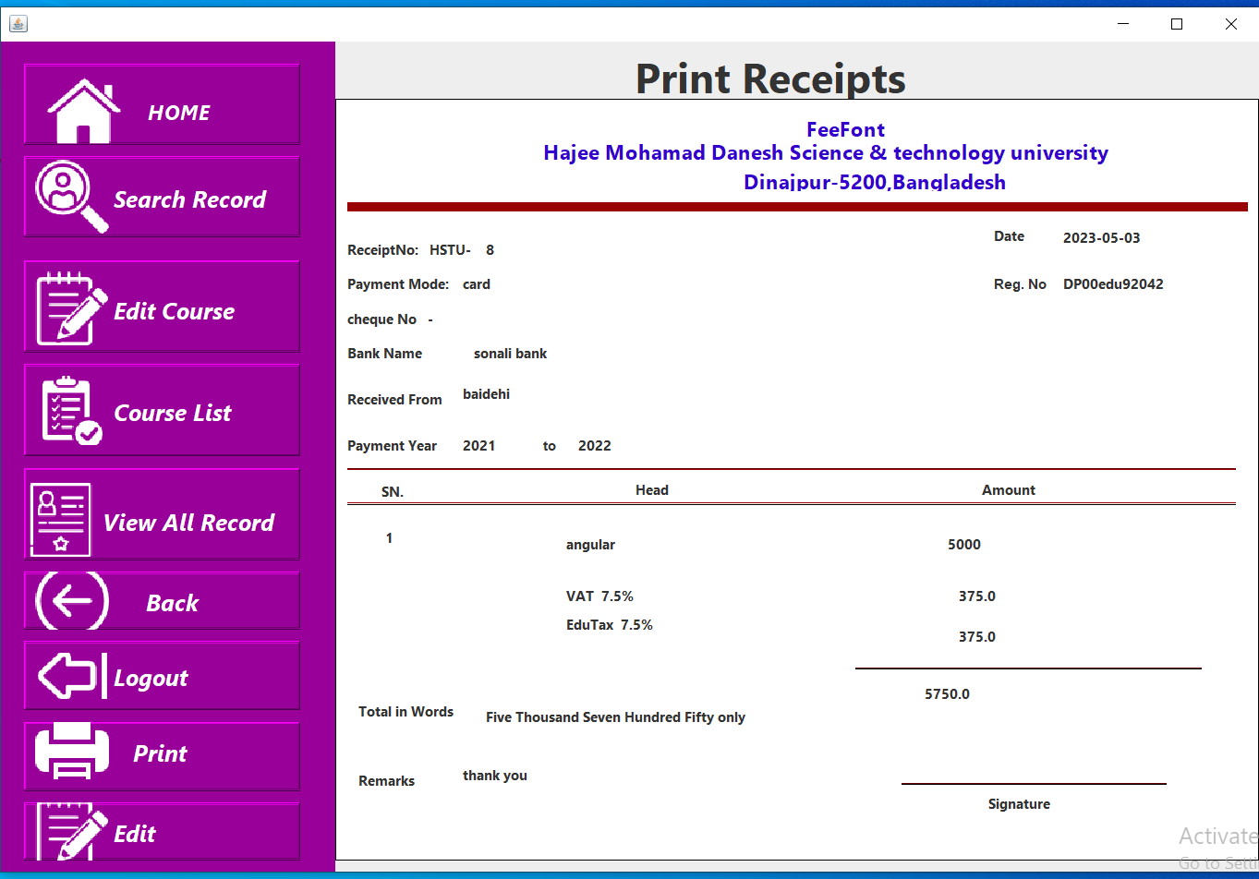
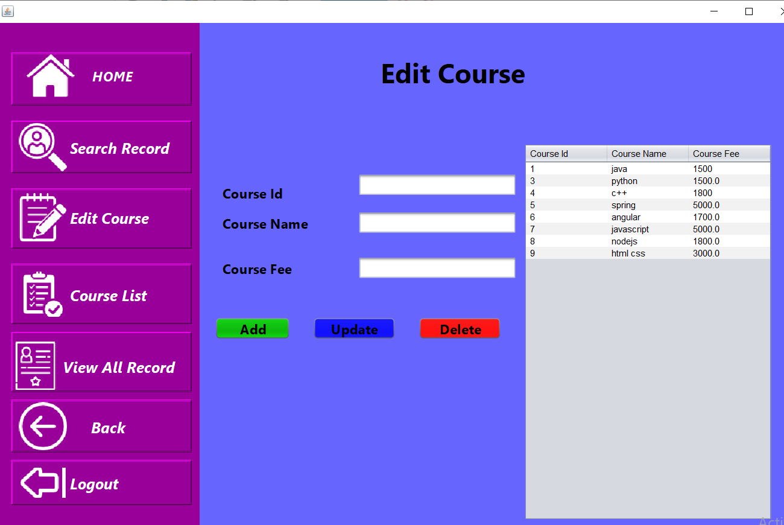

Slide 13

Testing
Unit Testing:
Unit testing is a software development process in which the smallest testable parts of an application, called units, are individually scrutinized for proper operation.
Functional testing:
Functional testing is a type of testing that seeks to establish whether each application feature works as per the software requirements.

Slide 14
Requirement Analysis
Hardware Requirement
Processor – Core i3 8th gen (Recommended – core i7 11th gen and above)
RAM – 4 GB (Recommended – 8 GB)
Disk space – 2 GB (Recommended – 10 GB)
Software Requirement
Java – JDK 20 (Recommended – Openjdk version 20)

Slide 15
Tools and Technology
Netbeans as IDE
Xaamp
Git
Java Swing
MySQl as Database
Github For Collabaration

Slide 16

Limitations and Future works
Although the application performs the intended task it was meant to do. These Limitations and future works includes
An email or sms to parents or guardian to confirm their payments.
Better UI Design
Mobile Application equivalent.

Slide 17

THANK YOU!

