Slide 1
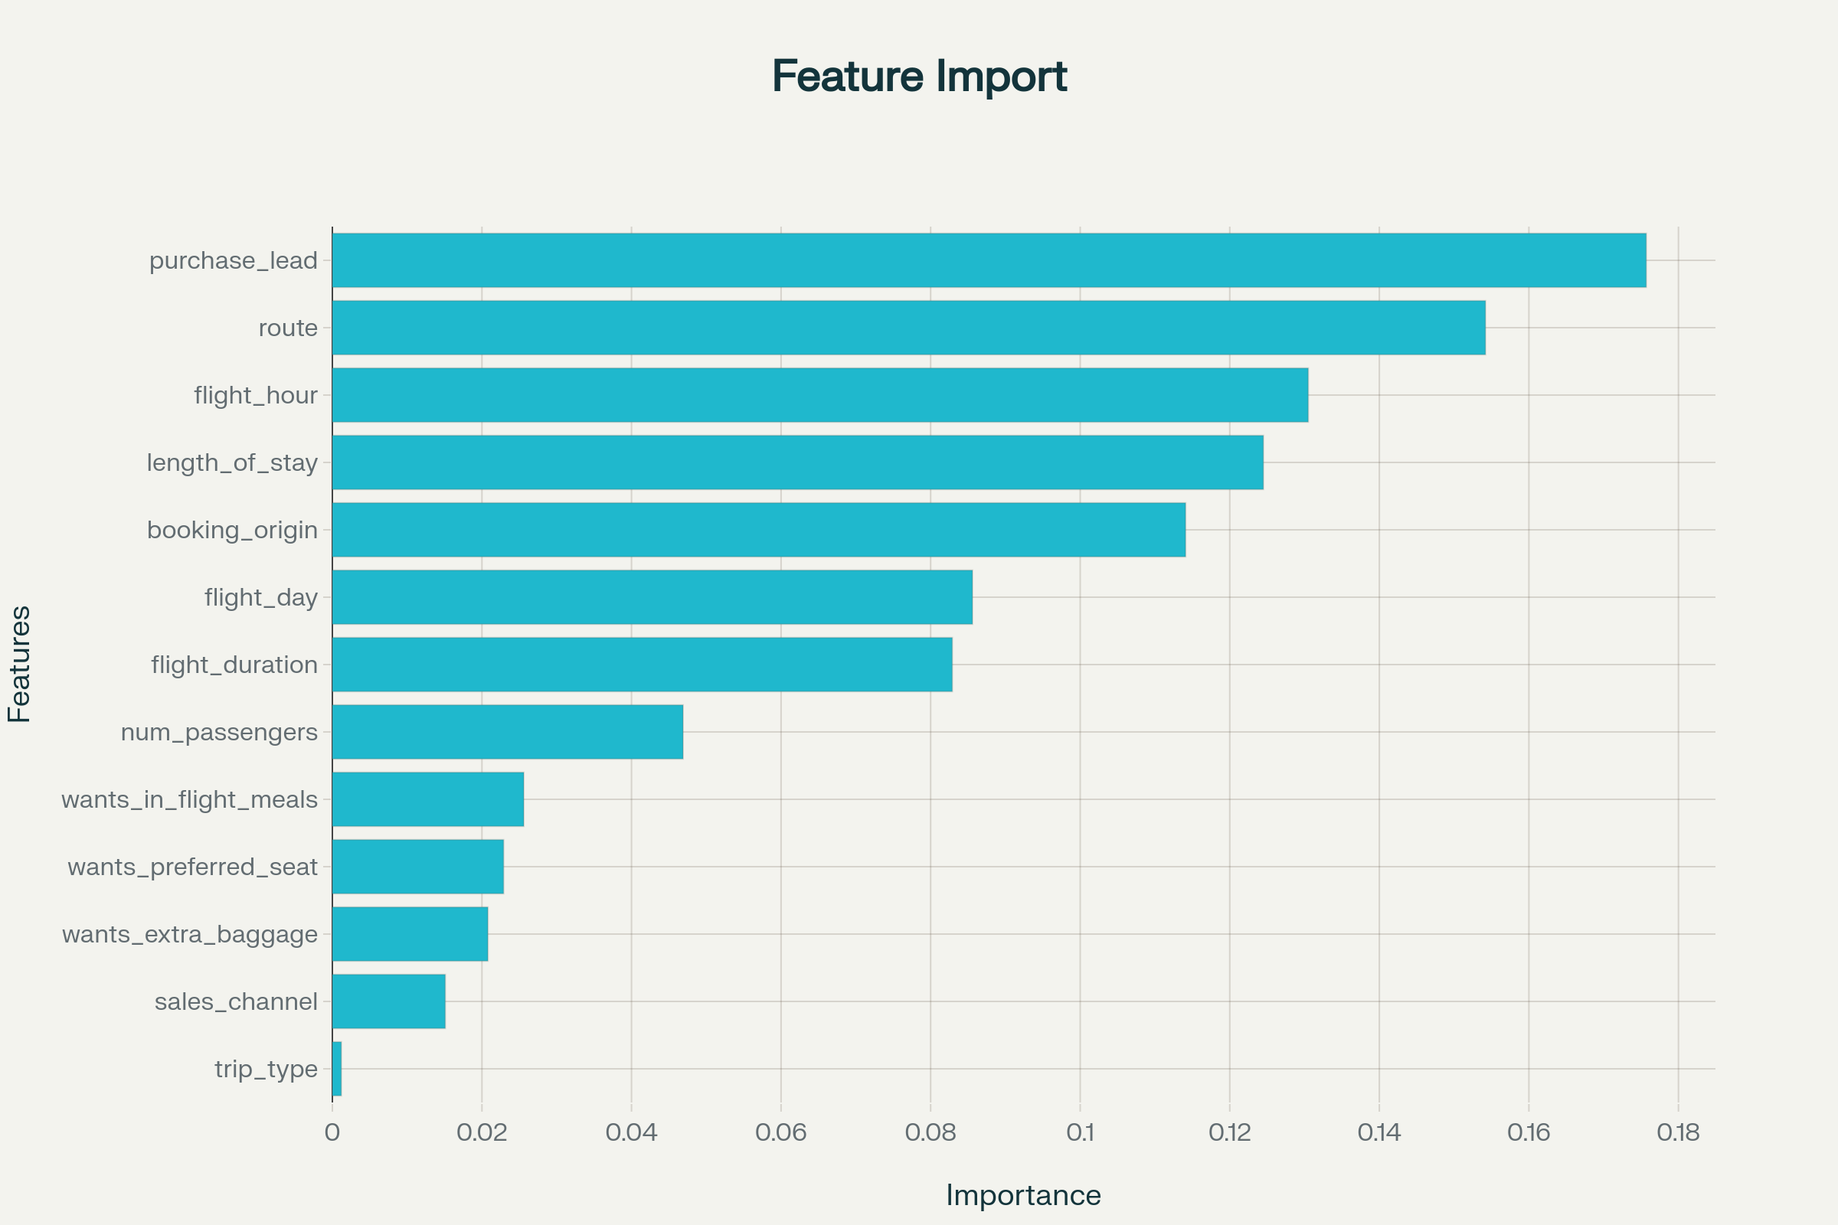
Predictive Modeling of Customer Holiday Bookings
Task Overview:
- Predict customers booking holidays using airline booking data (50,000 records).
- Key features include purchase lead time, flight details, route, preferences.
Modeling Approach:
- RandomForest Classifier: interpretable and effective.
- Sampled 10,000 records, categorical encoding applied.
- Evaluated using 5-fold cross-validation and ROC-AUC.
Key Results:
- ROC-AUC: 0.75, Accuracy: 85%
- Booking recall low (~7%), some missed bookings.
Important Predictive Features:
- Purchase lead time, route, flight hour/day, length of stay, booking origin

