Slide 1
Introduction
- Text generation using LSTM models is a fascinating and important area of research in natural language processing.
- A trained language model learns the likelihood of occurrence of a word based on the previous sequence of words used in the text. Language models can be operated at character level, sentence level or even paragraph level. I will explain how to create a language model for generating natural language text by implement and training state-of-the-art Recurrent Neural Network.
- The objective of this project is to explore the use of LSTM models for text generation and analyze their performance and limitations.

Slide 2
Background on LSTM Text Generation
Text generation is the creation of meaningful text using computational models.
LSTM (Long Short-Term Memory) models, a type of recurrent neural network (RNN), are widely used for text generation.
LSTM models excel at capturing long-term dependencies in data, ensuring proper grammar and semantics.

Slide 3
LSTM Model Architecture
LSTM architecture includes multiple LSTM cells: input gate, forget gate, and output gate.
The input gate manages current input storage in the cell state.
The forget gate determines which data from the previous cell state to discard.
The output gate regulates information output from the current cell state.
The cell state maintains long-term memory.
The hidden state (output state) represents short-term memory for predictions.
LSTM excels at capturing long-term dependencies in input sequences, facilitating coherent text generation.
Advantages of LSTM Models
The use of gates allows selective information retention, preventing gradient problems.
LSTM's architecture facilitates learning and capturing dependencies over longer sequences, essential for generating text with proper grammar and semantics.

Slide 4
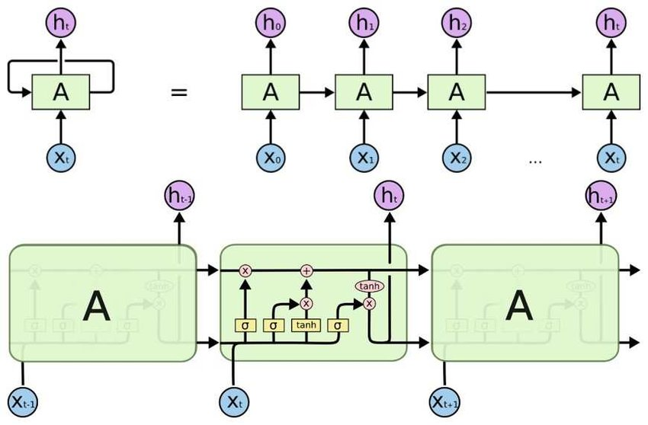
Here the first gate (sigmoidal) is the forgate Gate
the second gate is(sigmoidal +tanh) Input Gate
the third gate is (sigmoidal +tanh) Output Gate

Slide 5
Data Pre-Processing
Data Preprocessing:
1.1 Involves tokenization, removing stopwords, handling special characters and lower casing all the words
1.2 Creating Sequence of N-gram Tokens
Language modelling requires a sequence input data, as given a sequence (of words/tokens) the aim is the predict next word/token.
The next step is Tokenization. Tokenization is a process of extracting tokens (terms / words) from a corpus. Python’s library Keras has inbuilt model for tokenization which can be used to obtain the tokens and their index in the corpus. After this step, every text document in the dataset is converted into sequence of tokens.
1.3 Padding the Sequences and obtain Variables : Predictors and Target once we have sequence of tokens, it is possible that different sequences have different lengths. Before starting training the model, we need to pad the sequences and make their lengths equal. We can use pad_sequence function of Kears for this purpose. To input this data into a learning model, we need to create predictors and label. We will create N-grams sequence as predictors and the next word of the N-gram as label.

Slide 6
Model Construction:
LSTM model is built with specified layers and hidden units (three layers in the model)
1. Input Layer(embedding):It transforms the input data (sequence of words) into a fixed-size vector representation.
2. LSTM Layer : Computes the output using LSTM units. I have added 100 units in the layer, but this number can be fine tuned later.
3. Dropout Layer : A regularisation layer which randomly turns-off the activations of some neurons in the LSTM layer. It helps in preventing over fitting. (Optional Layer)
4. Output Layer : Computes the probability of the best possible next word as output

Slide 7
Training
The model is trained with input sequences and target sequences shifted by one time step. It learns to predict the next word based on context.
PREDICTORS --> LABEL
they --> are
they are --> learning
they are learning --> data
they are learning data --> science
Activation Function: “Softmax” helps in converting model output into a probability distribution over words, which is crucial for text generation.
Optimization: Adam for training the LSTM-based text generation model. Adam is known for its ability to adapt learning rates during training, making it suitable for a wide range of deep learning tasks.
Loss Function: “Catogorical Cross-entropy” it quantifies the dissimilarity between predicted and actual word distributions, providing feedback for the model to improve its predictions.

Slide 8
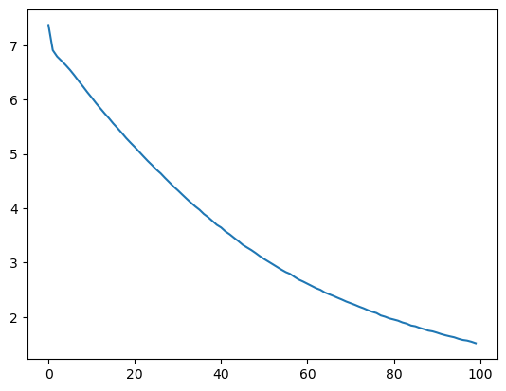
Loss graph for 100 epochs
X(axis)=epochs
Y(axis)=loss

Slide 9
Evaluation Metrics for Text Generation
Metrics Variety: Various metrics assess text generation quality.
Automated Metrics: BLEU and ROUGE compare generated text to references, but may lack semantic evaluation.
Human-Based Evaluation: Human judges assess fluency, relevance, and coherence, offering a holistic view.
Combined Approach: Best results achieved by using both automated and human-based metrics.
Application-Specific Criteria: Criteria vary per application. Chatbots focus on relevance and coherence, while translation emphasizes accuracy and fluency.
Tailored Evaluation: Define metrics aligning with specific project goals and needs for accurate assessment.

Slide 10
Challenges in LSTM Text Generation
Diverse Text: Generating diverse and creative text remains a challenge in LSTM models, often producing repetitive or generic content.
Controlled Text: Guiding models to meet specific requirements or constraints is difficult, requiring improved control mechanisms.
Evaluation Hurdles: Automated metrics like BLEU and ROUGE may not fully assess text quality and coherence.
Data Standardization: The need for standardized datasets, especially for low-resource languages, is crucial for model training and evaluation.
5.Interpretability: Understanding model text generation patterns is vital to improve performance and mitigate biases.
6.Scalability and Efficiency: Scaling LSTM models for long and complex text generation poses computational and time challenges.
This abbreviated version effectively highlights the core challenges and research gaps in LSTM text generation.

Slide 11
Key Takeaways
LSTM Challenges include diverse text generation, control, and better evaluation metrics.
Standardized datasets, especially for low-resource languages, are vital for progress.
Future directions: Enhance diversity, control, and develop interpretable models.
LSTMs introduce an additional 'cell state,' enabling the network to selectively remember or forget information. This cell state helps address the Vanishing Gradient issue and allows the model to better retain important knowledge.
Overall, LSTM text generation offers vast potential for improved accuracy and creativity.

Slide 12
Challenges & Impact
Limitations: LSTM models may produce biased text, require extensive training data, and demand significant computational resources.
Interpretability: Lack of understanding how the model generates text is a concern.
Ethics: Consider the ethical implications of generated text.
Implications: LSTM text generation has vast potential for applications, including content creation, chatbots, and translation. Ongoing research can enhance accuracy and creativity.

Slide 13
Conclusion
This systematic literature review (SLR) provides an in-depth look at text generation with deep neural networks, particularly LSTM models.
We've identified key contributions, challenges, and research gaps in LSTM text generation.
While LSTM models show promise in human-like text generation, they come with limitations and ethical concerns.
Future research should target robustness, external knowledge integration, multi-modal generation, and ethical aspects.
Focus on explainability, transfer learning, real-time generation, and user interaction is essential.
The lack of research in low-resource languages and the importance of basic NLP operations are highlighted.
Overall, LSTM text generation holds significant potential, with ongoing research leading to improved accuracy and creativity.

