Slide 1
Hostel Management System
Submitted to : prof. Rosy Sarmah

Slide 2
Team Members
Sonu Mittal (CSM19021)
Rishav Mittal (CSM19047)
Abdul Kadir (CSM19015)
Rohit B Nikhre (CSM19012)
Guided By:
Prof. Rosy Sarmah

Slide 3
Introduction
Hostel Management System is a web application designed for the automating the hostel room allocation.
This application intends to provide a very user friendly easy to use experience with the efficiency of using database design.
Solution of the large amount of file handling happening in the hostels.
Student check the vacant room and register itself.
Admin manage the all student and managers.
Simplification of the process of allocation and management of different hostels under an institute.

Slide 4
It is reduce the amount of human resources or any other resources resulting in lesser implementation cost.
Avoiding long waiting and data's getting lost during paper-works.

Slide 5
Problem Statement
To design and build an online Hostel Management System to simplify the day to day processes of the hostels in Tezpur University
This system provide a solution for the large amount of file handling happening in the hostels.
In the current manual system, it will very difficult to find the hostel record and other information of student manually.
The manual system requires longer time for allocation the student to respective bed, dorm and hostel.
Student write the complaints and query.

Slide 6
Hardware Requirements
Processor : 1 GHz
RAM : 512 MB
Storage : 1 GB

Slide 7
Software Configuration
Front end tool : HTML, CSS, Java Script
Backend : PHP, MYSQL
Server : Local Wamp Server
Query Language : MYSQL,
Operating System : Windows

Slide 8
Feasibility Study
Technical Feasibility
The technical feasibility is the proposed system deals with the technology used in the system.
It is deals with the hardware and software used in the system whether they are of latest technology or not.
This system use window platform, and PHP as Back end technology and SQL server as Query Language and MySql as Database Server.
The online Hostel Management System is technically feasible.

Slide 9
Economical Feasibility
Economic analysis is the most frequently used method for evaluating the effectiveness of a new system. Most commonly known as cost/benefit analysis.
PHP and mysql database easily available in the internet.

Slide 10
Operational Feasibility
This project very easy for a person with little computer knowledge to operate.
This project very user friendly and does not require any technical person to operate.
This project is even operationally feasible.

Slide 11








DFD Level 0
H
ostel Manager
Hostel
Management
Hoste
S
tudent
System
l
Admin

Slide 12
Level 1
Hostel Admin Management
Appoint/Remove Hostel Manager
Hostel Manager Management
Manage Hostel/Student Details
Hostel Management System
Manage Room Allocation Allocated/Empty/Vacate Details
Room Management
Allotees Management
Check Allotee Details
Complaint/Massage Management
Check Complaint/Message Details

Slide 13
Level 2
New Student Registration
Login
Login To System
Check Role of Access
Check Credentials
Student
Hostel Manager
Hostel Admin
Apply For Hostel’s Room
Check Students/Allotee Details
Appoint/Remove Hostel Manager
Complaint/Massage To Hostel Manager
Check Complaint/Message Details
Check Students Details By Roll Number
Profile Details
Allocated/Empty/Vacate Hostel’s Room to Student

Slide 14
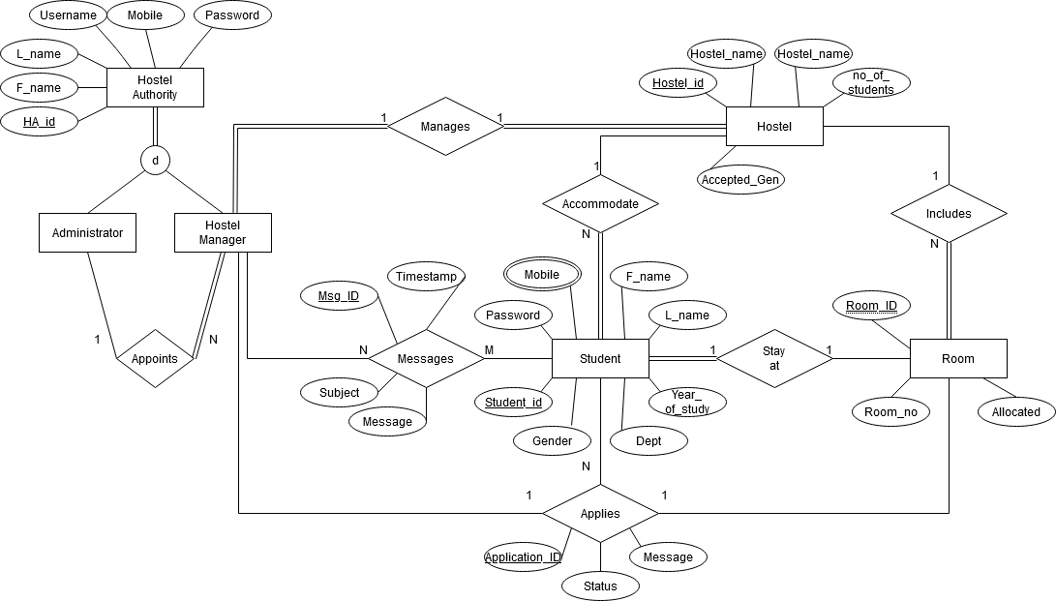
ER Diagram

Slide 15















Structure Chart
HOSTEL MANAGEMENT SYSTEM
STUDENT
ADMIN
HOSTEL MANAGER
PROFILE LOGIN
PROFILE LOGIN
ALLOCATE ROOMS
CONTACT
APPOINT MANAGER
MESSAGES
MANAGER
APPLY HOSTEL
REMOVE MANAGER
PROFILE LOGIN
SEARCH STUDENT
ROOMS

Slide 16
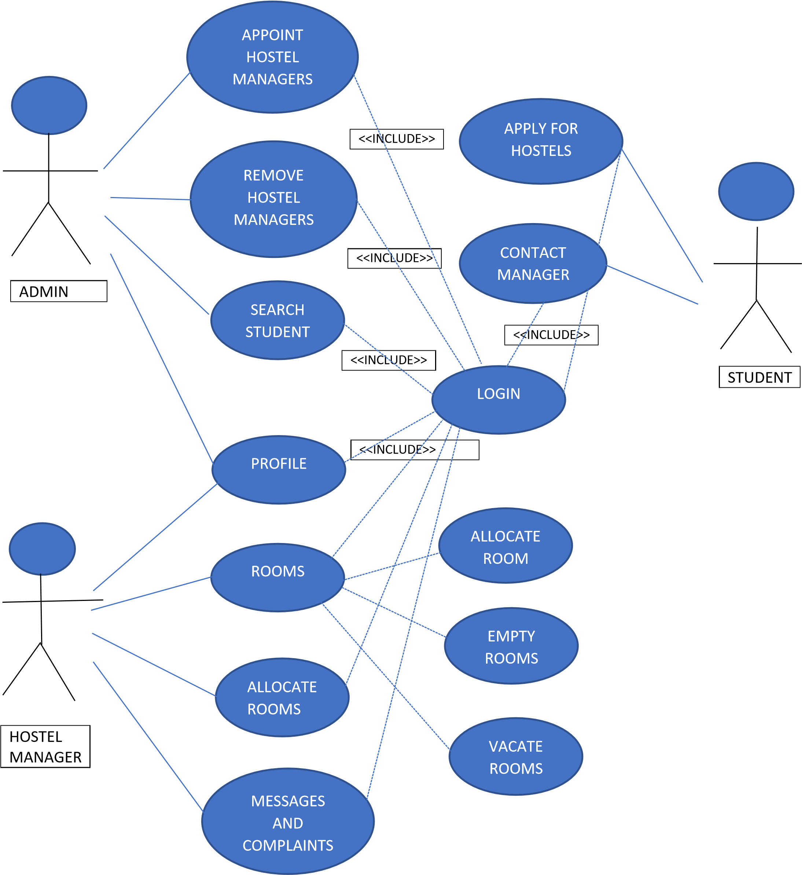
Use Case Diagram

Slide 17
Database
NAME | DATA TYPE | TYPE
HOSTEL_ID | Integer | Primary key attribute
HOSTEL_NAME | String | Non key attribute
NO_OF_ROOMS | integer | Non key attribute
NO_OF_STUDENTS | integer | Non key attribute
ACCEPTED_GEN | integer | Non key attribute
Hostel

Slide 18
NAME | DATA TYPE | TYPE
HA_ID | integer | Primary key attribute
F_NAME | string | Non key attribute
L_NAME | string | Non key attribute
USERNAME | string | Key attribute
MOBILE | string | Key attribute
PASSWORD | string | Non key attribute
Admin

Slide 19
Hostel Manager
NAME | DATA TYPE | TYPE
HM_ID | Integer | Primary key attribute
F_NAME | String | Non key attribute
L_NAME | String | Non key attribute
USERNAME | String | Key attribute
MOBILE | String | Key attribute
PASSWORD | String | Non key attribute
ADMIN | Integer | Foreign key attribute
HOSTEL_ID | Integer | Foreign key attribute

Slide 20
Room
NAME | DATA TYPE | TYPE
ROOM_ID | Integer | Primary key attribute
ROOM_NO | Integer | Non key attribute
HOSTEL_ID | Integer | Foreign key attribute
ALLOCATED | Boolean | Non key attribute

Slide 21
NAME | DATA TYPE | TYPE
STUDENT_ID | Integer | Primary key attribute
F_NAME | String | Non key attribute
L_NAME | String | Non key attribute
YEAR | String | Non key attribute
DEPT | String | Non key attribute
PASSWORD | String | Non key attribute
HOSTEL_ID | Integer | Foreign key attribute
ROOM_ID | Integer | Foreign key attribute
GENDER | Integer | Non key attribute
Student

Slide 22
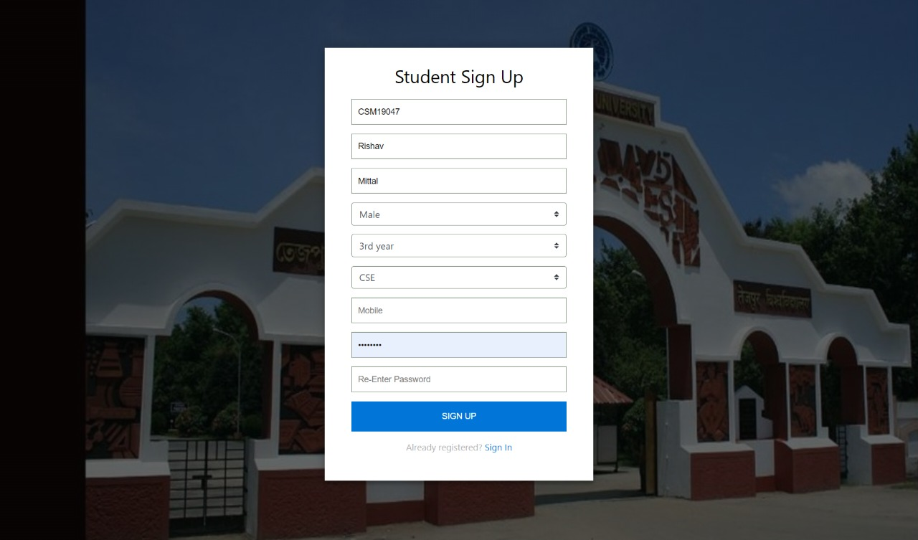
Testing and Result
Student Sign Up Form
For sign up, Students have to fill details such as roll no, first name, last name, gender, year of study, branch, mobile no, password and confirm their password.

Slide 23
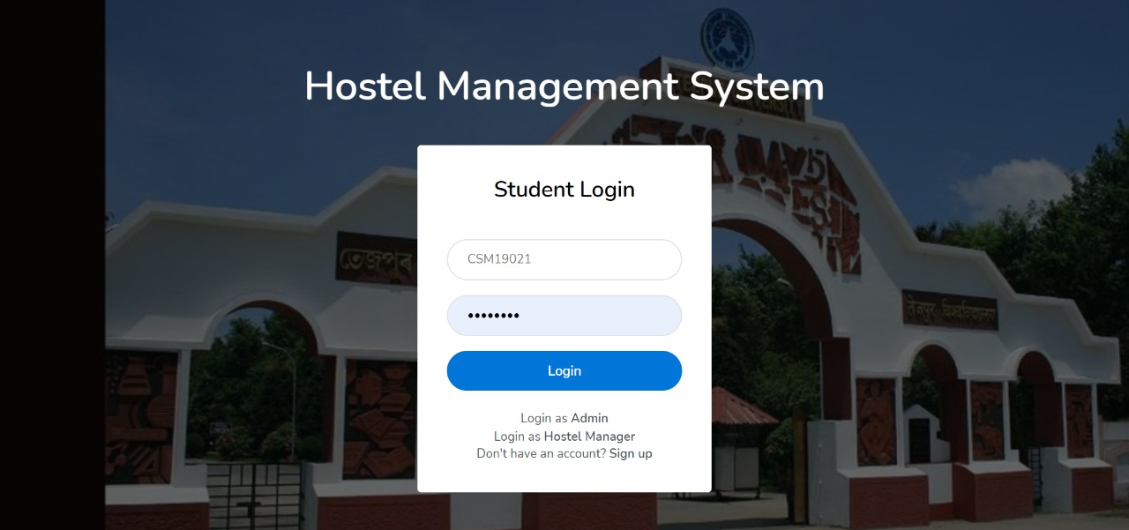
Student Login
After giving the correct username and password, students will be logged into their student home page. Otherwise the corresponding error will pop up.

Slide 24
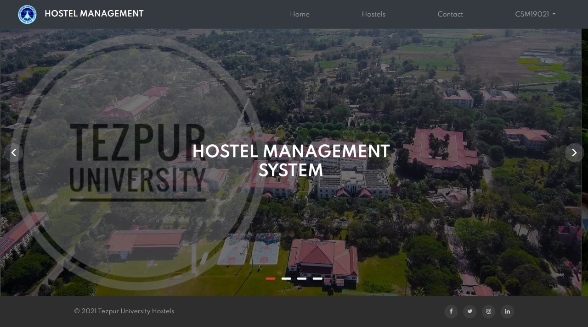
After Successfully Login

Slide 25
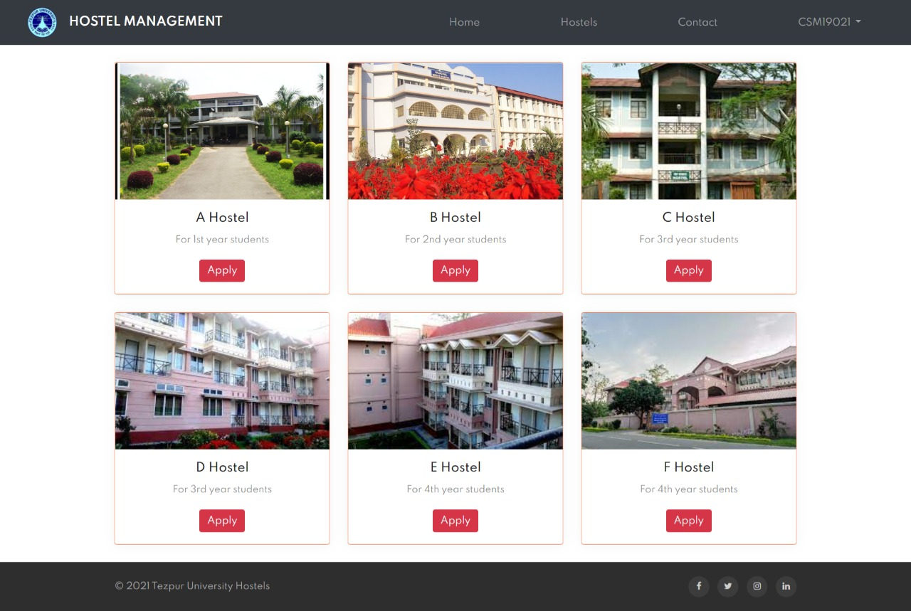
Student applying for hostel room
Now students have to select the appropriate hostel according to his/her year of study. Here in our application A hostel is reserved for 1st year, B hostel for 2nd year, C and D for 3rd year, E and F for 4th year.

Slide 26
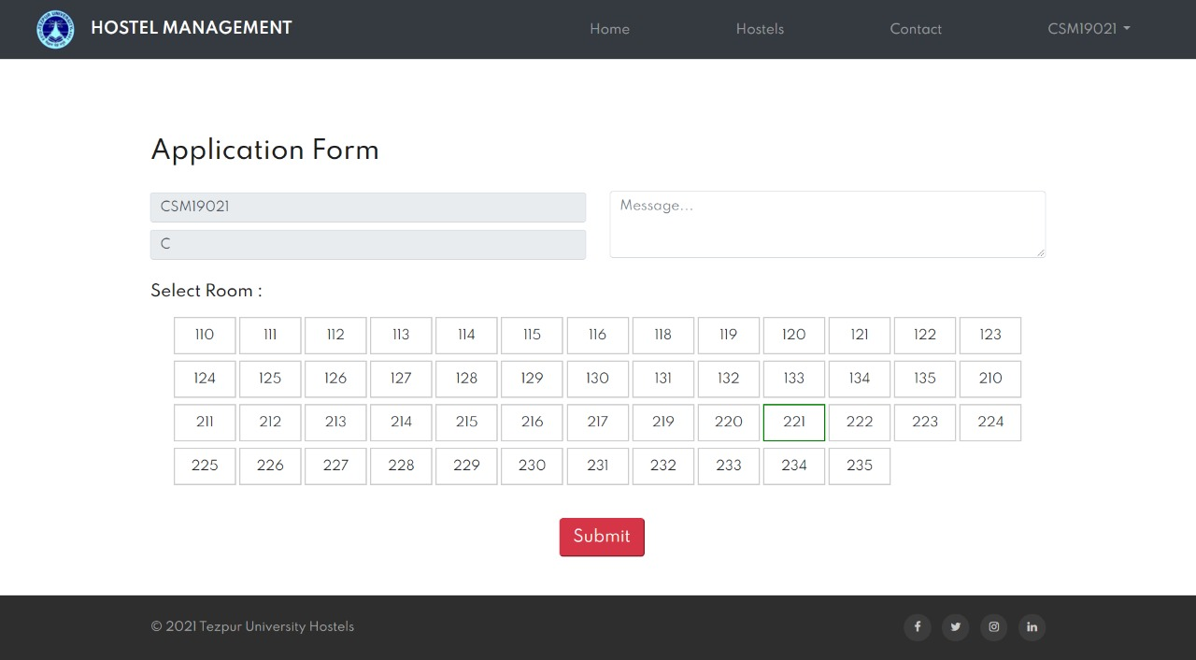
Room Select

Slide 27
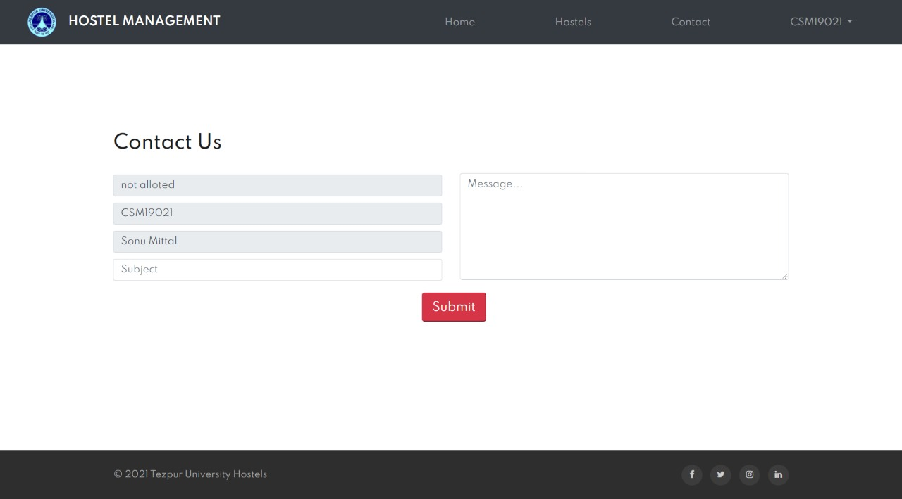
Contact and Query

Slide 28
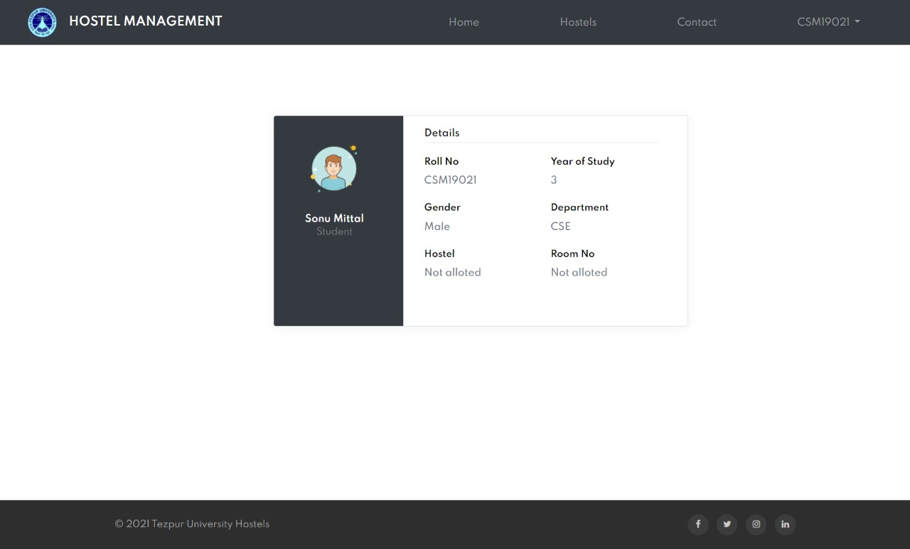
Room Allocation Status
If a student has applied for a hostel room and is waiting for the hostel manager to allocate the room. Then inside the student profile, The Application pending status is displayed in the Hostel name column.

Slide 29
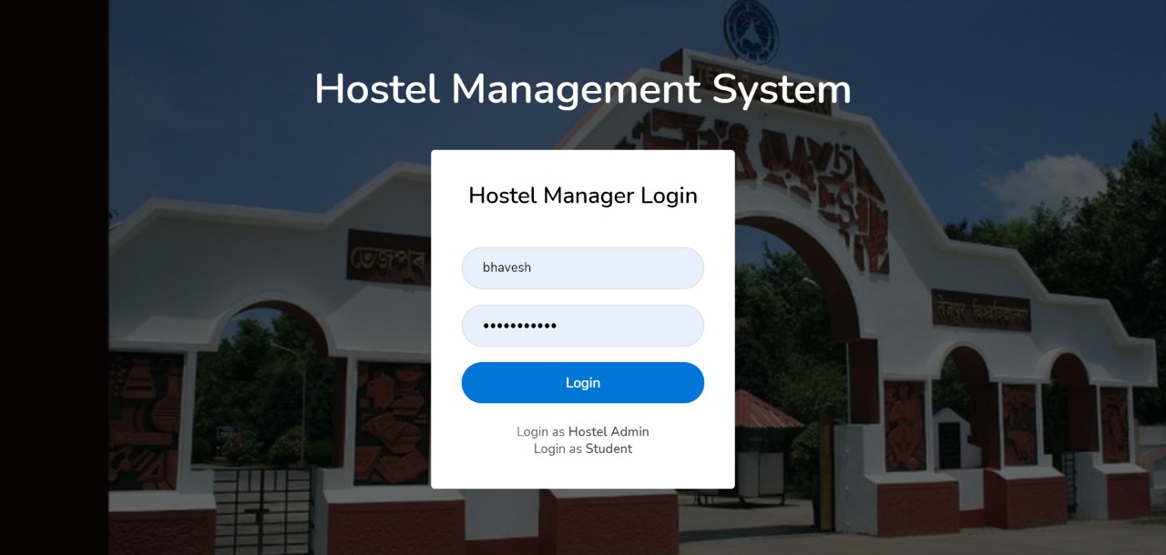
Hostel Manager Login
Hostel managers are appointed by the hostel admin. For each hostel one hostel manager is appointed.

Slide 30
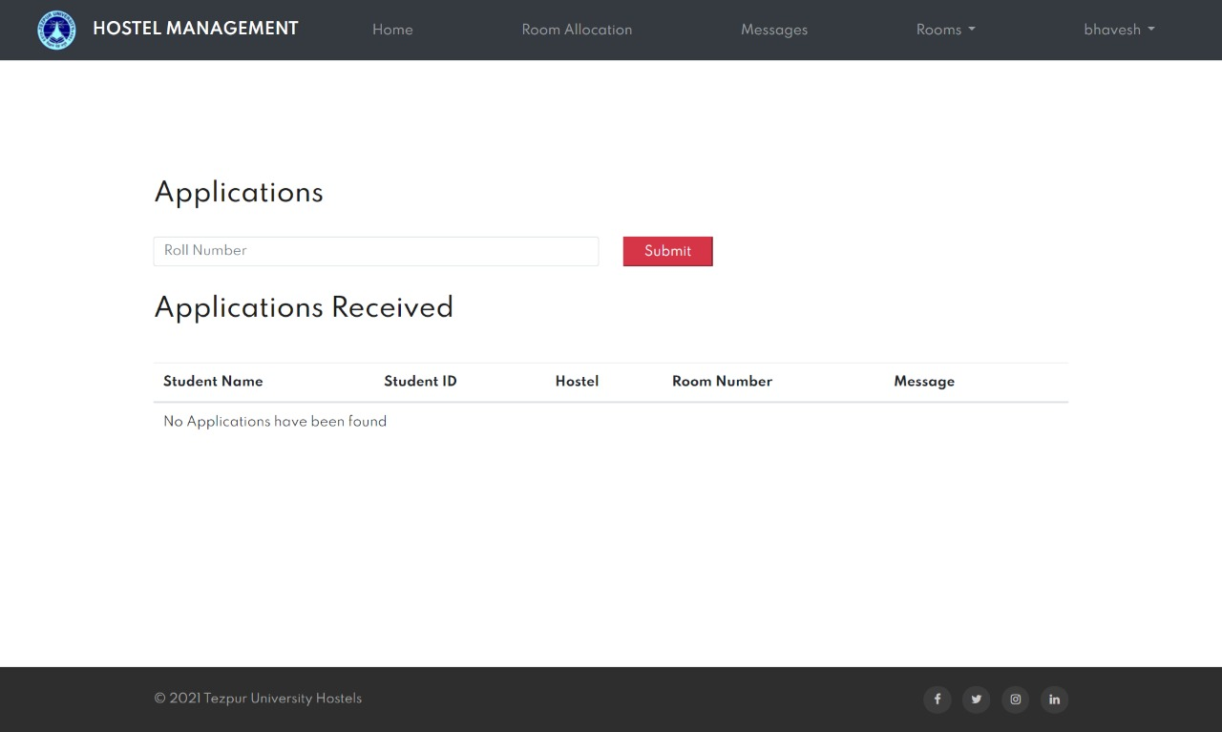
Hostel Manager Allocation Rooms
Hostel manager can now see all the last applications sent by the student as discussed earlier. Now he can allocate by just pressing the allocate button corresponding to each application row.

Slide 31
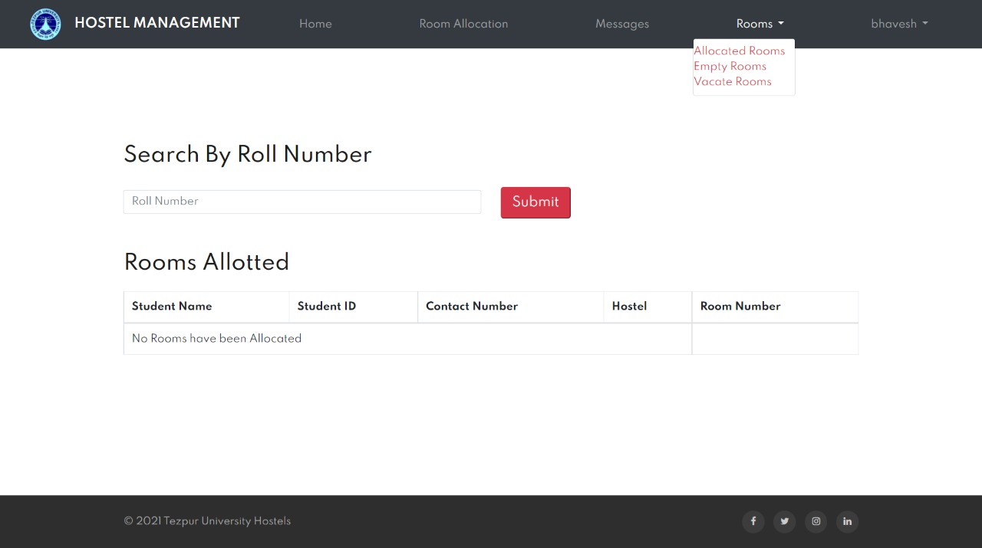
Showing Allotted Rooms
Hostel managers can see all the rooms allotted application list by clicking on the allotted rooms option from ‘Rooms’ menu.

Slide 32
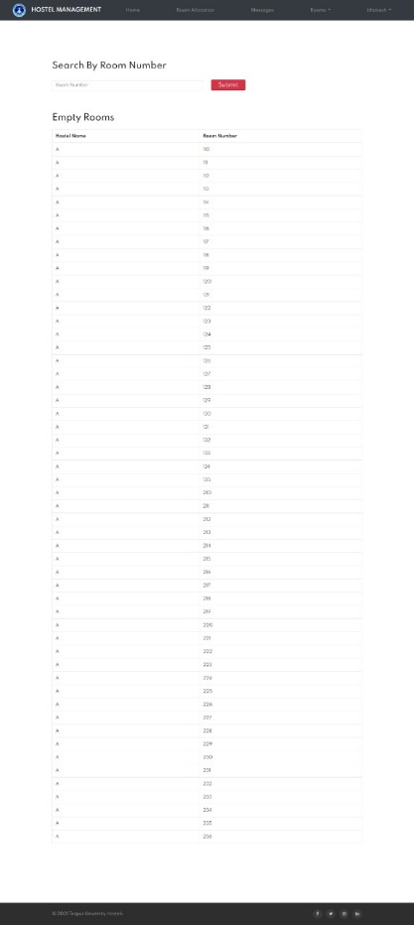
Showing Empty Rooms

Slide 33
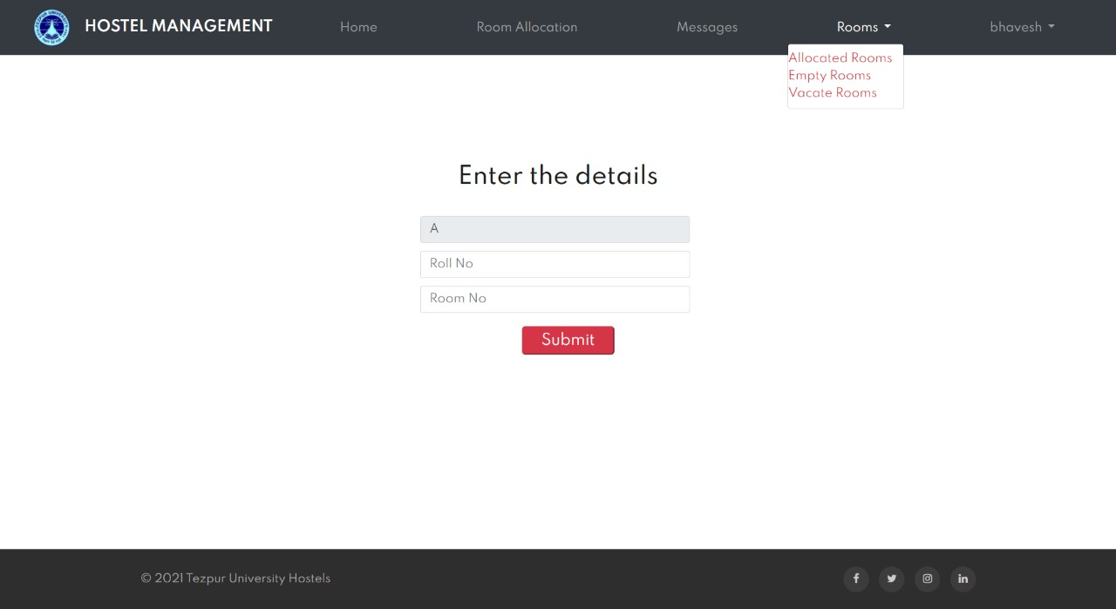
Vacant Rooms
Hostel Manager can vacate the student with Roll No ‘B180437CS’ and Room No 117. A pop up will be displayed after successfully vacating the student.

Slide 34
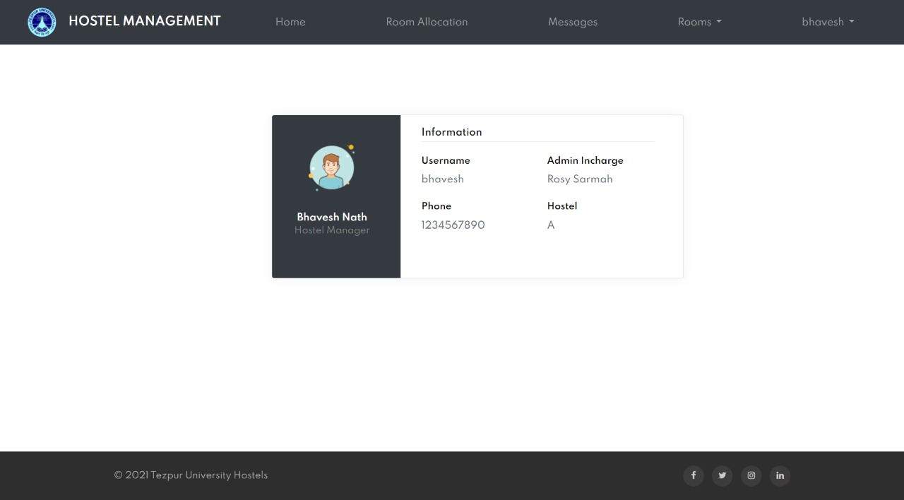

Slide 35
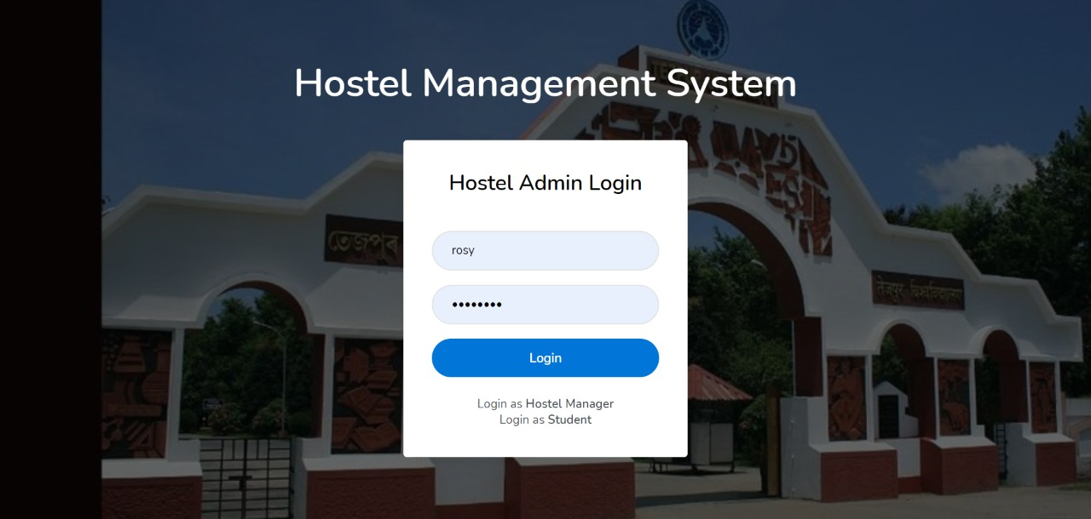
Admin Login

Slide 36


Slide 37
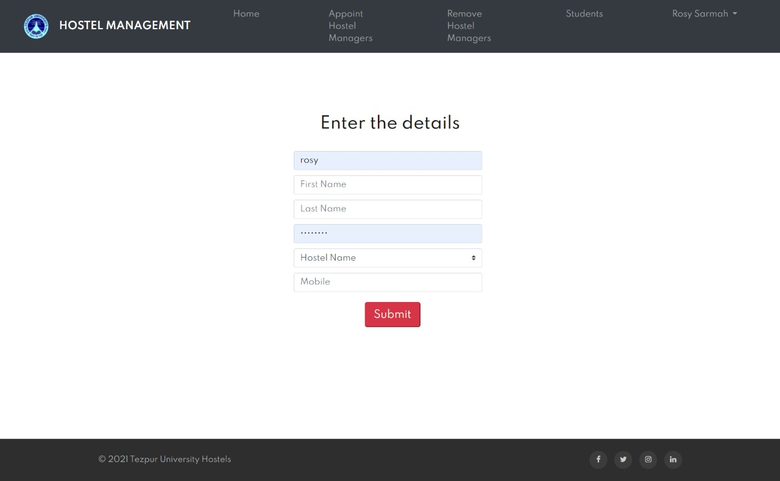
Admin Appointing Hostel Manager

Slide 38
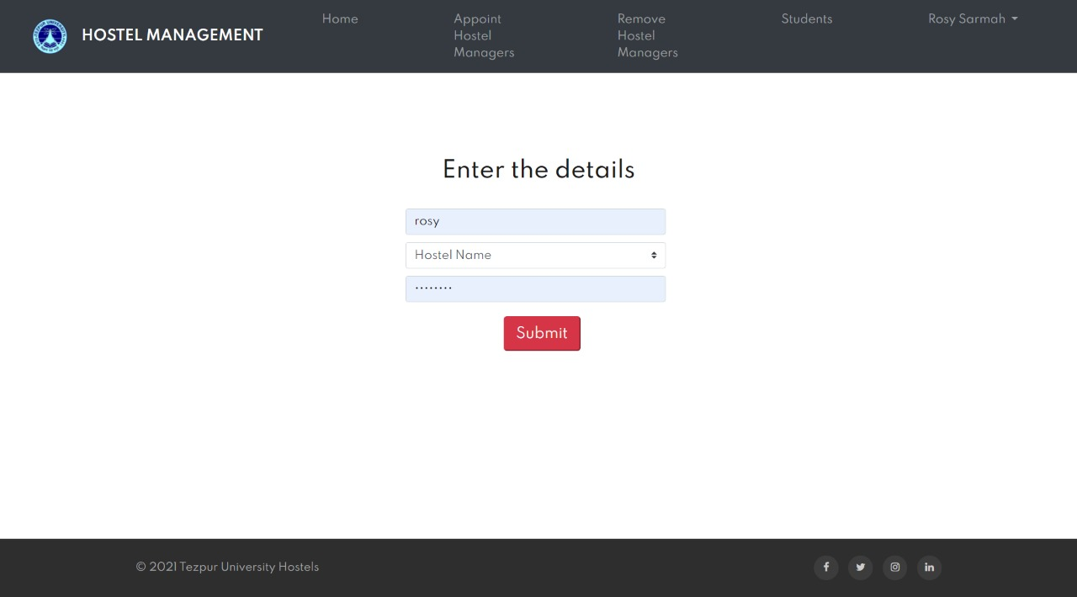
Admin Remove Hostel Manager

Slide 39
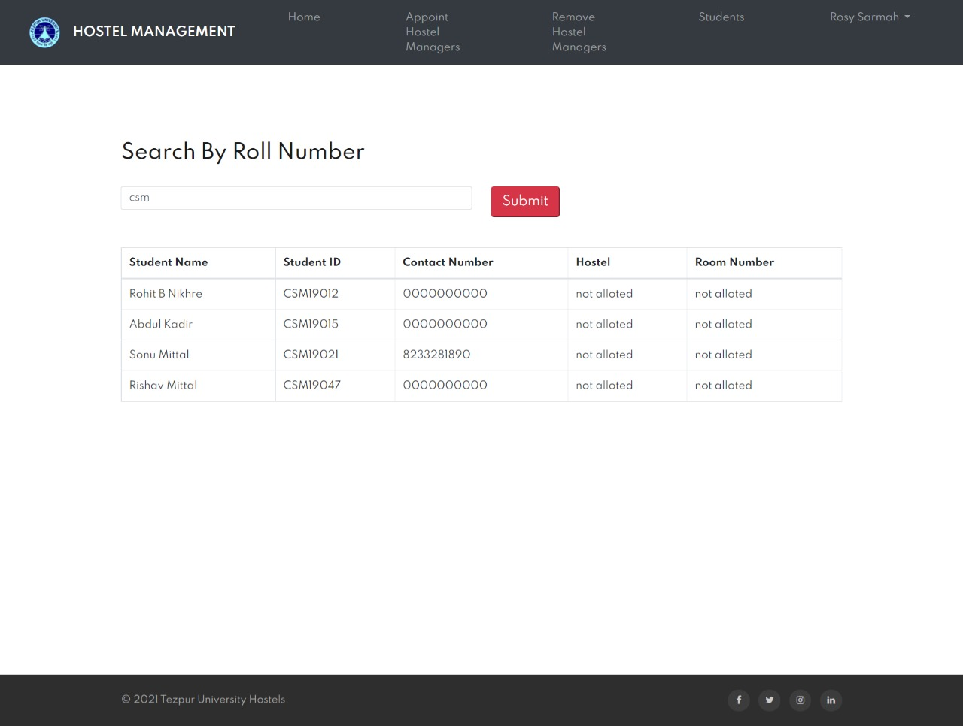
Admin Searching For a Student

Slide 40
Conclusions
To conclude the description about the project : The project, developed using PHP and MySQL is based on the requirement specification of the users and the analysis of the existing system, with flexibility for future enhancement.
This particular project deals with the problems on managing a hostel and avoids the problems which occur when carried manually. Identification of the drawbacks of the existing system leads to the designing of computerized systems that will be compatible to the existing system with the system which is more user friendly and more GUI oriented.

Slide 41
Thank You

