Slide 1

B9IS109 Web Development for Information Systems
WebApplication: EscapeFlights
Student Name: Sonavva Nandagaon
Student Number: 10622824
Module Lecturer: Obinna Izima

Slide 2
Introduction
EscapeFlight is a flight booking web application that enables users to search and book flights from different airlines. It provides users with a convenient way to compare flight schedules, prices, and other travel-related information in one place. With a flight booking application, users can easily search for available flights to their desired destination, choose the most convenient flight for them, and make reservations.

Slide 3
Research and Planning:
The web application EscapeFlight is created for users who love travelling via flights, to save time by avoiding long queues at ticket counters and the need to physically visit a travel agency. Python is used to develop the functionalities in the application, Django framework was used to develop this application and on the backend side Sqlite3 is used for the database design. To make the application responsive across multiple devices CSS3 and HTML5 were used. Javascript has been utilized for validation. Have used online logo maker websites to create own logo for the application. Application was deployed into pythonanywhere cloud platform.

Slide 4
Technologies Used
Python
Django Framework
Sqlite3
HTML5
CSS3
JavaScript
Pythonanywhere

Slide 5
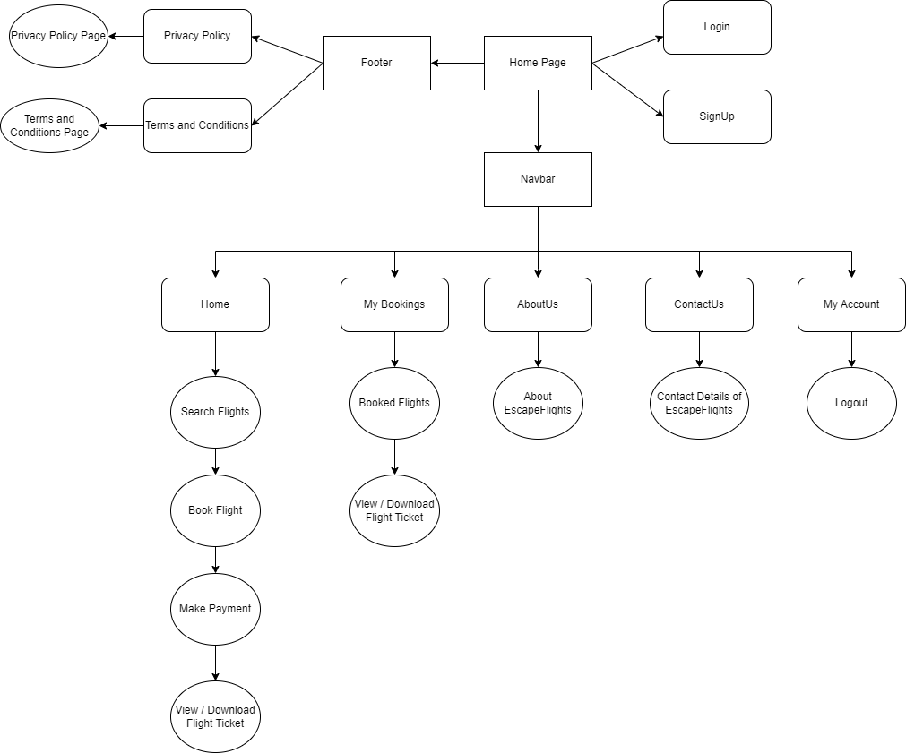
Flow Diagram

Slide 6
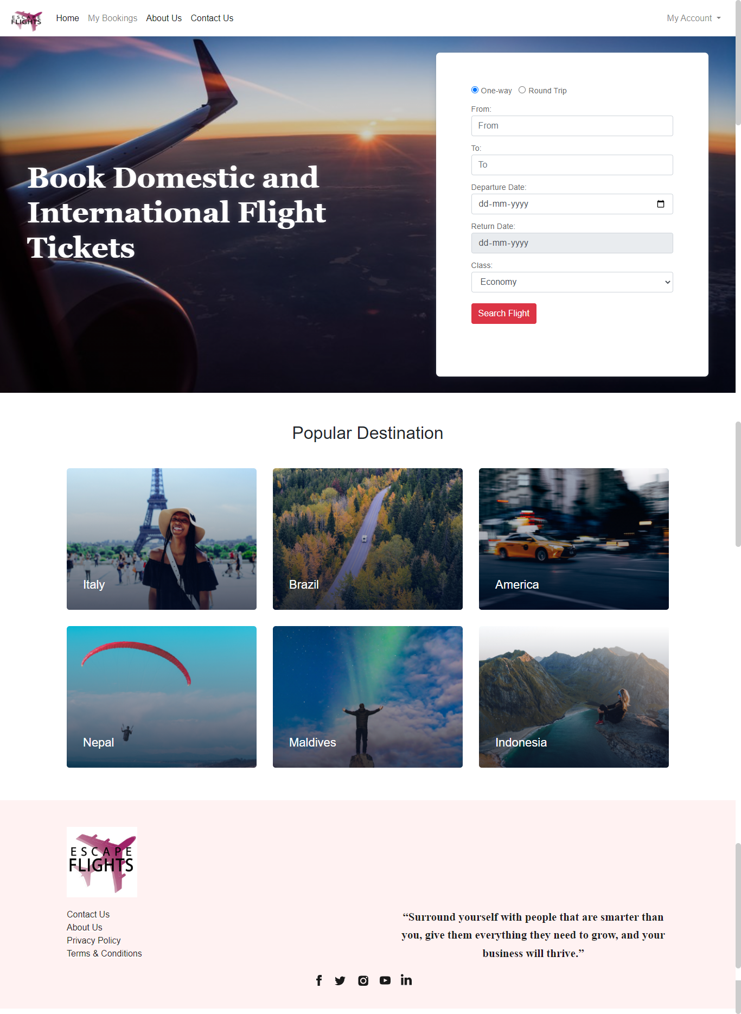
Home Page

Slide 7
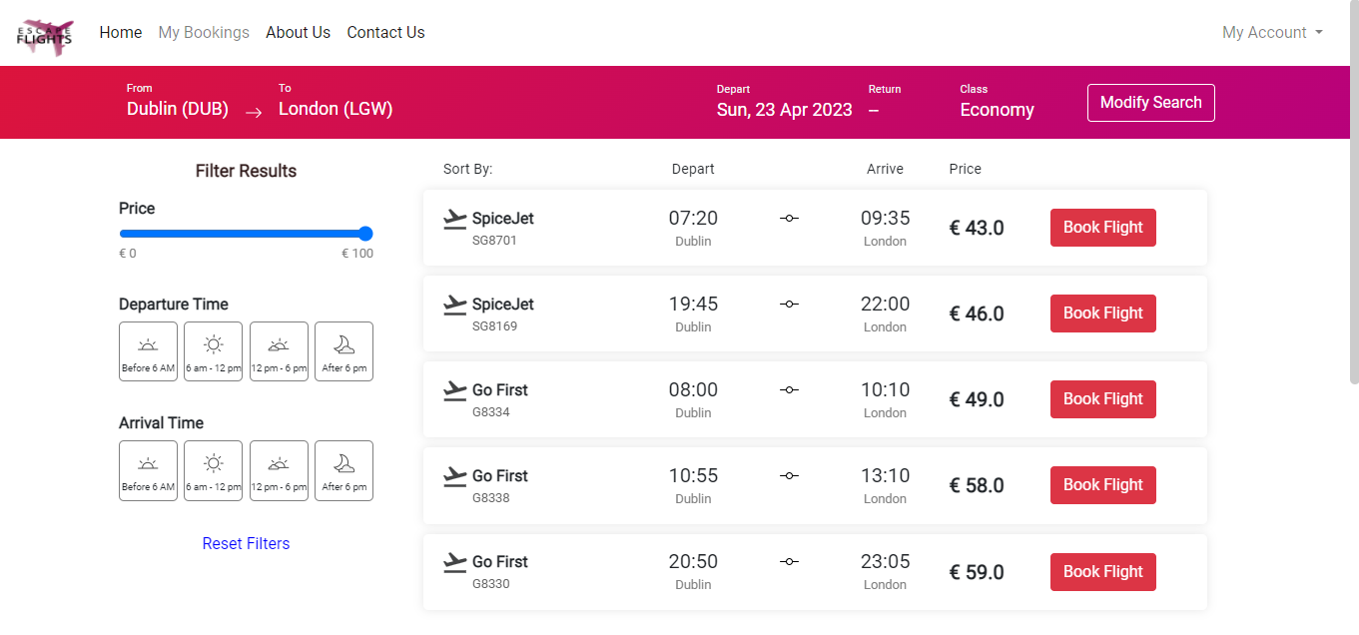
Searched Flights Page

Slide 8
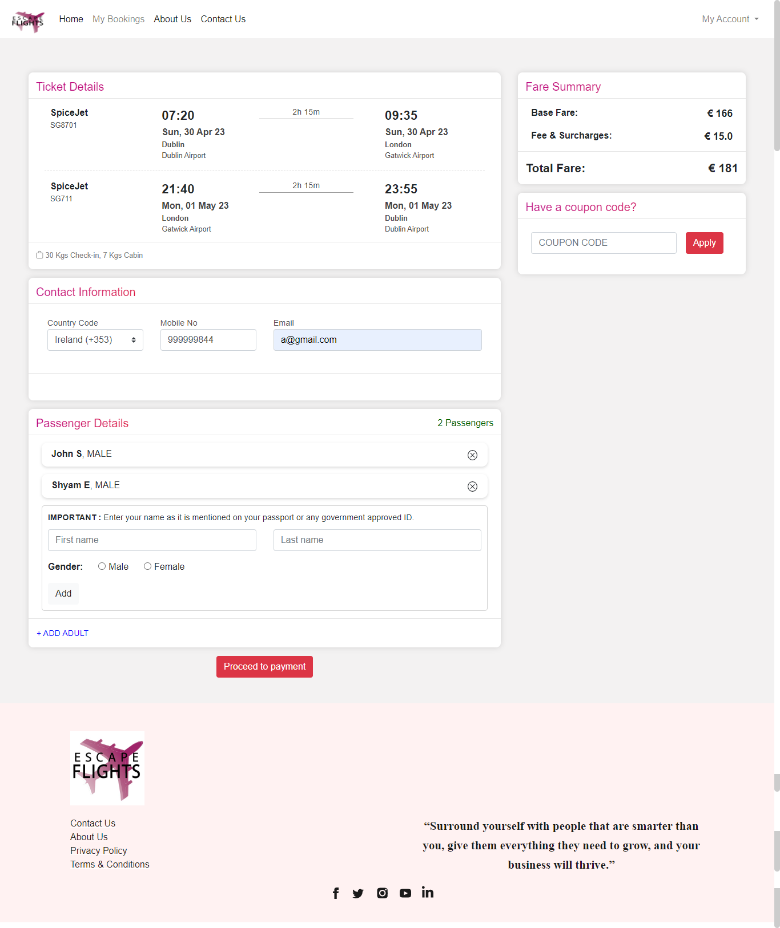
Flight Booking Page

Slide 9
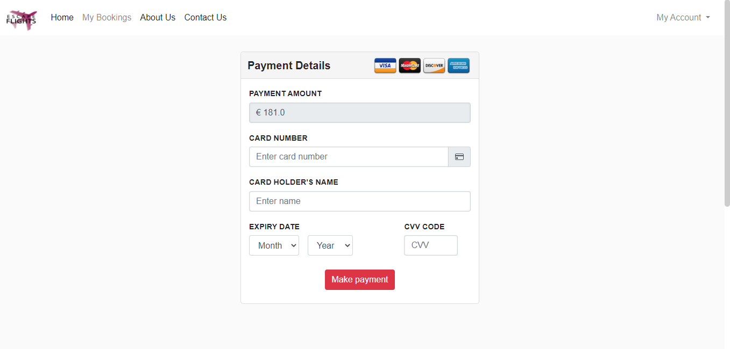
Payment Page

Slide 10
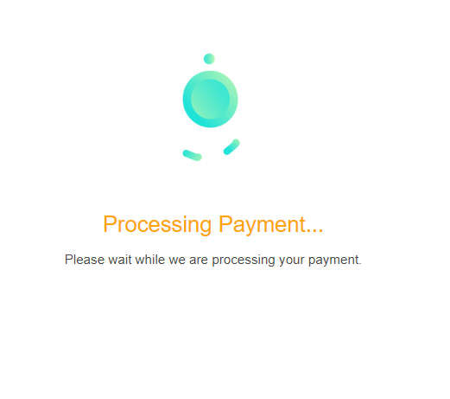
Payment Processing Page

Slide 11
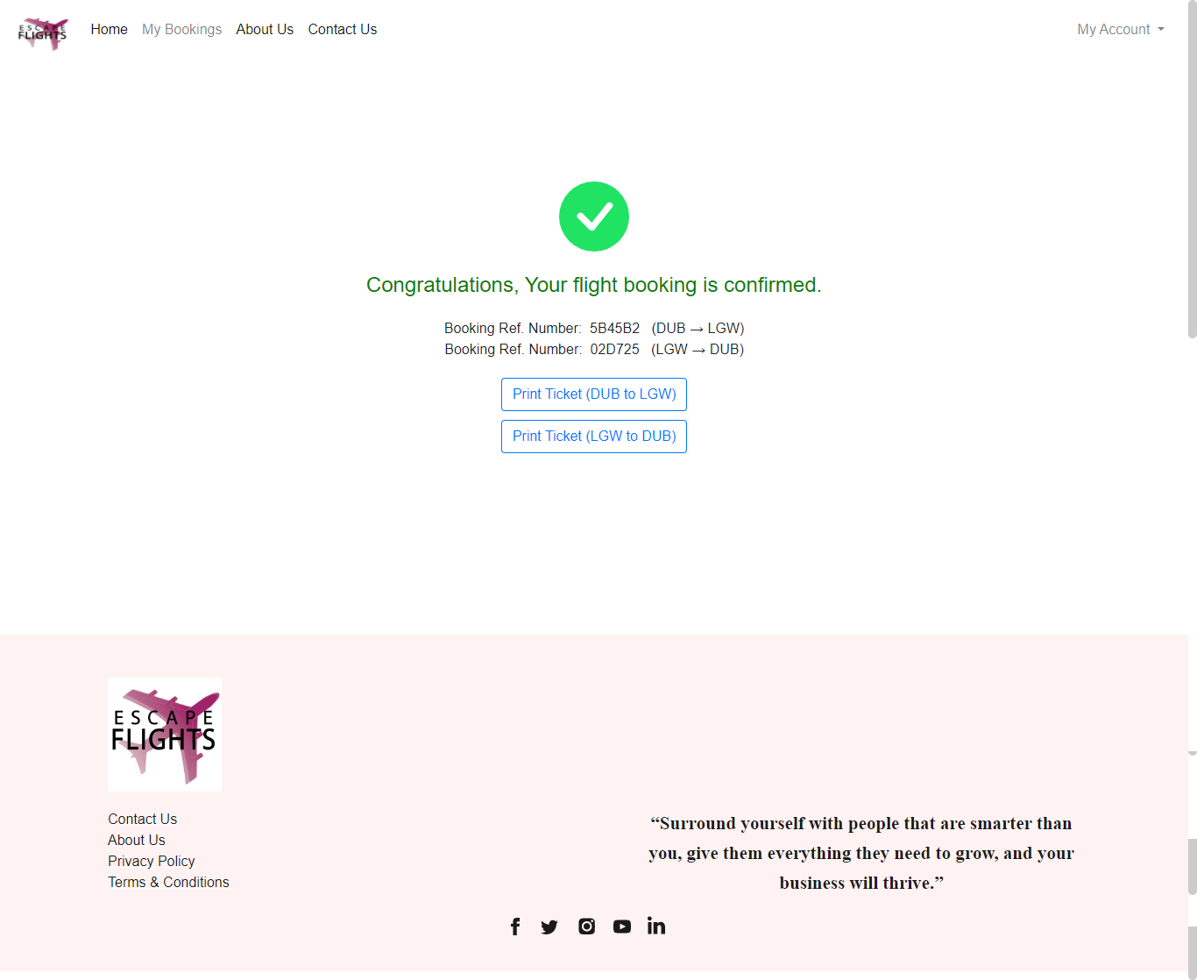
Payment Confirmation Page

Slide 12
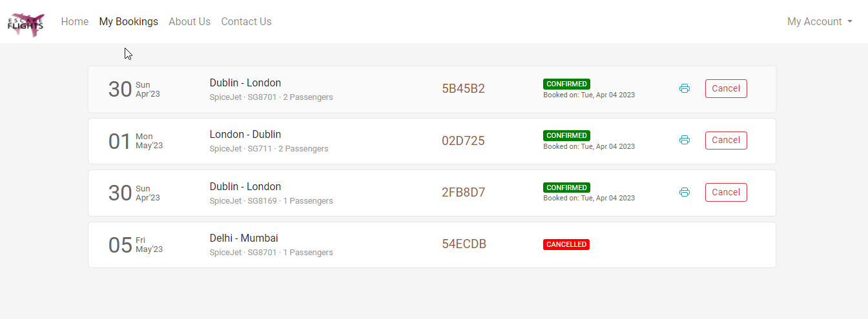
My Bookings Page

Slide 13
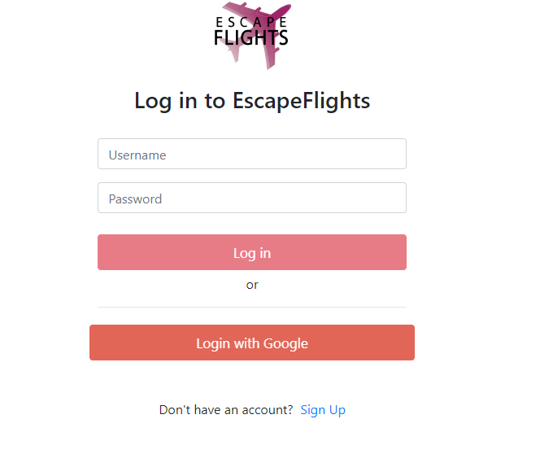
Web Service
Login using Google

Slide 14
Web Application Features
SearchFilters
Search filter by Price
Search filter by Departure Time
Search filter by Arrival TimeTravel
Travel Distance Tooltip
Payment Processing by Gif Image
My Account Dropdown
Modify Search
About Us Page
Contact Us Page
Privacy Policy Page
Terms and Conditions Page

Slide 15
Thank You

