Slide 1
Leadhero

Slide 2
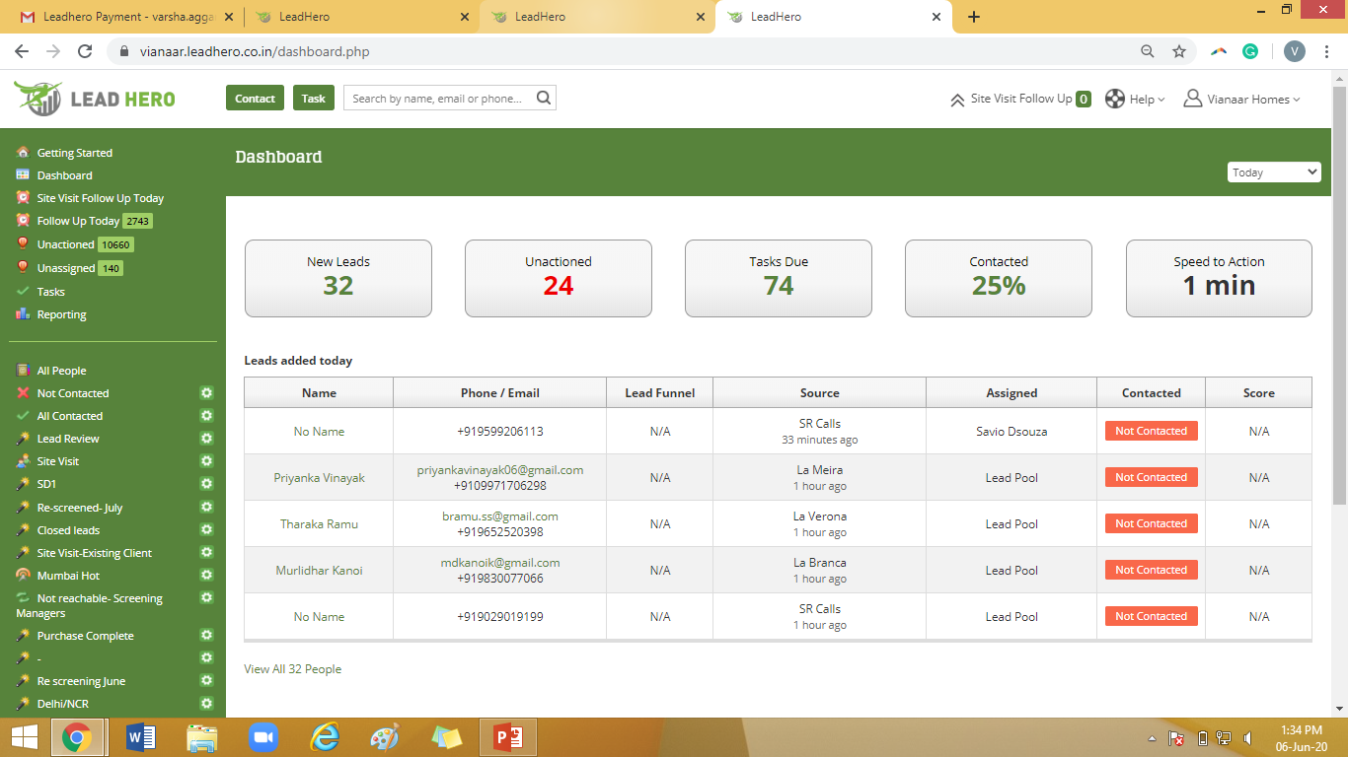
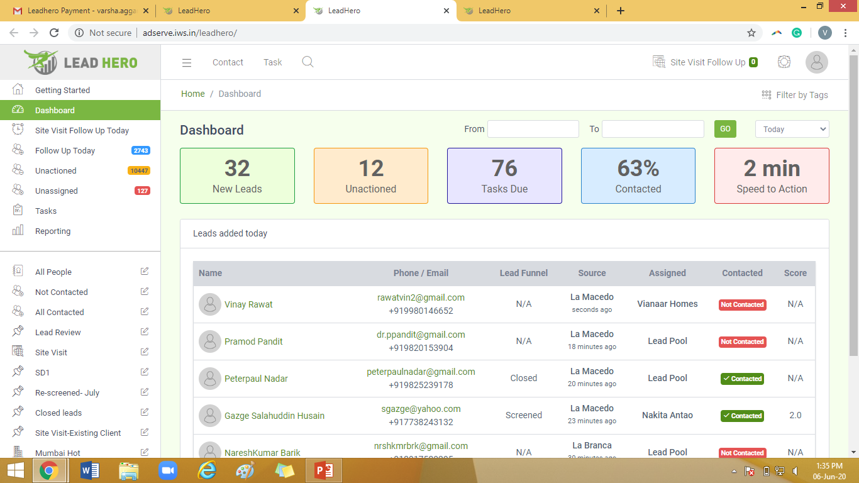
Dashboard: 1. The overall size needs to be reduced so all the information can be see in one screen. 2. The left hand side column with information: Dashboard, Getting Started, etc. should also be in green so it is highlighted. Right now it’s kind of getting mixed up into the rest if the information on the page.
Current Leadhero
New Leadhero

Slide 3
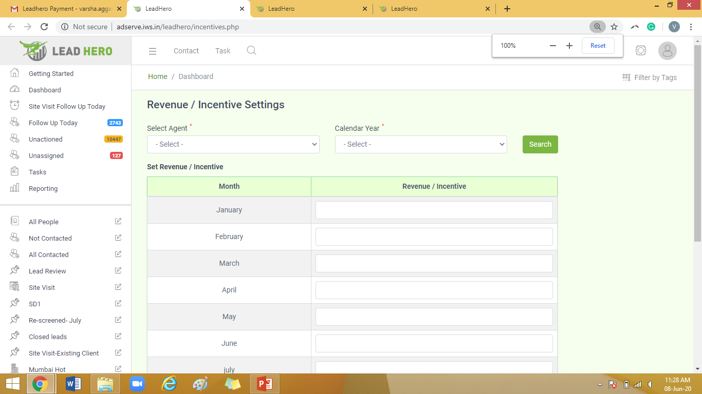
Revenue/Incentives: Can we please disable this option? We have not used the system to show the managers their revenues or incentives so far.

Slide 4
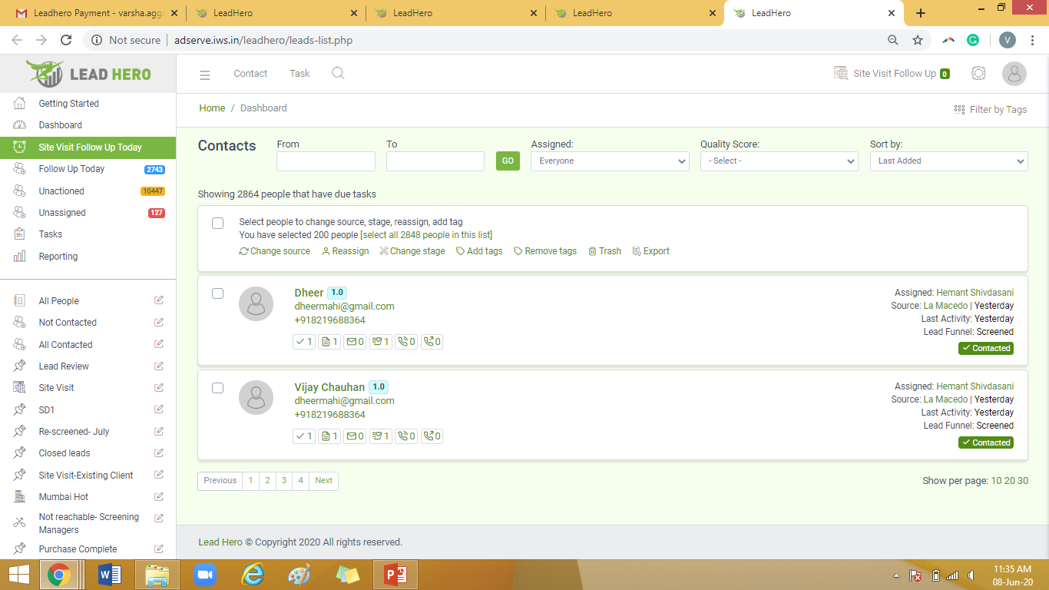
Leads list view: This needs to be a bit more compact and the options for filtering the leads/ selecting the leads can be highlighted in green, may be to have it more stand out?

Slide 5
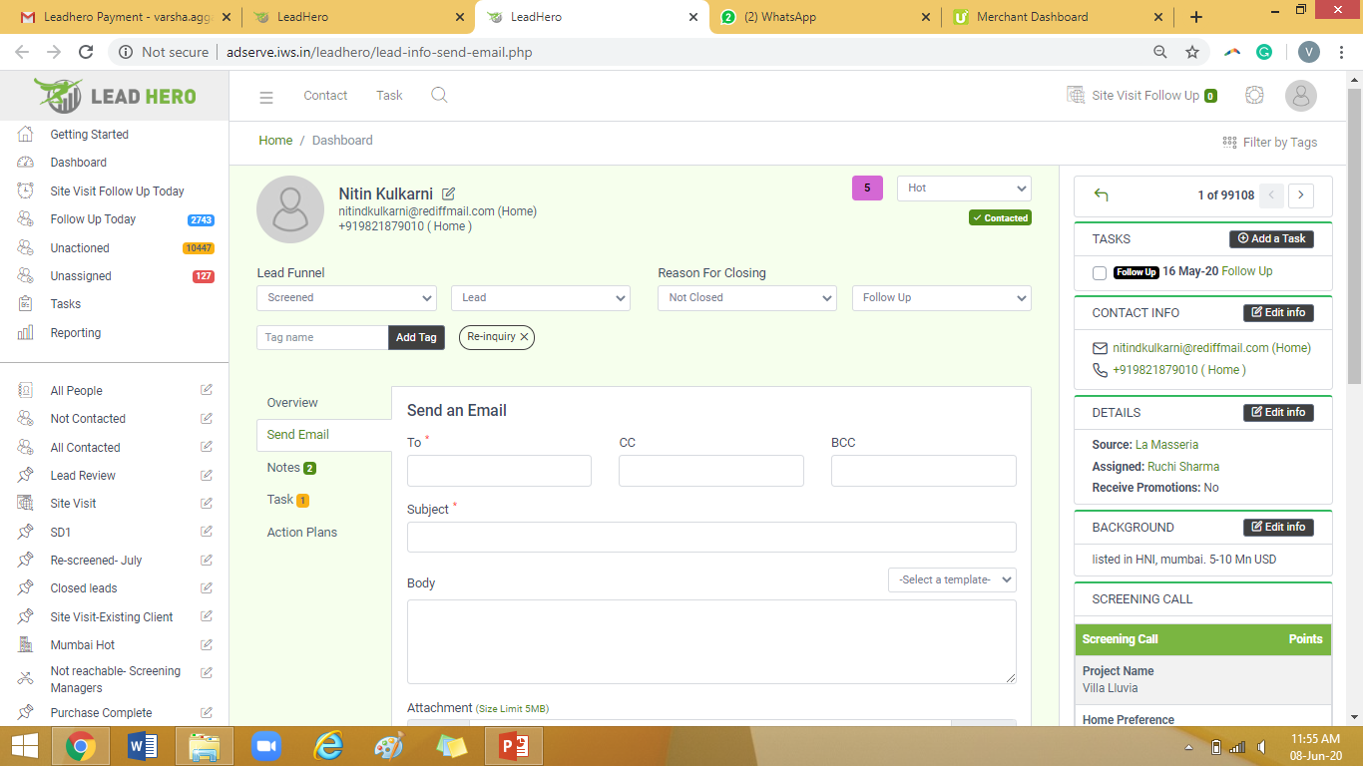
Lead info- notes 1. The right hand side column seems very messy and clustered. We need to reduce the font size and make the view more compact. 2. Is there a purpose to have the contact details under the name as well? It was not like this in the previous system. 3. We also need to add the Whatsapp messages option along with the send an email option. We had discussed this point, but it is not visible here.

Slide 6
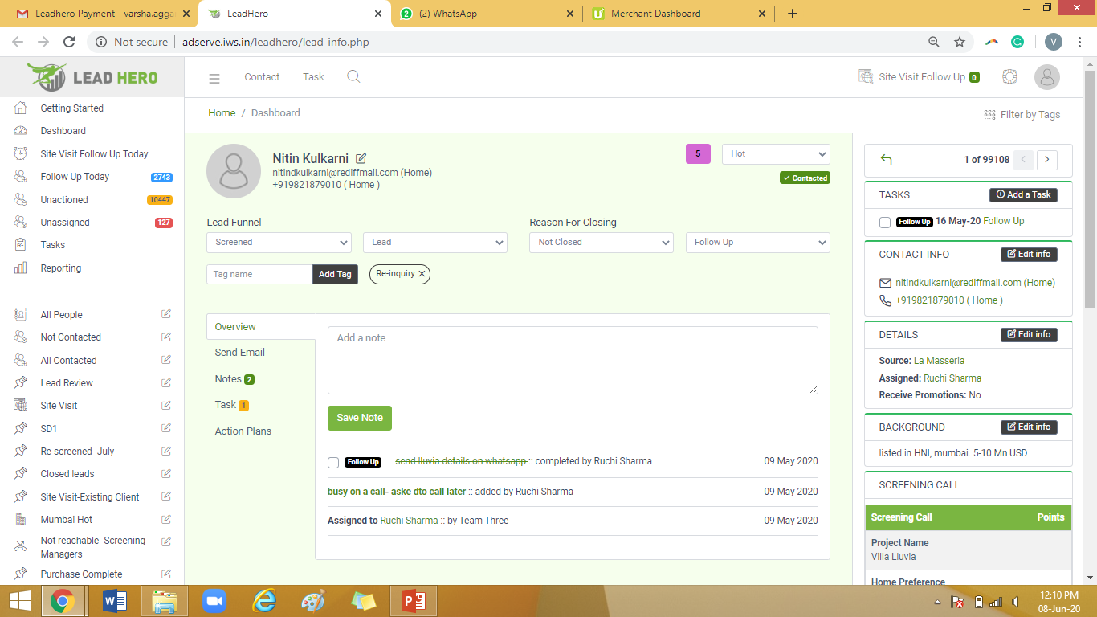
Lead info page: Changes (comparison)

Slide 7
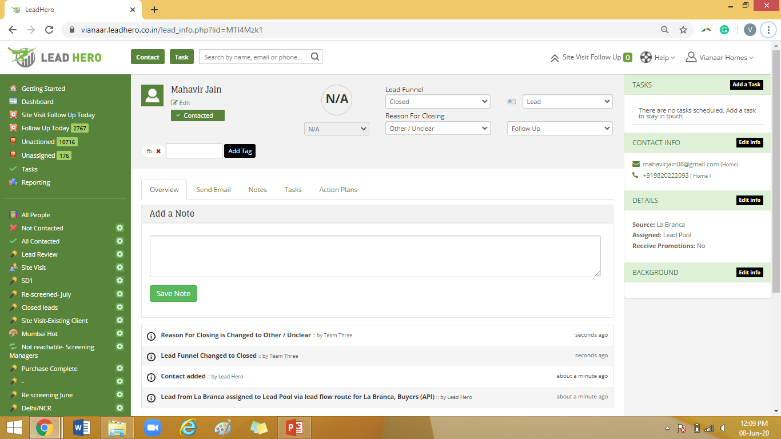
Lead info page: Changes (comparison)

Slide 8
Additions that have to be made into the system
There were also a few updates that we had requested for over our email conversations. Sharing a list of them below, so they do not get missed out:
Currently, when a lead is marked Closed with the reason for closing as Purchase Complete, the lead segment (Hot, Warm or Cold) remains the same. We need the segment to automatically change to Cold once the Purchase Complete option (along with the date of purchase) is filled.
While creating a smart list, currently we have an option to create a list based on the lead's location. Can we also get options to create smart lists for the other details in Screening Call form (budget, home preference, etc.)
Currently, in the list named All People (on the left hand), when we choose a specific lead score (e.g: Hot) from the options on top, it sorts the leads by the lead score (3.50-5) and not by the lead segment. Can we please have this sorted/filtered by the lead segment?
WhatApp API and message templates: We would like to add an option on the system where the users can send WhatsApp messages to the contacts directly from Leadhero. We would also like to add some template messages which the managers can select from, and edit the message before sending it out to the contact. (This function will be similar to the Send Email function we currently have on the system) If the user is accessing the system on Desktop, this function will be redirected on WhatsApp Web, and if it is being accessed on the mobile browser, it will function on the Whatsapp mobile application.
Leadpool access to Sales Managers: Currently, the leads in Lead pool can only be accessed by a Screening Manager's account. We would also like to give this access to the Sales Managers, along with the statistic of leads screened by them.

Slide 9
Additions that have to be made into the system
We wanted to check if we can add attachments to the email templates on Leadhero, in case we want to send our emails with attachments via Action Plans. I did find an option to add images, but unfortunately, it was too confusing to use.
I also noticed that the emails sent via Leadhero mostly end up going to the Spam box of the recipient. We are in the process of asking our team to use Leadhero only to send out emails to clients and this glitch might be a big issue for us once we implement it.
We would also like to add a tab called Closing on the lead_info page, which would get highlighted to green when clicked on. Each lead with this tab active will be added to a smartlist with the same name. The leads can be added or removed from the list by clicking this tab and each manager will have access to their own closing leads, while Sheetal Chadha will have access to all closing leads.
In addition to these points, I would also like to reiterate the points mentioned by me on the email on April 15th:
Currently, when a lead is marked Closed with the reason for closing as Purchase Complete, the lead segment (Hot, Warm or Cold) remains the same. We need the segment to automatically change to Cold once the Purchase Complete option (along with the date of purchase) is filled.
While creating a smart list, currently we have an option to create a list based on the lead's location. Can we also get options to create smart lists for the other details in Screening Call form (budget, home preference, etc.)
Currently, in the list named All People (on the left hand), when we choose a specific lead score (e.g: Hot) from the options on top, it sorts the leads by the lead score (3.50-5) and not by the lead segment. Can we please have this sorted/filtered by the lead segment?
On Leadhero, once a user connects their Leadhero account with Gmail, they get an option to Share Emails with the team. We want to remove this option on the new system and make it compulsory for their email conversations with the client/lead to be shared on Leadhero.

