Slide 1

Title: Virtual Dine Restaurant Ordering Hub
Student Name: Sonu Paswan
Student ID: 2520090204
Cluster:01
Section: 01
Under the Guidance
of
Supervisor Name: K.Rajesh
Assistant Professor
Department of CSE

Slide 2
Abstract
The Virtual Dine Restaurant Ordering Hub is a Java-based application developed to simulate a digital restaurant ordering system while demonstrating the practical implementation of Data Structures and Algorithms (DSA). The system allows users to view menu items, add food to the cart, and place orders efficiently. It integrates core DSA concepts such as linked lists, stacks, queues, and hashing to manage menu data and customer orders effectively.
This project focuses on applying algorithm analysis and abstract data types (ADTs) to build a structured and efficient ordering platform. By combining Java programming with real-world restaurant scenarios, the system helps in understanding how data structures can be used to organize, process, and retrieve information efficiently in practical applications.

Slide 3
Existing System
In traditional restaurant systems:
Customers need to physically visit the restaurant to place orders.
Menu browsing is done manually using printed menus.
There is no digital room selection system.
Food ordering requires waiter interaction.
Order management is not automated.
These limitations make the process slower and less efficient for both customers and restaurant staff.

Slide 4
Proposed System
The Virtual Dine system provides a modern solution for restaurant ordering.
Features include:
Digital room selection system (Couple Room, Family Room, Regular Table).
Multiple cuisine filtering such as Italian, Indian, Chinese, etc.
Dynamic food menu display.
Users can add or remove items from cart.
Automatic total price calculation.
Simple and interactive user interface.
This system improves the user experience and ordering efficiency.

Slide 5
System Architecture
The system follows a client-side web architecture.
Main components:
Frontend Layer
HTML – Structure of the webpage
CSS – Styling and layout design
Application Logic Layer
Java handles:
Room selection
Cuisine filtering
Cart management
Order placement
Data Handling
Food items stored using Java arrays and objects
Cart data stored using Local Storage

Slide 6
Project Modules
The project is divided into the following modules:
1. Room Selection Module
Allows users to select:
Couple Room
Family Room
Regular Table
2. Cuisine Filtering Module
Users can filter food based on cuisine types:
Italian
Indian
Chinese
Mexican
Japanese
Thai
Mediterranean
Indo-Chinese

Slide 7
3. Food Display Module
Displays food cards containing:
Food Image
Food Name
Price
Add to Cart button
4. Cart Management Module
Handles:
Adding items to cart
Removing items from cart
Total price calculation
5. Order Placement Module
Allows users to confirm and place the final order.

Slide 8
Objectives
The main objectives of the project are:
To design a digital restaurant ordering system.
To implement room selection functionality.
To allow users to browse multiple cuisines.
To develop a dynamic food menu interface.
To implement cart management using JavaScript.
To create an interactive and responsive UI.

Slide 9
Co’s Attainments - DSA
CO1 – Basic Data Structures
Understand the concepts of basic data structures such as arrays, linked lists, stacks, and queues and their applications in solving problems.
CO2 – Algorithm Design
Develop algorithms to solve computational problems and understand the step-by-step procedure for problem solving.
CO3 – Complexity Analysis
Analyze the time complexity and space complexity of algorithms using Big-O notation to determine efficiency.
CO4 – Implementation of Data Structures
Implement various data structures such as stacks, queues, and linked lists and perform operations like insertion, deletion, and traversal.
CO5 – Sorting and Searching Techniques
Apply different sorting algorithms (Bubble Sort, Selection Sort, Insertion Sort) and searching techniques (Linear Search, Binary Search) for efficient data processing.
CO6 – Problem Solving Using Data Structures
Apply suitable data structures and algorithms to solve real-world problems effectively and optimize program performance.

Slide 10
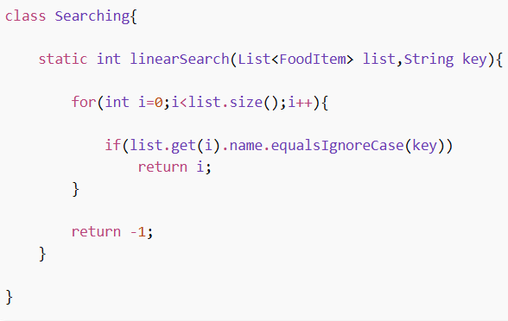
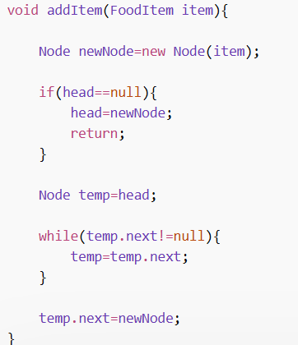
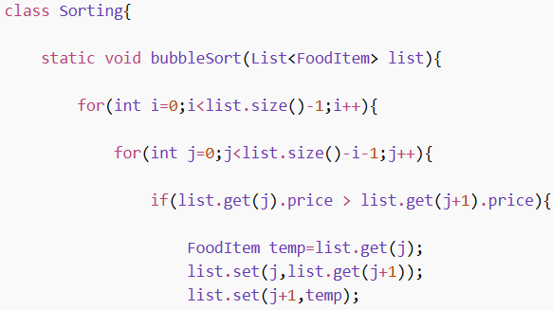
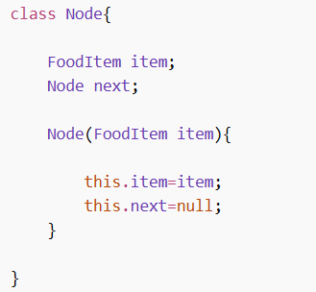
Screenshots for DSA co-1 co-2

Slide 11
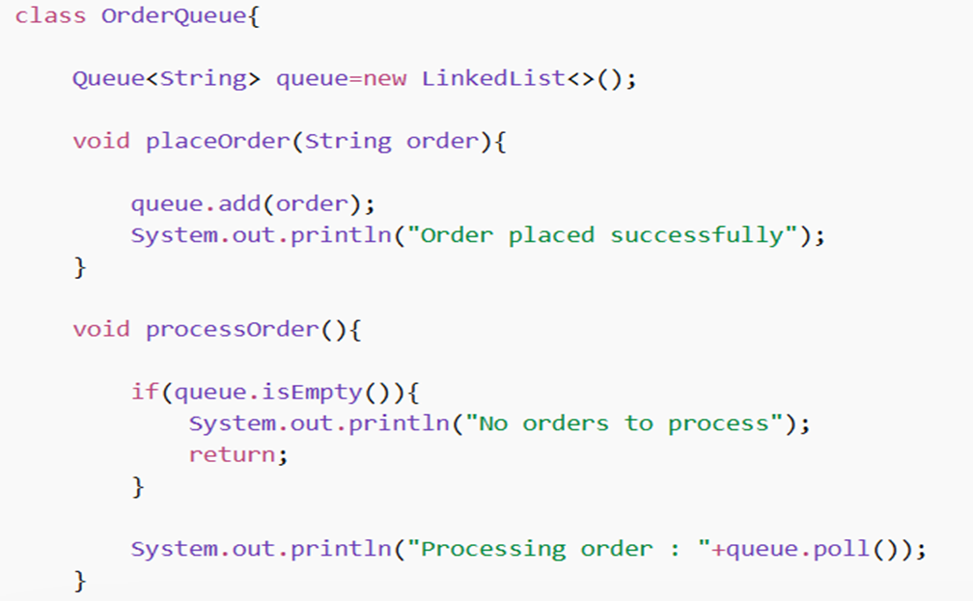
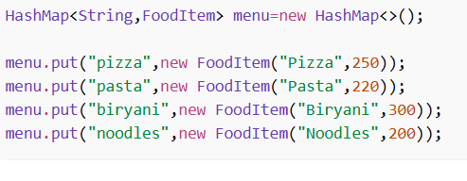
CO-3 CO-4

Slide 12
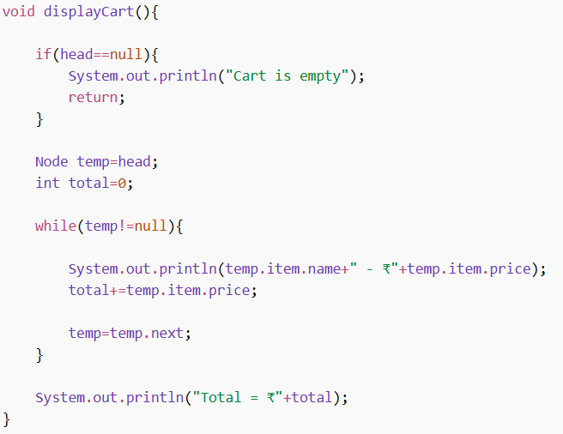
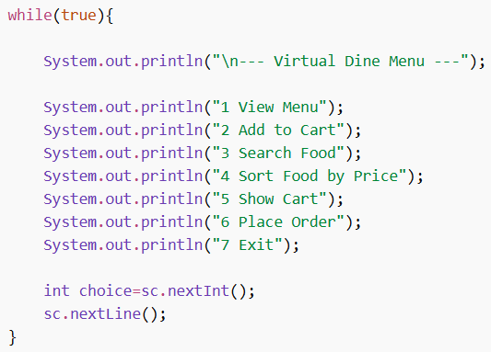
CO-5 CO-6

Slide 13
Conclusion
Virtual Dine provides a modern restaurant ordering solution using web technologies.
Key achievements of the project:
Interactive and user-friendly interface.
Dynamic food menu system.
Real-time cart management.
Room selection feature.
Efficient order placement process.
The project demonstrates practical knowledge of HTML, CSS, Java, DOM manipulation, and frontend development concepts.

Slide 14
THANK YOU

