Slide 1
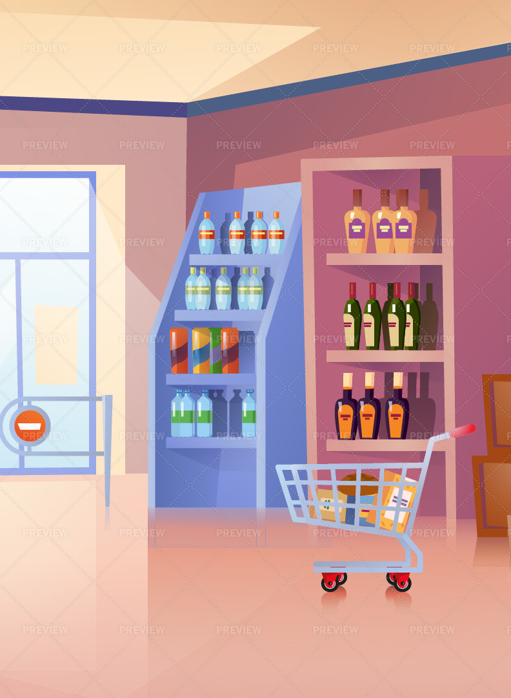
FROM GROCERIES TO GROWTH: A Data-Driven Story of Loyalty, Retention, and Growth
A Master’s Project by Manideep Racharla
Instructor: Dr. Ravindranath Arunasalam
03 Dec 2024

Slide 2
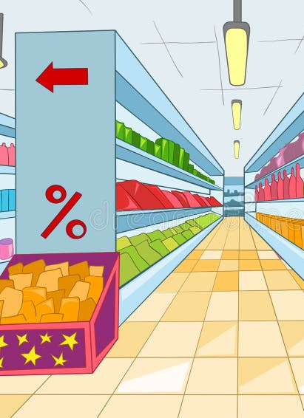
Introduction
Context:
• Small grocery stores face competition from supermarkets and online platforms.
• Customer retention and personalized marketing are crucial for survival.
Motivation:
• Growing up in a family running a small grocery store, I saw the challenges firsthand.
• This inspired me to explore affordable, data-driven solutions for customer engagement.

Slide 3
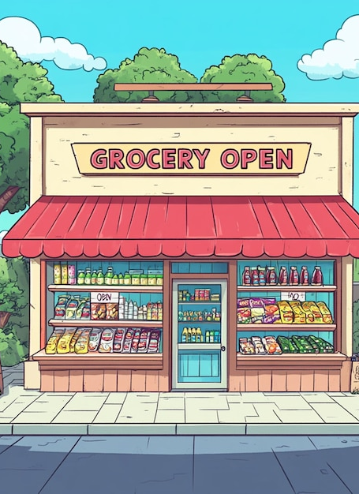
Research Questions
1. How can customer segmentation improve targeted marketing?
2. How can churn (Risk of losing a customer) prediction help small grocery stores?
3. How can RFM(Recency, Frequency, Monetary) analysis be used to segment customers?
4. How accurately can machine learning models predict churn?
5. What insights can be derived from clustering, and how can they improve marketing strategies?

Slide 4

Keywords
• Customer Segmentation
• Targeted Marketing
• Churn Prediction
• RFM (Recency, Frequency, Monetary) Analysis
• K-Means Clustering
• Machine Learning
• Small Grocery Stores
• Home Delivery

Slide 5
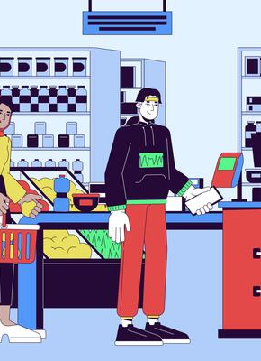
Methodology
Data Used:
• 541,909 transactional entries (CustomerID, InvoiceDate, Stockcode,Quantity, UnitPrice, etc.).
Techniques:
• RFM Analysis: To quantify customer behavior.
• K-Means Clustering: To group customers into distinct segments.
• Churn Prediction Models: Logistic Regression, Random Forest, and Gradient Boosting.
Churn =0- Minimal risk of losing the customer.
Churn =1- Potential risk of losing the customer.
Steps:
• Data cleaning and preparation.
• RFM score computation.
• Clustering and churn modeling.

Slide 6
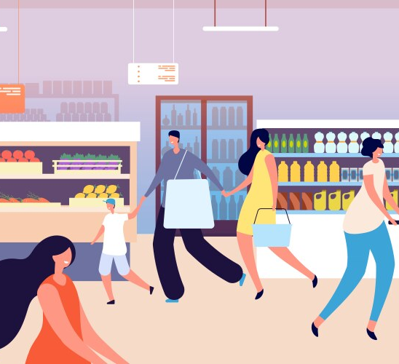
Results & Analysis
RFM Insights:
• Loyal customers had low Recency and high Frequency/Monetary values.
• Disengaged customers had high Recency, requiring re-engagement.
Clustering:
• Four clusters identified (0-Loyal, 1- Moderate,
2-Occasional, and 3-At-Risk customers).
• Silhouette Score: 0.601.

Slide 7
Churn Prediction:
• All models achieved 100% accuracy.
• Recency was the most critical feature for predicting churn.
CustomerID | Recency | Frequency | Monetary | Churn
12347.0 | 1 | 182 | 4310.00 | 0
12348.0 | 74 | 27 | 1595.64 | 0
12349.0 | 18 | 72 | 1457.55 | 0
12350.0 | 309 | 17 | 334.40 | 1
12352.0 | 35 | 89 | 1545.41 | 0

Slide 8
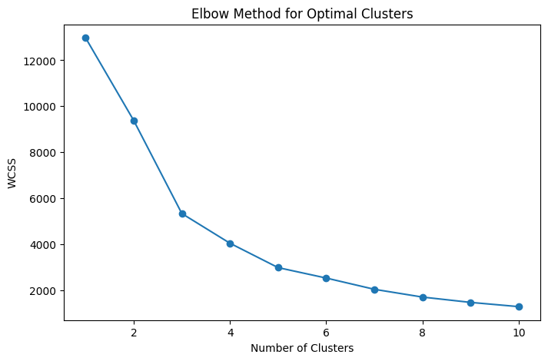
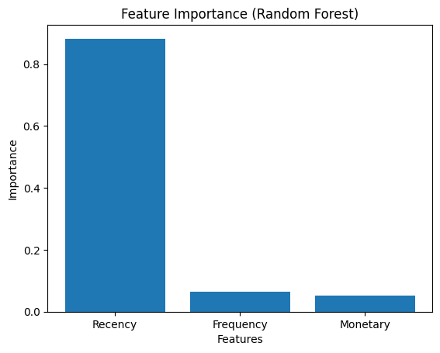
Visuals
Elbow Method graph for determining the number of clusters.
(b) Feature Importance chart (Random Forest model).
(a)
(b)

Slide 9
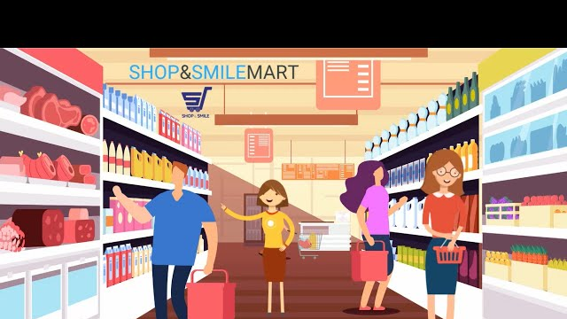
Impacts
Actionable Segmentation:
• Targeted strategies for loyalty programs (Cluster 0).
• Re-engagement campaigns for at-risk customers (Cluster 3).
Churn Prediction:
• Enabled early identification of disengaged customers.
Marketing Optimization:
• Enhanced efficiency in resource allocation.

Slide 10
Recommendations
• Implement RFM-based segmentation for personalized campaigns.
• Focus on loyalty programs for high-value customers.
• Use churn prediction to guide re-engagement strategies.
• Integrate demographic data to refine customer insights.
• Apply real-time analytics for dynamic segmentation.

Slide 11
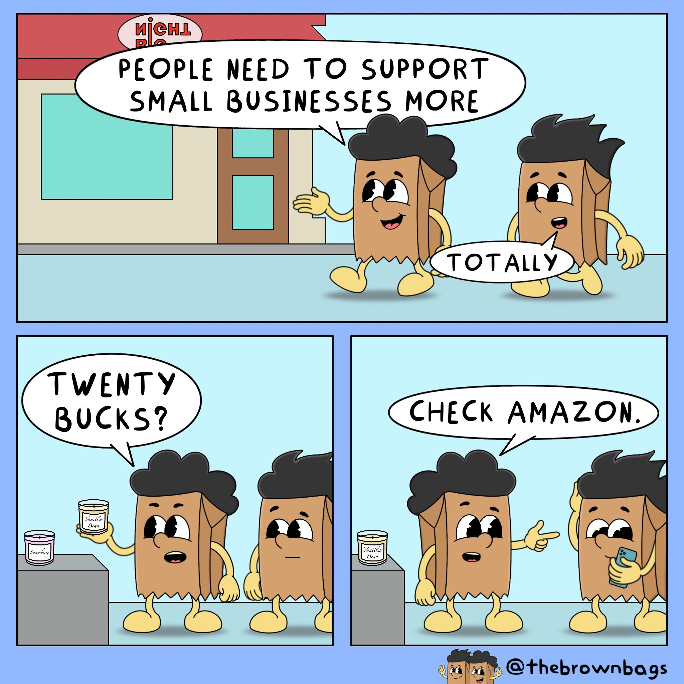
Limitations
Data Constraints:
• Transactional data only; demographic or behavioral data was not included.
Scalability:
• Findings are specific to a single grocery store context.
Generalizability:
• Results may vary for other geographic locations or larger datasets.

Slide 12
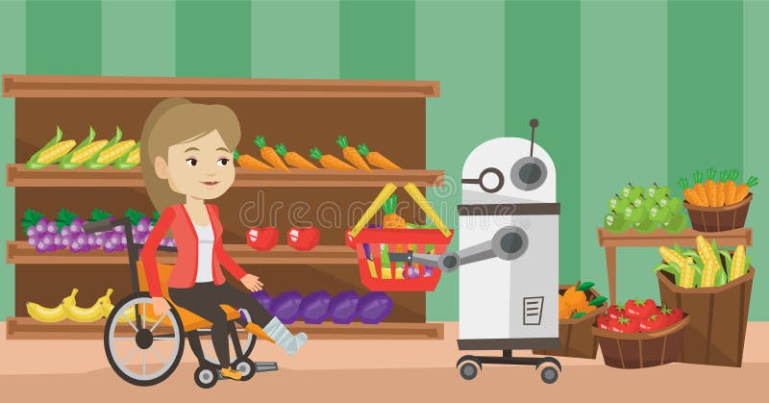
Future Work
Integration of Real-Time Analytics:
• Update RFM metrics dynamically for responsive marketing.
Scaling:
• Test on larger datasets and multi-store environments.
Incorporating Additional Data:
• Demographics, purchase preferences, and seasonal trends.
Recommendation Systems:
• Build personalized product recommendations for customers.

Slide 13

Acknowledgments
• I am Grateful to Dr. Ravindranath Arunasalam for his invaluable guidance and support.
• Thankful to my peers and colleagues at Saint Louis University for their constructive feedback.
• Special thanks to my parents for their hard work and dedication in running our family grocery store, which inspired this research.

Slide 14


