Slide 1
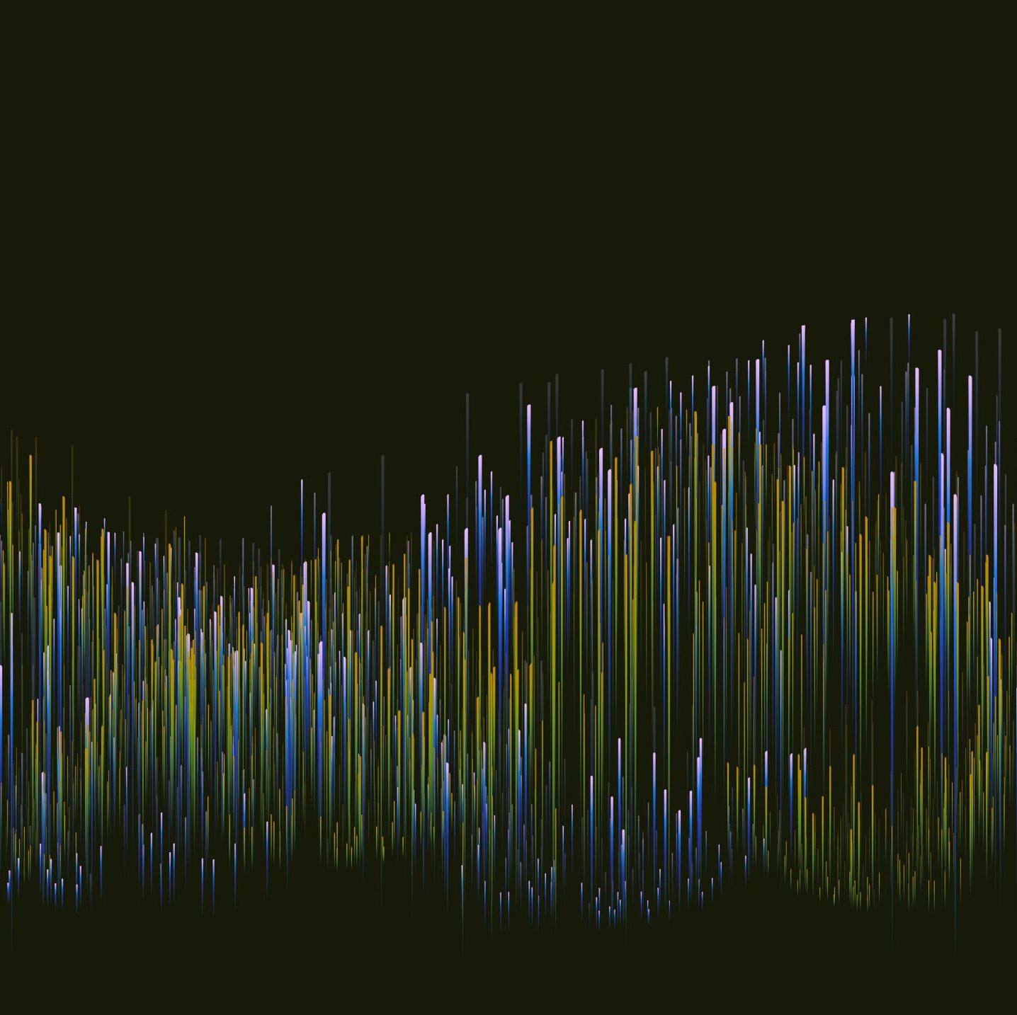

ANALYSIS OF NEURONAL INTERACTIONS USING INFORMATION- THEORETICAL MODELS
Onur Doğan
in collaboration with Deniz Gencaga and Sevgi Şengül Ayan
Antalya Bilim University, Department Of Computer Engineering
ICFAS21

Slide 2
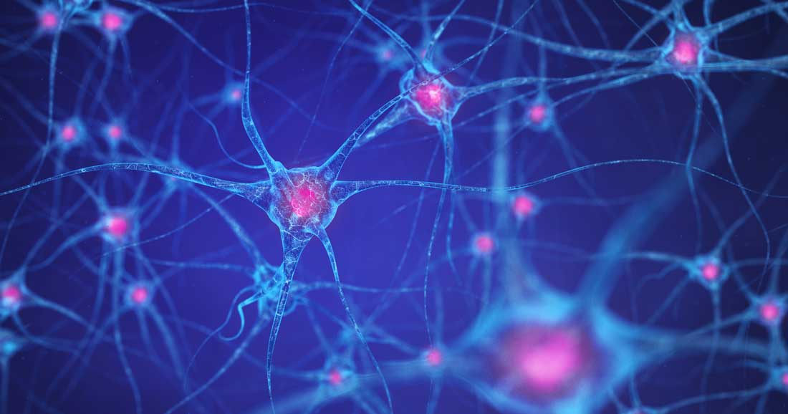
EXCITABLE CELLS AND NEURONS
Example: Nerve cells, muscle cells, heart cells and secretary cells such as pituitary cell, pancreatic beta cells.
The signals circulating neurons forms the basis of memories, thoughts and emotions.

Slide 3
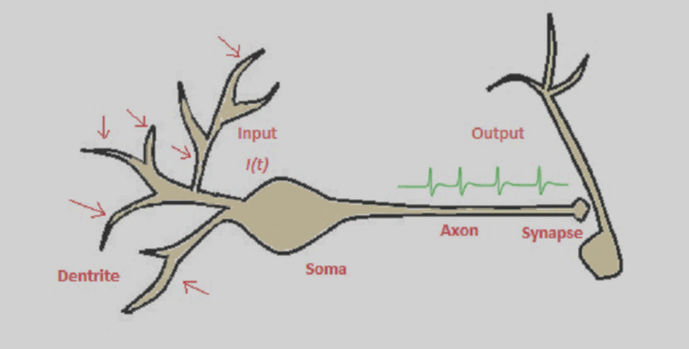
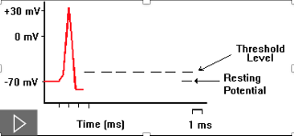
NEURON ACTION POTENTIAL
Neurons sends messages electrochemically. It means that chemical cause an electrical signal.

Slide 4
Modelling action potentıal ın neurons

Slide 5
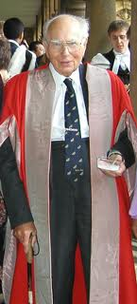
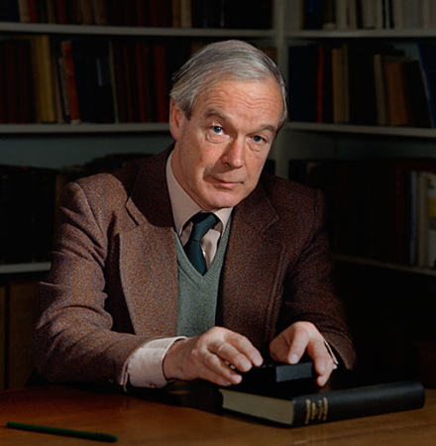
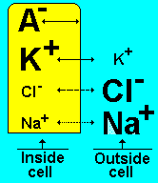
HODGKIN HUXLEY MODEL
Alan Hodgkin and Andrew Huxley conducted experiment to understand the movement of ions in a nerve cell during an action potential

Slide 6
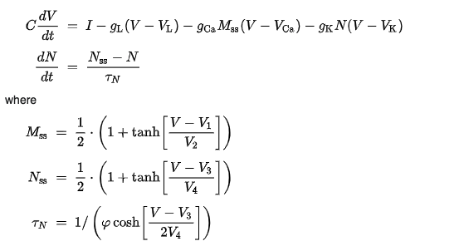
MORRIS LECAR MODEL
The Morris–Lecar neuron model is a 2-D nonlinear differential system.
In comparison to the four-dimensional Hodgkin–Huxley model, it is considered a simpler model.
I : applied current
C : membrane capacitance
gL, gCa, gK : leak, Ca++, and K+ conductances through membranes channel
VL, VCa, VK : equilibrium potential of relevant ion channels
V1, V2, V3, V4: tuning parameters for steady state and time constant
φ: reference frequency

Slide 7

HINDMARSH ROSE MODEL
This is non-conductance model
In experiments, Hindmarsh and Rose observed Spiking behaviour of the membrane potential
Membrane potential: Electic potential between the interior and the exterior of a biological cell.
x(t)=Membrane potential
y(t)=Spiking variable
z(t)=Adaption current

Slide 8
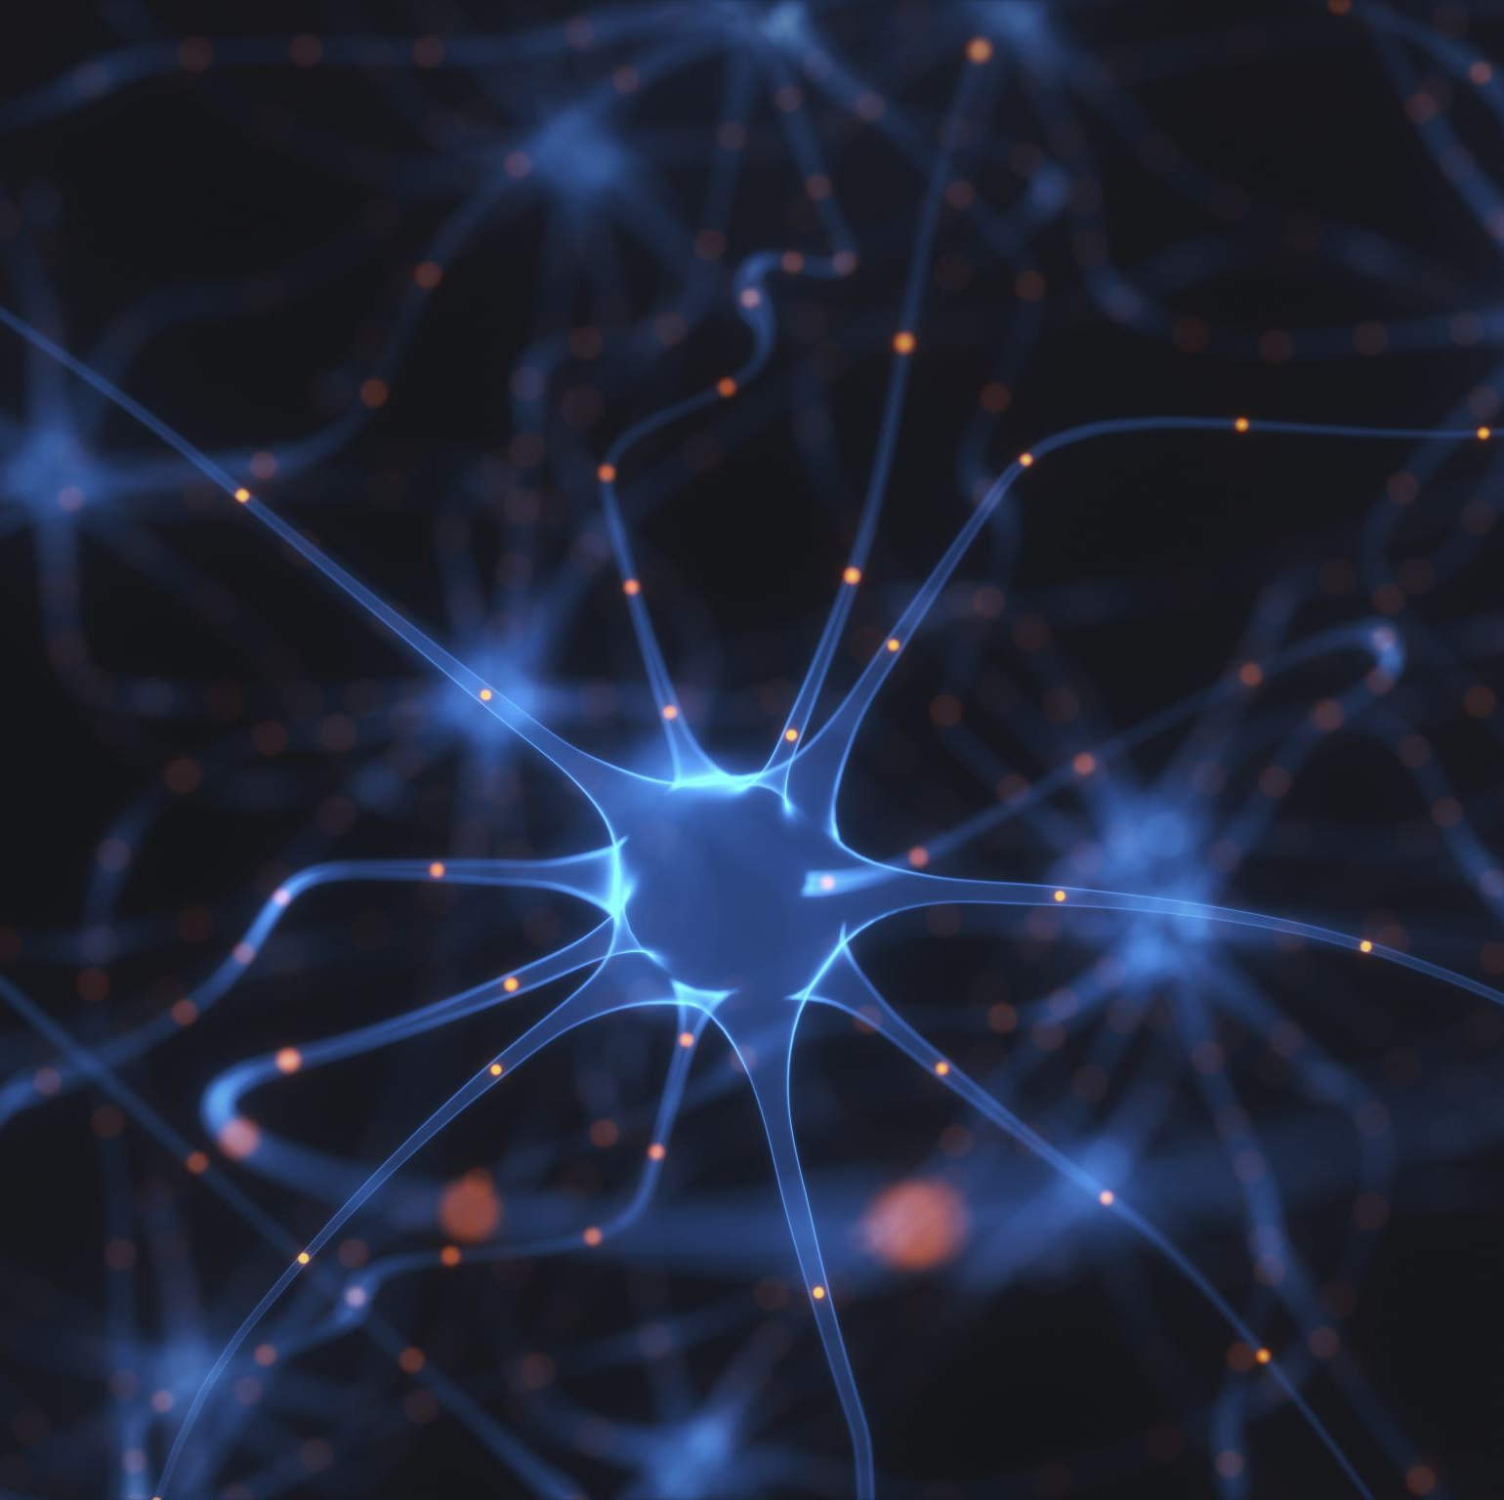
Understand and analyze interaction betwEen neurons will GIVE better understanding how brain works We apply information-theoretic methods to analyze such effects
Which neurons are related?
What is the direction of the information flow (causal interactions)?

Slide 9
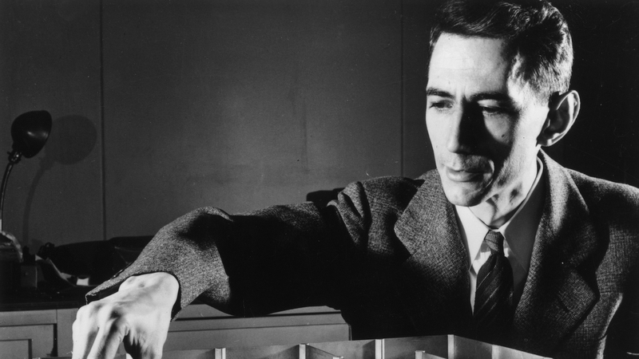

INFORMATION THEORY
Entropy: Fundamental information theoretical quantity to describe the average uncertainty of a system.
Claude Shannon
$$H\left(X\right)=−\sum_{x∈X}{\left.p\left(x\right)\log\left(p\left(x\right)\right)\right)}$$
where H denotes the entropy of a random variable “X” and p(x) represents its probability density function (pdf).
INFORMATION is reduction in uncertainty

Slide 10
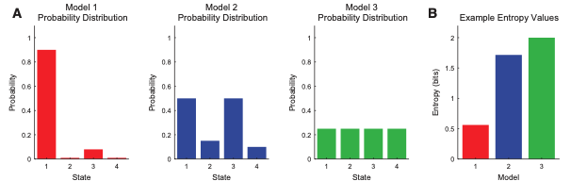
Systems with varied distribution , the entropy is lower
Systems with uniform distributions, the entropy is higher
Timme, Nicholas & Lapish, Christopher. (2018). A Tutorial for Information Theory in Neuroscience. eneuro. 5. ENEURO.0052-18.2018. 10.1523/ENEURO.0052-18.2018.

Slide 11
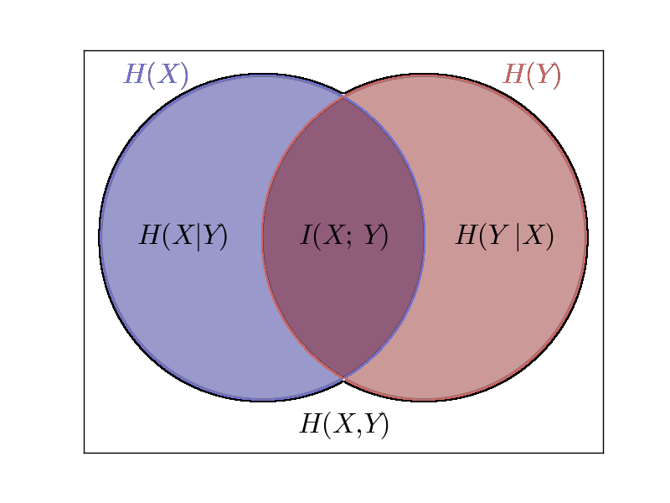


MUTUAL INFORMATION (MI)
Conditional Entropy which quantifies the uncertainty in a variable given the state of another variable.
MI (I(X;Y)):
We can quantity reduction in uncertainty so we can quantity information

Slide 12
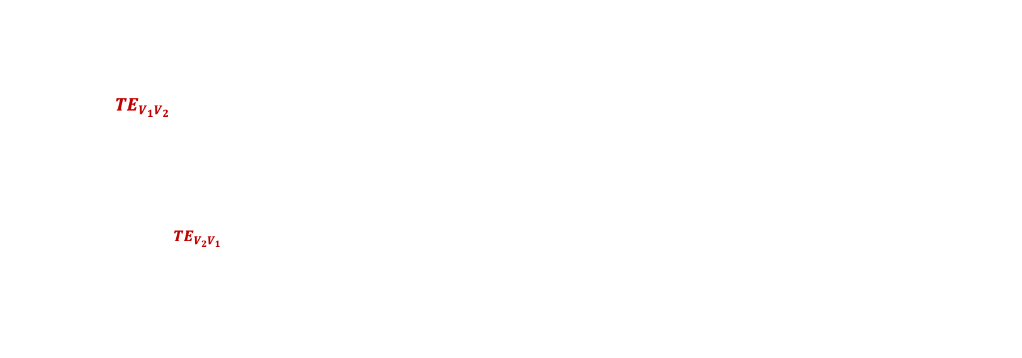
TRANSFER ENTROPY(TE)
To identify the direction of information flow from one variable to another, we use Transfer Entropy which is capable of detecting the direction.
Information Flow: Information we learn from the past state of one variable about the current state of the other
The TE in two directions are calculated from data by using the following equations
$${TE}_{V_{1}V_{2}}=T\left({V_{2}}_{\left(i+1\right)} | {V_{2}}_{\left(i\right)}^{\left(k\right)},{V_{1}}_{\left(i\right)}^{\left(l\right)}\right)=\sum_{{v_{2}}_{\left(i+1\right)},{v_{2}}_{\left(i\right)}^{\left(k\right)},{v_{1}}_{\left(i\right)}^{\left(l\right)}}{p\left({v_{2}}_{\left(i+1\right)},{v_{2}}_{\left(i\right)}^{\left(k\right)},{v_{1}}_{\left(i\right)}^{\left(l\right)}\right)\log_{2}\frac{p\left({v_{2}}_{\left(i+1\right)}|{v_{2}}_{\left(i\right)}^{\left(k\right)},{v_{1}}_{\left(i\right)}^{\left(l\right)}\right)}{p\left({v_{2}}_{\left(i+1\right)}|{v_{2}}_{\left(i\right)}^{\left(k\right)}\right)}},$$
$${TE}_{V_{2}V_{1}}=T\left({V_{1}}_{\left(i+1\right)} | {V_{1}}_{\left(i\right)}^{\left(k\right)},{V_{2}}_{\left(i\right)}^{\left(l\right)}\right)=\sum_{{v_{1}}_{\left(i+1\right)},{v_{1}}_{\left(i\right)}^{\left(k\right)},{v_{2}}_{\left(i\right)}^{\left(l\right)}}{p\left({v_{1}}_{\left(i+1\right)},{v_{1}}_{\left(i\right)}^{\left(k\right)},{v_{2}}_{\left(i\right)}^{\left(l\right)}\right)\log_{2}\frac{p\left({v_{1}}_{\left(i+1\right)}|{v_{1}}_{\left(i\right)}^{\left(k\right)},{v_{2}}_{\left(i\right)}^{\left(l\right)}\right)}{p\left({v_{1}}_{\left(i+1\right)}|{v_{1}}_{\left(i\right)}^{\left(k\right)}\right)},}$$
Gencaga, Deniz & Sengul Ayan, Sevgi & Farnoudkia, Hajar & Okuyucu, Serdar. (2020). Statistical Approaches for the Analysis of Dependency Among Neurons Under Noise. Entropy. 22. 387. 10.3390/e22040387.

Slide 13

$${TE}_{V_{1}V_{2}}=T\left({V_{2}}_{\left(i+1\right)} | {V_{2}}_{\left(i\right)}^{\left(k\right)},{V_{1}}_{\left(i\right)}^{\left(l\right)}\right)=\sum_{{v_{2}}_{\left(i+1\right)},{v_{2}}_{\left(i\right)}^{\left(k\right)},{v_{1}}_{\left(i\right)}^{\left(l\right)}}{p\left({v_{2}}_{\left(i+1\right)},{v_{2}}_{\left(i\right)}^{\left(k\right)},{v_{1}}_{\left(i\right)}^{\left(l\right)}\right)\log_{2}\frac{p\left({v_{2}}_{\left(i+1\right)}|{v_{2}}_{\left(i\right)}^{\left(k\right)},{v_{1}}_{\left(i\right)}^{\left(l\right)}\right)}{p\left({v_{2}}_{\left(i+1\right)}|{v_{2}}_{\left(i\right)}^{\left(k\right)}\right)}},$$
$${TE}_{V_{2}V_{1}}=T\left({V_{1}}_{\left(i+1\right)} | {V_{1}}_{\left(i\right)}^{\left(k\right)},{V_{2}}_{\left(i\right)}^{\left(l\right)}\right)=\sum_{{v_{1}}_{\left(i+1\right)},{v_{1}}_{\left(i\right)}^{\left(k\right)},{v_{2}}_{\left(i\right)}^{\left(l\right)}}{p\left({v_{1}}_{\left(i+1\right)},{v_{1}}_{\left(i\right)}^{\left(k\right)},{v_{2}}_{\left(i\right)}^{\left(l\right)}\right)\log_{2}\frac{p\left({v_{1}}_{\left(i+1\right)}|{v_{1}}_{\left(i\right)}^{\left(k\right)},{v_{2}}_{\left(i\right)}^{\left(l\right)}\right)}{p\left({v_{1}}_{\left(i+1\right)}|{v_{1}}_{\left(i\right)}^{\left(k\right)}\right)},}$$
$${v_{1}}_{\left(i+1\right)}^{\left(k\right)}=\left\{{v_{1}}_{(i)},v_{1(i−1)}…,{v_{1}}_{(i−k)}\right\}$$
$${v_{2}}_{\left(i+1\right)}^{\left(l\right)}=\left\{{v_{2}}_{(i)},v_{2(i−1)}…,{v_{2}}_{(i−l)}\right\}$$
Gencaga, Deniz & Sengul Ayan, Sevgi & Farnoudkia, Hajar & Okuyucu, Serdar. (2020). Statistical Approaches for the Analysis of Dependency Among Neurons Under Noise. Entropy. 22. 387. 10.3390/e22040387.

Slide 14
NetTE
The NetTE allows us to compare the relative values of information flow in both directions giving a sense of main interaction direction between the two variables X and Y.

Slide 15
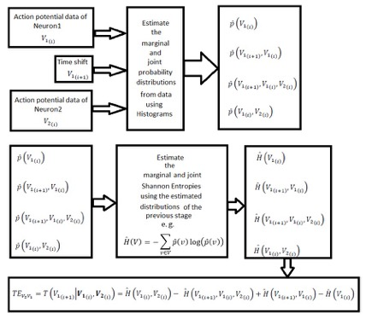


Estimation Of TE From Data
$H\left({V_{1}}_{(i)},{V_{2}}_{(i)}\right),H\left({V_{1}}_{(i+1)},{V_{1}}_{(i)},{V_{2}}_{(i)}\right),H\left({V_{1}}_{(i+1)},{V_{1}}_{(i)}\right), H\left({V_{1}}_{(i)}\right)$.
Finally, TE from $V_{2}{ to V}_{1}$is computed

Slide 16
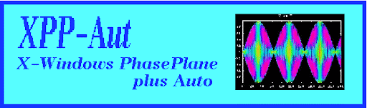
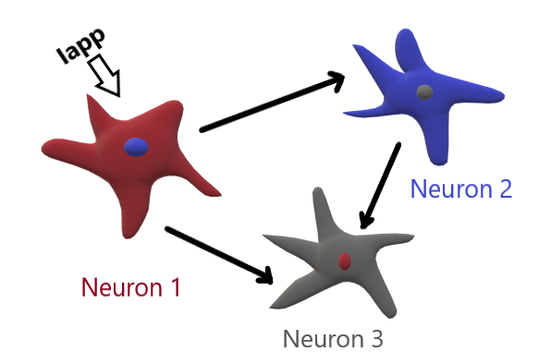
SIMULATIONS
Coupling For All 3 Neuron Model

Slide 17
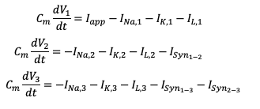

HH Model Simulation
$I_{Syn_{i−j}}=k_{x}(V_{i}−V_{j})$ is the synaptic current defined from pre-synaptic neuron i to post-synaptic neuron j.
TE RESULT:
NETTE RESULT:
n1
n1
0.9105
1.3747
0.6982
1.2217
0.2123
0.1530
n2
n3
n2
n3
1.5023
0.7106
0.7917
n1:Neuron1 n2:Neuron2 n3:Neuron3

Slide 18
ML 3 Neuron Model Simulation
TE RESULT:
NETTE RESULT:
n1
n1
0.3810
0.4628
0.5792
0.4424
0.0018
0.0204
n2
n3
n2
n3
0.4207
0.2103
0.2104
n1:Neuron1 n2:Neuron2 n3:Neuron3

Slide 19
ML 2 Neuron Model Simulation
Model Simulation Copuling:
TE RESULT:
n1
n2
n1
-0.0048
n2
0.3296
NETTE RESULT:
n1
n2
0.3344
n1:Neuron1 n2:Neuron2

Slide 20
HR 3 Neuron Model Simulation
TE RESULT:
NETTE RESULT:
n1
n1
0.6304
0.6149
0.0152
0.2198
0.6152
0.3951
n2
n3
n2
n3
0.6576
0.2484
0.4092
n1:Neuron1 n2:Neuron2 n3:Neuron3

Slide 21
HR 2 Neuron Model Simulation
Model Simulation Copuling:
TE RESULT:
n1
n2
n1
0.4865
n2
0.6401
NETTE RESULT:
n1
n2
0.1536
n1:Neuron1 n2:Neuron2

Slide 22
Summary
Neuronal interactions were analyzed by information-theoretic methods
Different neural interaction models have been considered
Cause and effect between neurons have been analyzed using these models
Successful interaction modelling for each case

Slide 23
Thank You

Slide 24
Acknowledgment
We would like to thank Joseph Lizier for JIDT
This research is funded by the Scientific and Technological Research Council of Turkey (TUBITAK) with project number 118E765

Slide 25

RESEARCH TEAM
Deniz Gencaga
Sevgi Şengül Ayan
Onur Doğan

