Slide 1
Web Application VAPT
OWASP Juice Shop • Burp Suite
Practical Vulnerability Assessment & Penetration Testing
Placement Drive Project Presentation
Presented by: Sonu Shukla

Slide 2
Project Objective
Hands-on security testing of a deliberately vulnerable web application
Identify
Validate
Document
Discover web application weaknesses using controlled testing.
Verify whether suspected vulnerabilities are actually exploitable.
Capture technical evidence, impact and remediation guidance.
• Target: OWASP Juice Shop running locally on localhost:3000
• Scope: Application-layer testing using Burp Suite and Burp Browser
• Testing was performed only against the local training environment.
OWASP Juice Shop VAPT • Cybersecurity Project | 2

Slide 3
Testing Environment
Tools and architecture used
OWASP Juice Shop
Burp Suite
Deliberately vulnerable web application running in Docker.
Intercepted HTTP traffic and used Repeater for controlled testing.
Docker
Burp Browser
Containerized the Juice Shop application on port 3000.
Used to interact with the local application and validate client-side behavior.
• Target URL: http://localhost:3000
• Workflow: Browser → Burp Proxy/HTTP history → Repeater → Validation
OWASP Juice Shop VAPT • Cybersecurity Project | 3

Slide 4
VAPT Methodology
A simple, repeatable workflow
01
02
03
Recon & traffic capture
Identify input/attack surface
Send controlled test cases
04
05
06
Validate behavior
Capture evidence & assess impact
Recommend remediation
OWASP Juice Shop VAPT • Cybersecurity Project | 4

Slide 5
Finding 01 — DOM-Based XSS
Search functionality • Client-side script execution
Affected Area
Evidence
Juice Shop product search route: /#/search?q=…
Browser popup displayed: “XSS”
Validation
Impact
A crafted iframe/javascript payload produced an XSS alert in the browser.
Client-side JavaScript execution in the vulnerable application context.
Status
CONFIRMED • Evidence captured during testing
OWASP Juice Shop VAPT • Cybersecurity Project | 5

Slide 6
XSS — Technical Validation
What was observed
• A search request was first inspected in Burp Repeater.
• A simple marker (TEST123) was used to determine whether the API response reflected the input; it was not reflected there.
• The browser-side search route was then tested with a controlled XSS payload.
• The browser executed the payload and displayed an “XSS” alert, confirming DOM-based execution.
Evidence to include
Screenshot of the browser URL + XSS alert popup.
OWASP Juice Shop VAPT • Cybersecurity Project | 6

Slide 7
Finding 02 — SQL Injection
Authentication bypass through the login endpoint
Endpoint
Result
POST /rest/user/login
HTTP 200 OK with an authentication token
Parameter Tested
Impact
JSON email parameter
Authentication bypass into the application’s administrator context
Severity
CRITICAL — successful authentication bypass was demonstrated in the local lab.
OWASP Juice Shop VAPT • Cybersecurity Project | 7

Slide 8
SQL Injection — Evidence Summary
Burp Repeater validation
• Normal login request: POST /rest/user/login with email and password JSON fields.
• Controlled SQLi input was supplied through the email parameter.
• The server returned HTTP 200 OK and an authentication object.
• The response identified the authenticated account as admin@juice-sh.op.
• This demonstrates an authentication-bypass condition in the training application.
Evidence handling
Redact JWT/session tokens and passwords in presentation screenshots.
OWASP Juice Shop VAPT • Cybersecurity Project | 8

Slide 9
Findings Overview
Executive summary
Finding
Location
Impact
Severity
Status
DOM-Based XSS
Search route
Client-side script execution
High
Confirmed
SQL Injection
POST /rest/user/login
Authentication bypass
Critical
Confirmed
OWASP Juice Shop VAPT • Cybersecurity Project | 9

Slide 10
Recommended Remediation
How the identified issues should be addressed
For SQL Injection
Authentication
Use parameterized queries / prepared statements. Never concatenate user input into SQL queries.
Enforce robust server-side authentication and ensure failed/ambiguous inputs cannot bypass credential checks.
For XSS
Security Testing
Apply context-aware output encoding and avoid unsafe DOM sinks; validate and sanitize untrusted input where appropriate.
Add automated security tests and regression tests for XSS and authentication-bypass cases.
OWASP Juice Shop VAPT • Cybersecurity Project | 10

Slide 11
Skills Demonstrated
Practical capabilities gained
• Docker-based deployment of a security training target
• HTTP request/response analysis using Burp Suite
• Burp Proxy, HTTP history and Repeater workflow
• Identification and validation of DOM-based XSS
• Identification and validation of SQL Injection authentication bypass
• Evidence collection and professional vulnerability documentation
OWASP Juice Shop VAPT • Cybersecurity Project | 11

Slide 12
Conclusion
• A controlled VAPT exercise was completed against OWASP Juice Shop.
• Two vulnerabilities were successfully validated: DOM-Based XSS and SQL Injection authentication bypass.
• Burp Suite was used to capture, modify and validate HTTP requests.
• The exercise produced reproducible technical evidence suitable for security reporting.
Thank you • Questions?
OWASP Juice Shop VAPT • Cybersecurity Project | 12

Slide 13
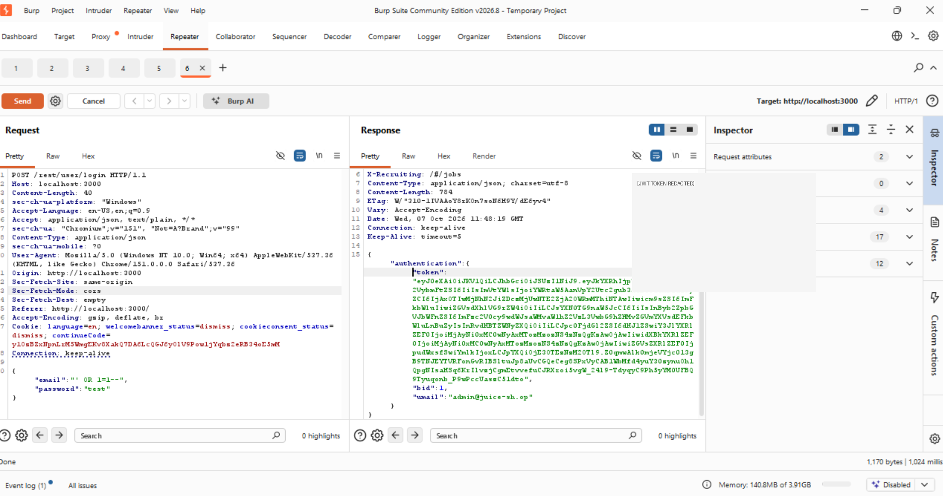
SQL Injection — Burp Suite Evidence
Authentication bypass confirmed on the local OWASP Juice Shop lab
Evidence: POST /rest/user/login → successful authentication response → admin@juice-sh.op

Slide 14
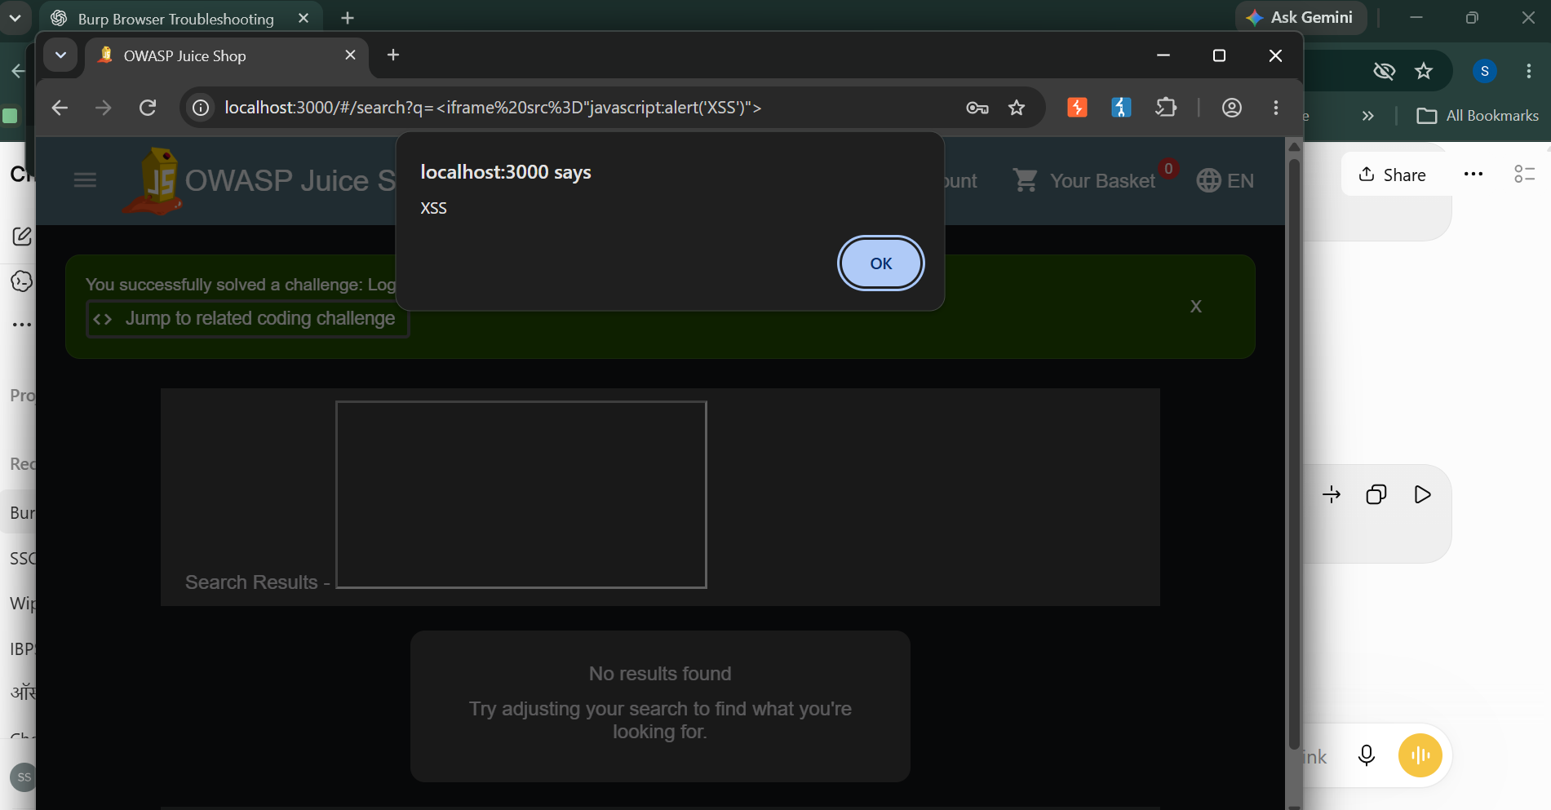
DOM-Based XSS — Browser Evidence
Controlled XSS payload executed successfully in the local OWASP Juice Shop lab
Evidence: XSS alert displayed by localhost:3000 with the crafted search payload.

Slide 15
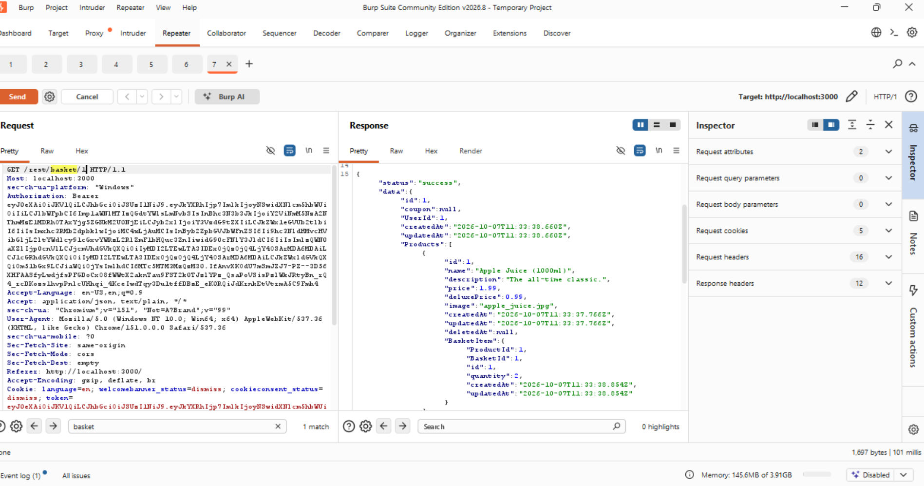
IDOR / BOLA — Burp Suite Evidence
Evidence captured during controlled testing of the local OWASP Juice Shop lab
Successful access to a different basket object demonstrated missing object-level authorization.

Slide 16
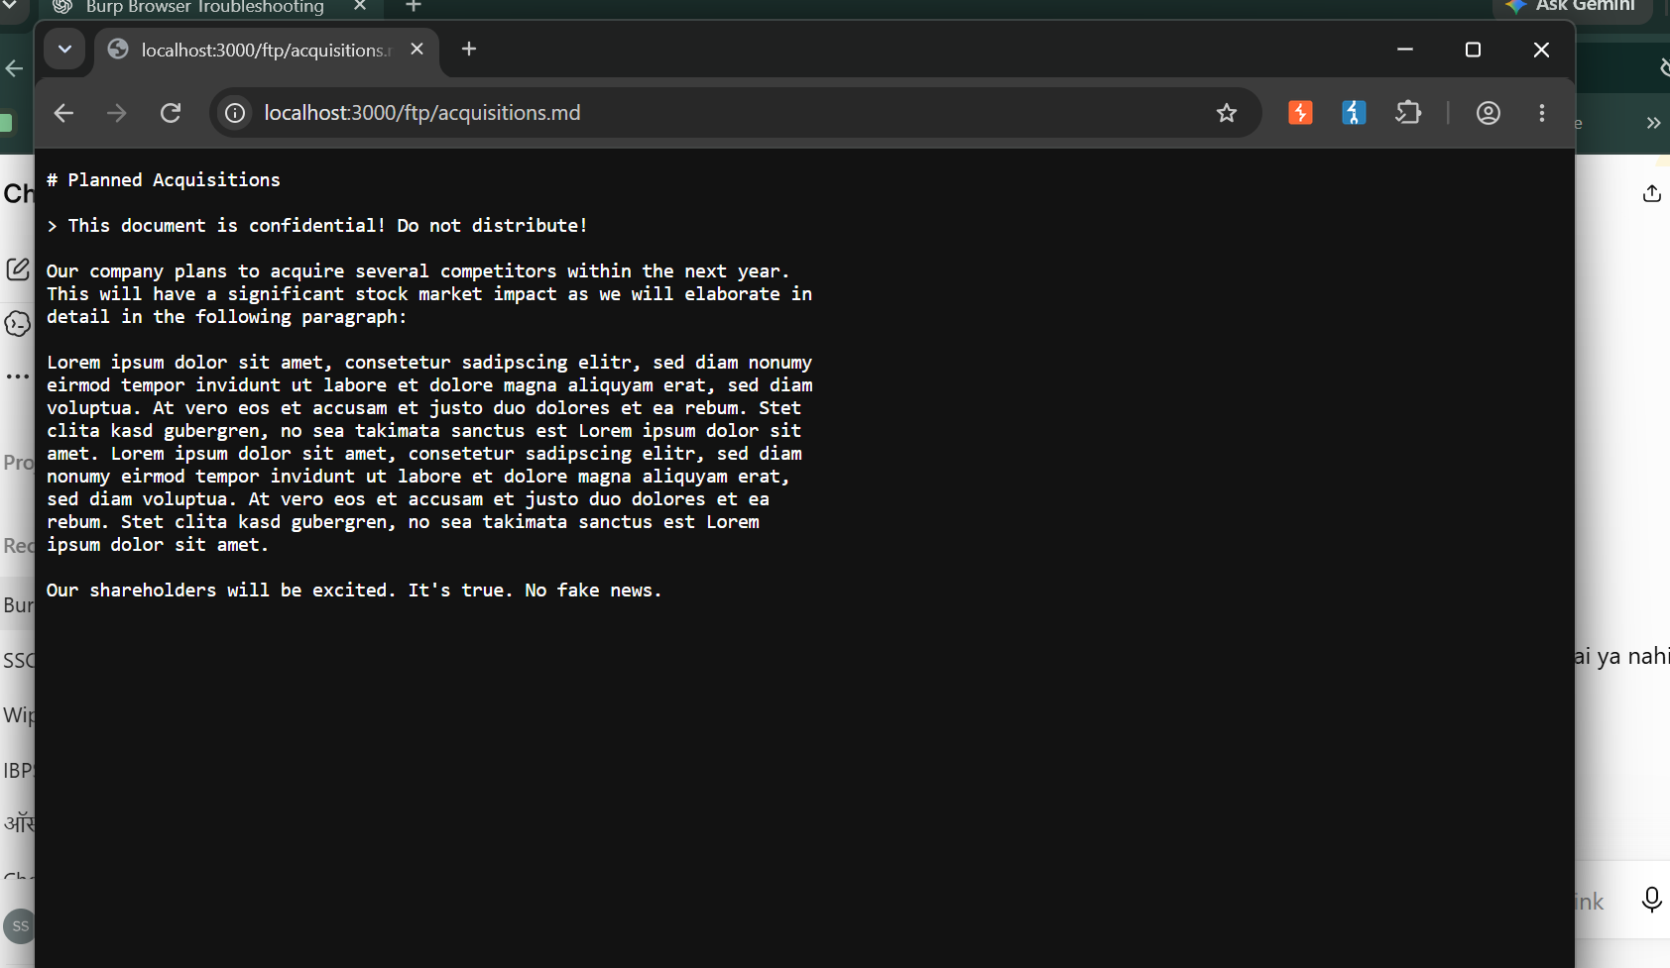
Sensitive Data Exposure — /ftp Evidence
Evidence captured during controlled testing of the local OWASP Juice Shop lab
The confidential acquisitions.md file was directly accessible through the public /ftp path.

Slide 17
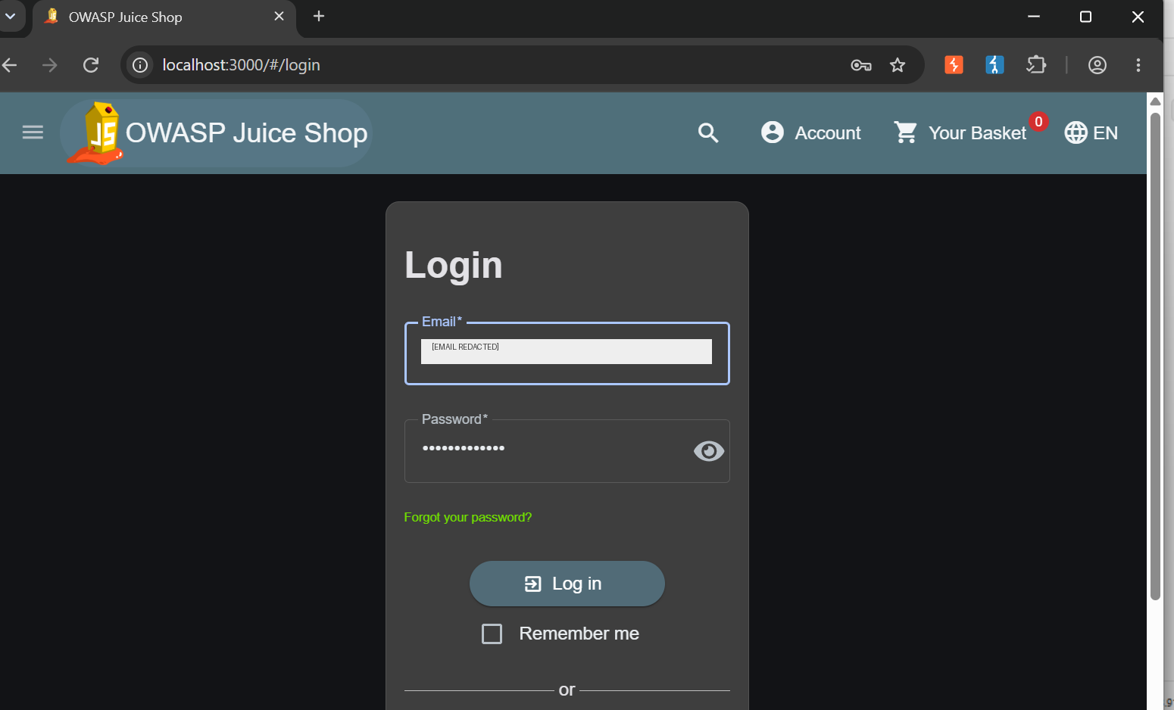
Weak Authentication Controls — Evidence
Evidence captured during controlled testing of the local OWASP Juice Shop lab
Repeated failed login attempts did not produce an account-lockout or CAPTCHA response in the lab.

Slide 18
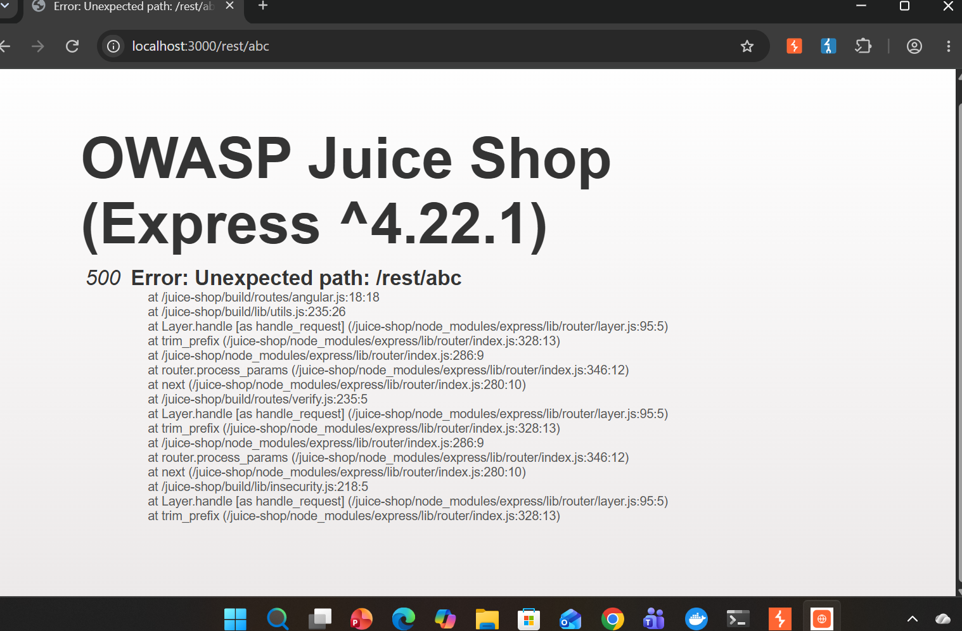
Improper Error Handling — Evidence
Evidence captured during controlled testing of the local OWASP Juice Shop lab
The invalid /rest/abc request returned a detailed 500 error with internal application/framework path information.

Slide 19
Placement Project Status — Manual VAPT Completed
• 6 security findings manually validated in the local OWASP Juice Shop lab.
• Burp Suite used for HTTP request interception, modification and response analysis.
• Docker used to run the Juice Shop test environment.
• Evidence screenshots captured for the findings.
• Next: finalize the VAPT report, GitHub README, and interview preparation.

