Slide 1


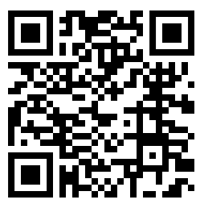









Scan to RSVP
Or
Follow this link
https://bit.ly/2M8nYJ4
IIT Dharwad, Walmi Campus
August 11, 2019
10:00 am – 4:00 pm
Organized by
In Collaboration with

