Slide 1
MATH 102 Ideas of Math
Day 1

Slide 2
Introduction
Instructor:
Văn Phụng Trường Sơn
Office hours:
Teaching Assistants:
Nguyễn Công Thành
Office hours:
Quách Thị Xuân Trang
Office hours:

Slide 3


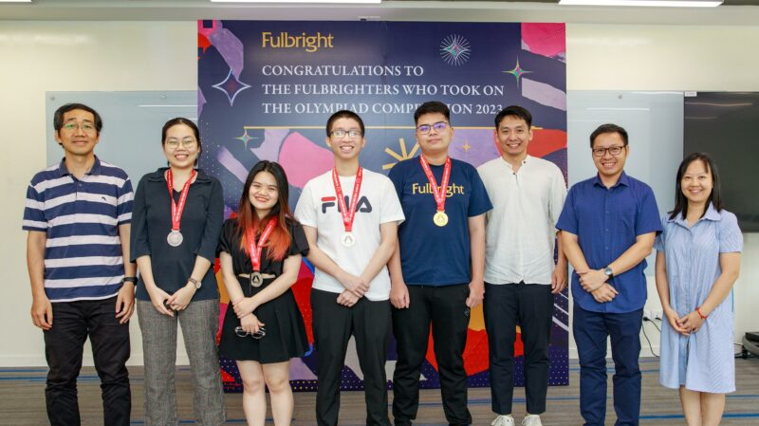



Thành
Trang

Slide 4
Syllabus
https://www.tsvan.xyz/Ideas/

Slide 5
Quiz (10 minutes)
What do you personally think mathematics is?
State one of the concepts discussed in the reading.

Slide 6
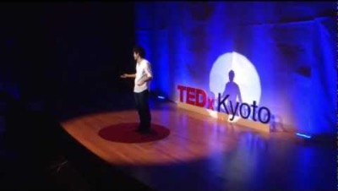
What is mathematics?

Slide 7
Logic
What is logic?

Slide 8
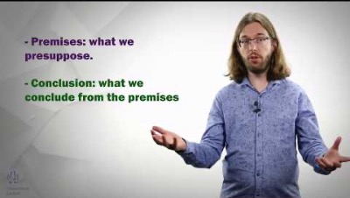
Reasoning

