Slide 1
MATH 102 Ideas of Math
Day 2

Slide 2

From last time
Conjecture 1. Suppose $n$ is an integer larger than 1 and $n$ is prime. Then $2^{n}−1$ is prime.
Conjecture 2. Suppose $n$ is an integer larger than 1 and $n$ is not prime. Then $2^{n}−1$ is not prime.

Slide 3
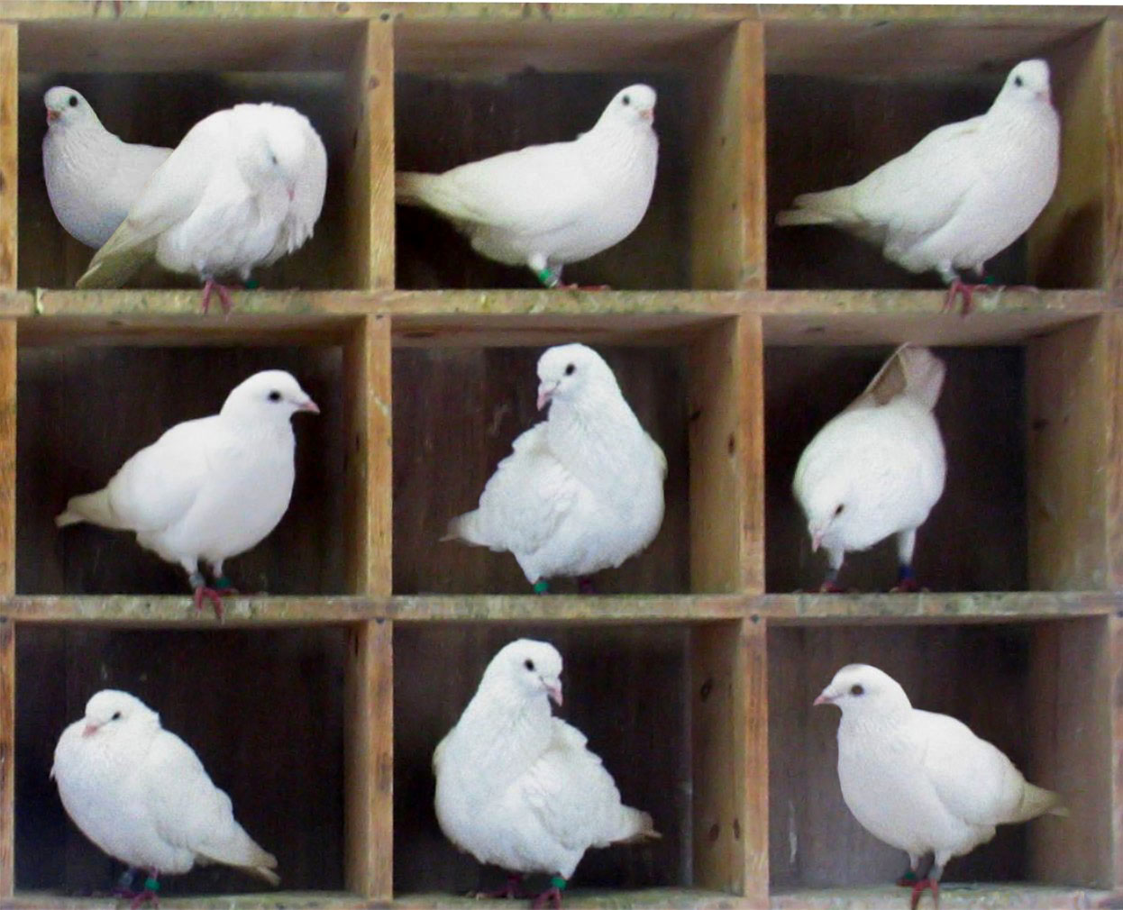
Pigeonhole Principle

Slide 4
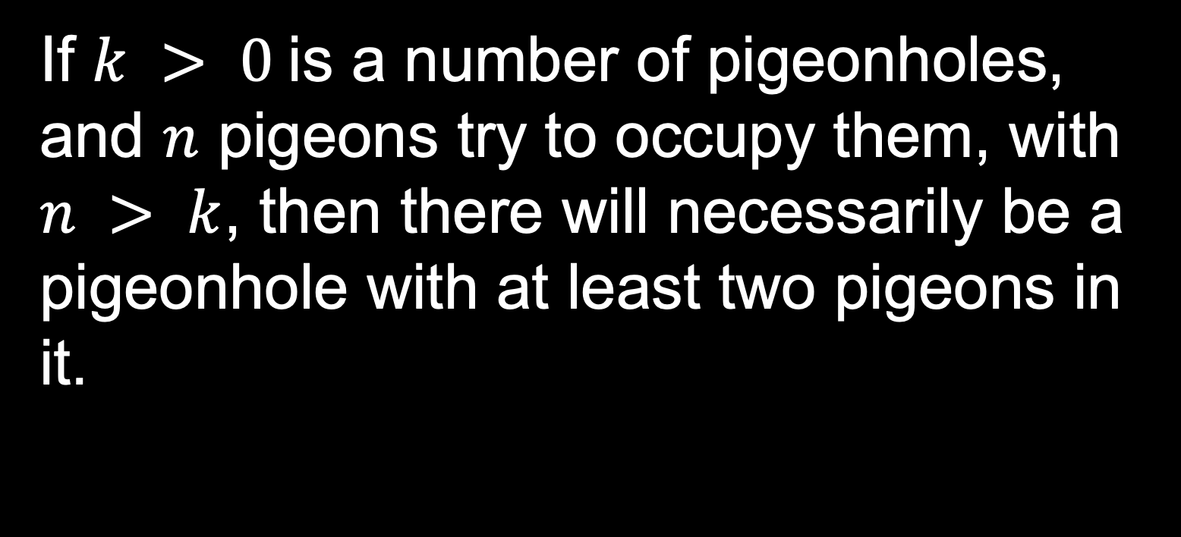
If $k > 0$is a number of pigeonholes, and $n$ pigeons try to occupy them, with $n > k$, then there will necessarily be a pigeonhole with at least two pigeons in it.

Slide 5
Example
There are at least two people at FUV who have the same birthday.
What this is NOT saying: there is someone who has the same birthday as you at FUV.

