Slide 1
MATH 102 Ideas of Math
DAY 3

Slide 2

Deductive reasoning
It will either rain or snow tomorrow. It’s too warm for snow. Therefore, it will rain.
If today is Sunday, then I don’t have to work. Today is Sunday. Therefore I don’t have to go to work today.
$\sqrt{4}$ is a non-negative number so that its square is 4. $−2$ is not a non-negative number. Therefore, $−2$ is not $\sqrt{4}$.

Slide 3


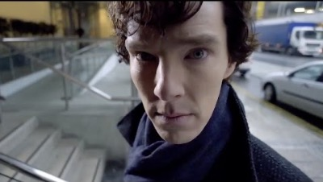




Slide 4
Structure
Assumptions / Premises: Given to be true (even though may fail to be true in real life)
Goal / Conclusion: Typically the last sentence.
Only care about the validity of the whole argument, not the truthfulness of the assumptions.
In other words, an argument is valid if the premises cannot all be true without the conclusion being true as well.

Slide 5

Logical connectives
Not ($¬$, $\neg$)
And ($∧$, $\wedge$)
Or ($∨$, $\vee$)

