Slide 1
Point of sale
Home
Contact
User Name
5 Latest Sales
Dashboard
Products manage
Products
Categories
Sales manage
Quotation manage
Purchases manage
Warehouse manage
Member manage
Customer | Order Date | Price | Shipping Fee | Is Complete | Action
Mr. Cristobal Jacobi | 2021-10-05 | 67.62 | 4.92 | 1 | View
Mr. Cristobal Jacobi | 2021-10-02 | 72.75 | 74.73 | 1 | View
Josephine Gorczany | 2021-09-28 | 91.23 | 57.98 | 1 | View
Adaline Parisian DDS | 2021-09-22 | 74.44 | 98.38 | 1 | View
Weston Goldner PhD | 2021-09-19 | 5.54 | 52.65 | 1 | View
Top 5 Best Selling Yearly
Top | Product Name | Selling Quantity | Action
1 | Deleniti voluptatibus voluptatem at cum qui. | 4 | View Product
2 | Dolorem aut aut nostrum illo illo voluptates. | 4 | View Product
3 | Et mollitia rerum qui aut. | 2 | View Product
4 | Quasi eligendi eos non veritatis. | 1 | View Product
5 | Atque modi in quam vitae doloribus. | 1 | View Product

Slide 2

Point of sale
Home
Contact
User Name
Product
Dashboard
Products manage
Products
Categories
Sales manage
Quotation manage
Purchases manage
Warehouse manage
Member manage
Create a new product
Copy | Csv
ID | Name | Photo | Price | Quantity | Brand | Action
2 | Quasi eligendi eos non veritatis. |  | 168924.00 | 4 | sdfxxvf | View Edit Delete
3 | Dolorem aut aut nostrum illo illo voluptates. |  | 175848.00 | 3 | sdfxxvf | View Edit Delete
4 | Id corrupti maxime vel sequi vel. |  | 994548.00 | 3 | sdfxxvf | View Edit Delete
5 | Deleniti voluptatibus voluptatem at cum qui. |  | 750778.00 | 2 | sdfxxvf | View Edit Delete
6 | Laboriosam consequatur eos ad eos. |  | 546258.00 | 5 | sdfxxvf | View Edit Delete
7 | Aut quaerat maiores possimus nam aut doloribus. |  | 390109.00 | 4 | sdfxxvf | View Edit Delete
Previous
1
2
Next

Slide 3

Point of sale
Home
Contact
User Name
Product Add
Dashboard
Products manage
Products
Categories
Sales manage
Quotation manage
Purchases manage
Warehouse manage
Member manage
Create
Name
Price
Quantity
Brand
Adias
Category ID
Description
Photo
Choose file
No file chosen
Cancel
Create new product

Slide 4
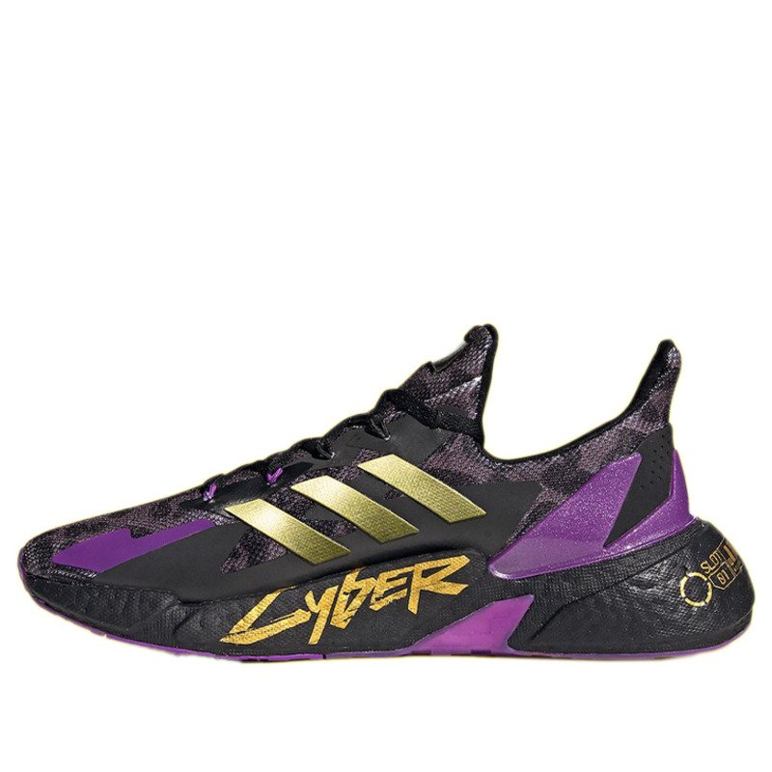
Point of sale
Home
Contact
User Name
Quasi eligendi eos non veritatis.
Dashboard
Products manage
Products
Categories
Sales manage
Quotation manage
Purchases manage
Warehouse manage
Member manage
Information
Name
Quasi eligendi eos non veritatis.
Price
168924.00
Quantity
4
Brand
Adias
Category
Aut ea et ut voluptatem.
Description
Iusto occaecati et quae odit aliquam est tempore velit. Doloremque pariatur rerum et. Sed repellendus ullam ut velit consequatur.
Photo
Back

