Slide 1
Git IDE Tool
CHƯƠNG TRÌNH ĐÀO TẠO NHÂN VIÊN
Trình bày: Vũ Quang Sơn
HANOI – NOV, 2015

Slide 2
Table of Content
Git on Netbeans 8.1
Git on Sublime 3.0
Git on PHPStorm 10.0

Slide 3
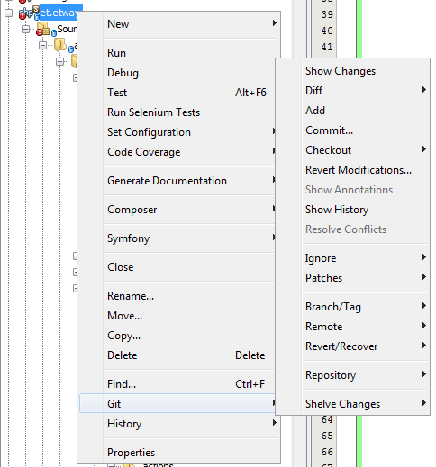
Git on Netbeans
Support all commands like other git tools

Slide 4
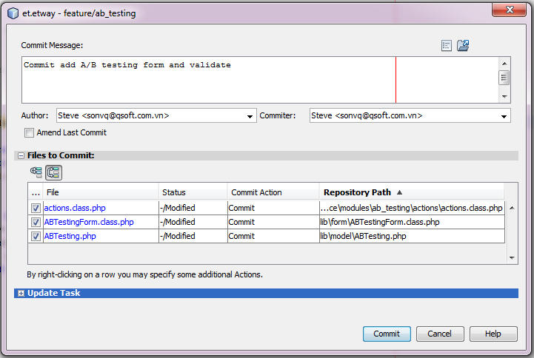
Git on Netbeans
Review changed files before commit

Slide 5
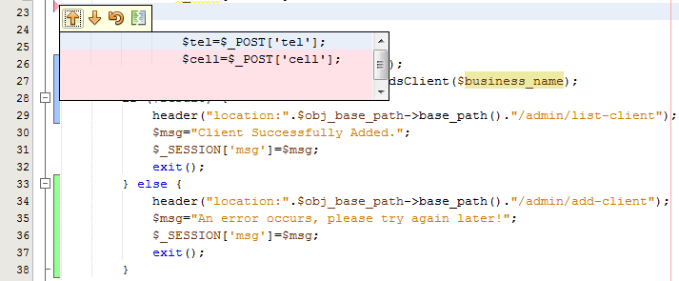
Git on Netbeans
Easy view changed codes

Slide 6
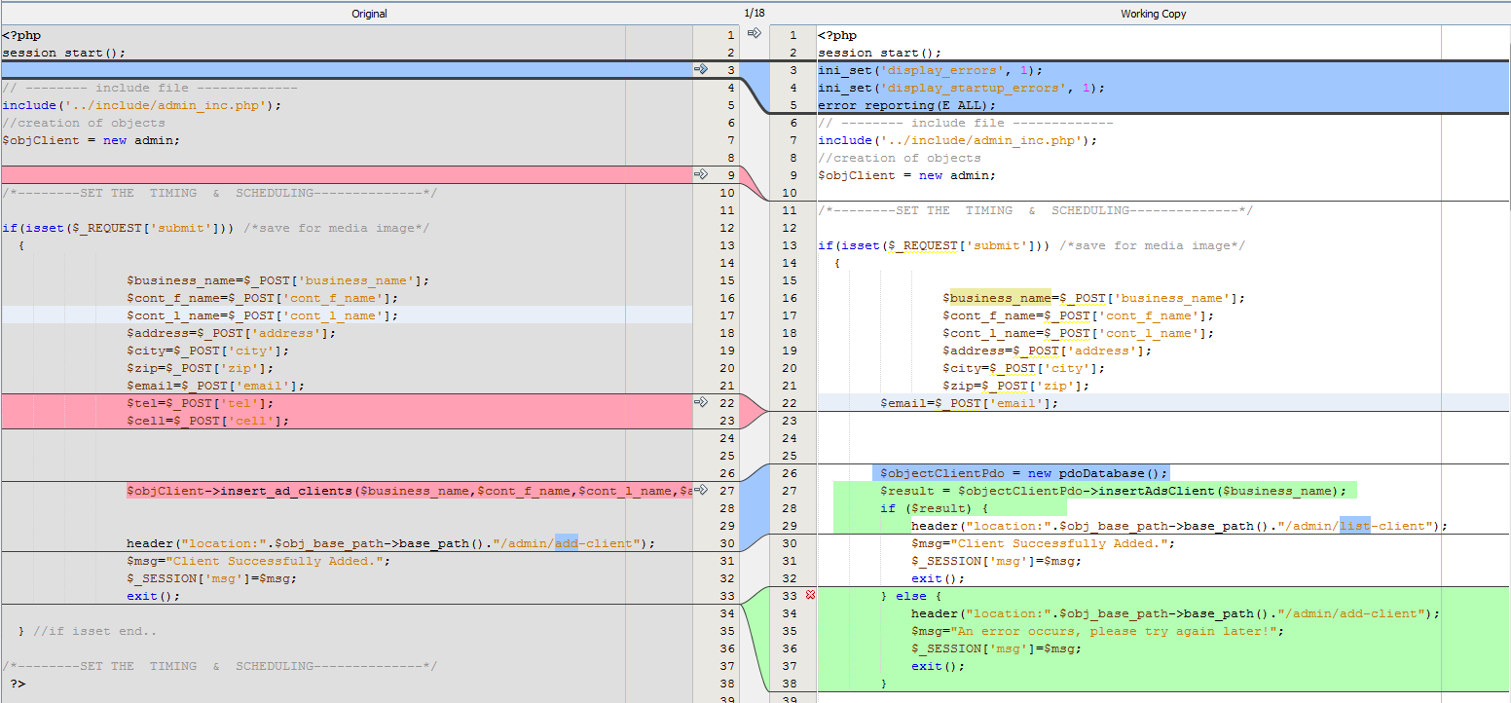
Git on Netbeans
Highlighting on diff

Slide 7
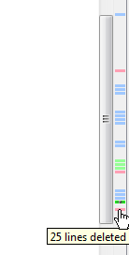
Git on Netbeans
Blue ( ): lines has been changed
Green ( ): lines has been added
Red ( ): lines has been removed

Slide 8
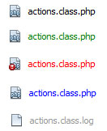
Git on Netbeans
Black: file has no changed
Green: file added
Red: file in merge conflict
Blue: file modified
Gray: file ignored

Slide 9
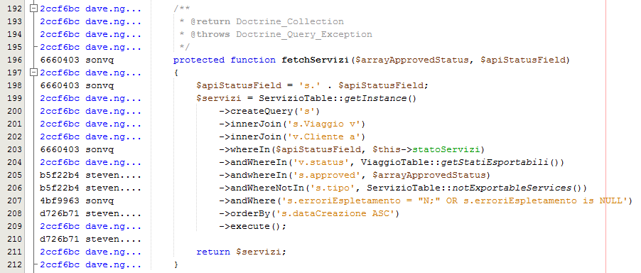
Git on Netbeans
Show Annotations

Slide 10
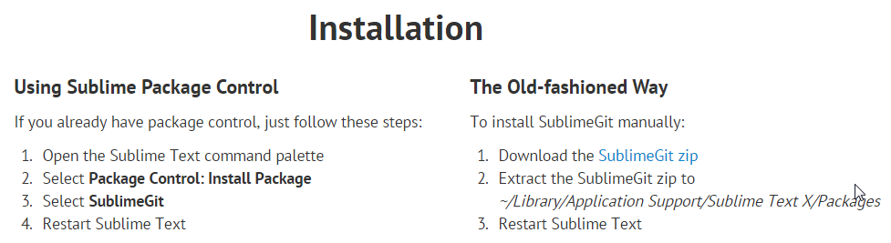
Git on Sublime
https://sublimegit.net/
Install via package controls or download

Slide 11
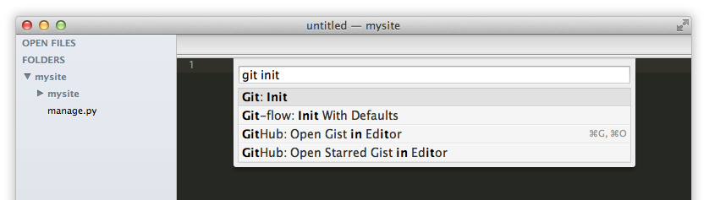
Git on Sublime
Quick and Convenience command

Slide 12
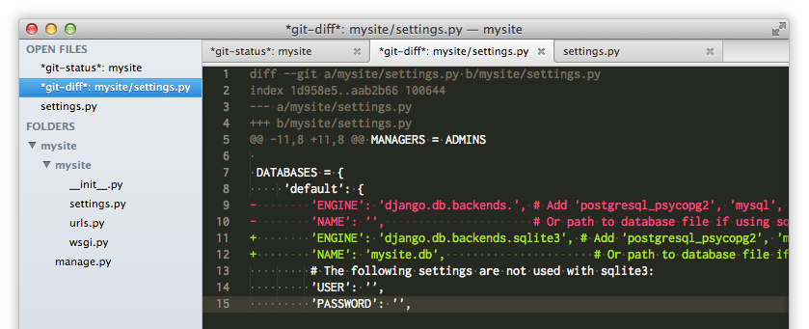
Git on Sublime
Clearly diff

Slide 13
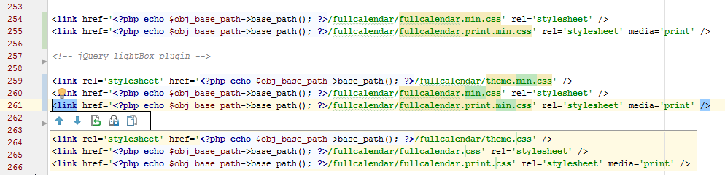
Git on PHPStorm
Changes are marked clearly

Slide 14
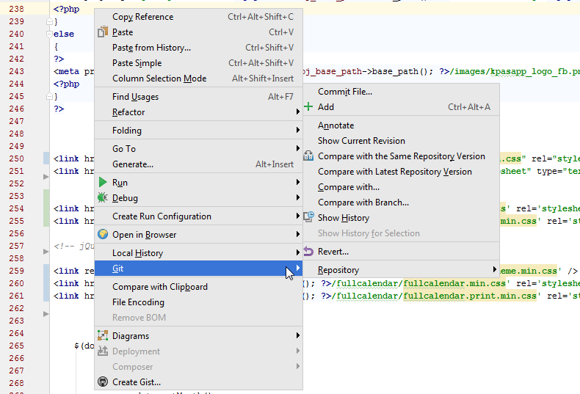
Git on PHPStorm
Quickly access git tool inside a file

Slide 15


Slide 16
THANK YOU!

