Slide 1
AngularJS Overview
CHƯƠNG TRÌNH ĐÀO TẠO NHÂN VIÊN
MÔN HỌC: Javascript
Trình bày: TaiPM
HANOI – SEP, 2015

Slide 2
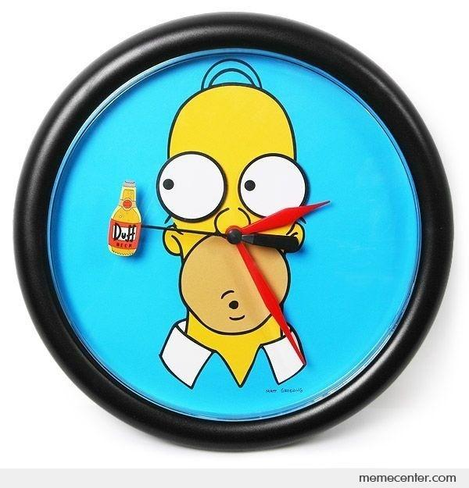
15’ trình bày
15’ chia team & thảo luận

Slide 3
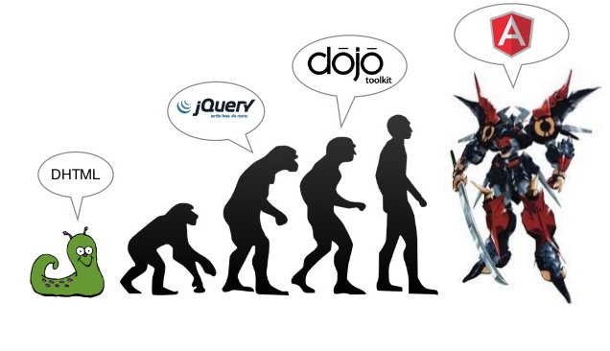
EVOLUTION OF WEB APPs
Notes:
It all started because we wanted a better User Experience.
We wanted dynamic things without having to refresh the page.
Angular JS is a product of that want.

Slide 4
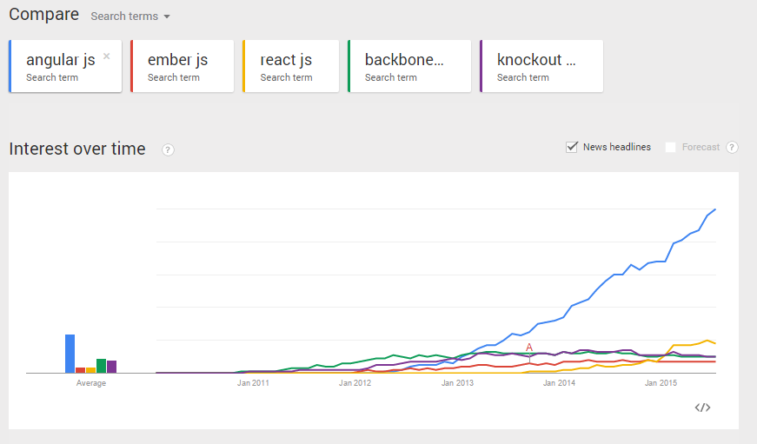
TREND

Slide 5
OUTLINE
What is AngularJS
Why use AngularJS
Core Features
Two-way data binding
Modules
Controllers
Directive
Expresstion
DI
Topics

Slide 6
WHAT IS ANGULAR.JS?
A JavaScript Framework
For Building single page applications
Kung-foo for JavaScript
Learn its MVW structure, get superpowers
It's supposed to be easy

Slide 7

WHY USE ANGULARJS

Slide 8
WHY USE ANGULARJS
It provides powerful two-way data binding
It uses expressive HTML via directives
It is designed to be testable
Built in route navigation
Because its popular
DI
….

Slide 9
WHAT'S MVW?
Model, View, Whatever (usually a Controller)
Model = Data, View = Templates
Whatever (Controllers) = JavaScript that connects
Separating this makes apps easie

Slide 10
CORE FEATURES
Modules
Services
Expressions
Filters
Directives
Form Validation
Dependency Injection
End to end Integration Testing / Unit Testing
Routing
Template

Slide 11
SET UP A PROJECT
Include JS file: https://ajax.googleapis.com/ajax/libs/angularjs/1.5.5/angular.min.js
Put ng-app to HTML body

Slide 12
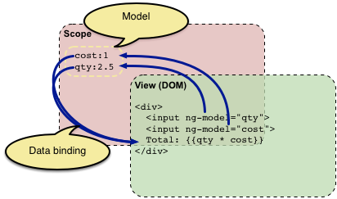
TWO-WAY DATA BINDING

Slide 13
EXAMPLE

Slide 14
MODULES
Container for different parts of your application – controllers, services, filters, etc.
Declaratively specify how an application is to be bootstrapped
Builds reusable component packages
Can be loaded in any order (or even in parallel)

Slide 15
CONTROLLERS
Logic behind the view
Constructs the Model and publishes it to the View
Instantiate the ViewModel object or “$scope”
Set up the initial state of the $scope
Add behavior to $scope

Slide 16
SERVICE
To organize and share code across your app
Implement dependency injection (DI)
Business logic should be placed in services

Slide 17
EXPRESSION
JavaScript-like code snippets that are usually placed in bindings
such as {{ expression }}

Slide 18
EXPRESSION
No
Access objects outside of $scope
Conditionals, loops, or exceptions
Function declarations
Create regular expressions

Slide 19
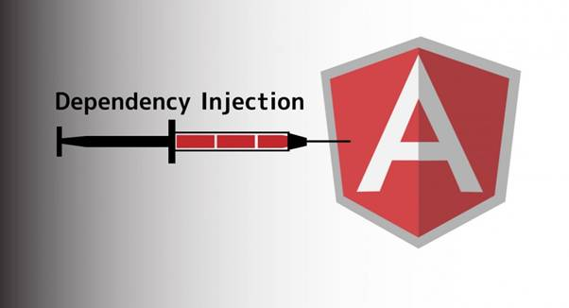
DEPENDENCY INJECTION

Slide 20
DEPENDENCY INJECTION
Built-in Dependency Injection Subsystem
Easier to understand and test
Modular Development
Just ask for things that you want to use (built-in or custom services)

Slide 21
DIRECTIVE
Extends the HTML with custom attributes and elements
use prefix: ng-

Slide 22
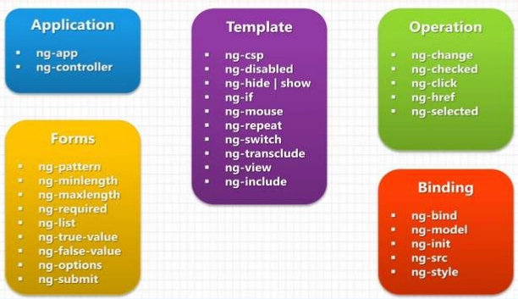
DIRECTIVE

Slide 23
TOPIC 1 : BASICS OF ANGULAR
Getting Started
Data Binding
Function
Modules
Scopes
Controllers (Controller Hierarchy)
Expressions
Notes:
TEAM : 6 Thang

Slide 24
TOPIC 2 : INTERMEDIATE
Introduction to Directives (Core)
Built-In Directives
Multiple Views
Routing
Dependency Injection
Filter
Notes:
TEAM a Canh

Slide 25
TOPIC 3 : ADVANCED
Form (validation )
Provider
Animation
Services
Improve AngularJS Performance
Working with jquery
Notes:
TEAM Huong

Slide 26
TOPIC 4: SUPERHERO
$q and the Promise
Event ($on,$emit…)
Best practices
Security
AngularJS 2.x Overview and Migration Strategy
Notes:
Team 2 tHAI

Slide 27
TOPIC 5 : COMMUNICATING WITH SERVERS.
Communicating Over $http
Response Object
Caching HTTP Requests
Interceptors
Configuring the $httpProvider
Working with RESTful Resources
Notes:
TEAM 4 DAT

Slide 28
TOPIC 6 : TESTING, TOOL AND DEPLOY
Unit Test (E2E) - Karma
IDEs
Debugging – Batarang
Yeoman, Grunt (Gulp)
Notes:
Sd5 + SD2 hUNG

Slide 29
THANK YOU!

