Slide 1
AngularJS IDEs
CHƯƠNG TRÌNH ĐÀO TẠO NHÂN VIÊN
MÔN HỌC: Javascript
Trình bày: DucNT
HANOI – MAY, 2015

Slide 2
IDE & Text Editor
In programming world, 2 types of editors:
Full featured Integrated Development Environment (IDE)
Lightweight text editors
For faster development workflow

Slide 3
WebStorm
Suited for JS, HTML, CSS
Live editor (without refreshing browser)
Carries the AngularJS plugin bundle by default
Notes:
https://www.jetbrains.com/webstorm/

Slide 4
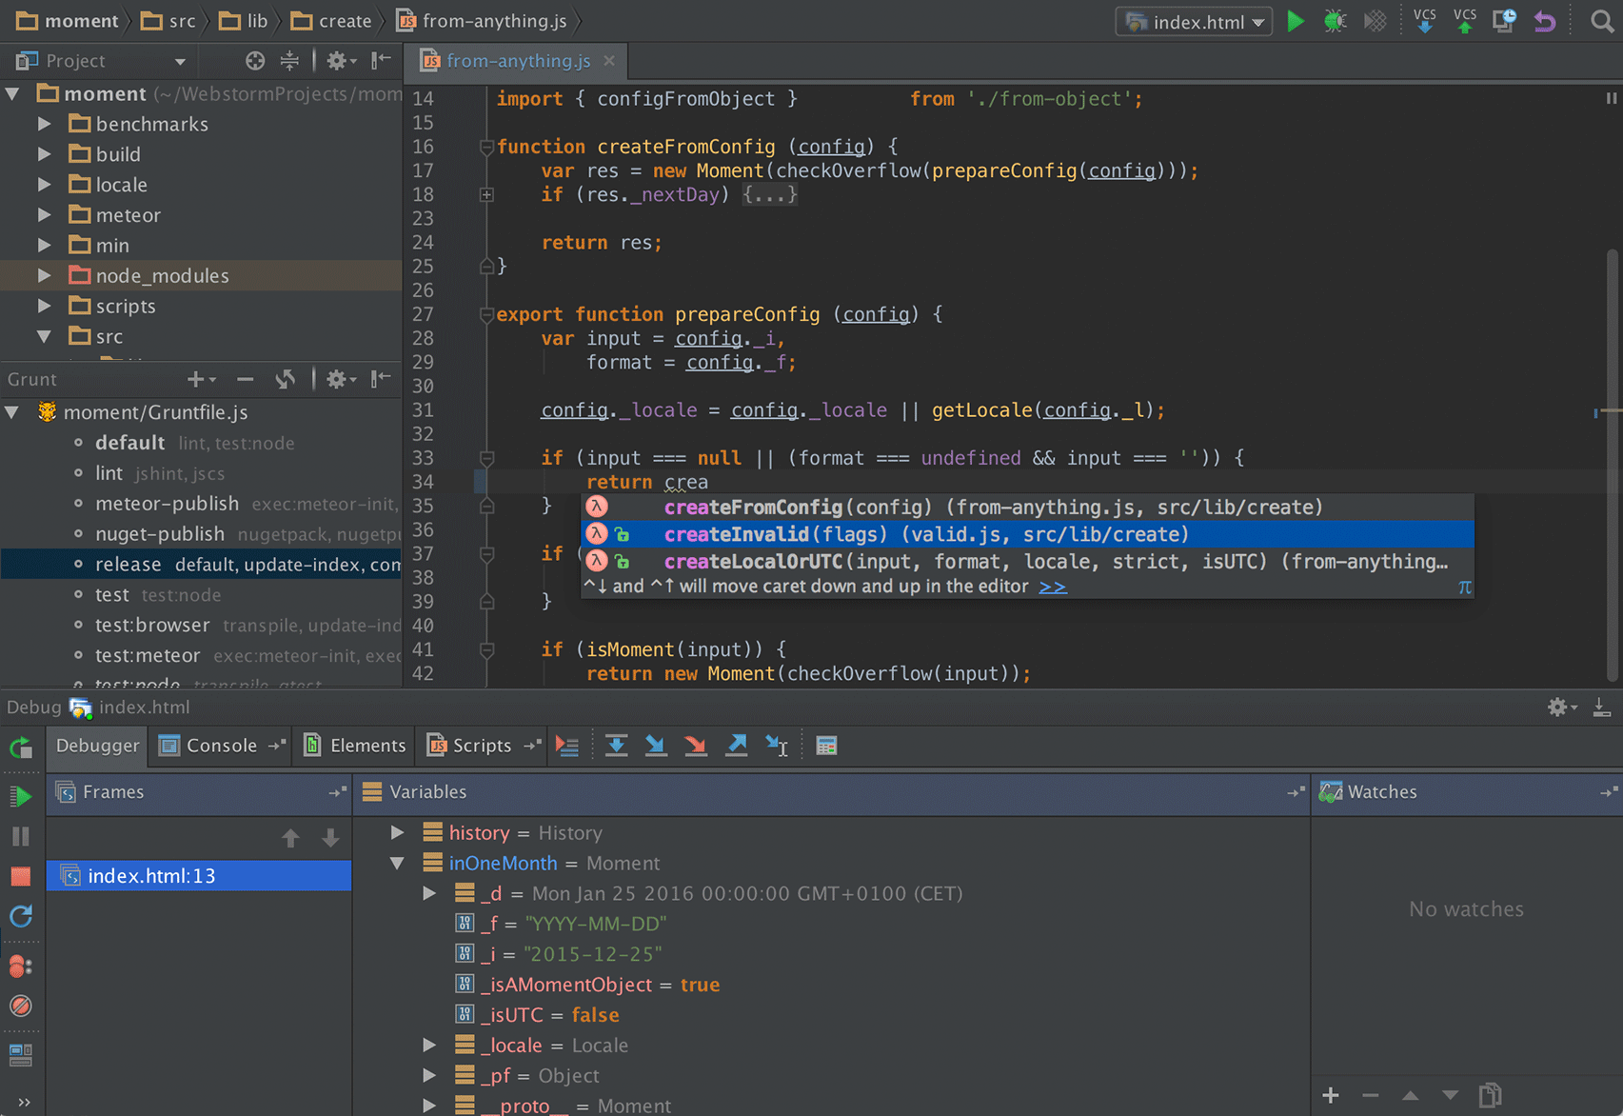
WebStorm
Notes:
https://www.jetbrains.com/webstorm/

Slide 5
Sublime Text
Customizability to adapt any kind of programming environments
Need to download AngularJS package
Notes:
http://www.sublimetext.com/
https://github.com/angular-ui/AngularJS-sublime-package

Slide 6
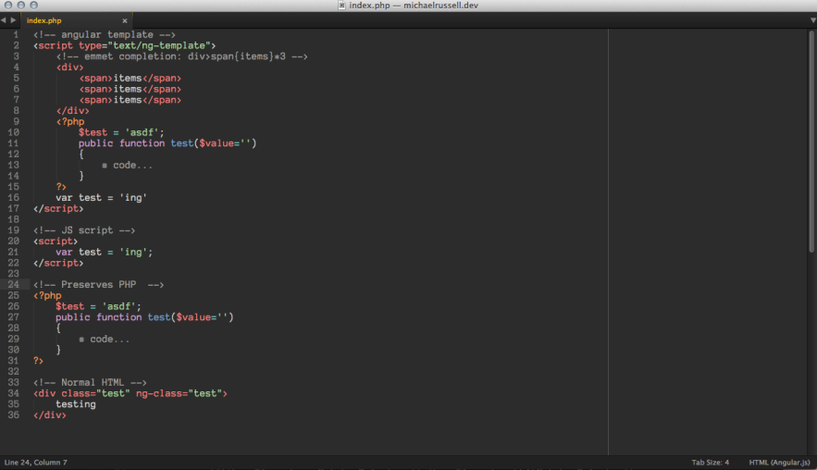
Sublime Text
Notes:
http://www.sublimetext.com/
https://github.com/angular-ui/AngularJS-sublime-package

Slide 7
Aptana
Free open source
Customized of Eclipse to focus on JS, HTML, CSS…
Need to download AngularJS Eclipse extension
Notes:
http://www.aptana.com/
https://github.com/angelozerr/angularjs-eclipse

Slide 8
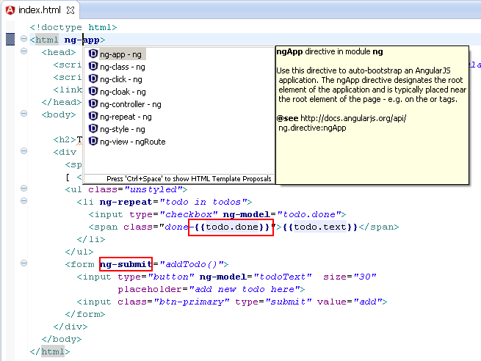
Aptana
Notes:
http://www.aptana.com/
https://github.com/angelozerr/angularjs-eclipse

Slide 9
THANK YOU!

