Slide 1

Google SEO
CHƯƠNG TRÌNH ĐÀO TẠO NHÂN VIÊN
Trình bày: Vũ Quang Sơn
HANOI – NOV, 2015

Slide 2
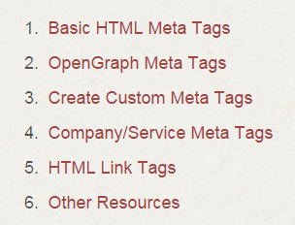
What’s Meta tag?
Texts tell SE about web page content
Don’t appear on page, only in code (<head>)
Contains several kinds
Complete list of meta tags

Slide 3
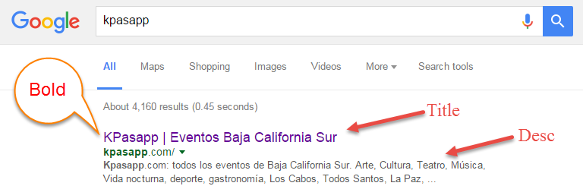
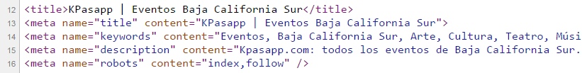
How to use Meta tag?

Slide 4
Does Meta tag help SEO?
Yes, but not all of them and not all of the time
Title - “title" of page, most important! ~ 55 chars
Keywords - keywords relevant, doesn’t make much sense now
Description - Page about, quite useful, attract visitor, ~155 chars
Robots - Indication to SE crawlers (robots/bots)
index/noindex
follow/nofollow

Slide 5
Open Graph Meta
og:title og:type og:description og:image og:url

Slide 6
Know about ur keyword
Focus keyword should appear in:
Article Heading (<h1>)
Page title (<title>)
Page url
Content
Meta description

Slide 7
Structured Data

Slide 8
Clean and meaningful URL

Slide 9
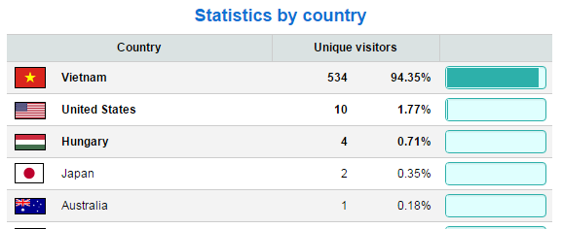
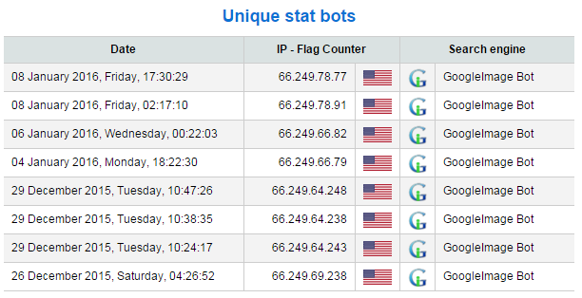
Optimize images

Slide 10
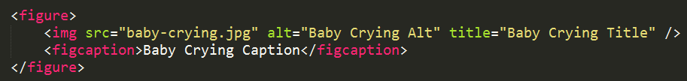


Optimize images
Alt text (important for crawlers), Title, Name, Caption ~16 words
File size
File as small as possible
Resize image before show

Slide 11
Bounce Rate
What is it?
How to fix?

Slide 12
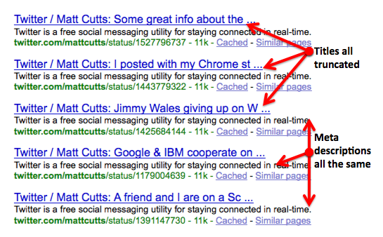
Best practice (MetaTag)
Don’t put too long/short title and meta
Avoid missing/duplicate/non-informative title and meta

Slide 13
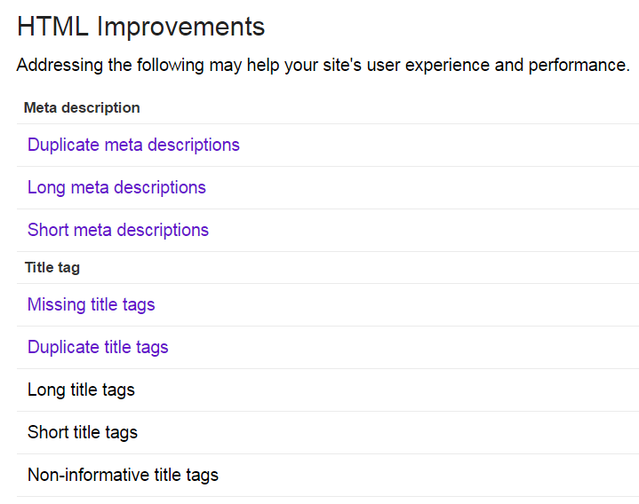

Slide 14
Best practice (MetaTag)
Keyword and description tag aren’t do much, but attract visitor
Robots - Indication to SE crawlers (robots/bots)
index/noindex
follow/nofollow

Slide 15
Tool
Google Webmaster Tool
Structured Data Testing Tool
Facebook Debugger Tool

Slide 16

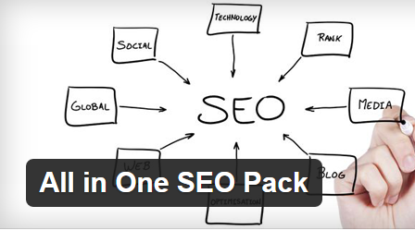
Wordpress (plugin)
Yoast SEO
All in One SEO Pack

Slide 17
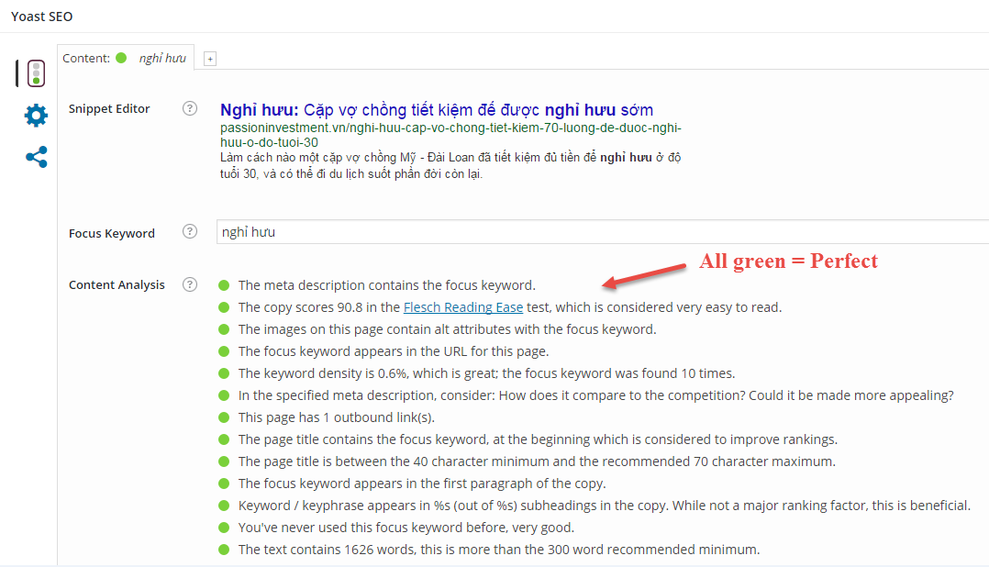

Slide 18
Yoast recommend
Easy to read (11-yr old child), > 300 words, has outbound link
Title is 40 ~ 70 chars
Keyword density:
URL, Desc, img’s alt, Title at beginning, Subheadings , first <p>, more…
Never used Keyword before

Slide 19
Reference
http://code.lancepollard.com/complete-list-of-html-meta-tags/
http://www.wordstream.com/meta-tags
http://searchengineland.com/figz/wp-content/seloads/2013/10/nofollowtag-1000-2919.png
https://moz.com/learn/seo/meta-description
http://webmasters.stackexchange.com/questions/403/how-should-i-structure-my-urls-for-both-seo-and-localization

Slide 20
Reference (cont)
https://yoast.com/flesch-reading-ease-score/
http://www.cyberalert.com/blog/index.php/the-guide-to-creating-and-optimizing-metadata-for-seo/
http://diythemes.com/thesis/wordpress-seo-image-optimization/
http://backlinko.com/google-ranking-factors

Slide 21


Slide 22
THANK YOU!

