Slide 1
HTML5 Storage

Slide 2
Out line
Offline Storage
Local Storage
Session Storage
Indexed DB
References

Slide 3
Offline Storage
*(Give definition and basic concept of web offline storage)

Slide 4
Usage
*(List realistic usages)
Store Offline data
Single page app
data synchronization
Fat-Client website

Slide 5
Indexed DB - Concept
A way to store significant amounts of structured data in client-side (offline NoSQL database)
Fast indexing and searching of objects
JS objects & keys
Asynchronous API

Slide 6
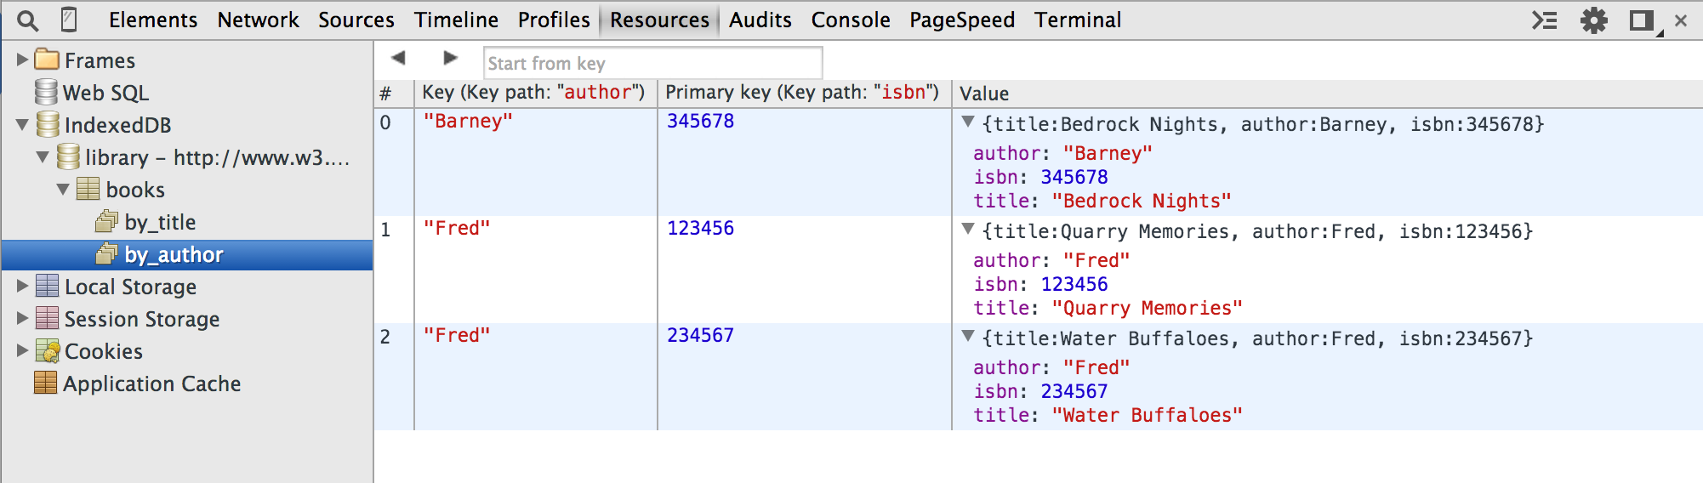
Indexed DB - Concept
How does it work?

Slide 7
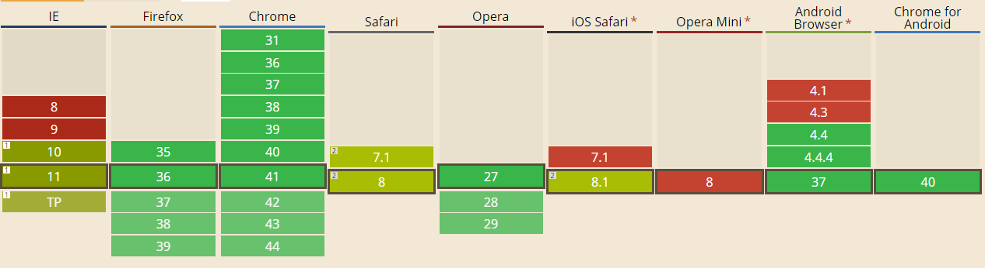
Indexed DB - Support
Polyfills
IndexDB Shim by Parashuram - WebSql adapter

Slide 8
Indexed DB – Pros and Cons
Advantage points
Store whole JavaScript object
Indexing and searching
Large amount of storage
Asynchronous API (does not block other works)
Limitations
Does not support old browsers
Safari does not fully support
Very complex API resulting in large amounts of nested callbacks

Slide 9
Indexed DB – Pros and Cons
Vs. LocalStorage
Larger storage quota
Can store JS object
Fast indexing and searching
When should we use it?
Fan of NoSQL
LocalStorage is not enough

Slide 10
Indexed DB - Coding
Open
Insert, Update, Delete
Indexing, Sorting

Slide 11
Transaction
There are two types of transactions: readonly and readwrite
Adding data will be a readwrite operation

Slide 12
Keys
Keys are IndexedDB's version of primary keys.
Adding data will be a readwrite operation

Slide 13
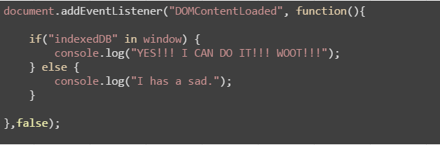
Demo
Does your browser fit it?

Slide 14
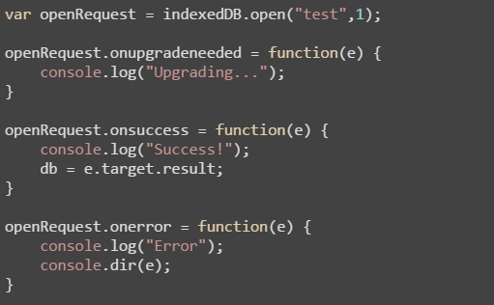
Open a DB
DB name
Schema version
onupgradeneeded

Slide 15
Data
One of the coolest aspects of IndexedDB
lets you store an object as is (JavaScript object)
Transactions
readonly | readwrite
Adding data = readwrite operation

Slide 16
References
Working With IndexedDB http://code.tutsplus.com/tutorials/working-with-indexeddb--net-34673
http://www.girliemac.com/blog/2014/07/03/indexeddb/
Good library
Jquery IndexedDB Plugin
http://nparashuram.com/jquery-indexeddb/

Slide 17
THANK YOU FOR YOUR ATTENTION!

