Slide 1
HTML5 Storage

Slide 2
Out line
Offline Storage
Local Storage
Session Storage
Indexed DB
References

Slide 3
Offline Storage
*(Give definition and basic concept of web offline storage)

Slide 4
Usage
*(List realistic usages)
Store Offline data
Single page app
data synchronization
Fat-Client website

Slide 5
Local Storage
Concept
*(basic idea, mechanism and how does it work?)

Slide 6
Local Storage
Advantage points
Limitations
When should we use it?

Slide 7
Local Storage
Coding syntax

Slide 8
Session Storage
Concept
*(basic idea, mechanism and how does it work?)
Coding syntax

Slide 9
Indexed DB - Concept
A way to store significant amounts of structured data in client-side
Fast indexing and searching of objects
JS objects & keys
Asynchronous API

Slide 10
Indexed DB - Concept
How does it work?

Slide 11
Indexed DB – Pros and Cons
Advantage points
Limitations
When should we use it?
Compare to other storages?
Performance issues

Slide 12
Indexed DB - Coding
Open
Insert, Update, Delete
Indexing, Sorting

Slide 13
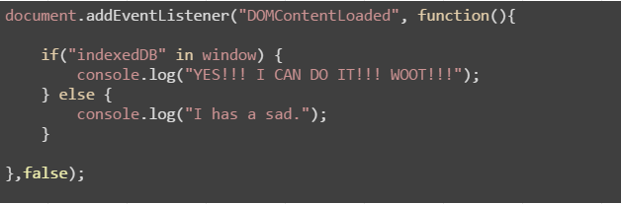
Demo
Does your browser fit it?

Slide 14
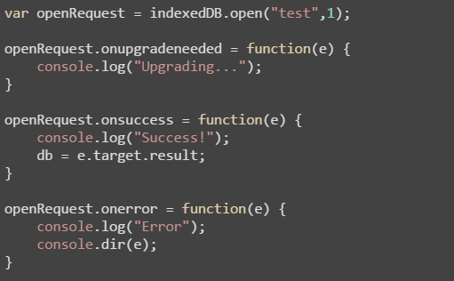
Open a DB
DB name
Schema version
onupgradeneeded

Slide 15
Data
One of the coolest aspects of IndexedDB
lets you store an object as is (JavaScript object)
Transactions
readonly | readwrite
Adding data = readwrite operation

Slide 16
References
Working With IndexedDB http://code.tutsplus.com/tutorials/working-with-indexeddb--net-34673
http://www.girliemac.com/blog/2014/07/03/indexeddb/
Good library
Jquery IndexedDB Plugin
http://nparashuram.com/jquery-indexeddb/

Slide 17
THANK YOU FOR YOUR ATTENTION!

