Slide 1
HTML5 Storage

Slide 2
Out line
Offline Storage
Local Storage
Session Storage
Indexed DB
References

Slide 3
Usage
Store Offline data
Single page app
Data synchronization
Fat-Client website

Slide 4
IndexedDB - Concept
A way to store significant amounts of structured data in client-side (offline NoSQL database)
Fast indexing and searching of objects
JS objects & keys
Asynchronous API

Slide 5
IndexedDB - Concept
Database version

Slide 6
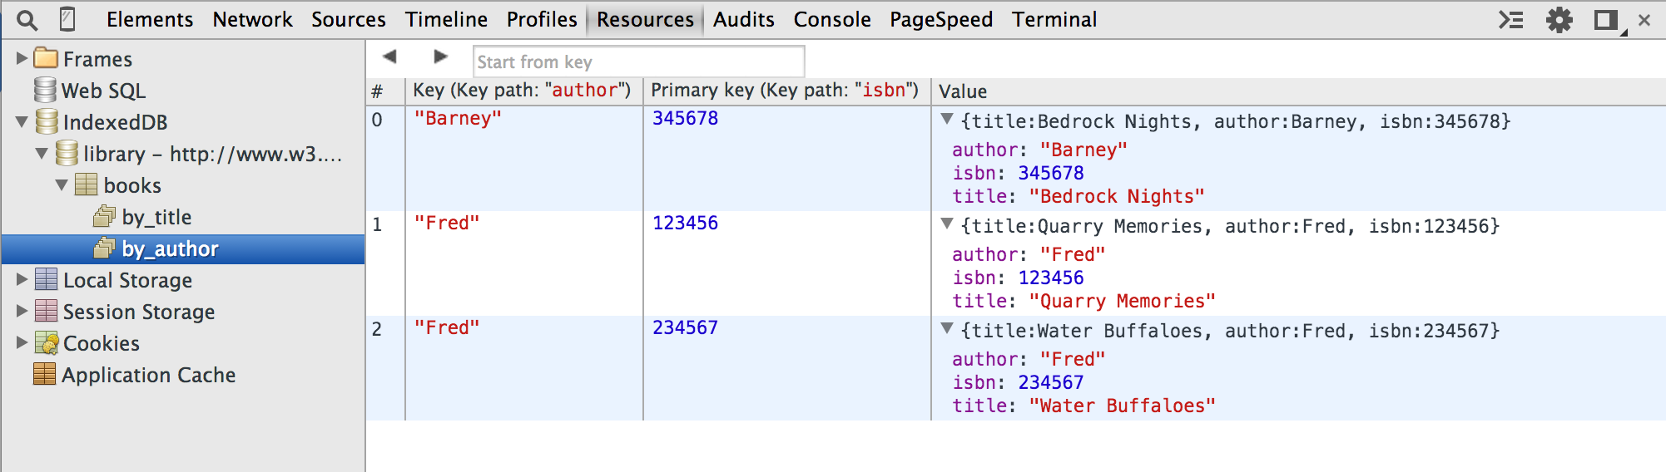
IndexedDB - Concept
Object Stores
Key

Slide 7
IndexedDB - Concept
Transaction
Is required for any data modification action
3 modes:
“readonly”
“readwrite”
“versionchange”
Is asynchronous

Slide 8
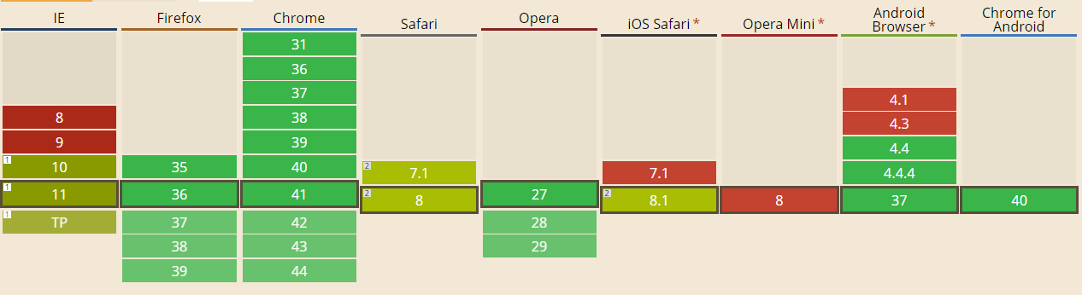
IndexedDB - Support
Polyfills
IndexDB Shim by Parashuram - WebSql adapter

Slide 9
IndexedDB - Coding
Open
Insert, Update, Delete
Indexing, Sorting

Slide 10
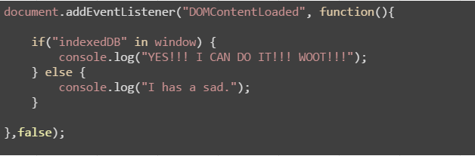
IndexedDB - Coding
Does your browser fit it?

Slide 11
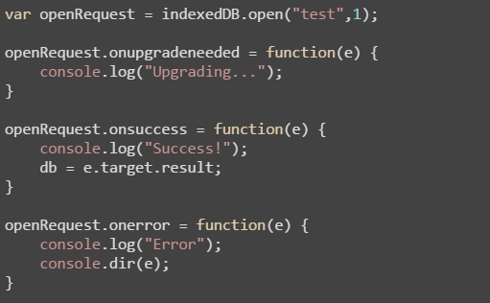
Step 1: Open a DB
DB name
Schema version

Slide 12
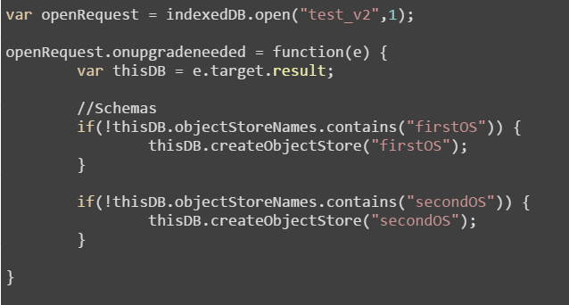
Step 2: Create Object Store
Event
onupgradeneeded

Slide 13
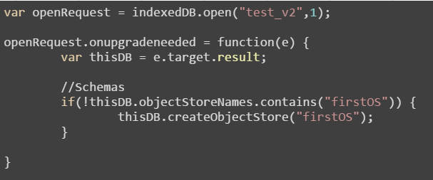
Step 3: Start a transaction
DB name
Schema version
onupgradeneeded
Object Stores

Slide 14
Step 3: Start a transaction
DB name
Schema version
onupgradeneeded
Object Stores

Slide 15
IndexedDB – Pros and Cons
Advantage points
Store whole JavaScript object
Indexing and searching
Large amount of storage
Asynchronous API (does not block other works)
Limitations
Does not support old browsers
Safari does not fully support
Complex API, nested callbacks

Slide 16
IndexedDB – Pros and Cons
Vs. LocalStorage
Larger storage quota
Can store JS object
Faster indexing and searching
When should we use it?
Fan of NoSQL
LocalStorage is not enough

Slide 17
Data
One of the coolest aspects of IndexedDB
lets you store an object as is (JavaScript object)
Transactions
readonly | readwrite
Adding data = readwrite operation

Slide 18
References
Working With IndexedDB
http://code.tutsplus.com/tutorials/working-with-indexeddb--net-34673
IndexedDB in detail
https://developer.mozilla.org/en-US/docs/Web/API/IndexedDB_API/Using_IndexedDB
IDB transaction
https://developer.mozilla.org/en-US/docs/Web/API/IDBTransaction
Asynchronous and Transactional Operation With IndexedDB
http://www.extremecss.com/asynchronous-and-transactional-operation-with-indexeddb-tutorial/
Good library
Jquery IndexedDB Plugin
http://nparashuram.com/jquery-indexeddb/

Slide 19
THANK YOU FOR YOUR ATTENTION!

