Slide 1
HTML5 Storage
Presenter
Vu Quang Son
Pham Van Quy

Slide 2
Out line
Offline Storage
Local Storage
Session Storage
Indexed DB
References

Slide 3
Usage
Store Offline data
Single page app
Data synchronization
Fat-Client website

Slide 4
IndexedDB - Concept
A way to store significant amounts of structured data in client-side (offline NoSQL database)
Fast indexing and searching of objects
JS objects & keys
Asynchronous API

Slide 5
IndexedDB - Concept
Database version

Slide 6
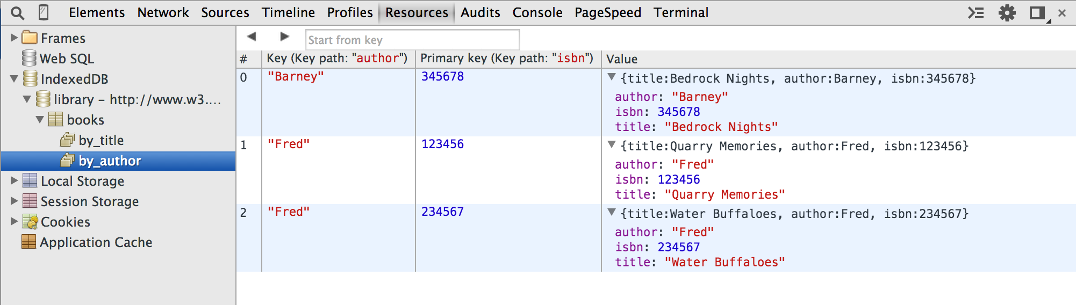
IndexedDB - Concept
Object Stores
Key

Slide 7
IndexedDB - Concept
Data format
Anything that can be expressed in JavaScript ( boolean, number, string, date, object, array, regexp, undefined, and null)

Slide 8
IndexedDB - Concept
Transaction
Is required for any data modification action
3 modes:
“readonly”
“readwrite”
“versionchange”
Is asynchronous

Slide 9
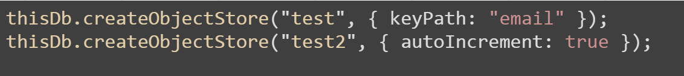
IndexedDB - Concept
Key
Keys are IndexedDB's version of primary keys.

Slide 10
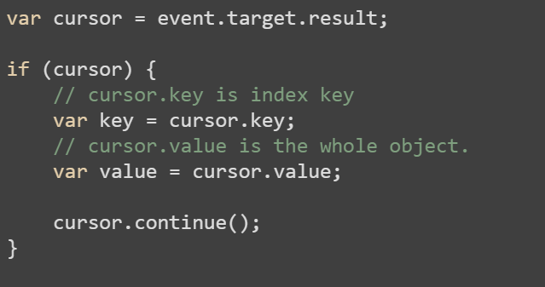
IndexedDB - Concept
Cursor
A way to run for loop in querying data
Notes:
var cursor = event.target.result;
if (cursor) {
// cursor.key is index key
var key = cursor.key;
// cursor.value is the whole object.
var value = cursor.value;
cursor.continue();
}

Slide 11
IndexedDB - Concept
Cursor
A way to run for loop in querying data
Notes:
var cursor = event.target.result;
if (cursor) {
// cursor.key is index key
var key = cursor.key;
// cursor.value is the whole object.
var value = cursor.value;
cursor.continue();
}

Slide 12
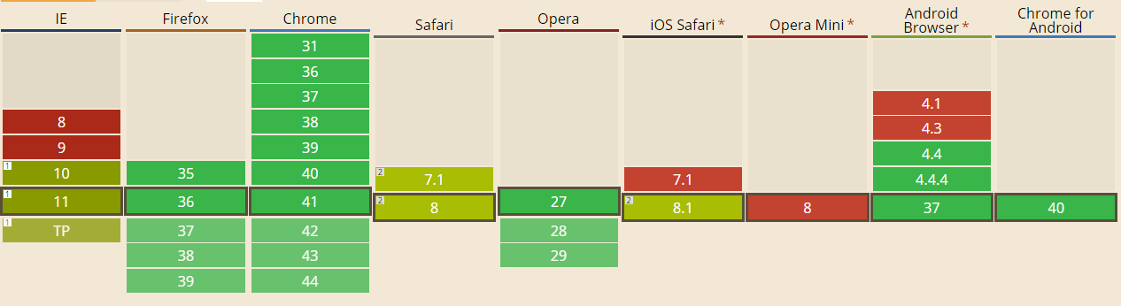
IndexedDB - Support
Polyfills
IndexDB Shim by Parashuram - WebSql adapter

Slide 13
IndexedDB – Pros and Cons
Advantage points
Store whole JavaScript object
Indexing and searching
Large amount of storage
Asynchronous API (does not block other works)
Limitations
Does not support old browsers
Safari does not fully support (Safari 8 promised to improve it)
Complex API, nested callbacks
Data can be deleted manually by users

Slide 14
IndexedDB – Pros and Cons
Vs. LocalStorage
Larger storage quota
Can store JS object
Faster indexing and searching
When should we use it?
Fan of NoSQL
LocalStorage is not enough

Slide 15
IndexedDB - Coding
Open
Insert, Update, Delete
Indexing, Sorting

Slide 16
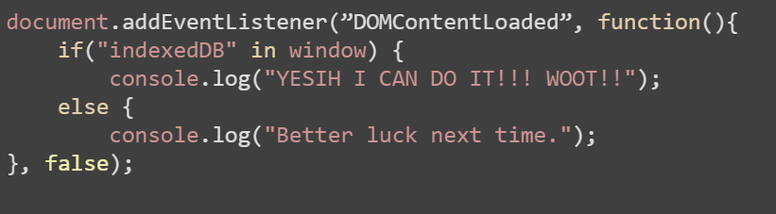
IndexedDB - Coding
Does your browser fit it?
Notes:
document.addEventListener(”DOMContentLoaded”, function(){
if("indexedDB" in window) {
console.log("YESIH I CAN DO IT!!! WOOT!!");
else {
console.log("Better luck next time.");
}, false);

Slide 17
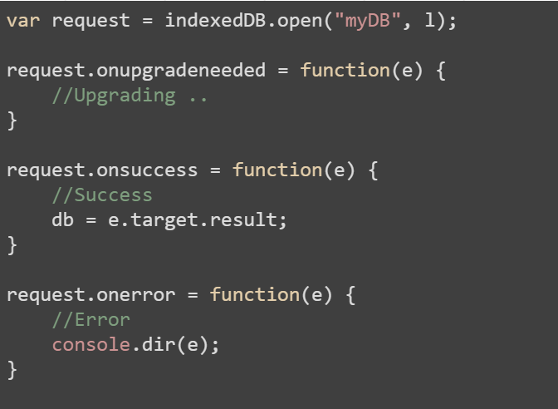
Step 1: Open a DB
DB name
Schema version is integer
Notes:
var request = indexedDB.open("myDB", l);
request.onupgradeneeded = function(e) {
//Upgrading ..
}
request.onsuccess = function(e) {
//Success
db = e.target.result;
}
request.onerror = function(e) {
//Error
console.dir(e);
}

Slide 18
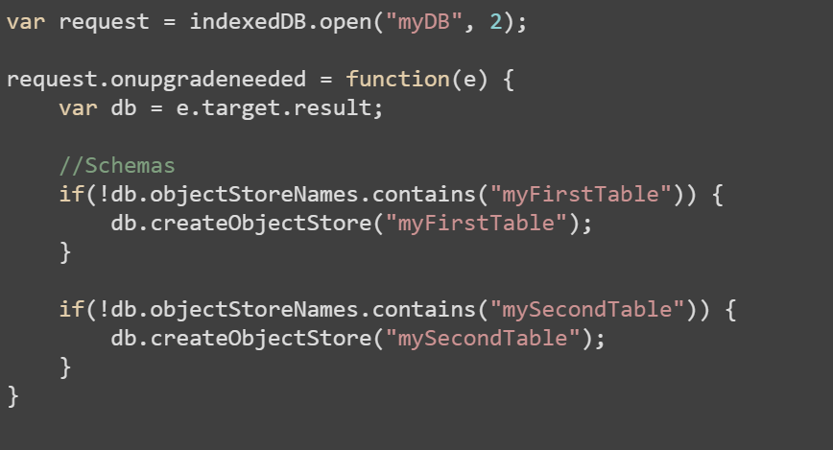
Step 2: Create Object Store
Event: onupgradeneeded

Slide 19
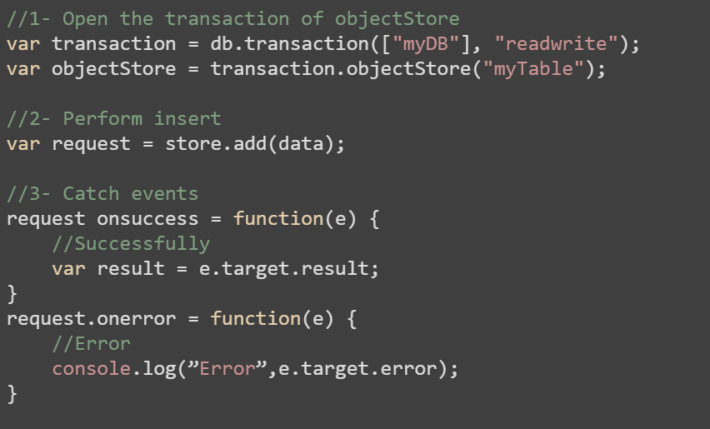
Step 3: Insert data
Insert data is
“readwrite” type
of transaction //TODO: check to see if insert action do has return value
Notes:
//1- Open the transaction of objectStore
var transaction = db.transaction(["myDB"], "readwrite");
var objectStore = transaction.objectStore("myTable");
//2- Perform insert
var request = store.add(data);
//3- Catch events
request onsuccess = function(e) {
//Successfully
var result = e.target.result;
}
request.onerror = function(e) {
//Error
console.log(”Error”,e.target.error);
}

Slide 20
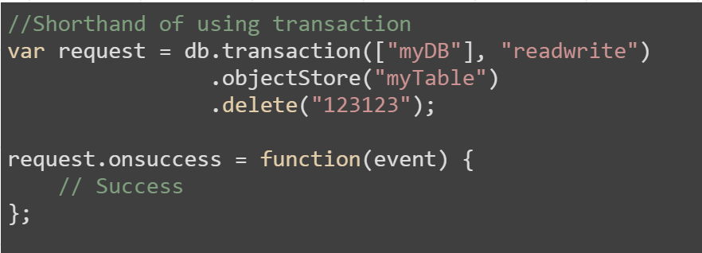
Step 4: Remove data
Input for delete function is Key of row data

Slide 21
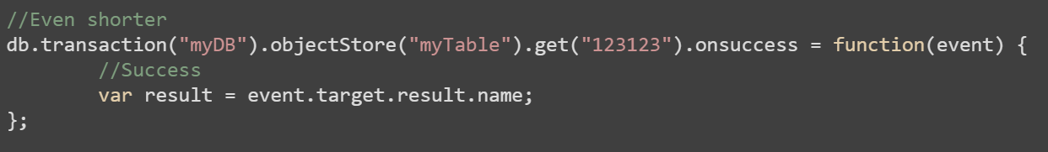
Step 5: Get data
Notes:
//Even shorter
db.transaction("myDB").objectStore("myTable").get("123123").onsuccess = function(event) {
//Success
var result = event.target.result.name;
}

Slide 22
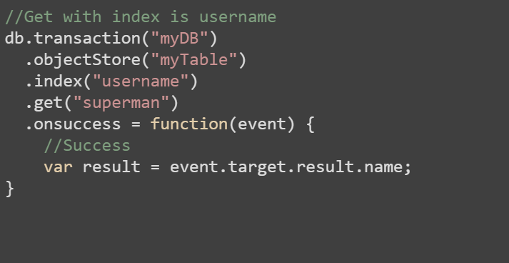
Step 5: Get data with index
Notes:
//Get with index is username
db.transaction("myDB")
.objectStore("myTable")
.index("username")
.get("123123")
.onsuccess = function(event) {
//Success
var result = event.target.result.name;
}

Slide 23
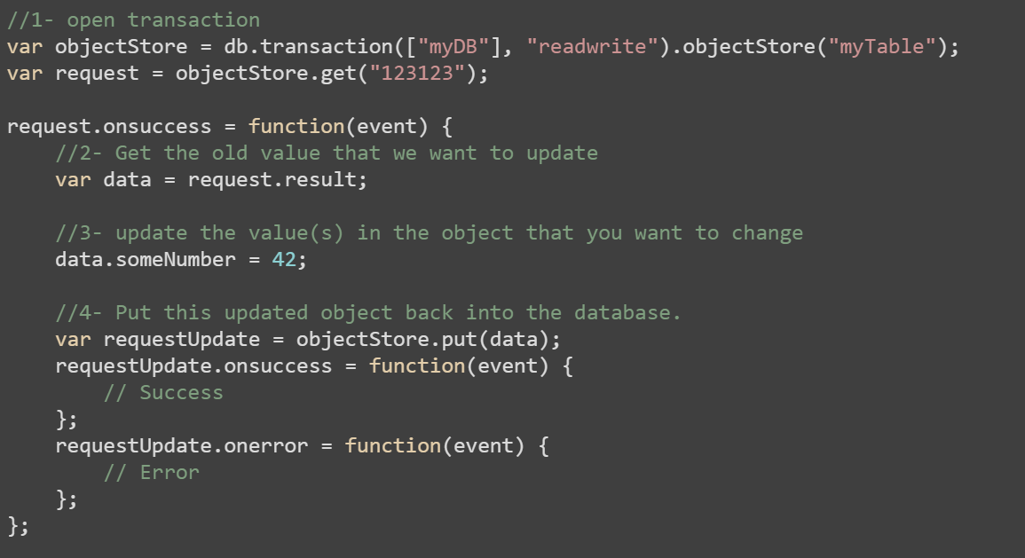
Step 6: Update data
Notes:
//1- open transaction
var objectStore = db.transaction(["myDB"], "readwrite").objectStore("myTable");
var request = objectStore.get("123123");
request.onsuccess = function(event) {
//2- Get the old value that we want to update
var data = request.result;
//3- update the value(s) in the object that you want to change
data.someNumber = 42;
//4- Put this updated object back into the database.
var requestUpdate = objectStore.put(data);
requestUpdate.onsuccess = function(event) {
// Success
};
requestUpdate.onerror = function(event) {
// Error
};
};

Slide 24
IndexedDB - Polyfill
Browsers which do not support IndexedDB
Fallback to WebSQL
http://nparashuram.com/IndexedDBShim/index.html
Helpful for Safari browser and mobile browsers

Slide 25
References
All definitions
https://developer.mozilla.org/en-US/docs/Web/API/IndexedDB_API/Basic_Concepts_Behind_IndexedDB
Working With IndexedDB
http://code.tutsplus.com/tutorials/working-with-indexeddb--net-34673
IndexedDB in detail
https://developer.mozilla.org/en-US/docs/Web/API/IndexedDB_API/Using_IndexedDB
IDB transaction
https://developer.mozilla.org/en-US/docs/Web/API/IDBTransaction
Asynchronous and Transactional Operation With IndexedDB
http://www.extremecss.com/asynchronous-and-transactional-operation-with-indexeddb-tutorial/
Good library
Jquery IndexedDB Plugin
http://nparashuram.com/jquery-indexeddb/

Slide 26
THANK YOU FOR YOUR ATTENTION!

