Slide 1


Slide 2
What is jQuery
Javascript Library
Fast and concise
Simplifies the interaction between HTML and JavaScript

Slide 3
Why jQuery?
Lightweight : 19KB in size (Minified and Gzipped)
CSS1 - 3 Complaint
Cross Browser
(IE 6.0+, FF 2+, Safari 3.0+, Opera 9.0+, Chrome)

Slide 4
Why jQuery?
Lightweight : 19KB in size (Minified and Gzipped)
CSS1 - 3 Complaint
Cross Browser
(IE 6.0+, FF 2+, Safari 3.0+, Opera 9.0+, Chrome)
Great Community Plugins
Tutorials TestCoverage
Open (free) license Books

Slide 5
A ajax and DOM manipulation example
if (!document.ELEMENT_NODE) { document.ELEMENT_NODE = 1; document.ATTRIBUTE_NODE = 2; document.TEXT_NODE = 3; document.CDATA_SECTION_NODE = 4; document.ENTITY_REFERENCE_NODE = 5; document.ENTITY_NODE = 6; document.PROCESSING_INSTRUCTION_NODE = 7; document.COMMENT_NODE = 8; document.DOCUMENT_NODE = 9; document.DOCUMENT_TYPE_NODE = 10; document.DOCUMENT_FRAGMENT_NODE = 11; document.NOTATION_NODE = 12; } document._importNode = function(node, allChildren) { switch (node.nodeType) { case document.ELEMENT_NODE: var newNode = document.createElement(node » .nodeName); /* does the node have any attributes to add? */ if (node.attributes && node.attributes » .length > 0) for (var i = 0; il = node.attributes.length; » i < il) newNode.setAttribute(node.attributes » .nodeName, node.getAttribute(node.attributes[i++] » .nodeName)); /* are we going after children too, and does » the node have any? */ if (allChildren && node.childNodes && » node.childNodes.length > 0) for (var i = 0; il = node.childNodes.length; » i < il) newNode.appendChild(document._importNode » (node.childNodes[i++], allChildren)); return newNode; break; case document.TEXT_NODE: case document.CDATA_SECTION_NODE: case document.COMMENT_NODE: return document.createTextNode(node.nodeValue); break; } };
http://www.alistapart.com/articles/crossbrowserscripting

Slide 6
It’s just a single line in jQuery
$(“#content”).load(“page.html #content”);

Slide 7














Who’s using jQuery?
http://docs.jquery.com/Sites_Using_jQuery

Slide 8
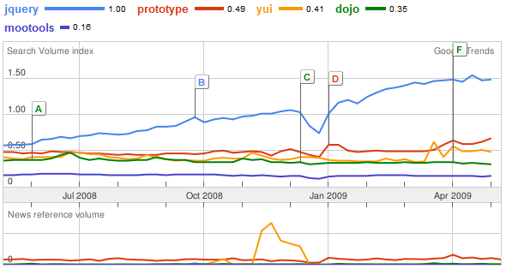
Dominating the world
Google trends comparison of last JS framework 12 months
http://www.google.com/trends?q=jQuery%2C+prototype%2C+yui%2C+dojo%2C+mootools&ctab=0&geo=all&date=ytd&sort=0

Slide 9
Let’s Start
Download jQuery
http://docs.jquery.com/Downloading_jQuery

Slide 10
Embed in you page
<html>
<head>
<script src=“path/to/jquery-x.x.js"></script>
</head>
<body> … </body>
</html>

Slide 11
Embed in you page
<html>
<head>
<script src="path/to/jquery-x.x.js"></script>
<script>
$(document).ready(function(){
// Start here
});
</script>
</head>
<body> … </body>
</html>

Slide 12
$(“div”).addClass(“xyz”);
jQuery philosophy
{
Find Some Elements
}
Do something with them
jQuery Object

Slide 13
A Basic Example
<body>
<div>
<p>I m a paragraph 1</p>
<p>I m a paragraph 2</p>
</div>
<p>I m another paragraph</p>
</body>

Slide 14
A Basic Example
Select all paragraphs.
$(“p”)
<body>
<div>
<p>I m a paragraph 1</p>
<p>I m a paragraph 2</p>
</div>
<p>I m another paragraph</p>
</body>

Slide 15
A Basic Example
Select all paragraphs. Add a class to them.
$(“p”).addClass(“red”);
<body>
<div>
<p class=“red”>I m a paragraph -1</p>
<p class=“red”>I m a paragraph -2</p>
</div>
<p class=“red”>I m another paragraph</p>
</body>

Slide 16
Selector Basics
Just pass a selector to $()
What is selector?
Use any CSS selector

Slide 17
Selector Basics
Think about your simplest css file.
#header{
margin : 0 auto;
}
div{
margin : 0px;
padding : 0px
}
ul.menu li{
…..
}

Slide 18
Selector Basics
The red colored items are selectors
#header{
margin : 0 auto;
}
div{
margin : 0px;
padding : 0px
}
ul.menu li{
…..
}

Slide 19
Selector Basics
Selecting using selectors
Selecting By Id
$(“#header”)

Slide 20
Selector Basics
Selecting using selectors
Selecting By Id
$(“#header”)
Selecting By Class
$(“.updated”)

Slide 21
Selector Basics
Selecting using selectors
Selecting By Id
$(“#header”)
Selecting By Class
$(“.updated”)
Selecting by tag name
$(“table”)

Slide 22
Selector Basics
Selecting using selectors
Selecting By Id
$(“#header”)
Selecting By Class
$(“.updated”)
Selecting by tag name
$(“table”)
Combine them
$(“table.user-list”)
$(“#footer ul.menu li”)

Slide 23
Basic Selector Example
This is my page
<body>
<div id=“header”>
<span id=“logo”>Logo here…</span>
<ul class=“menu”>
<li>user name</li>
…..
<li>logout</li>
</ul>
</div>
……
</body>

Slide 24
Basic Selector Example
$(“#header”)
<body>
<div id=“header”>
<span id=“logo”>Logo here…</span>
<ul class=“menu”>
<li>user name</li>
…..
<li>logout</li>
</ul>
</div>
……
</body>

Slide 25
Basic Selector Example
$(“ul.menu”)
<body>
<div id=“header”>
<span id=“logo”>Logo here…</span>
<ul class=“menu”>
<li>user name</li>
…..
<li>logout</li>
</ul>
</div>
……
</body>

Slide 26
Basic Selector Example
$(“ul.menu li”)
<body>
<div id=“header”>
<span id=“logo”>Logo here…</span>
<ul class=“menu”>
<li>user name</li>
…..
<li>logout</li>
</ul>
</div>
……
</body>

Slide 27
Using filters for selecting
Basic Filters
:first, :last, :even, :odd, …...

Slide 28
Basic Filters Example
Student list table. Lets make it zebra.
Name | Class | Roll No. | Comment
Raju | XII | 2 | Good
Masud | IX | 1 | Good
Apu | XII | 3
Mizan | XII | 5
Karim | VI | 2 | Satisfactory

Slide 29
Basic Filters Example
$(“#students tr:even”).css(“background-color”, “#dde”)
Name | Class | Roll No. | Comment
Raju | XII | 2 | Good
Masud | IX | 1 | Good
Apu | XII | 3
Mizan | XII | 5
Karim | VI | 2 | Satisfactory

Slide 30
Using filters for selecting
Basic Filters
:first, :last, :even, :odd, …...
Content Filters:
:empty , :contains(text), :has(selector), …..

Slide 31
Content Filters Example
$(“#students tr:even”).css(“background-color”, “#dde”);
$(“#students td.comment:empty”).text(“No Comment”);
Name | Class | Roll No. | Comment
Raju | XII | 2 | Good
Masud | IX | 1 | Good
Apu | XII | 3 | No Comment
Mizan | XII | 5 | No Comment
Karim | VI | 2 | Satisfactory

Slide 32
Using filters for selecting
Basic Filters
:first, :last, :even, :odd, …...
Content Filters:
:empty , :contains(text), :has(selector), …..
Attribute Filters:
[attribute], [attribute=value], [attribute!=value], …..

Slide 33
Attribute Filters Example
$(“#students tr:even”).css(“background-color”, “#dde”);
$(“#students td.comment:empty”).text(“No Comment”);
$(“#students td[align=‘center']").addClass(“ocean”);
Name | Class | Roll No. | Comment
Raju | XII | 2 | Good
Masud | IX | 1 | Good
Apu | XII | 3 | No Comment
Mizan | XII | 5 | No Comment
Karim | VI | 2 | Satisfactory

Slide 34
Using filters for selecting
Basic Filters
:first, :last, :even, :odd, …...
Content Filters:
:empty , :contains(text), :has(selector), …..
Attribute Filters:
[attribute], [attribute=value], [attribute!=value], …..
Forms
:input, :text, :submit, :password, …..
:enabled, :disabled, :checked, …..

Slide 35
Forms Selector Example
$(":submit").click(function(e){ … });
$("input:disabled").val(“You cannot change me");
$(“#form-id input:checked”).addClass(“selected”);

Slide 36
Now we can Select
Let’s perform some action

Slide 37
jQuery Methods
DOM Manipulation
before(), after(), append(), appendTo(), …..

Slide 38
Dom Manipulation Example
Move all paragraphs in div with id “contents”
$(“p”)
<body>
<h1>jQuery</h1>
<p>jQuery is good</p>
<p>jQuery is better</p>
<div id=“contents”></div>
<p>jQuery is the best</p>
</body>

Slide 39
Dom Manipulation Example
Move all paragraphs in div with id “contents”
$(“p”).appendTo(“#contents”);
<body>
<h1>jQuery</h1>
<div id=“contents”>
<p>jQuery is good</p>
<p>jQuery is better</p>
<p>jQuery is the best</p>
</div>
</body>

Slide 40
Dom Manipulation Example
Move all paragraphs in div with id “contents”
$(“p”).appendTo(“#contents”);
$(“h1”).append(“ Dom Manipulation”);
<body>
<h1>jQuery Dom Manipulation</h1>
<div id=“contents”>
<p>jQuery is good</p>
<p>jQuery is better</p>
<p>jQuery is the best</p>
</div>
</body>

Slide 41
jQuery Methods
DOM Manipulation
before(), after(), append(), appendTo(), …..
Attributes
css(), addClass(), attr(), html(), val(), …..

Slide 42
Attributes Example
Make the texts of last paragraph bold
$(“#contents p:last”).css(“color”, “green”);
<body>
<h1>jQuery Dom Manipulation</h1>
<div id=“contents”>
<p >jQuery is good</p>
<p>jQuery is better</p>
<p style=“color:green”>jQuery is the best</p>
</div>
</body>

Slide 43
More Attributes Example
Setting
$(“img.logo”).attr(“align”, “left”);
$(“p.copyright”).html(“&copy; 2009 ajaxray”);
$(“input#name”).val(“Spiderman”);

Slide 44
More Attributes Example
Setting
$(“img.logo”).attr(“align”, “left”);
$(“p.copyright”).html(“&copy; 2009 ajaxray”);
$(“input#name”).val(“Spiderman”);
Getting
var allignment = $(“img.logo”).attr(“align”);
var copyright = $(“p.copyright”).html();
var username = $(“input#name”).val();

Slide 45
jQuery Methods
DOM Manipulation
before(), after(), append(), appendTo(), …..
Attributes
css(), addClass(), attr(), html(), val(), …..
Events
click(), bind(), unbind(), live(), …..

Slide 46
Event Example
Start when DOM is ready
$(document).ready(function(){
$(selector).eventName(function(){…});
});

Slide 47
Event Example
Bind all interactions on events.
$(document).ready(function(){
$(“#message”).click(function(){
$(this).hide();
})
});
<span id=“message” onclick=“…”> blah blah </span>

Slide 48
Event Example
You can fire events manually.
$(document).ready(function(){
$(“span#message”).click(function(){
$(this).hide();
})
$(“#form-id:reset”).click();
});

Slide 49
jQuery Methods
DOM Manipulation
before(), after(), append(), appendTo(), …..
Attributes
css(), addClass(), attr(), html(), val(), …..
Events
click(), bind(), unbind(), live(), …..
Effects
hide(), fadeOut(), toggle(), animate(), …..

Slide 50
Effects Example
When “show-cart” link clicked, slide up/down “cart” div.
$(“a#show-cart”).click(function(){
$(“#cart”).slideToggle(“slow”);
})

Slide 51
Effects Example
Build your custom animation
$(“a#show-cart”).click(function(){
$(“#cart”).slideToggle(“slow”);
})
$("#showdown").click(function(){
$("#my-div").animate({
width: "70%",
opacity: 0.4,
fontSize: "3em“
}, 1200 );
});

Slide 52
jQuery Methods
DOM Manipulation
before(), after(), append(), appendTo(), …..
Attributes
css(), addClass(), attr(), html(), val(), …..
Events
click(), bind(), unbind(), live(), …..
Effects
hide(), fadeOut(), toggle(), animate(), …..
Ajax
load(), get(), ajax(), getJSON(), …..

Slide 53
Ajax Examples
Load a page in a container
$(“#comments”).load(“/get_comments.php”);
$(“#comments”).load(“/get_comments.php”, {max : 5});

Slide 54
Ajax Examples
Send ajax request with data
$.get(“/edit_comment.php",
{id: 102, comment: “I m edited"}
);

Slide 55
Ajax Examples
You can send serialized form as data
$.get(“/edit_comment.php",
$(“#edit-comment”).serialize()
);
id=102&comment=I+m+edited

Slide 56
Ajax Examples
Set a callback function for handling response data
$.get(“edit_comment.php",
$(“form#cmm-edit”).serialize(),
function(data){
if(data == “success”)
alert(“Comment Edited!”);
}
);

Slide 57
Chaining Methods
Most jQuery methods return jQuery object
You can chain them together

Slide 58
Chaining Methods
Most jQuery methods return jQuery object
You can chain them together
$(“#deleted”).addClass(“red”).fadeOut(“slow”);
$(“:button”).val(“Click Me”).click(function(){…})

Slide 59
Chaining Methods
Most jQuery methods return jQuery object
You can chain them together
$(“#deleted”).addClass(“red”).fadeOut(“slow”);
$(“:button”).val(“Click Me”).click(function(){…})
This will not work -
$(“:button”).val().click(function(){…})
This method will return string

Slide 60
jQuery Plugins
jQuery is extensible.

Slide 61
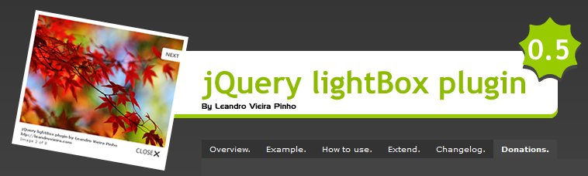
jQuery Plugins
jQuery lightBox
http://leandrovieira.com/projects/jquery/lightbox/

Slide 62


jQuery Plugins
Slider Plugins
http://www.hieu.co.uk/blog/index.php/imageswitch/
http://medienfreunde.com/lab/innerfade/

Slide 63
And thousands of more…
http://plugins.jquery.com/

Slide 64
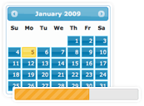
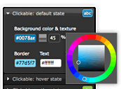

jQuery UI
Build highly interactive web applications

Slide 65
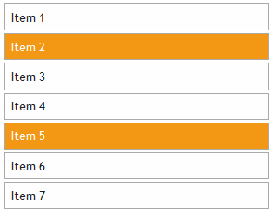
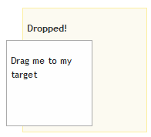
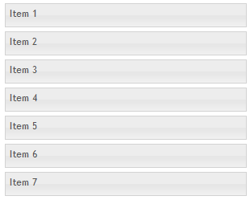
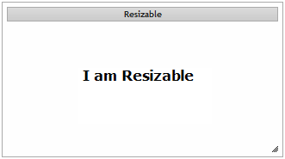
jQuery UI – Interactions
(Draggale, Droppable, Resizable, Selectable, Sortable)

Slide 66
jQuery UI – Sortable Example
$("#items").sortable();

Slide 67
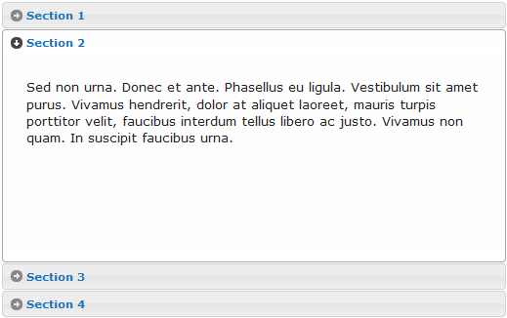
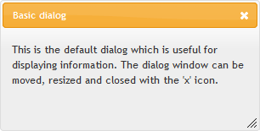
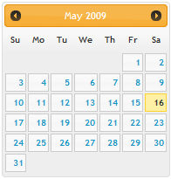
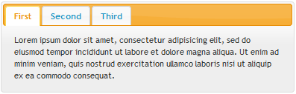
jQuery UI – Widgets
(Accordion, Datepicker, Dialog, Progressbar, Slider, Tabs)

Slide 68
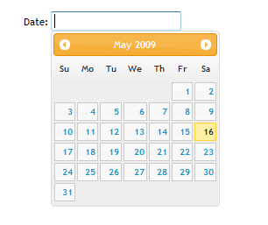
jQuery UI – Datepicker Example
$("#date").datepicker();

Slide 69
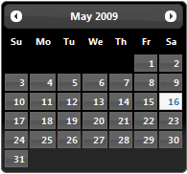
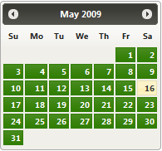
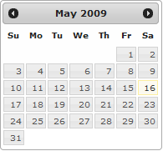
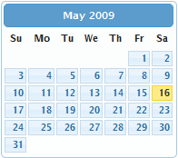
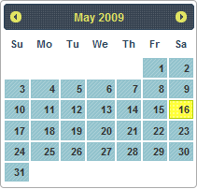
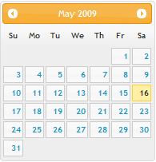
Which one will match your site?

Slide 70
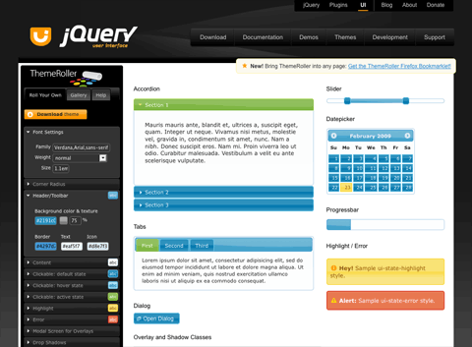
Designing a jQuery UI theme - Themeroller
http://ui.jquery.com/themeroller

Slide 71
Anis uddin Ahmad
Sr. Software Engineer
Right Brain Solution Ltd.
http://ajaxray.com

Slide 72
Questions?

Slide 73
THANK YOU

