Slide 1

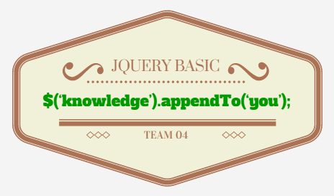
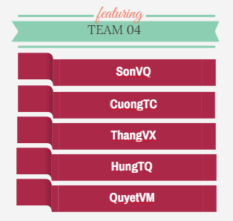
CHƯƠNG TRÌNH ĐÀO TẠO NHÂN VIÊN

Slide 2
TABLE OF CONTENT
JQUERY INTRODUCTION
TIÊU ĐỀ 02
TIÊU ĐỀ 03
…

Slide 3

What is jQuery
Light-weight Javascript library (19kb minified)
Easy and fast HTML DOM selection
Open Source
Work on all “modern” browsers (IE6+, FF 2.0+, Safari 3.0+, Opera 9+, Chrome 1.0+)

Slide 4

What is JQuery
Hi, I’m IE!

Slide 5
Advantages of jQuery
Well documented (http://docs.jquery.com)
Huge community of developers
Blogs, Twitter, Online Tutorials, Books, Conferences, Classes
jQuery is Extensible
Create/release your own plugins
Thousands of plugins available
jQuery works with other libraries
Prototype, Mootools
https://learn.jquery.com/using-jquery-core/avoid-conflicts-other-libraries/

Slide 6
Who is using jQuery
Google
Amazon
IBM
Microsoft
Netflix
Twitter
Dell, Inc.
NBC
EA
Match
MLB
ESPN
Best Buy

Slide 7
Setting up jQuery
Include jQuery on the page
Download latest from jQuery.com <script src=“jquery-1.11.3.min.js”></script>
<script src=“jquery-2.1.4.min.js” ></script>
Include the latest from Google AJAX Libraries API <script src="http://ajax.googleapis.com/ajax/libs/jquery/2.1.4/jquery.min.js" type="text/javascript"></script>

Slide 8
CSS
hasClass()
addClass()
removeClass()
toggleClass()
css()
offset()
posision()
jQuery.cssHooks
jQuery.cssNumber
scrollLeft()
scrollTop()
height()
innerHeight()
outerHeight()
width()
innerWidth()
outerWidth()

Slide 9
Attributes
attr()
html()
prop()
removeAttr()
removeProp()
val()

Slide 10
Manipulation
after()
append()
appendTo()
before()
clone()
detach()
empty()
insertAfter()
insertBefore()
pretend()
pretendTo()
remove()
replaceAll()
replaceWidth()
text()
unwrap()
wrap()
wrapAll()
wrapInner()

Slide 11
SUMMARIZE
Tổng hợp các ý chính
Đề xuất các nội dung tiếp theo
…

Slide 12
REFERENCES
www.qsoftvietnam.com
www.qsoftvietnam.com
…

Slide 13


Slide 14
THANK YOU!

