Slide 1

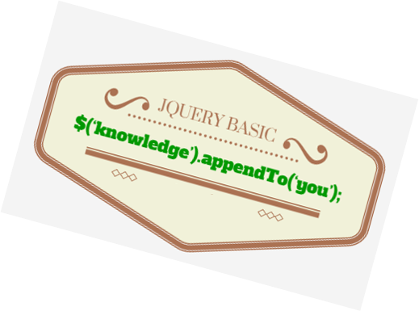
BASIC JQUERY TRAINING

Slide 2

Table of contents
What is Javascript
What is Jquery
JQuery Main Function
How to debug
JS best practices
Some Demo
Q & A

Slide 3
What is Javascript
React to user action on web
Included in html
Make effect for website
Process user request without page reload
Do things across multiple browsers (IE, Safari)
Do things that css cannot do or too complicated

Slide 4

What is Javascript
Hi, I’m IE!

Slide 5

What is jQuery
Light-weight Javascript library (19kb minified)
Easy and fast HTML DOM selection
Open Source
Work on all “modern” browsers (IE6+, FF 2.0+, Safari 3.0+, Opera 9+, Chrome 1.0+)

Slide 6
JQuery Main Function
Data Processing
  Calculate frontend data (add to cart, draw charts)
  Communicate backend through Ajax (CRUD)

Slide 7
JQuery Main Function
Effect for web, react to user action, animation,...
  JS selectors (like css selector)
  Css (hasClass, addClass, height, offset, position,...)
  Attributes (attr, val, html,...)
  Manipulation (append, empty, pretend…)
  Responsive with js
  Binding event, prevent default, stop propagation

Slide 8
How to debug
Console.log
Alert
Debug tool of chrome

Slide 9
JS best practices
Right place to put javascript in html
  Priority for each js files
  Priority for each js code block, setTimeout function
  Put js files at bottom
  Remember using DOM ready check
Use minified version if using 3rd party js library
Minify js when deploy
Combine js files to reduce number of js files
Use common and specific js file separately

Slide 10
Want to see some real demo?

Slide 11


Slide 12


