Slide 1

Beginning
Notes:
START TIMER!!!
I’d like to welcome you to jQuery Conference 2009.
This is Beginning jQuery
!!!REMEMBER SLOW DOWN!!!! BREATHE!!!!

Slide 2
Introduction
Ralph Whitbeck
Senior Web Application Engineer
BrandLogic Corporation
http://brandlogic.com
Blog: http://ralphwhitbeck.com
Twitter: RedWolves
Notes:
My name is Ralph Whitbeck
I am a senior web application engineer for BrandLogic Corporation which specialized in branding, design and interactive applications where we use jQuery to create rich user interfaces for our clients.
You can read my blog at ralphwhitbeck.com where I write about jQuery, ASP.NET and other various web development topics that are interesting to me.
And finally you can follow me on Twitter with my screen name RedWolves

Slide 3
Introduction
Tip Jar is open
Tips can be sent via paypal
ralph.whitbeck@gmail.com
*Speaker Note*
Pause so audience can write down address
Notes:
Please note that the tip jar is currently open.

Slide 4
Setting Expectations
  This begins the first part of a three part beginners track
Notes:
The first three talks in the Io room will be beginner focused and will help you get up to speed quickly.

Slide 5
Setting Expectations
  This begins the first part of a three part beginners track
    Beginning jQuery
Notes:
The first talk is Beginning jQuery and I’ll go over what we’ll cover in this talk in a minute.

Slide 6
Setting Expectations
  This begins the first part of a three part beginners track
    Beginning jQuery
    Extending jQuery - Understanding plugins
Notes:
At some point jQuery core methods will not be enough to make the desired rich user interfaces and functionality that is needed. That’s when it becomes necessary to turn to jQuery plugins or extend jQuery yourself.
Cody Lindley will explore plugins and their usefulness and how to extend jQuery by walking us through making your own plugin.

Slide 7
Setting Expectations
  This begins the first part of a three part beginners track
    Beginning jQuery
    Extending jQuery - Understanding plugins
    Beginning jQuery UI
Notes:
In the third talk Richard D. Worth with walk us through jQuery UI. jQueryUI is a suite of official jQuery plugins that can be used to build rich internet applications
You will learn about the major components in each jQuery UI area
-Interactions
-Widgets
-Theming
-Effects

Slide 8
Setting Expectations
Notes:
So let’s set some expectations of this talk

Slide 9
Setting Expectations
  This talk is for those just starting out with jQuery
Notes:
You should be here if you are new to jQuery and want to learn more about jQuery and how to use it. Beginners and those just starting out is the intended audience.

Slide 10
Setting Expectations
  This talk is for those just starting out with jQuery
  We'll explore jQuery's history
Notes:
We'll quickly walk through the progression of jQuery from start to it’s current release.
Because it's important to understand the path of how we got here.
Plus I’ll throw a couple of interesting tid bits of fun facts at you as well.

Slide 11
Setting Expectations
  This talk is for those just starting out with jQuery
  We'll explore jQuery's history
  Meet the core team
Notes:
I’ll show you how the core jQuery team is structured tell you how each smaller team helps to develop, promote and support jQuery and the community and I’ll Introduce you to the individual team members

Slide 12
Setting Expectations
  This talk is for those just starting out with jQuery
  We'll explore jQuery's history
  Meet the core team
  How jQuery works
Notes:
We'll break a line of jQuery down to see why it’s structured the way it is we’ll also see how to use jQuery and how it's simplistic focus works to make client side development easy by looking at examples of jquery in action.

Slide 13
Setting Expectations
  This talk is for those just starting out with jQuery
  We'll explore jQuery's history
  Meet the core team
  How jQuery works
  Get jQuery on your page
Notes:
We’ll explore what you need to do to get jQuery in your web page so you can start to write less and do more with your javascript.

Slide 14
Setting Expectations
  This talk is for those just starting out with jQuery
  We'll explore jQuery's history
  Meet the core team
  How jQuery works
  Get jQuery on your page
  Walk through a real-world examples
Notes:
Finally, from scratch we’ll roll up our sleeves and get our hands dirty and write some code.
We’ll write a few lines of code and display some of my tweets from twitter in a web page using jQuery and the Twitter API.

Slide 15
What is jQuery?
Notes:
So What is jQuery?

Slide 16
What is jQuery?
  jQuery is JavaScript
Notes:
jQuery is valid JavaScript because jQuery is built with JavaScript.
jQuery makes writing JavaScript Easier.

Slide 17
What is jQuery?
  With JavaScript show a hidden element
if (browserType == "gecko" ) document.poppedLayer =
eval('document.getElementById(”HiddenDIV")');
else if (browserType == "ie") document.poppedLayer =
eval('document.getElementById(”HiddenDIV")');
else
document.poppedLayer =
eval('document.layers[”HiddenDIV"]'); document.poppedLayer.style.visibility = "visible";
Notes:
To make an element visible that is set to display: none with css using straight JavaScript would take at least these number of lines.
Take note of the browser sniffing. For each browser we need to get at the element using different methods. So we have tests for the various browser types then we load the DOM element into a object which we can then set the css style visibility to visible and the element with then show.
What we aren’t seeing in this example is the block that is setting the value of browserType which is done using feature detection and user agent sniffing. Which you must do manually. So you can test if document.all is true which means it’s functionality is available and we know that document.all is ie specific. We then set BrowserType to IE.
That has to be setup on every manually and browser tested everytime we are going to access the DOM.
jQuery gives us a better way.

Slide 18
What is jQuery?
  Show a hidden div using jQuery
  $(“#HiddenDIV”).show();
Notes:
With jQuery we initialize the jQuery object which provides us with all the cross browser capabilities built in. We then select our DOM elements and we then perform an action against it.
So in this example in one line of code we can do the same thing as the dozen or so lines of code but we do not need to worry about how to reference the DOM in IE or Firefox or Opera or Safari because jQuery is handling all the cross-browser quirks for us.
In case I didn’t get across that jQuery allows you to do more with less let me try to illustrate this point visually.
Let's pretend for a minute we were going to use JavaScript and jQuery to make Star Wars. jQuery can't make Star Wars...yet, but if it could, lets see what would happen. This’ll be fun.
Now lets say as a developer we were to use straight JavaScript with no library support; after a few months and a couple of thousands of lines of code most developers would come up with something like this...

Slide 19
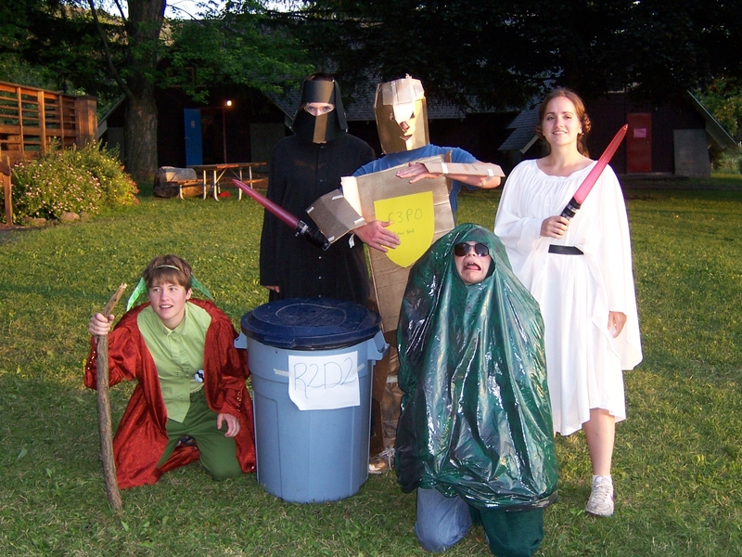
Notes:
it's distguishable as Star Wars to most but it's not very professional or I would say "polished".
There are so many problems with this you wouldn’t even know where to begin.
Seriously, what is the garbage kid? Giedo or a really bad Jabba the Hutt?
Needless to say Most would say it's not cross-platform. For instance this wouldn't work on TV or on the Big Screen.
It's probably safe to say this version of Star Wars would not of been awarded or nominated for an Academy Award in 1977.
It really works on the internet…maybe.
Now if you used jQuery to make Star Wars, after a couple of weeks of development and a few hundred lines of code you'd get this...

Slide 20
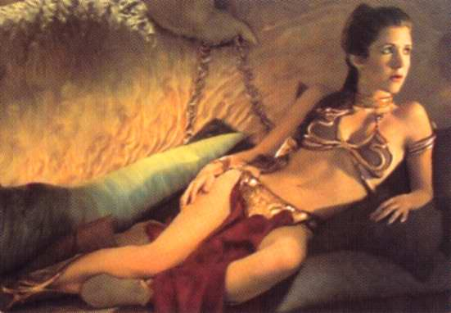
Notes:
Now this is the star wars we’ve come to know and love.
This is cross-platform as it works on all platforms, TV, Movies, as a poster in my bedroom in 1983.
We are able to select HTML DOM elements from DOMa the hutt and we can chain actions and events together to get Bikini Princess Leia. Plus it took a lot less work.
Yeah it's a stretch but you get the idea.

Slide 21
What is jQuery?
  jQuery is JavaScript
  It's a light-weight library (19kb minified and GZIPed)
Notes:
So back to what is jQuery?
So with all this cross-browser support you might think that a library that makes writing JavaScript easier would be huge.
But It has a relatively small foot print. At 19K it’s smaller then most of the graphics you may also be loading onto the page.
when you download the production version which is minified and GZIPed for maximum efficiency the total file size is 19KB
We'll learn how we can utilize Google's Content Delivery Network to cache jQuery for faster loading.

Slide 22
What is jQuery?
  jQuery is JavaScript
  It's a light-weight library (19kb minified and GZIPed)
  Easy and fast HTML DOM Selection
Notes:
The power of jQuery comes in it's selector engine which makes working with the HTML DOM easy. In a recent release the selector engine was changed to the blazing fast Sizzle selector engine which is open source as well.

Slide 23
What is jQuery?
  jQuery is JavaScript
  It's a light-weight library (19kb minified and GZIPed)
  Easy and fast HTML DOM Selection
  Built to work on all "modern" browsers
  (IE6+, FF 2.0+, Safari 3.0+, Opera 9+, Chrome 1.0+)
Notes:
jQuery works and is supported in all the modern browsers listed here including IE6. We all would love a day when our clients stop using IE 6 but until that day comes jQuery will support IE 6 and it helps immensely in overcoming some of it’s many short falls.
jQuery is tested to work is all modern browsers. The team ensures that there are no issue due to the extensive unit testing that is performed in each browser. Before a major or minor release jQuery’s test suite needs to be run and all tests must pass on each of the browsers listed here before it's released.
To make this job easier John Resig recently released a Mozilla Labs product called TestSwarm which helps javascript libraries like jQuery run their test suites on a distributed set of browsers running portions of the test suite in parallel making development and testing happen much faster.
Anyone can offer a browser to the swarm to help test. Just go to testswarm.com to find out how.

Slide 24
What is jQuery?
  jQuery is JavaScript
  It's a light-weight library (19kb minified and GZIPed)
  Easy and fast HTML DOM Selection
  Built to work on all modern browsers
  (IE6+, FF 2.0+, Safari 3.0+, Opera 9+, Chrome 1.0+)
  It's Open Source
Notes:
jQuery is licensed under both the MIT and GPL open source licenses and you can choose the license that best suits your personal or commercial project and use it accordingly.

Slide 25
What can jQuery Produce?
  High school students from Spotswood High School
  Jamie Gilar
  John Cicolella
  Demo’d http://www.jamie.strunex.net/homework/channel/
Notes:
So now that we know what jquery is let’s see what it can produce.
To demonstrate this I’d like to bring up a couple of special guests. Jamie Gillar and John Cicolella from Spotswood High school in New Jersey built a site for a school project that relied heavily on jQuery to produce a rich usable experience. They are going to come up here and tell us how jQuery made it easy for them to develop their site.

Slide 26
Benefits to jQuery
Notes:
Let’s explore some of the benefits to you as the developer or designer of working with jQuery.

Slide 27
Benefits to jQuery
  Well documented (http://docs.jquery.com)
Notes:
jQuery has one of the best documentation sites for any open source software package, in my opinion.
Methods are segmented into easy to understand categories that make finding what your looking for easier.
Third party tools make it easy to access the docs where ever you want for instance there is an Adobe AIR application available that has the API documentation so that it is easy to reference from your desktop. Plenty of cheat sheets are on the web including the one on the back of your program for easy look-up of methods and syntax.

Slide 28
Benefits to jQuery
  Well documented (http://docs.jquery.com)
  Thriving community of developers
    Blogs
    Twitter
    Online Tutorials
    Books
    Conferences
    Classes
Notes:
There is a strong community around jQuery
There are many blogs dedicated to jQuery such as
Learning jQuery.com
Many Twitter accounts dedicated to jQuery here are some official accounts:
@jQuery
@jqueryui
Then there are accounts like ElijahManor who tweets links to tutorials, blog posts, podcasts related to jQuery.
Online Tutorial sites
NETTUTS
15 days of jQuery
Numerous books that are out and that are slatted to come out
Learning jQuery
jQuery in Action
upcoming jQuery Cookbook that I cowrote which you all got an early copy of when you checked in this morning.
Conferences
jQuery Conference which is getting bigger year over year.
AJAX Experience which starts on Monday
Full Frontal JavaScrpt run by Remy Sharp in England
Every barcamp now at least has one presentation related to jQuery.
There seems to be a increases in training classes now offered for instance:
Karl Swedburg offers classes in Michigan and
Rebecca Murphy offers occasional classes in NC

Slide 29
Benefits to jQuery
  jQuery is Extensible
    Create/release your own plugins
    Thousands of plugins available
Notes:
jQuery is extensible, which means developers can develop plugins to extend the functionality of jQuery.
There are thousands of plugins currently available in the plugin repository at plugins.jquery.com. You can find many others by searching Google or Bing for your desired function followed by ‘jQuery plugin” and you’ll most likely find what you’ll need.

Slide 30
Benefits to jQuery
  jQuery is Extensible
    Create/release your own plugins
    Thousands of plugins available
  jQuery works with other libraries
    Prototype
    Mootools
Notes:
jQuery assigns the global $ variable to the jQuery object as a shortcut. But other libraries also assign an object to the global $ variable.
When this happens you'll have a conflict and one of the libraries won't work correctly.
jQuery offers a .noconflict method which frees the assignment to the $ back to the other library and you will need to reference the jQuery object as a variable named jQuery instead of the $ alias.
On a side note jQuery has only two global variables it uses. $ and the variable called jQuery. $ is the only variable that has a high chance of being overwritten which brings the chance of conflicts with other libraries and third party code very low.
So with this ease of writing rich applications that work cross-browser and with all these benefits you might expect jQuery to be used by some high profile companies…

Slide 31
Who is using jQuery?
  Google
  Amazon
  IBM
  Microsoft
  Netflix
  Twitter
  Dell, Inc.
  NBC
  EA
  Match
  MLB
  ESPN
  Best Buy
Notes:
And that’s exactly what we see. Here are just a select few of the featured sites using jQuery.
But many sites are using jQuery as it’s now included in many development environments making it easy for developers to build blogs, Content management systems and many other sites using jQuery.
Plus with the thriving jQuery community constantly giving back with plugins and tutorials it’s getting easier and easier to build richness into your site.
So how did we get this thriving community? Where did jQuery come from?

Slide 32
jQuery's History
jQuery was released:
January 14, 2006
BarCampNYC
Notes:
jQuery was released at BarCampNYC in January 14th
John gave two presentations that day
- A Hot Demo Session
John demo'd three projects he was working on for his company at the time, Juniper Bay one of those projects was jQuery
-jQuery
-Subverting Social Networks
-co presented with Eric Skiff
-Voted best presentation of BarCamp

Slide 33
jQuery's History
Versions
  1.0 - August 26, 2006
Notes:
1.0 was the first official release after an alpha release in june. It sported a new web site this release marked a huge overhaul in the development process.

Slide 34
jQuery's History
Versions
  1.0 - August 26, 2006
  1.1 - January 14, 2007
Notes:
The 1.1 release marked jQuery’s first birthday from it’s release at BarCampNYC. This release marked 10-20x faster speed improvements then it’s previous release. The API was significantly refactored into a more simplified and consolidated API. Many of the one off methods were condenst into a few methods that did common tasks. This release also sported another web site refresh. And the documentation was completely overhauled and really came into it’s own and started to look like it does today.

Slide 35
jQuery's History
Versions
  1.0 - August 26, 2006
  1.1 - January 14, 2007
  1.1.3 - July 5, 2007
Notes:
The 1.1.3 release boasted a 800% speed improvement over previous release as well as a rewritten event system which included graceful keyboad event handling and rewritten effects methods.
A major announcement that accompanied this release was the new official project that would bring a collection of user interface plugins to jQuery later that year, jQuery UI

Slide 36
jQuery's History
Versions
  1.2 - September 10, 2007
Notes:
1.2 was a Massive new release which included new features around selectors and new methods. The release removed a number of confusing or unused methods and a compatibility plugin was released in conjuction to help in the transition to this release.

Slide 37
jQuery's History
Versions
  1.2 - September 10, 2007
  jQuery UI released - September 16, 2007
Notes:
The first major release of jQuery UI is released.

Slide 38
jQuery's History
Versions
  1.2 - September 10, 2007
  jQuery UI released - September 16, 2007
  1.2.6 - May 24, 2008
Notes:
We quickly arrived at version 1.2.6 after a couple of buggy and problematic releases. This release boasted event handlers that were 103% faster, css selectors that were 13%faster then previous releases. The popular dimensions plugin that is used by plugin developers to determine positioning was incorporated into the core library. Finally this release came with more new features.

Slide 39
jQuery's History
Versions
  Web site redesign - August 28, 2008
Notes:
At the end of the summer last year the designers tried to have some fun with the design of the web site.

Slide 40
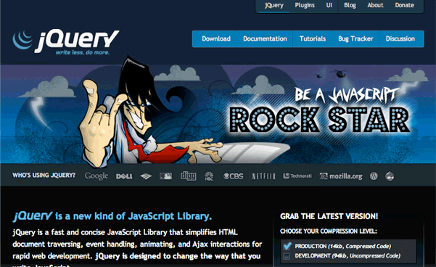
jQuery's History
Notes:
The “Be a JavaScript Rockstar” tag line proved to be controversal as it did not sit well with the community and the community voiced their opinion. Loudly. But the team listened to the feedback that was being given and quickly, within 24 hours removed the rockstar graphic and fixed the design into what you see today.

Slide 41
jQuery's History
Versions
  Web site redesign - August 28, 2008
  1.3 - January 14, 2009
Notes:
1.3
- released on jQuery's 3rd birthday. (seeing a pattern here yet)
The release was released with a new selector engine called Sizzle which boasted significant improvements in selector speed.
Live Events: ability to attach events to elements which might not be available at the time the page loads.
No More Browser Sniffing: Using feature detection to help jQuery last for many more years to come.
-jQuery announces it will join the Software Freedom Conservancy
This affords many benefits to the project the key being that copyright is transferred to the conservancy and ensures no one person owns contributions and patches.
This process of joining the conservancy is still being worked out between the team and the conservancy so look for more information on the blog sometime soon.

Slide 42
jQuery's History
Versions
  Web site redesign - August 28, 2008
  1.3 - January 14, 2009
  1.3.2 - February 20, 2009
Notes:
This brings us to the current release 1.3.2

Slide 43
jQuery's Core Team
Notes:
Now that we’ve reviewed jquery history…let’s meet the team that is responsible for development, evangelizing and supporting jquery.

Slide 44
jQuery's Core Team
Development
  John Resig
  Brandon Aaron
  Ariel Flesler
  Jörn Zaefferer
Notes:
The Development team is charged with developing the core jQuery library the team includes...

Slide 45
jQuery's Core Team
Evangelism
  Rey Bango
  Karl Swedberg
  Cody Lindley
Notes:
Evangelism team is charged with communicating and reaching out to the community and showing them why jQuery is the right tool for the job. Another job they hold is to listen to the community and come back to the development team and discuss what direction the community wants to go in next.

Slide 46
jQuery's Core Team
jQuery UI
  Paul Bakaus
  Richard D. Worth
  Scott González
  Todd Parker
  Many others
Notes:
The jQuery UI team is charged with making rich plugins, widgets and effects to help with User Interface Elements

Slide 47
jQuery's Core Team
Plugins
  Yehuda Katz
  Klaus Hartl
  Mike Alsup
Notes:
The plugin team is in charge of driving the actual plugin development process and answering questions and concerns of other plugin developers.
Ultimately they will also be in charge of maintaining official jQuery plugins that are coming soon.

Slide 48
jQuery's Core Team
Web, Design and Infrastructure
  Scott Jehl
  Mike Hostetler
  Jonathan Sharp
Notes:
The web and design team are responsible for designing and maintaining the jquery web infrastructure.

Slide 49
Setting up jQuery
Notes:
So what do you need to do to be able to use jQuery on your page.

Slide 50
Setting up jQuery
Include jQuery on the page
Notes:
You need to include jQuery on the page.
There are two ways to do this.

Slide 51
Setting up jQuery
Include jQuery on the page
  Download latest from jQuery.com
  <script src="jquery-1.3.2.min.js" type="text/javascript"></script>
Notes:
You can download the jquery library from the jquery site and save it somewhere in your site structure. Perhaps save it into a scripts folder or the root of the site.

Slide 52
Setting up jQuery
Include jQuery on the page
  Download latest from jQuery.com
  <script src="jquery-1.3.2.min.js" type="text/javascript></script>
  Include the latest from Google AJAX Libraries API
  <script src="http://ajax.googleapis.com/ajax/libs/jquery/1.3.2/jquery.min.js" type="text/javascript"></script>
Notes:
The second way is to reference the latest jquery file from the Google AJAX Libraries. You’ll gain the speed and the location based serving that Googles CDN offers. You’ll also gain the ability of pulling jQuery from the users cache because if a user accesses another site that used the Google CDN then your site will use that copy in your site.
Once you have jQuery on the page you need to wait till the DOM is loaded and ready before executing your jquery.

Slide 53
Setting up jQuery
Set jQuery to run when the DOM is loaded.
$(document).ready(function(){
//put your jQuery code here.
});
Notes:
To do that we call document dot ready which waits till the DOM is loaded and then starts the execution of the ready function.
This is useful if you bind an event to a DOM Element. By putting it in the Document.Ready method you will ensure the DOM is loaded before the event is attached. Otherwise the DOM element might not be load before the event is bound.

Slide 54
How jQuery Works
$("div").show();
Notes:
Here is a typical jQuery statement. All jQuery statements have this basic structure to it.
jQuery is all based around selecting some HTML DOM elements using CSS selectors and performing an action against it.
So let's break this statement down into it's parts and understand what's happening.

Slide 55
How jQuery Works
$
Initiate the jQuery Object
Notes:
The jQuery library maps the dollar sign variable to the jQuery Object.
You can also initiate the jQuery object directly like this...

Slide 56
How jQuery Works
jQuery("div").show();
Notes:
This is benifitial if you need to free up the $ alias to other libraries with the noconflict method.
but this line is syntatically the same as the previous version of this line.

Slide 57
How jQuery Works
("div")
Select Elements
Notes:
The power of jQuery lies in it's ability to quickly parse the HTML DOM and select the elements.
jQuery has full CSS Selector 1-3 support

Slide 58
How jQuery Works
$("div")
$("div#intro h2")
$("div.section > p")
$("a[href='http://www.jquery.com']")
$("ul#nav li:first")
Notes:
Here are some examples of typical jQuery selectors which are basic css 1-3 selectors.
jQuery has better css support then most browsers

Slide 59
How jQuery Works
.show()
Do Something
Notes:
After you've made your selection jQuery will return a collection.
Now, you need to do something with that collection like perform an action.
For instance you can manipulate the collection, set up interactions or create animations (as we are doing in this example),

Slide 60
How jQuery Works
Demo
(Demo based on: http://ejohn.org/apps/learn-jquery/)
Notes:
Learning-jquery.html

Slide 61
How jQuery is Structured
  Core
  Selectors
  Attributes
  Traversing
  Manipulation
  CSS
  Events
  AJAX
  Effects
Notes:
jQuery organizes it's methods into the following categories to make it easy to look up a method that you are looking to use.

Slide 62
jQuery Core
  .each()
  .length()
  .eq()
  .get()
  .index()
  .data()
  .removeData()
...and many more!
Notes:
jQuery Core provides essential methods to work with jquery objects, jquery data, methods for plugin development and interoperability with other libraries.

Slide 63
Selectors
#id
element
.class
:first
:last
:not(selector)
[attribute=value]
...and many more!
Notes:
Selectors provide the syntax for selecting DOM elements. jQuery provides the ability to do basic selectors, hierarchal selectors, Filters, content filtering, visibility filtering, attibute filtering, Child filters and form based filters.

Slide 64
Attributes
.removeAttr()
.addClass()
.hasClass()
.removeClass()
.toggleClass()
.html()
.val()
...and many more!
Notes:
Attributes allow you to get, set add and remove attributes from your matched elements as well as getting and setting the innerHTML, Text and values.

Slide 65
Traversing
.not()
.add()
.children()
.context()
.next()
.prevAll()
.siblings()
...and many more!
Notes:
Traversing allows you to work within your matched set. So you can more precisely pinpoint your matched set even further.
jQuery provides methods to filter the match set further, find another query in your matched set and restore the matched set to it's previous state before filtering and finding methods were run against the original matched set. Reword!!!!!

Slide 66
Manipulation
.append()
.after()
.insertAfter()
.wrap()
.replaceWith()
.empty()
...and many more!
Notes:
Manipulation allows you to manipulate the DOM to insert new elements, remove existing elements or manipulate existing elements by wrapping new tags around them.
jQuery has methods that let you change contents, insert elements inside existing elements, insert outside existing elements, insert around existing elements, replace elements, remove elements and copy elements. (remove elements)

Slide 67
CSS
.width()
.innerHeight()
.height()
.outerHeight()
.offset()
.position()
.css()
...and many more!
Notes:
CSS methods allow you to work directly with the css properties of the matched element. From retrieving the css value of a property to setting the css value. Retriveing and setting positioning values to height and width values.

Slide 68
Events
.ready()
.mouseout()
.trigger()
.hover()
.toggle()
.blur()
.live()
...and many more!
Notes:
Events allow you to bind event handlers to a matched element. Set up Live events for elements that may bubble up after the DOM is loaded. Be able to perform interactive functions with standard mouse and keyboard events like mouseover, mouseout, keydown and keyup amongst other events.

Slide 69
AJAX
.ajax()
.load()
.getJSON()
.getScript()
.serialize
.get()
.post()
...and many more!
Notes:
AJAX methods allow you to work with various forms of data, HTML, JSON, JavaScript all remotely.
jQuery allows you to send and receive AJAX requests and handle AJAX Events

Slide 70
Effects
.hide()
.show()
.fadeTo()
.slideToggle()
.toggle()
.slideUp()
.slideDown()
...and many more!
Notes:
Effects allow you to do some simple User Interface interactions by allowing you to show/hide elements. Slide or fade elements in or out. Or create custom animations that take and element from one CSS state to another by gradually moving the set css properties till they get to the new desired CSS properties.

Slide 71
Putting it all together
Real-World
Demo
(Demo based on: http://ralphwhitbeck.com/2007/11/20/PullingTwitterUpdatesWithJSONAndJQuery.aspx)
Notes:
Create Twitter feed widget.

Slide 72
Thank You
Speaker rate
http://speakerrate.com/talks/1400-beginning-jquery
Notes:
Ask if there are any questions if there is time.

Slide 73
Thank You
Speaker rate
http://speakerrate.com/talks/1400-beginning-jquery
Notes:
Ask if there are any questions if there is time.

