Slide 1

PHP Overview
CHƯƠNG TRÌNH ĐÀO TẠO NHÂN VIÊN
MÔN HỌC: PHP Programming
Trình bày: Nguyễn Phi Linh
HANOI – SEP, 2015

Slide 2

What is PHP
PHP: Hypertext Preprocessor
PHP is a widely-used, open source scripting language
PHP is free to download and use
It is deep enough to run the largest social network (Facebook)!

Slide 3
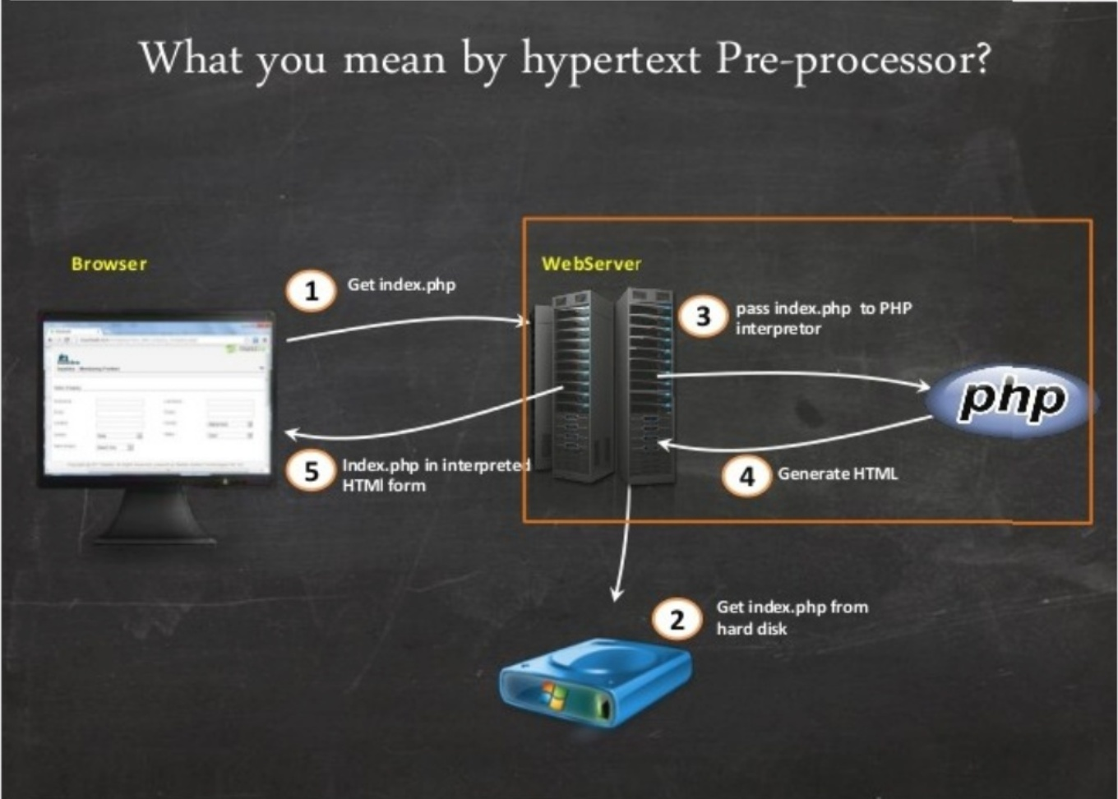
Work Flow

Slide 4
What is a PHP File ?
PHP files can contain text, HTML, CSS, Javascript, and PHP code
PHP code are executed on the server, and the result is returned to the browser as plain HTML
PHP file have extension ".php"

Slide 5
What Can PHP Do ?
PHP can generate dynamic page content
PHP can create, open, read, write, delete, and close files on the server
PHP can collect form data
PHP can add, delete, modify data in your database

Slide 6
Why PHP
PHP runs on various platform (Windows, Linux, Unix, Mac OS X, etc)
PHP is compatible with almost all servers used today (Apache, IIS, etc)
PHP supports a wide range of databases
PHP is free. Download it from the official PHP resource: www.php.net
PHP is easy to learn and runs efficiently on the server side

Slide 7

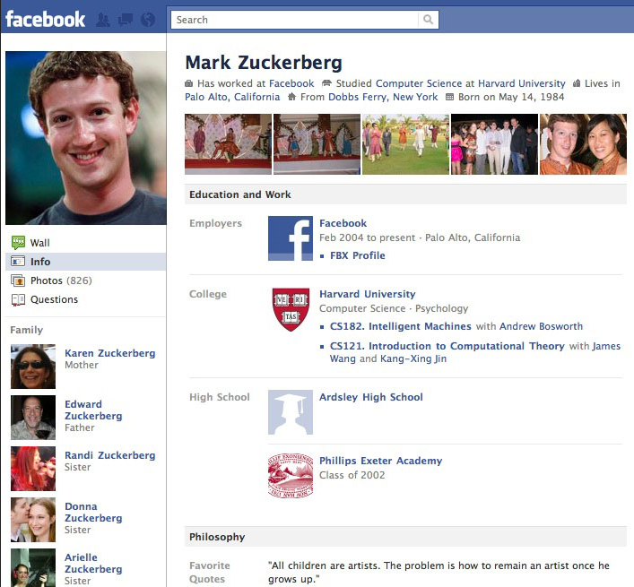
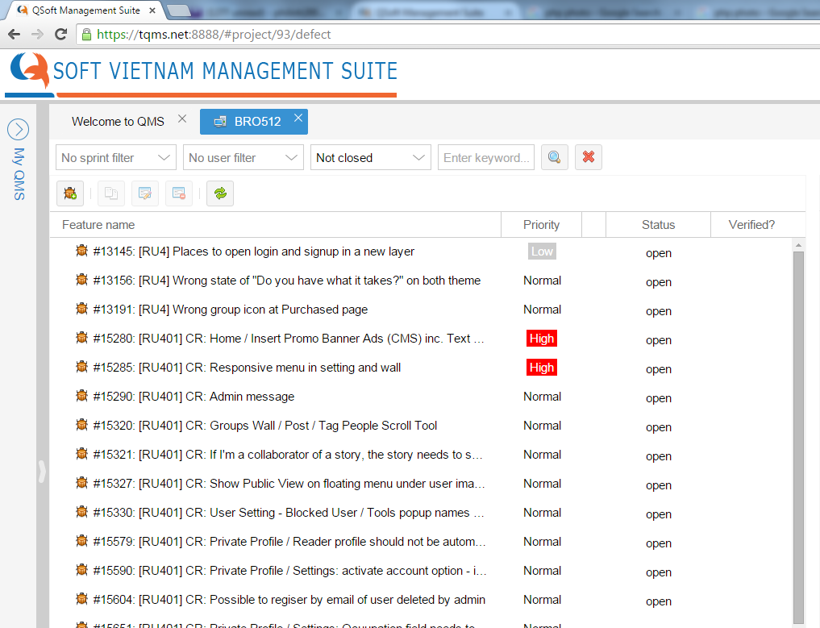
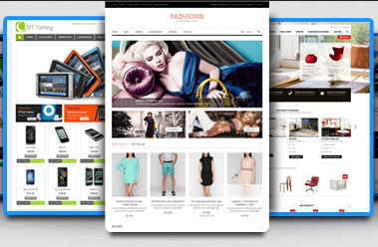
Who use PHP
20+ million domain

Slide 8
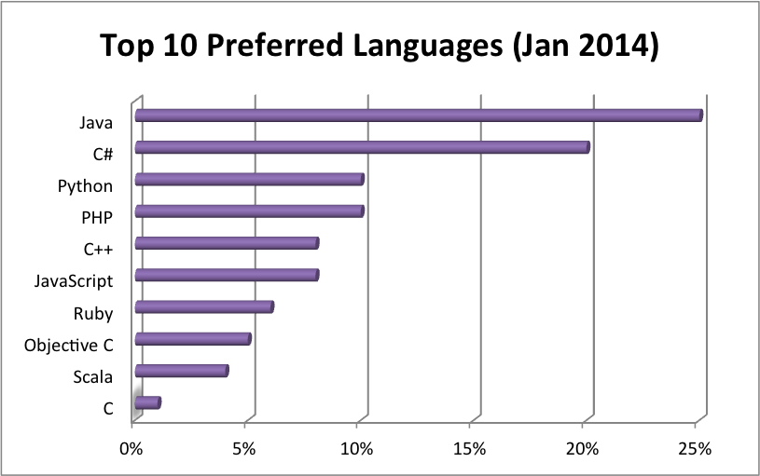
When we can use PHP
Now
Future …
Or looking for the Trends of PHP If you want

Slide 9
HOW ?

Slide 10


Install
install a web server
install PHP
install a database
ref: http://php.net/manual/en/install.php

Slide 11
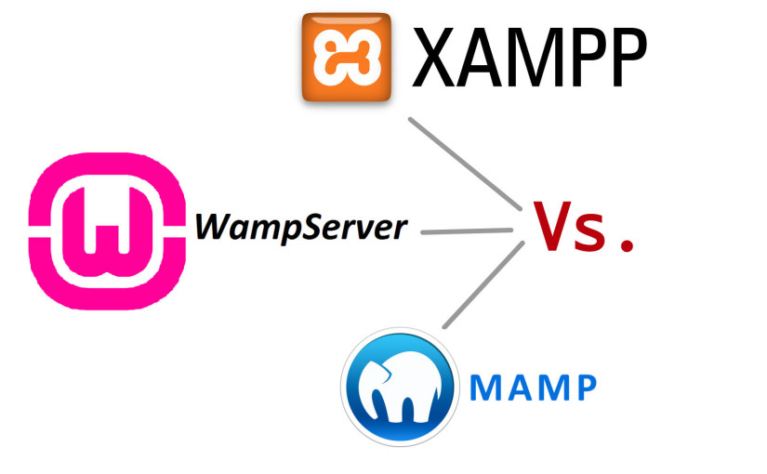
Bundle Install

Slide 12
The better 4 U
XAMPP
WAMP
MAMP
OS: Windows, Linux, Mac OS X
Apache
PHP
MySQL + phpMyAdmin
Updated OpenSSL
PHP XMLRPC
MSSQL PHP extension
PostgreSQL PHP extension
OS: Windows
Apache
PHP
MySQL + phpMyAdmin
OS: Windows, Mac OS X
Apache
PHP
eAccelerator
reverse proxy nginx support
APC cache library
Python
Perl
WHAT ABOUT YOU ?

Slide 13
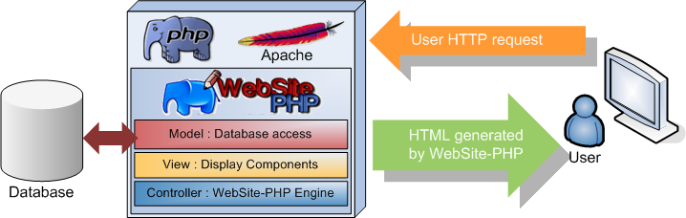
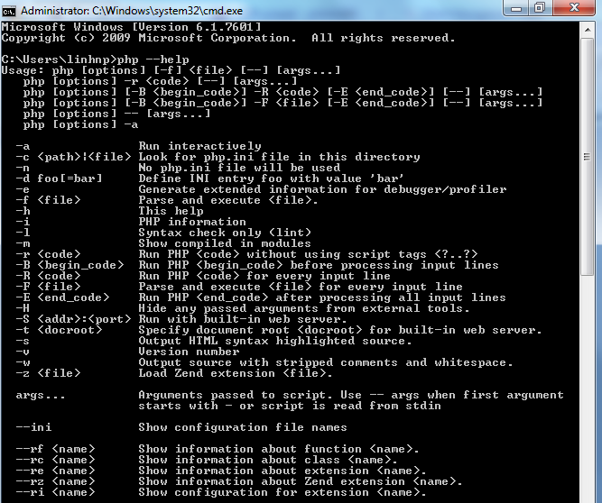
Execute PHP
Syntax:
<?php
//comment
?>
or short tag
<? echo “Hello”; ?>

Slide 14





Working with Database
THIS TRAINING FOCUS ON PHP & MySQL

Slide 15
Topics to Study
PHP Basic
PHP Advanced
III. MySQL Database
IV. PHP OOP
V. PHP - XML, AJAX, New feature
VI. PHP UNIT

Slide 16
I. PHP Basic
PHP Include
PHP Variables and Data Types
PHP Control structures
PHP Functions
PHP Superglobals
PHP Working with Form
PHP Using the Query String
PHP Send Email

Slide 17
II. PHP Advanced
PHP Working with Strings, Arrays
PHP Date and Time
PHP Working with File and Directory
PHP Cookies, Sessions
PHP Filters
PHP Error Handling and Exception
PHP Namespaces
PHP Debugging

Slide 18
III. MySQL Database
MySQL Connect to Database
MySQL Create DB
MySQL Create Table
MySQL Manipulate with Data (Insert, Update, Delete, Select)
MySQL Get Last ID
MySQL Prepared
MySQL Limit Data

Slide 19
IV. PHP OOP
The Benefits of OOP (Encapsulation, Inheritance, Polymorphism)
Key OOP Concepts (Classes, Objects, Fields, Properties, __set(), Constants, Methods)
Type Hinting
Constructors and Destructors
Static Class Members
The instanceof Keyword
Helper Functions
Autoloading Objects
Object cloning
Inheritance
Interfaces
Abstract classes

Slide 20
V. PHP - XML, AJAX, New feature
PHP XML Parsers
PHP SimpleXML Parser
PHP SimpleXML - Get
PHP XML Expat
PHP XML DOM
AJAX Working with PHP
AJAX RSS Reader
PHP New feature (Traits, Generators)

Slide 21
VI. PHP UNIT
Introduction to PHPUnit
Assertions, Writing a Useful Test and @dataProvider
Testing Protected/Private Methods, Coverage Reports and CRAP
Mock Objects, Stub Methods and Dependency Injection
Mock Methods and Overriding Constructors

Slide 22


Slide 23
THANK YOU!

