Slide 1
Demo
Unit testing

Slide 2
Assert Test
assertTrue, assertFalse
assertEquals, assertSame
assertArrayHasKey, assertContains

Slide 3
AdvancedAssertTest

Slide 4
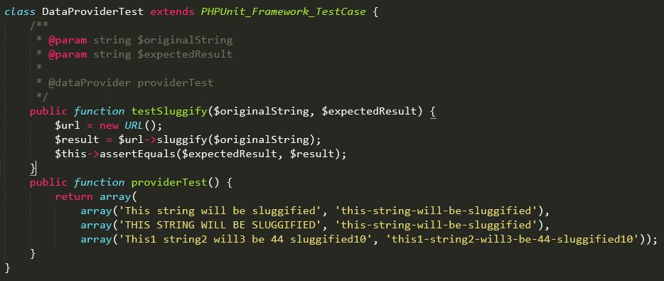
Data Provider Test

Slide 5
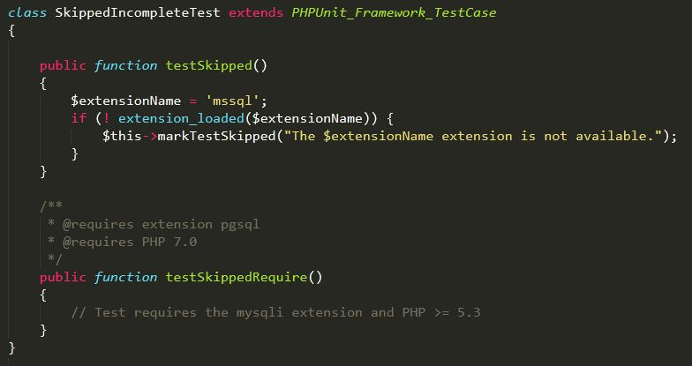
Skipped & Incomplete Test

Slide 6
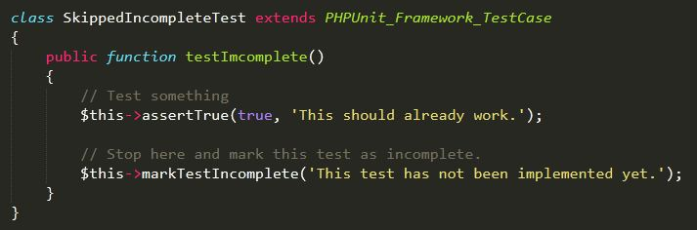
Skipped & Incomplete Test (cont)

Slide 7
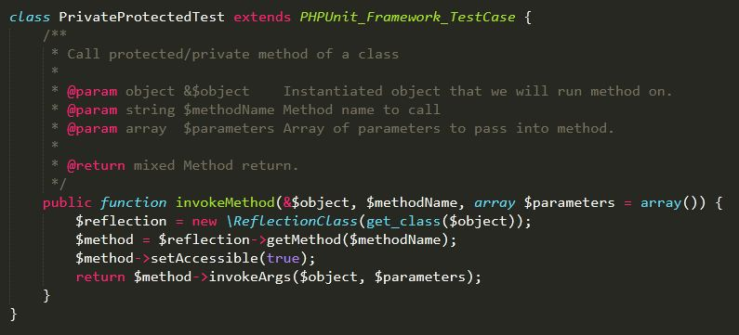
Private Protected Test

Slide 8
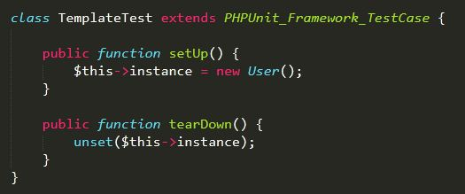
Template Test

Slide 9


Slide 10
THANK YOU!

