Slide 1
Demo
Unit testing

Slide 2
Assert Test
assertTrue, assertFalse
assertEquals, assertSame
assertArrayHasKey, assertContains
expectOutputString

Slide 3
AdvancedAssertTest

Slide 4
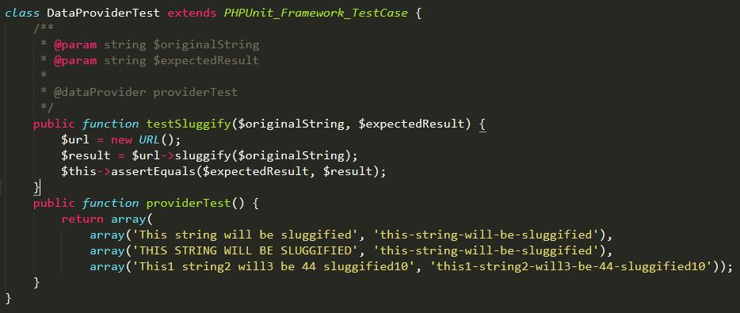
Data Provider Test

Slide 5
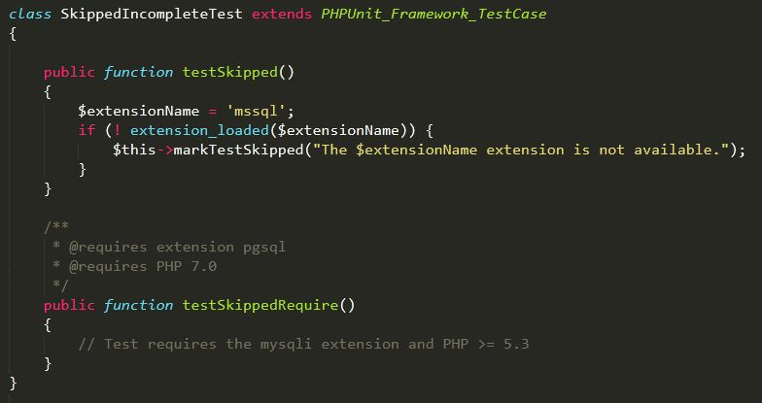
Skipped & Incomplete Test

Slide 6
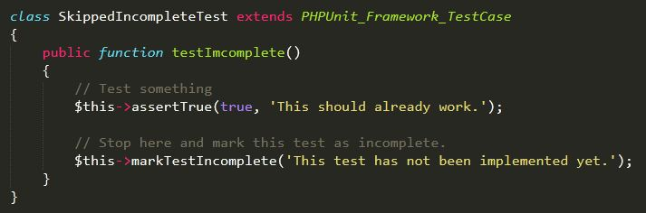
Skipped & Incomplete Test (cont)

Slide 7
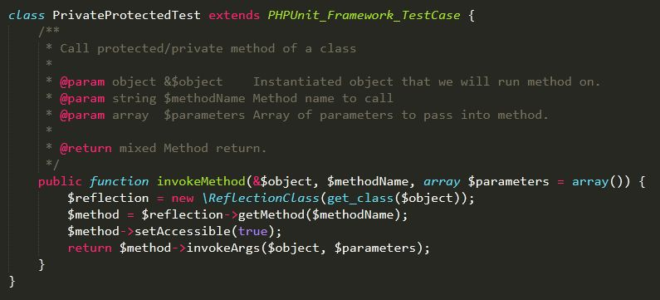
Private Protected Test

Slide 8
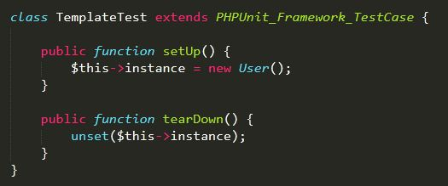
Template Test

Slide 9
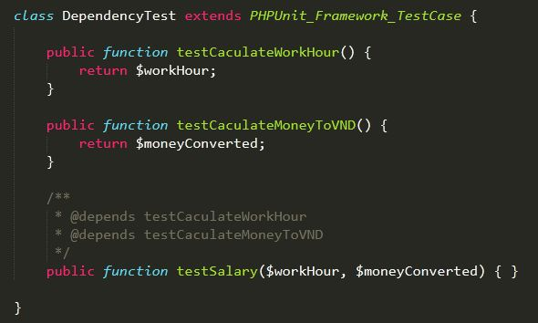
Dependency Test

Slide 10
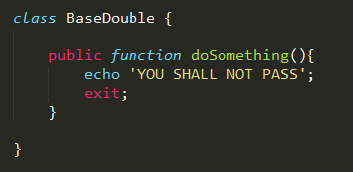
Test Doubles

Slide 11
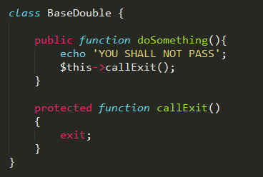
Test Doubles (cont)

Slide 12
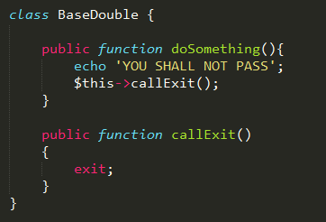
Test Doubles (cont)

Slide 13
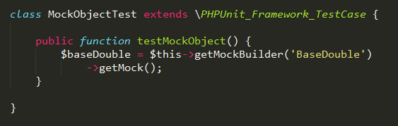
Test Doubles (cont)

Slide 14
4 ways of getMockBuilder
nothing | array() | null | array(‘foo’)
All stubs Return null Overridable | All stubs Return null Overridable | All mocks Run actual code Don’t allow override | Mixed Foo (same 1/2) Other (same 3)

Slide 15
Mock Object
A mock object is an object that extends the class you define
Allows to perform nifty tricks and assertions on it.

Slide 16
Stub Method
A stub method is a method contained within a mock object that returns null by default
But allows you to easily override the return value.

Slide 17
Mock Method
It does the exact same thing its original method does
Any code that is in the method you are mocking will run actual code and will not return null by default

Slide 18


Slide 19
THANK YOU!

