Slide 1
ExtJS Theming System
CHƯƠNG TRÌNH ĐÀO TẠO NHÂN VIÊN
Trình bày: Vũ Quang Sơn
HANOI – NOV, 2015

Slide 2
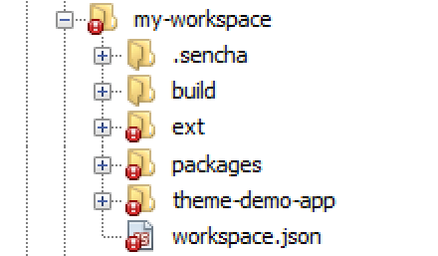
Generate App for Theme

Slide 3

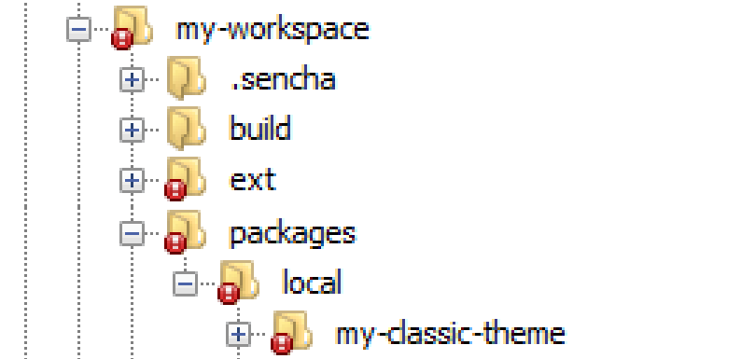
Generate Theme Package

Slide 4
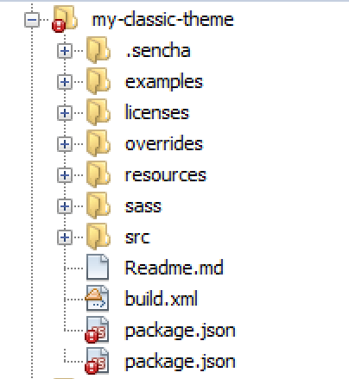
File Structure

Slide 5
File Structure
package.json | package properties (name, version, and dependencies)
sass/ | theme files
sass/var/ | variables
sass/src/ | rules and UI mixin
sass/etc/ | additional utility functions or mixins
sass/example | used in image slicing
resources/ | images and static resources
overrides/ | JavaScript overrides Ext JS component classes

Slide 6
Running Theme
?platformTags=fashion:true
Update changes on browser without refresh (nearly real time)

Slide 7


Slide 8
THANK YOU!

