Slide 1
PHPUnit
Julia Bondar
040593
IAPM23

Slide 2
Agenda
What is PHPUnit
How to write an automated test
Writing and running tests with PHPUnit
Advantages and disadvantages of PHPUnit

Slide 3
PHPUnit
Testing with PHPUnit means checking that your program behaves as expected, and performing a battery of tests, runnable code-fragments that automatically test the correctness of parts (units) of the software. These runnable code-fragments are called unit tests.

Slide 4
Print-based test -> Automated test
<?php
$fixture = array();
// $fixture is expected to be empty.
$fixture[] = 'element';
// $fixture is expected to contain one element.
?>

Slide 5
Print-based test -> Automated test
<?php
$fixture = array();
print sizeof($fixture) . "\n";
$fixture[] = 'element';
print sizeof($fixture) . "\n";
?>
0
1

Slide 6
Print-based test -> Automated test
<?php
$fixture = array();
print sizeof($fixture) == 0 ? "ok\n" : "not ok\n";
$fixture[] = 'element';
print sizeof($fixture) == 1 ? "ok\n" : "not ok\n";
?>
ok
ok

Slide 7
Automated test
<?php
$fixture = array();
assertTrue(sizeof($fixture) == 0);
$fixture[] = 'element';
assertTrue(sizeof($fixture) == 1);
function assertTrue($condition)
{
if (!$condition) {
throw new Exception('Assertion failed.');
}
}
?>

Slide 8
Writing Tests with PHPUnit
<?php
require_once 'PHPUnit/Framework.php';
class ArrayTest extends PHPUnit_Framework_TestCase
{
public function testNewArrayIsEmpty()
{
// Create the Array fixture.
$fixture = array();
// Assert that the size of the Array fixture is 0.
$this->assertEquals(0, sizeof($fixture));
}
public function testArrayContainsAnElement()
{
// Create the Array fixture.
$fixture = array();
// Add an element to the Array fixture.
$fixture[] = 'Element';
// Assert that the size of the Array fixture is 1.
$this->assertEquals(1, sizeof($fixture));
}
}
?>

Slide 9
Test class should extend the class PHPUnit_Framework_TestCase.
The tests are public methods that expect no parameters and are named test*
Inside the test methods, assertion methods such as assertEquals() are used to assert that an actual value matches an expected value.

Slide 10
The Command-Line Test Runner
The PHPUnit command-line test runner can be invoked through the phpunit command.
>phpunit ArrayTest
PHPUnit 3.0.0 by Sebastian Bergmann.
..
Time: 00:00
OK (2 tests)
.
  Printed when the test succeeds.
F
  Printed when an assertion fails while running the test method.
E
  Printed when an error occurs while running the test method.
S
  Printed when the test has been skipped.
I
  Printed when the test is marked as being incomplete or not yet implemented.

Slide 11
Incomplete Tests
public function testSomething()
{
// Stop here and mark this test as incomplete.
$this->markTestIncomplete(
'This test has not been implemented yet.‘);
}
A test as being marked as incomplete or not yet implemented.

Slide 12
Skipping Tests
<?php
require_once 'PHPUnit/Framework.php';
class DatabaseTest extends PHPUnit_Framework_TestCase
{
protected function setUp()
{
if (!extension_loaded('mysqli')) {
$this->markTestSkipped(
'The MySQLi extension is not available.'
);
}
}
}
?>

Slide 13
Fixtures
setUp() method – is called before a test method run
tearDown() method – is called after a test method run
setUp() and tearDown() will be called once for each test method run.

Slide 14
Use of setUp() method
<?php
require_once 'PHPUnit/Framework.php';
class ArrayTest extends PHPUnit_Framework_TestCase
{
protected $fixture;
protected function setUp()
{
$this->fixture = array(); // Create the Array fixture.
}
public function testNewArrayIsEmpty()
{
// Assert that the size of the Array fixture is 0.
$this->assertEquals(0, sizeof($this->fixture));
}
public function testArrayContainsAnElement()
{
$this->fixture[] = 'Element'; // Add an element to the Array fixture.
// Assert that the size of the Array fixture is 1.
$this->assertEquals(1, sizeof($this->fixture));
}
}
?>

Slide 15
TestCase Extensions
Testing Exceptions
<?php
require_once 'PHPUnit/Extensions/ExceptionTestCase.php';
class ExceptionTest extends PHPUnit_Extensions_ExceptionTestCase
{
public function testException()
{
$this->setExpectedException('Exception');
}
}
?>

Slide 16
TestCase Extensions
Testing Output
<?php
require_once 'PHPUnit/Extensions/OutputTestCase.php';
class OutputTest extends PHPUnit_Extensions_OutputTestCase
{
public function testExpectFooActualFoo()
{
$this->expectOutputString('foo');
print 'foo';
}
public function testExpectFooActualBar()
{
$this->expectOutputString('foo');
print 'bar';
}
}
?>

Slide 17
TestCase Extensions
Testing Performance
<?php
require_once 'PHPUnit/Extensions/PerformanceTestCase.php';
class PerformanceTest extends PHPUnit_Extensions_PerformanceTestCase
{
public function testPerformance()
{
$this->setMaxRunningTime(2);
sleep(1);
}
}
?>

Slide 18
Code-Coverage Analysis
How do you find code that is not yet tested?
How do you measure testing completeness?
>phpunit --report ./report SomeTest
PHPUnit 3.0.0 by Sebastian Bergmann.
....
Time: 00:00
OK (4 tests)
Generating report, this may take a moment.

Slide 19
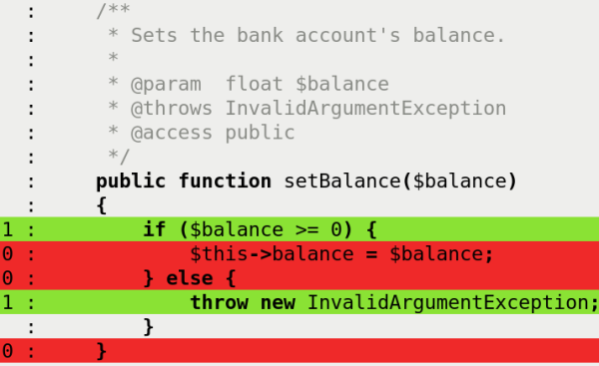
Lines of code that were executed while running the tests are
highlighted green, lines of code that are executable but were not
executed are highlighted red, and "dead code" is highlighted orange.

Slide 20
Advantages
Testing gives code authors and reviewers confidence that patches produce the correct results.
Detect errors just after code is written
The tests are run at the touch of a button and present their results in a clear format.
Tests run fast
The tests do not affect each other. If some changes are made in one test, the results of others tests do not change.

Slide 21
Disadvantages
Some people have trouble with getting started: where to put the files, how big the scope of one unit test is and when to write a separate testing suite and so on.
It would be difficult to write a test for people who are not programmers or familiar with PHP.

Slide 22
Questions?

