Slide 1
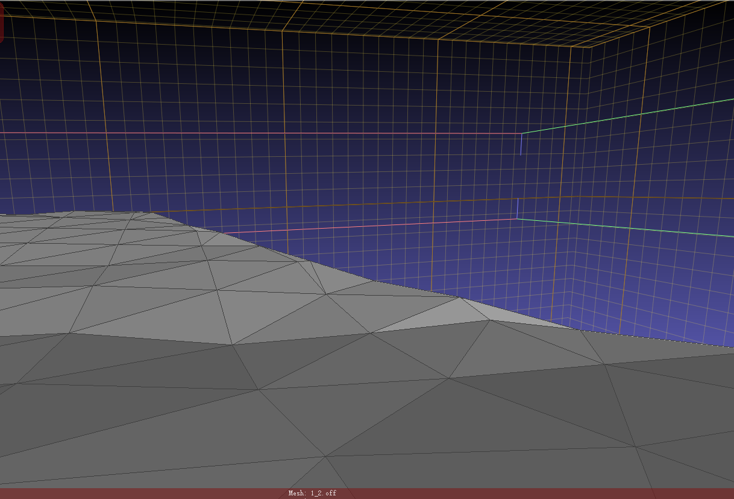
N3
N2
N1

Slide 2
N2
P2
N1
N3
P3
P1

Slide 3
N
z
y
x

Slide 4
V
1
0
1
U

Slide 5
z
y
x

Slide 6
A
n2
searchEdge
pStart
pStart.dual
P
C
n1
B

Slide 7
n1
A
C
pStart.dual
n2
n0
c
pStart
P
B

Slide 8
n1
A
C
pStart
pStart.dual
n2
n0
c
P
B

Slide 9
VA
VC
C=n1
pStart
pStart.dual
n2
P
VB

Slide 10
VA
pStart
pStart.dual
VC
c
P
VB

Slide 11
VA
VB
c
pStart
pStart.dual
P
VC

Slide 12
n1
A
C
pStart.dual
n2
n0
c
pStart
P
B

