Slide 1


INSTITUTE FOR ADVANCED COMPUTING AND SOFTWARE DEVELOPMENT AKURDI, PUNE
WEBSECBALANCER USING DVWA
GROUP NO: 18
Pratiksha Sonwane (233435)
Shobhana Undre (233445)
CENTRE COORDINATOR PROJECT GUIDE
Mr.Rohit Puranik Mr. Kartik Awari

Slide 2
Introduction
In a rapidly evolving digital landscape, the security of web applications cannot be compromised. That's where the WebSecBalancer steps in.
Recently, the revolutionary growth of web application usage started to increase in a large way which made the possibility of more web application weaknesses and vulnerabilities to appear and more infiltration attempts to happen on daily basis
This project is a convergence of two critical components: web application security testing and load balancing.
By synergizing these elements, we create a comprehensive system that not only exposes potential vulnerabilities but also optimizes application performance.

Slide 3
Purpose
The purpose this project is to create a controlled and educational environment for learning and practicing web application security testing. This project aims to achieve several goals such as :
Testing Techniques: The project provides a space for experimenting with various security testing techniques.
Safe Environment: The isolated nature of the project ensures that any security testing carried out is contained within the controlled environment .
Security Training: It allows to practice identifying vulnerabilities like SQL injection, cross-site scripting (XSS), and more in a safe and controlled environment.
Resource Optimization: The concept of a load-balanced system for security testing shows how a testing load can be distributed across multiple instances to ensure accurate results without overwhelming any single instance.

Slide 4
Requirement
Software
1. Operating system: Debian 10
2. EC2 Instances
3. DVWA
4. Docker
5. HAProxy
6 Burp suite
Hardware
Sr.no | Components | Minimum requirements
1 | CPU | 2.5 GHz
2 | RAM | 8 GB
3 | Storage | 500 GB
4 | Network | 100 Mbps

Slide 5
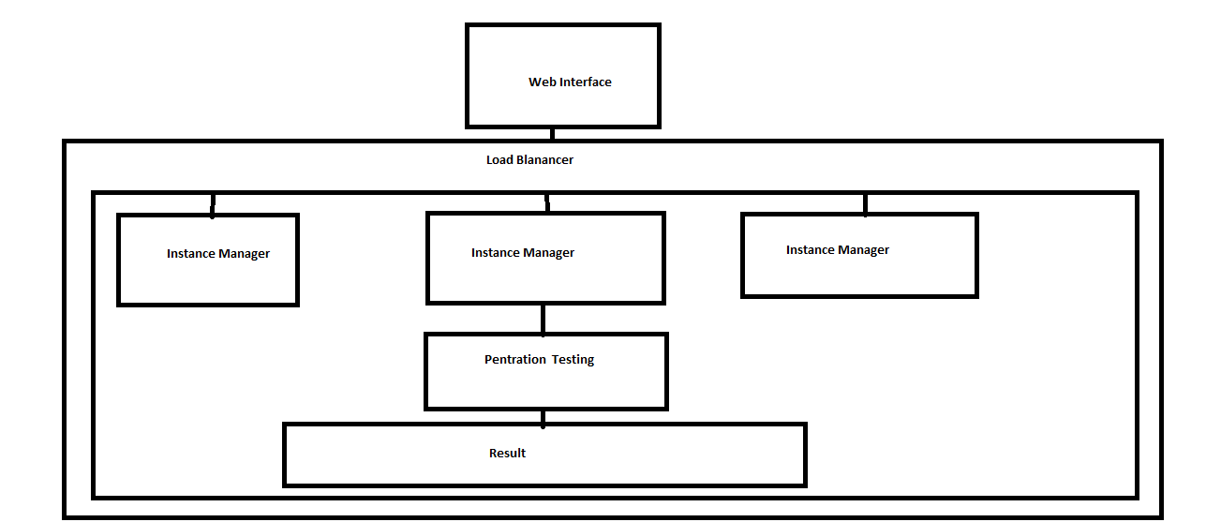
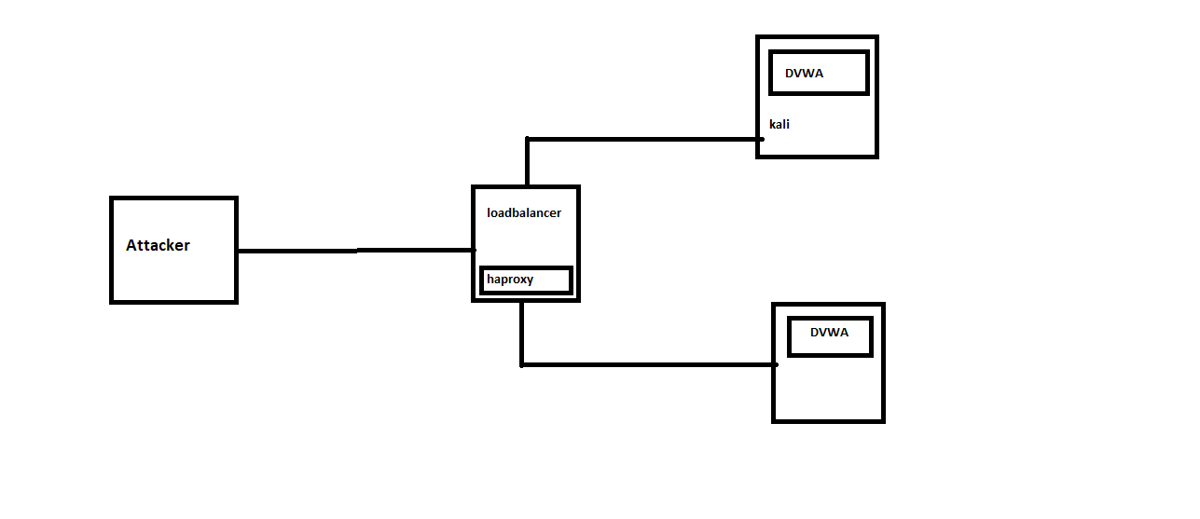
Architecture

Slide 6
Component Diagram
HAProxy
DVWA
Burp suit

Slide 7
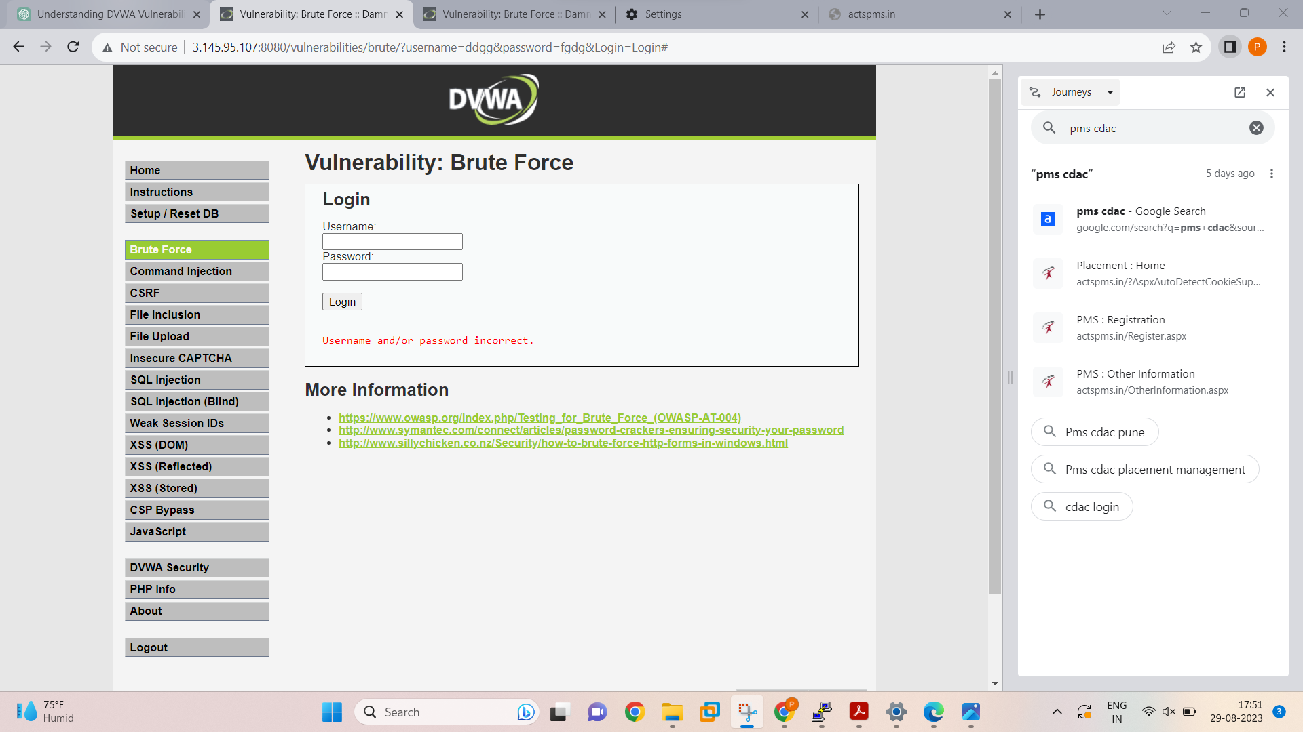
Project Execution
DVWA LOGIN PAGE

Slide 8
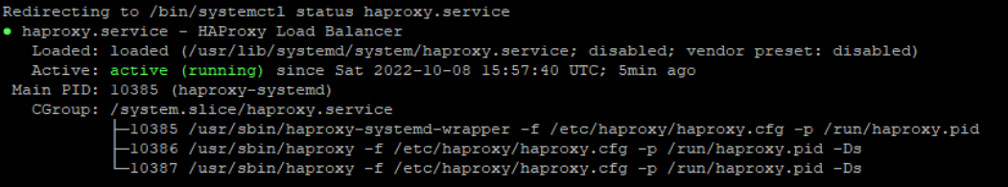
HAProxy

Slide 9
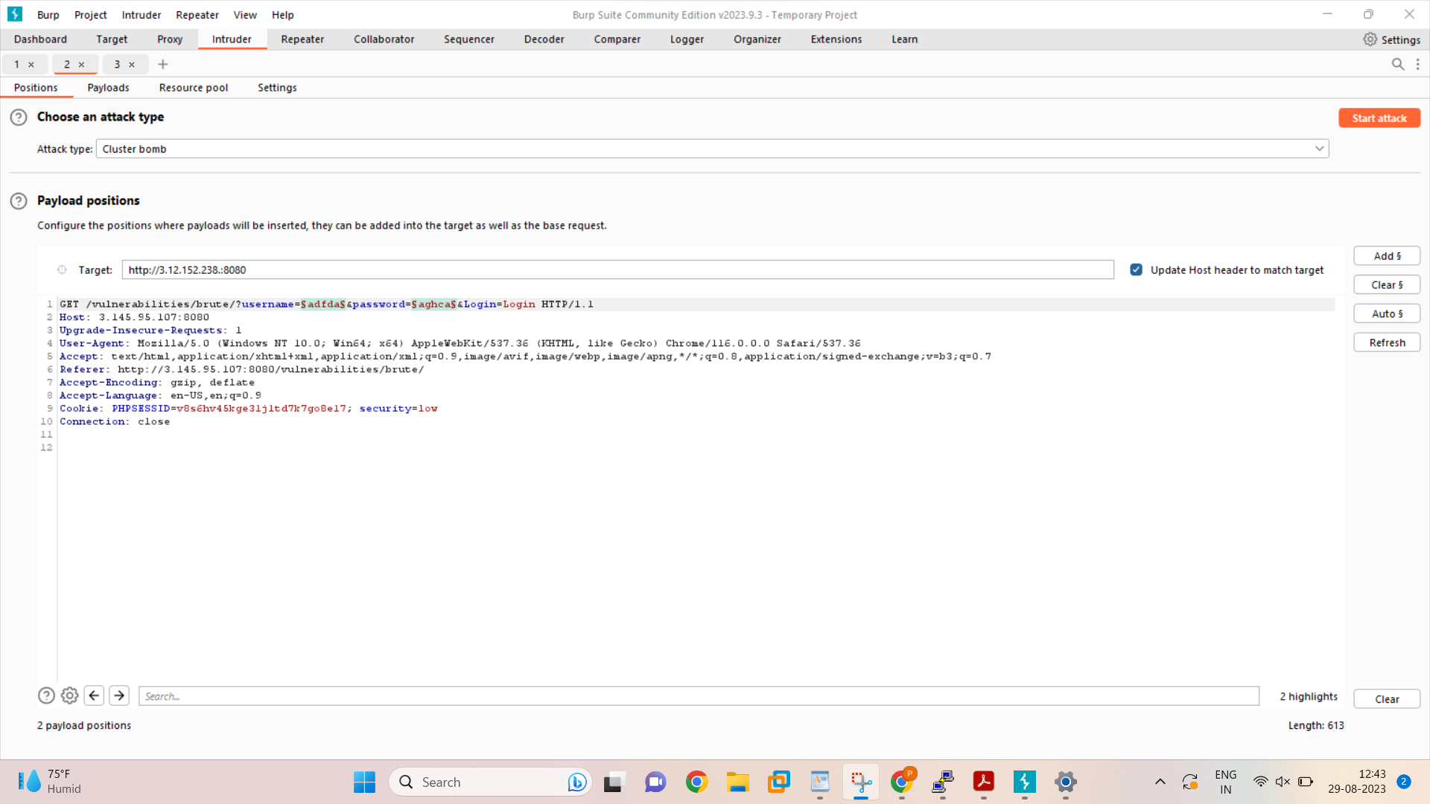
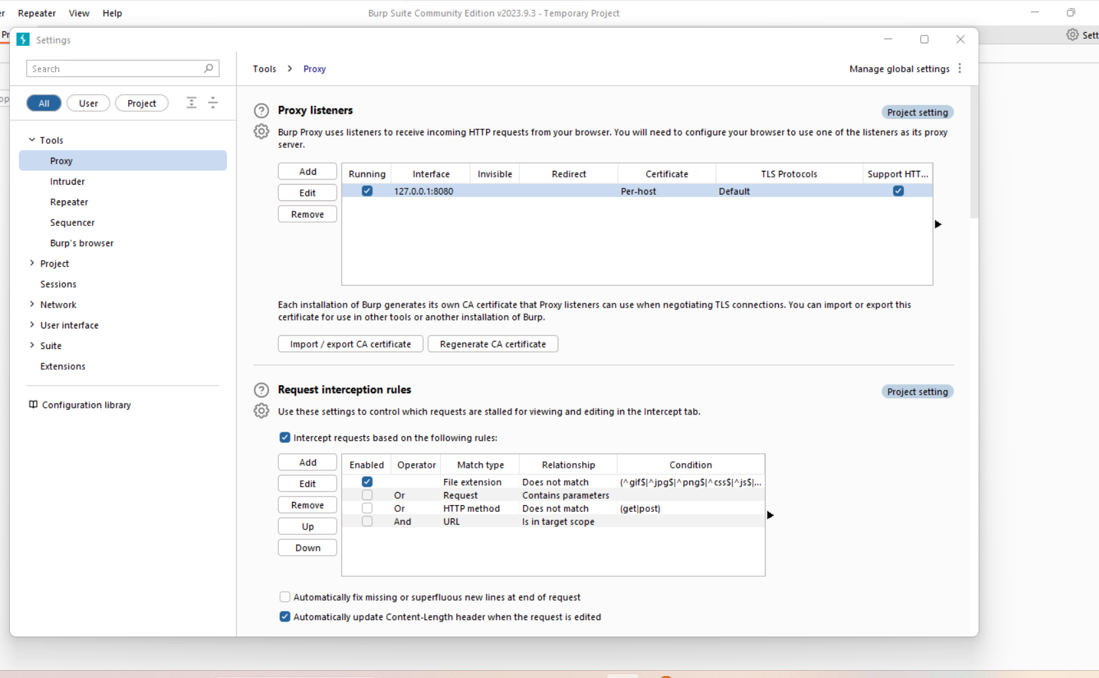
Burpsuite : For BruteForce attack

Slide 10
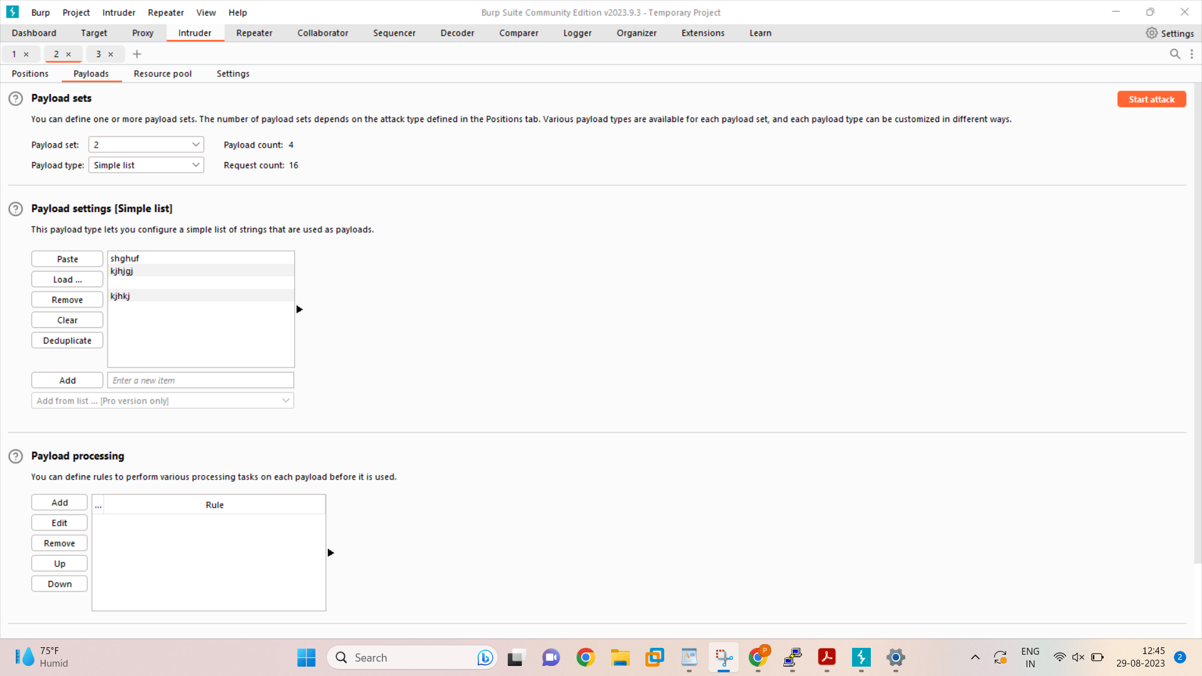

Start the attack to analyse.

Slide 11
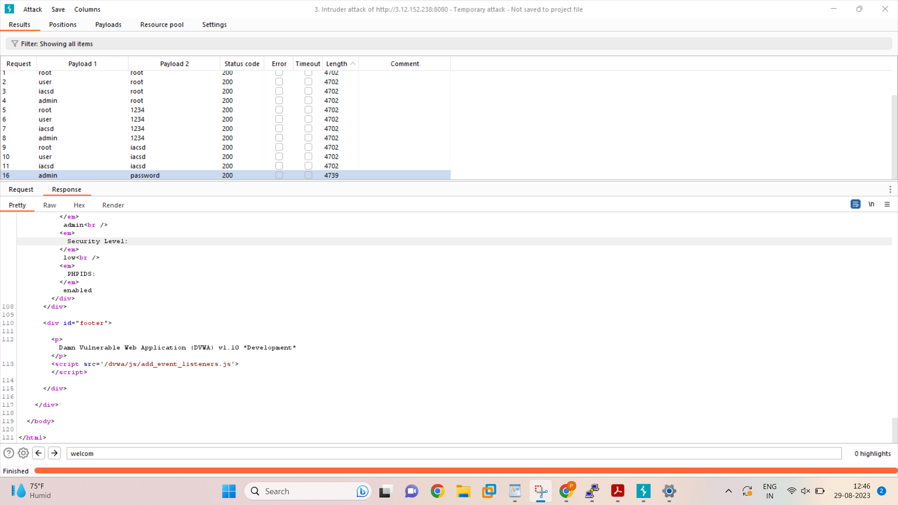
Analyse all the logs.

Slide 12
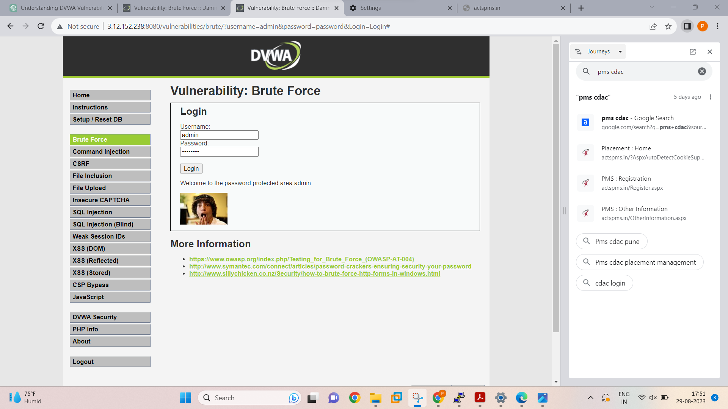
BruteForce Attack will get successful.

Slide 13
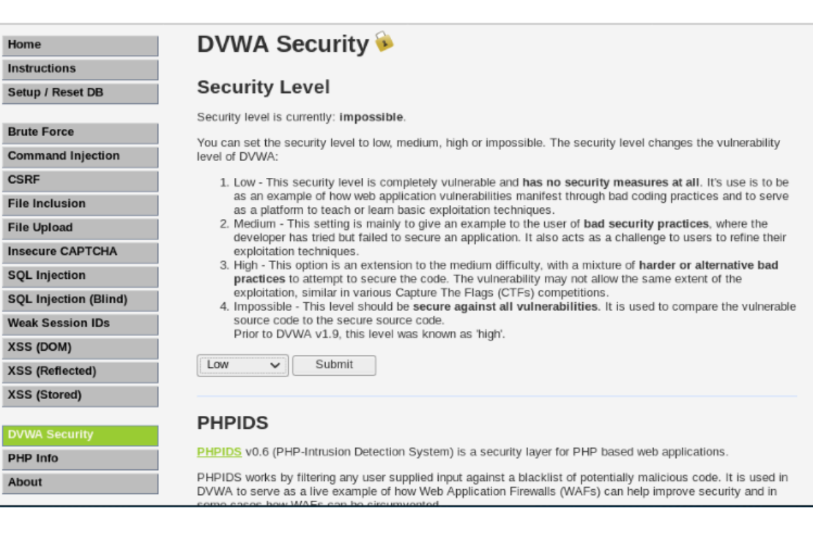
2. Command Injections.
We can set the security level at low, medium or impossible.

Slide 14
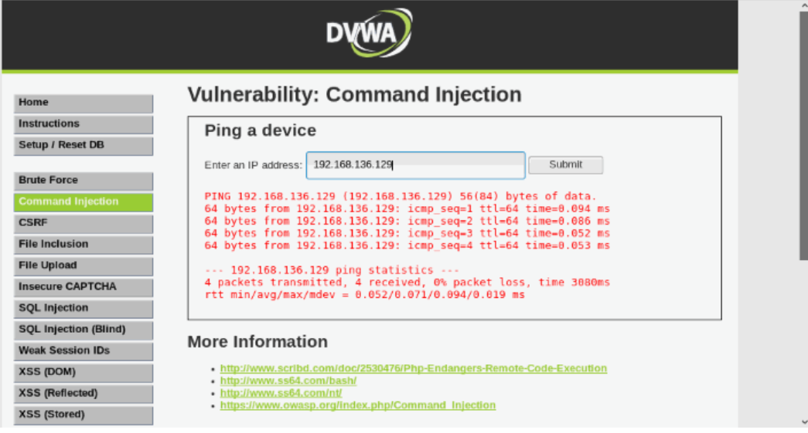

Slide 15
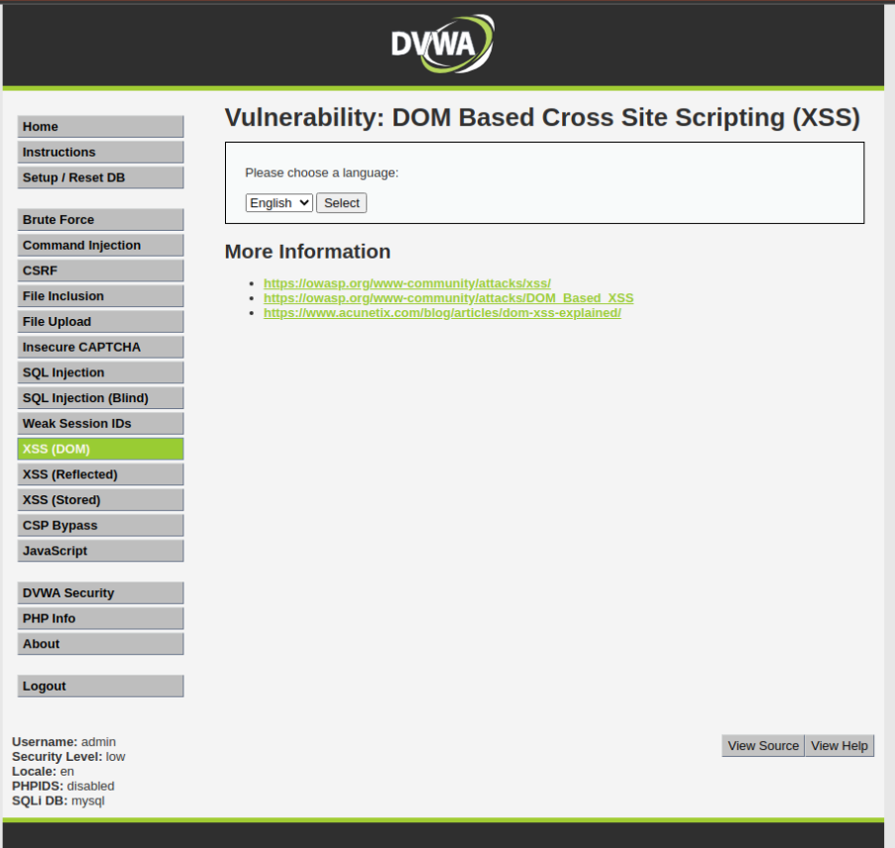
XXS (DOM)

Slide 16
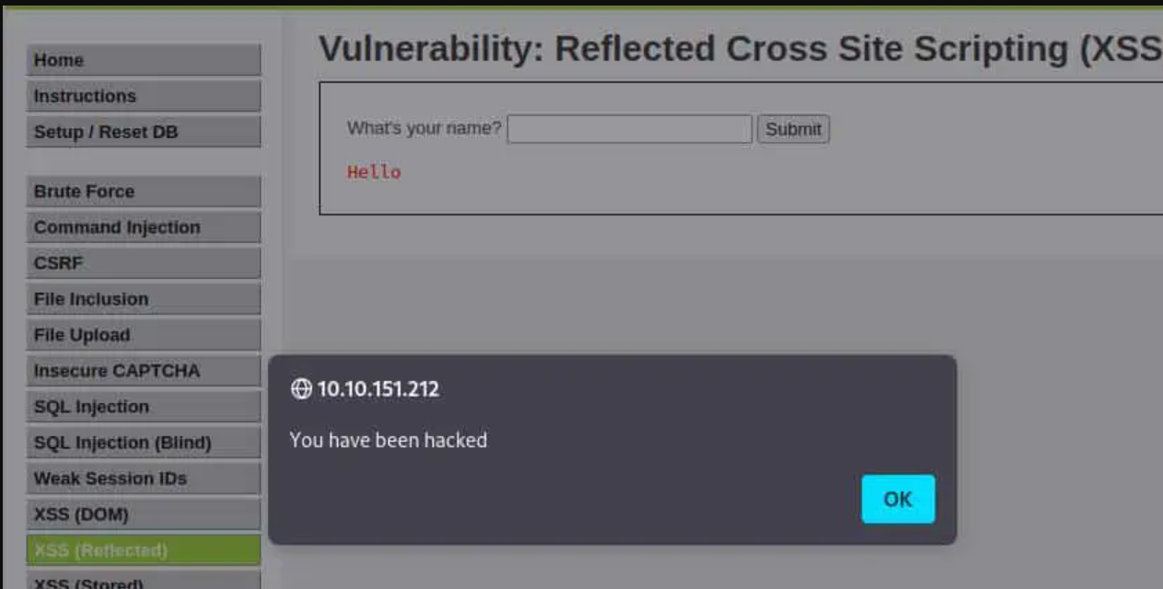
These attacks we performrd using dvwa.

Slide 17
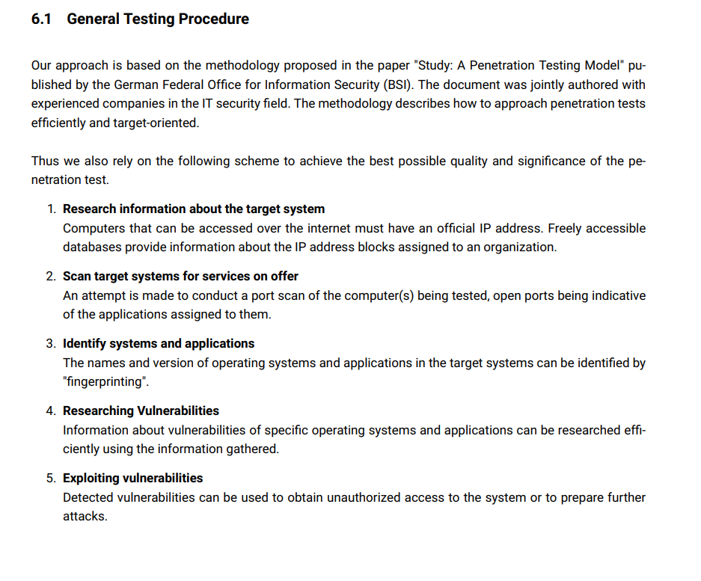
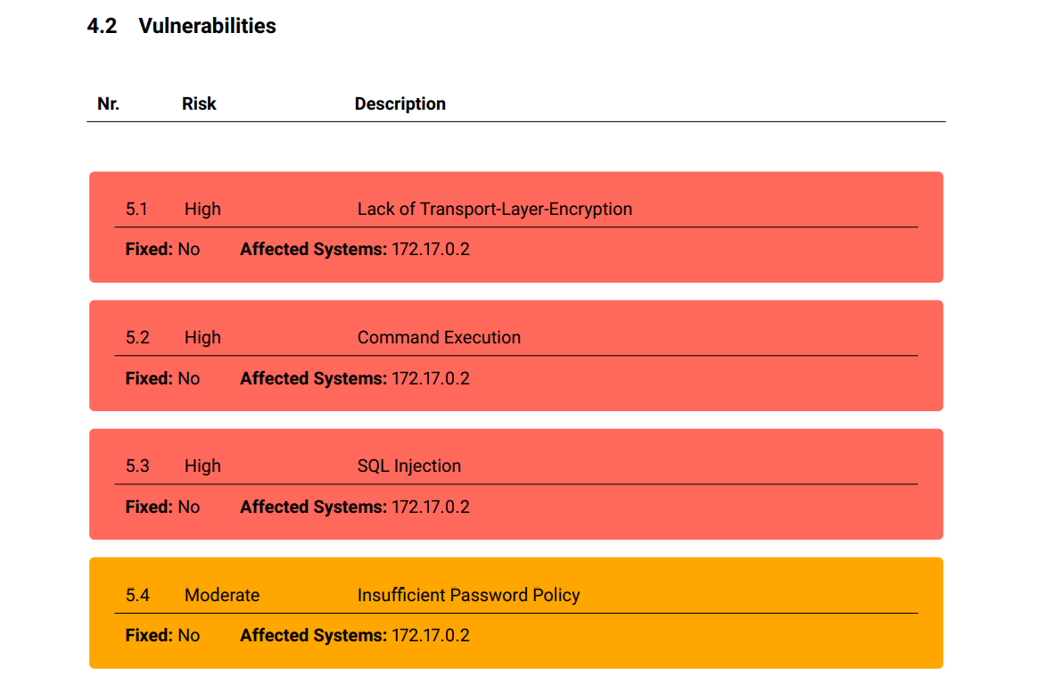
Finally we have to make reports on vulnerabilities including following points.

Slide 18
Conclusion
The above project discusses potential benefits of introducing a DVWA for the purpose of detecting, preventing and eliminating malicious users’ behavior from external network. It helps to understanding web application security by leveraging the controlled environment of Damn Vulnerable Web Application (DVWA) instances and implementing a load-balancing system, this project offers a range of benefits. The WebSecBalancer system itself serves as a model for resource optimization, showcasing how security testing loads can be effectively distributed across multiple instances. This architecture promotes efficient utilization of resources and accurate testing results, while also emphasizing the importance of load balancing in maintaining application availability and reliability.
Furthermore, the project encourages collaboration among different components like the Load Balancer, Instance Manager, Test Orchestrator, and Results Aggregator.

Slide 19
THANK YOU.

