Slide 1
OOP’s - Inheritance
OOP’S stands for Object Oriented Programming System .OOP’s is associated with different concepts like class, objects, Inheritance, Polymorphism, Abstraction, Encapsulation etc.

Slide 2
Inheritance:
Inheritance is acquiring the properties of one class from another class with the help of extends keyword.
There are two types of classes in inheritance. Super(Parent) class and sub(child) class.
Class1-class2=Inheritance—extends keyword.
Syntax:
class Subclass-name extends Superclass-name
{
//methods and fields
}

Slide 3
Types of Inheritance:
Single level Inheritance
Multilevel Inheritance
Multiple Inheritance
Hybrid Inheritance

Slide 4
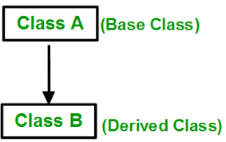
Single level Inheritance:
In this type, Inheritance is carried out between one super class and one sub class.

Slide 5
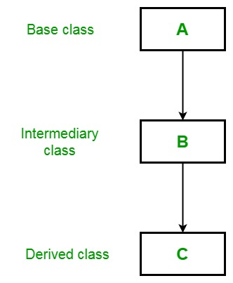
Multilevel Inheritance:
In this type, Inheritance is carried out between more than two classes.

Slide 6
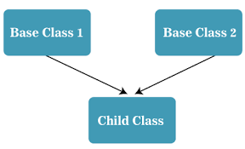
Multiple Inheritance:
In this type, there will be two super classes and one sub class. Sub class extends from more than one super class.

Slide 7
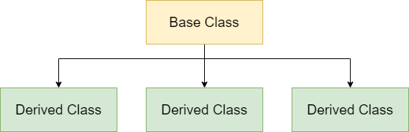
Hierarchical Inheritance:
In this type, there will be one super class and multiple subclasses, i.e...one class is inherited by many sub classes.

Slide 8
Benefits of Inheritance Concept:
Code Reusability: Inheritance allows the derived class to reuse the code from the base class, reducing duplication and promoting maintainability.
Code Organization: Organizing your code into a hierarchy of classes with inheritance can make it easier to understand the relationships and dependencies between different parts of your program.
Modularity: With inheritance, you can modify or extend the functionality of a base class without changing the base class itself. This modularity can enhance the flexibility and scalability of your code.

Slide 9
Example of Inheritance Concept:
Suppose we have a parent class "Animal" with properties like "name" and "age" and methods such as "eat" and "sleep".
We can create a derived class "Dog" that inherits these properties and methods from the "Animal" class.
Additionally, the "Dog" class can add new methods like "bark" and "fetch" to enhance its functionality.
Animal
Name
Age
Properties
Eat
Sleep
Methods
Dog

