Slide 1
Minimum Viable Product
Best Fracking Hydraulic Group
Sonya Pieklik, Marco Di Leo, Louie Wang, Kelly Chiu, Chris Lawson

Slide 2
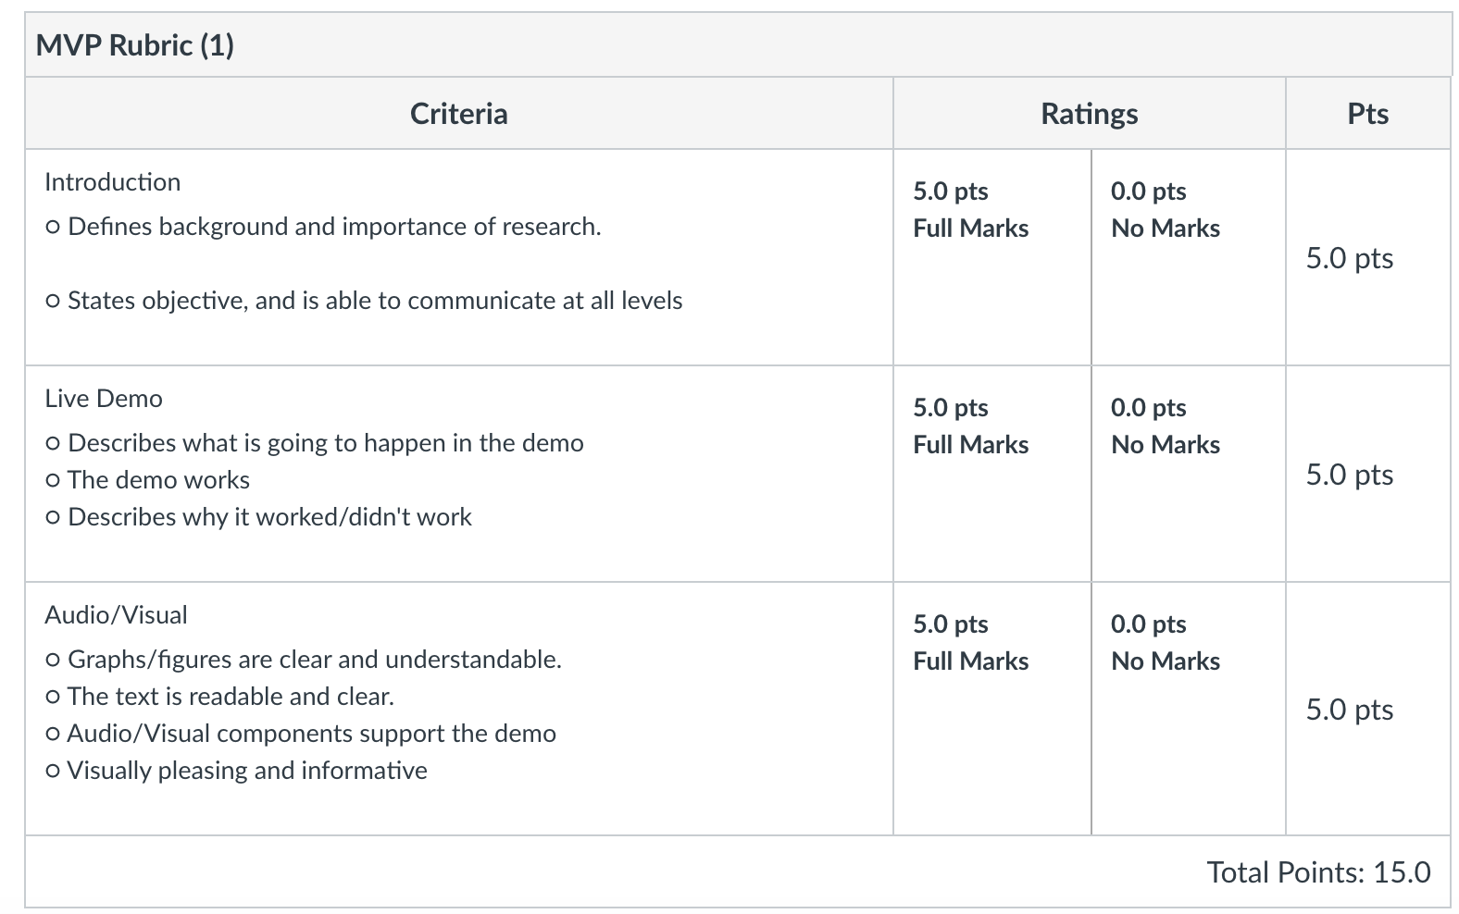
https://www.fortunebusinessinsights.com/industry-reports/hydraulic-fracturing-market-100419

Slide 3
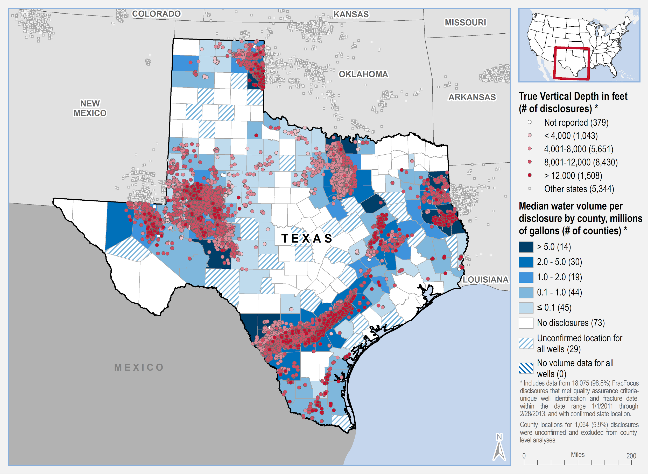
Importance
Texas is an important base for hydraulic fracturing industry
North America market dominates the total industry markets
Finding the best resources can improve competency and facilitate market expansion
Important for ConocoPhillips as the regulations related to fracking are increasing due to increased concerns of its environmental impacts
Hydraulic Fracturing Wells in Texas ¹
“EPA Analysis of FracFocus 1 Data.” EPA, Environmental Protection Agency, 6 May 2019, www.epa.gov/hfstudy/epa-analysis-fracfocus-1-data.

Slide 4
Introduction/Technical Challenge
Finding the Best Frac Crew
Using given features determine a “best” frac crew
Qualitative: Time logs - descriptions, unstructured text blocks
Quantitative: Engineering variables (Proppant, stage length, etc)
“Best” is unknown
Open to interpretation, makes it difficult to start
Allows us spot relationships that aren’t initially apparent

Slide 5
Initial Workflow -- make in graph
View features and files
Feature frequency
Feature definition
Qualitative v quantitative
Clean
Remove duplicates
Remove NANs
Drop insignificant at the moment
Remove qualitative atm
Assess
Pair plots
Duration feature created
Pick important features
Proppant Volume, Stages, Stage Length, Stage depth
Model and train idk

Slide 6
What we started with
4 Files representing
Stimulation stages data
Recompletion stages data
A cross file of the previous 2 files
Monthly production data
Issues that Arose
Time needed to be spent understanding variables
The Cross file had some errors
Missing Timelog data and error reports
How we plan to proceed with the data for Sprint 1
Only work with the Stimulation stages, Recompletion stages and Monthly production data. Once sprint 2 comes around, we should have all our data in order and should be able to use everything to our disposal.

Slide 7
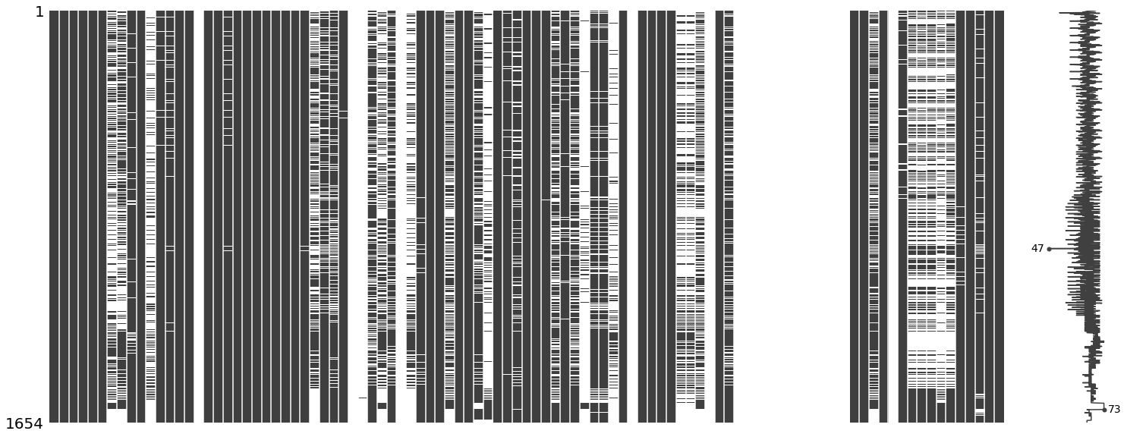
Cleaning Process - NANs
Visualizing NaNs for Recompletion Data
Visualizing NaNs for Stimulation Data
NaN removal policy will be to drop features that have more than 30% missing data.

Slide 8
Cleaning Process - Actual Data
Quantitative Data
Mainly just removing data duplication
Qualitative Data
Used label encoding

Slide 9
MVP 1 definition of “best”
For this sprint, “best” is going to be constructed from the following variables:
Volume of Proppant Pumped
Amount of Proppant Designed
Rig Duration
Stage Duration
Stage Length
These variables were picked based off of their percentage of missing values and because they were features that are influenced by the rig crew and by the engineers at CoP
We will be coming up with 2 “best” rig crews, a “best” for stimulation stages, and a “best” for recompletion stages.

Slide 10
Process for finding “Best”
After getting the desired variables, separate the data by rig crew.
Standardize each of the variables
Get the mean value for each of the different variables
Use the following weights for each feature to get a final ranking
Volume of Proppant pumped - 20%
Amount of Proppant designed - 20%
Rig Duration - 10%
Stage Duration - 35%
Stage Length - 15%

Slide 11
Visuals
Here and in the next couple slides, show how different rig contractors compared to one another by the different features that we used to quantify best
Hopefully this is where we jump and start presenting a dashboard

Slide 12
Results
Hopefully still in dashboard, but if not, put a chart here of the different rig crews compared to each other after our “grading” policy
Show our final verdict:
In the form of, “Given our definition of best, Rig contractor <blank> was the one that performed the best”
Show the “best” rig contractor statistics and compared to others

Slide 13
Things to Improve for next Sprint
Use Data aggregation to fill in some missing values to be able to get more meaningful results
Incorporate all the files given, mainly the timelog and error report data
Use machine learning models to be able able to come up with a different definition of “best”
Come up with a more sophisticated definition for what we will refer to as “best”

Slide 14
Conclusion
Potential Weaknesses
Our interpretation of the best frac crew could vary from ConocoPhillips because there is no clear definition as to what “best” means
Initially running our data through an unsupervised model might result in ineffective groupings of variables/features
Summary/Message
With the given data, we will determine the best frac crew by interpreting the features and its relationships to production
This is important because of the rise in unconventional natural gas energy, which can enhance the growth of the company

