Slide 1

MovieLens
Sonya Tahir, Jessica Smith

Slide 2
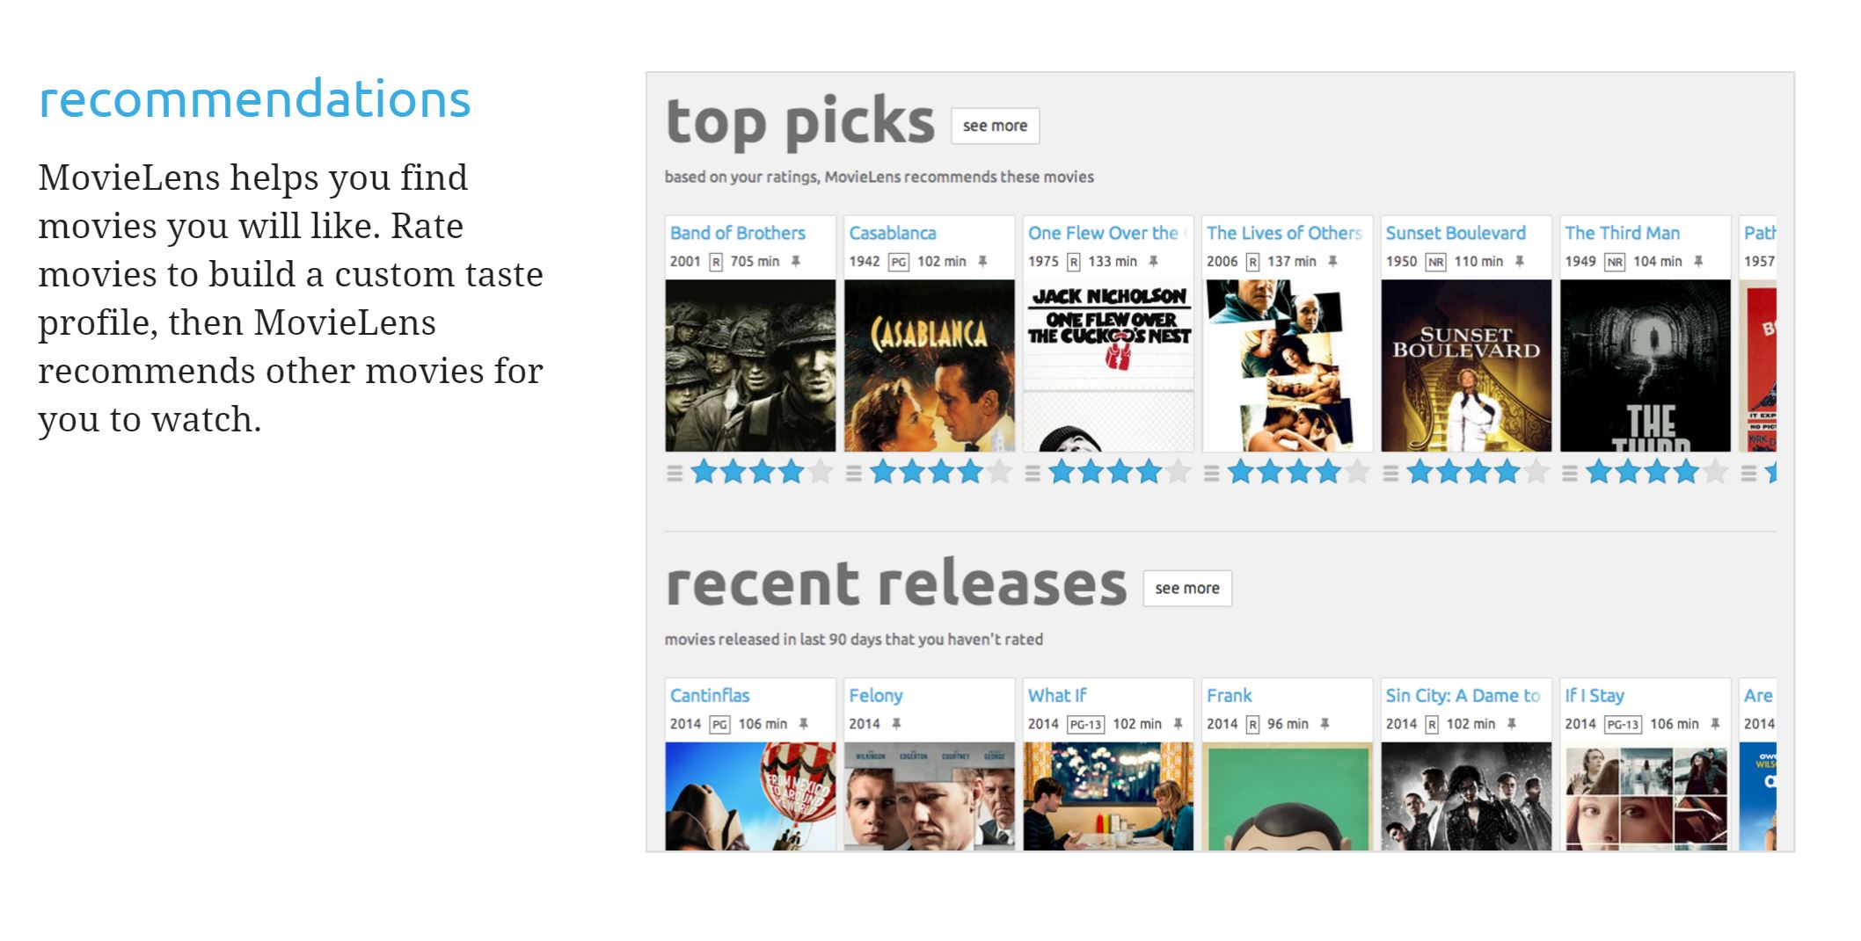
What is MovieLens?
Personalized Movie Recommendation Service
Based on User Preferences
Free Service
www.movielens.org

Slide 3





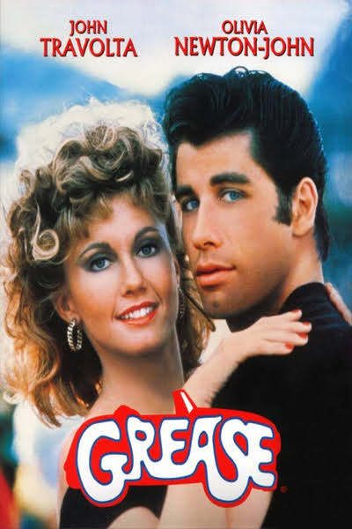
Data
User Information
Age Range
Gender
Occupation
Zip
No unique user ID provided
Genre Fields
Action, Adventure, Animation, Children, Comedy, Crime, Documentary, Drama, Fantasy, Film-Noir, Horror, Musical, Mystery, Romance, Sci-Fi, Thriller, War, Western
Rating
Score between 1 (lowest) and 5 (highest)
Over 1 million records

Slide 4
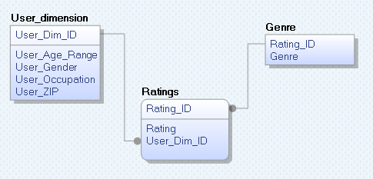
Transactional Database
The primary goal was to normalize data to make it storage efficient.
User_dimension includes all user attributes.
Ratings includes each unique rating.
Genre includes a list of genres associated with each rating.
Reduced the number of rows for the user information
Reduced the number of columns for the genre information

Slide 5
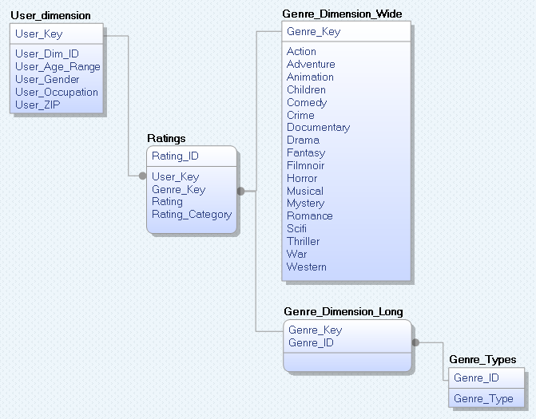
Data Warehouse
The primary goal was to create a star schema.
User dimension includes user attributes like before with an addition of a user key.
Genre is a multi-valued dimensional attribute. We created a bridge so that a single rating may be associated with as many genre fields as needed. Each genre combination has a unique key.
There is also a wide genre dimension table with true/false values to represent genre combinations.
Ratings is the fact table which includes user key, genre key, rating and a calculated field called rating category.

Slide 6
Genre_Dimension_Long
Genre_Types
Genre_Key | Genre_ID
1 | 1
1 | 2
2 | 3
Genre_ID | Genre_Type
1 | Action
2 | Adventure
3 | Animation
4 | Children
5 | Comedy
Ratings
Genre_Key
Analysts can query the genre information in long form or in wide form depending on the analytic requirement. To easily group by genre, the long dimension is useful. To easily search for specific combinations of genres, the wide dimension is appropriate.
Genre_Dimension_Wide
Genre_Key | Action | Adventure | Animation | Children | Comedy | Crime
1 | TRUE | TRUE | FALSE | FALSE | FALSE | FALSE
2 | FALSE | FALSE | TRUE | FALSE | FALSE | FALSE

Slide 7

Analysis

Slide 8
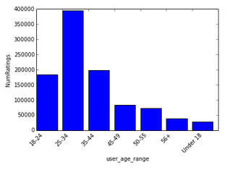
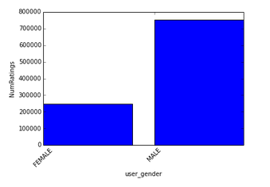
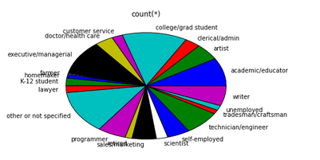
User
Users are primarily males aged 25-34
Primary occupations include college/grad student, academic/educator, executive/managerial

Slide 9
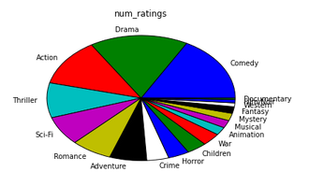
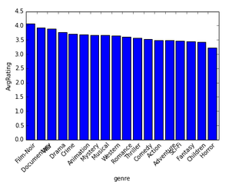
Genres
Drama and Comedy have the most movie ratings but Film-Noir and Documentary have the highest average rating.

Slide 10
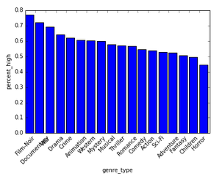
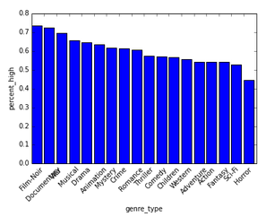
Gender Preferences
Male
Female
Uses the rating category to determine what portion of ratings are “High” (4 or 5).
Both men and women tend to rate Film-Noir, Documentary and War as High. Men are more likely to rate Crime High whereas women are more likely to rate Musical High.

Slide 11
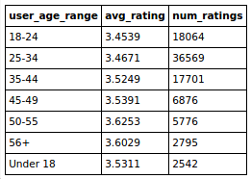
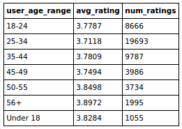
Genre Type by Age
Action and Adventure
Action and Drama
Do Action movies receive different ratings when they are Action/Adventure vs Action/Drama?
Action/Drama movies receive higher ratings across all age groups.

Slide 12
Conclusion
Limitation
We initially planned to mimic MovieLens’ predictive analysis. However, the lack of unique user IDs and unique movie titles rendered this impossible.
Challenge
When working with such a large dataset, it was critical to use joins to perform bulk inserts, updates and deletes. Otherwise these tasks took far too long to complete (if at all).
Dealing with genre classifications was a challenge because a movie can have any combination of 18 values.

Slide 13


